Slide 1
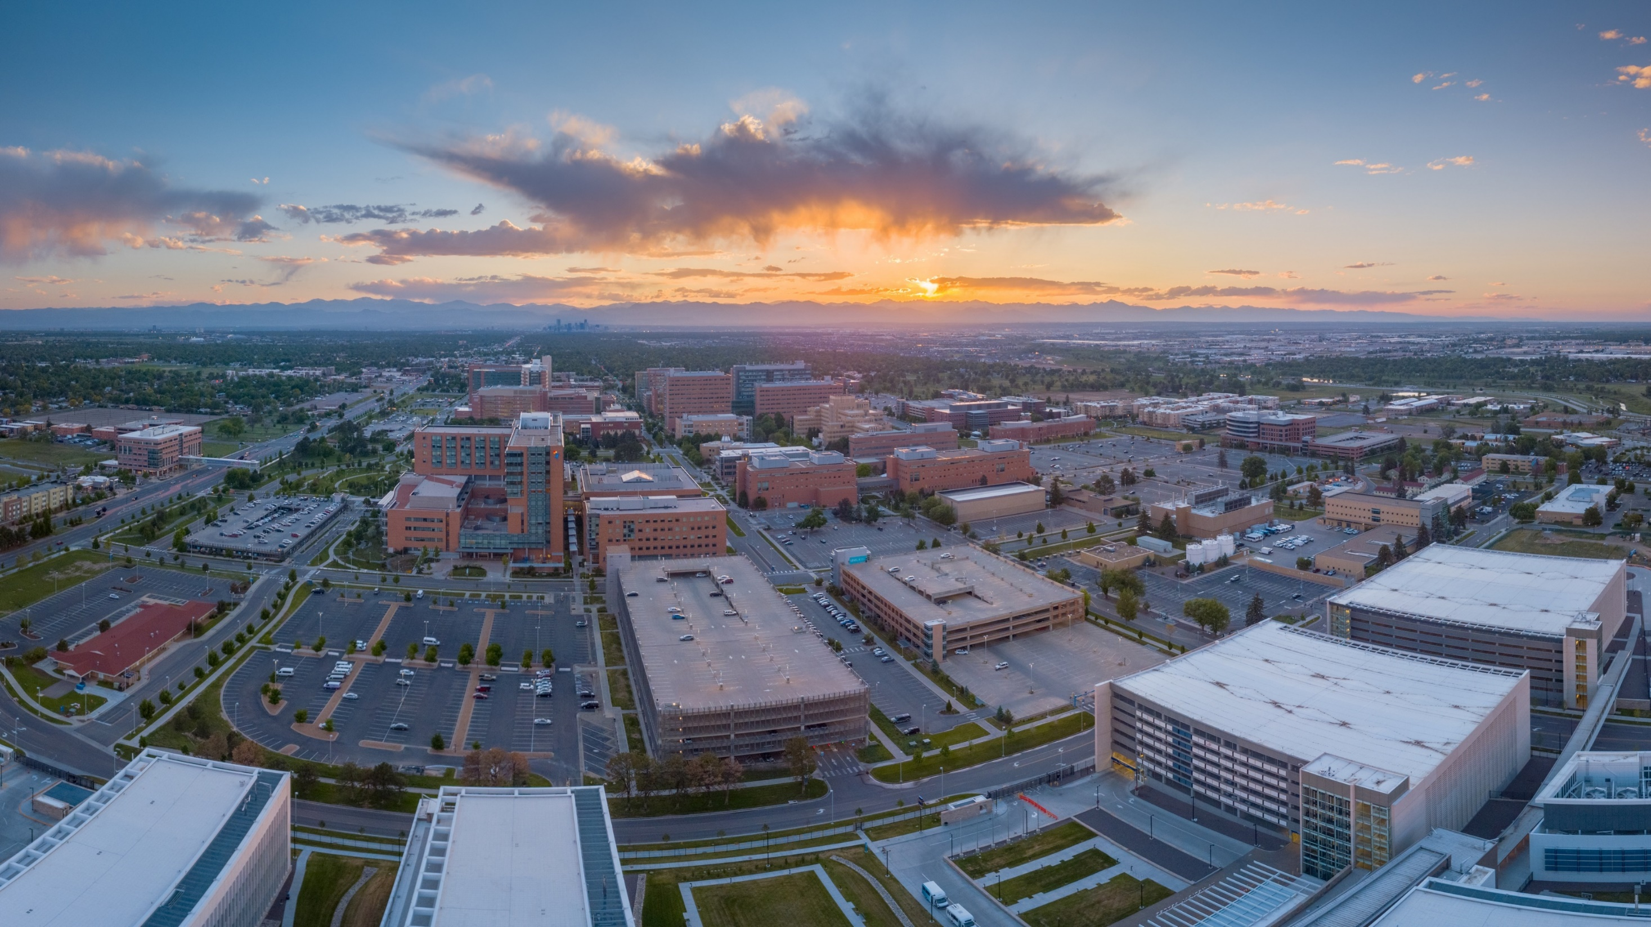

We will start at 12:10 pm
Meeting Agenda
Introductions – Poll Everywhere
Registration Process
Student Organization Announcements
Presidents Round Table
March 2023
Office of Student Engagement

Slide 2
PRT Meeting Agenda
Introductions – Poll Everywhere
Registration Process
Student Organization Announcements

Slide 3
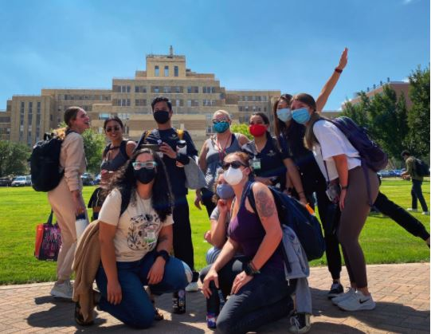
Types of Student Organizations
  Campus Wide
  Affiliated
  Associated

Slide 4
Re-Registration Process
The President and Advisor for the 23-24 AY must complete the registration forms with the Student Engagement Office.
  President Form: https://ucdenverdata.formstack.com/forms/ocss_studentorganization_registrationrenewal
  Advisor form: https://ucdenverdata.formstack.com/forms/ocss_studentorganization_registrationrenewal_copy
All registration materials will be reviewed for initial approval. You will be emailed with further instructions.
  Requirements: 3 members, appropriate constitution, and advisor

Slide 5
Re-Registration Process
TRAINING:
If approved,
  If the 23-24 AY president and advisor are the same from the 22-23 AY and did NOT complete the training in canvas, you do need to complete it. If you are not sure if you have completed the training, check here.
  If you are a NEW president or advisor for the 23-24 AY, you need to complete the canvas training.
  If the president and advisor from the 22-23 AY completed the training in canvas, you do NOT need to take it again, and there are no new policies at this point. If new policies come out, they will need to be completed.

Slide 6
Re-Registration Process
Training for all Presidents and Advisors:
Log into Canva https://ucdenver.instructure.com/
Click Student Organization Training
All presidents and advisors should already be invited to the course
  If you have any issues, please let me know
Complete all the
  Recorded and text modules
  2 Skillsoft training (in UCD Access)
  Pass the quiz at the end
    SDM – additional trainings and quiz in canvas

Slide 7
Re-Registration Process
You will be emailed once the process is complete.
  If you are a campus wide SO, you will be fully recognized by our office.
    If you are an affiliated SO with CSPH, AA, GRAD, you will be fully recognized by our office.
  If you are an Affiliated and Associated SO with the following offices/programs you will need to possibly complete additional training or registration. You will be forwarded to the appropriate correspondence.
    CON, PA, BIOE, SOM, SDM, SOP, CHAPA

Slide 8
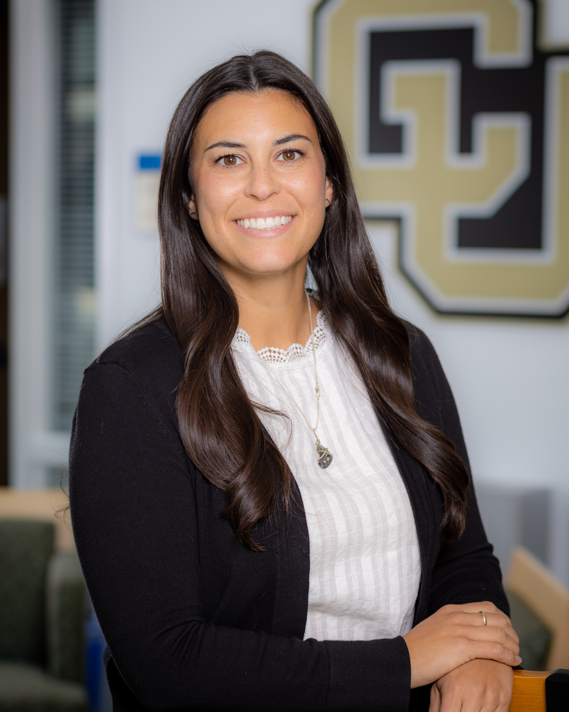
Contact Us
Student Affairs
Office of Student Engagement
Education 2 North, Suite 3200
studentaffairs@cuanschutz.edu – (o) 303.724.4435
Katelyn Martin
Coordinator of Student Engagement – Education 2 North, 3201
Katelyn.martin@cuanschutz.edu – 303.724.4435

