Slide 1
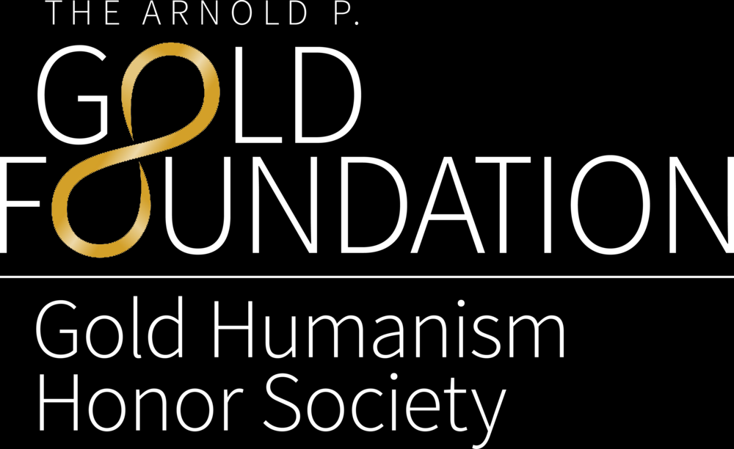

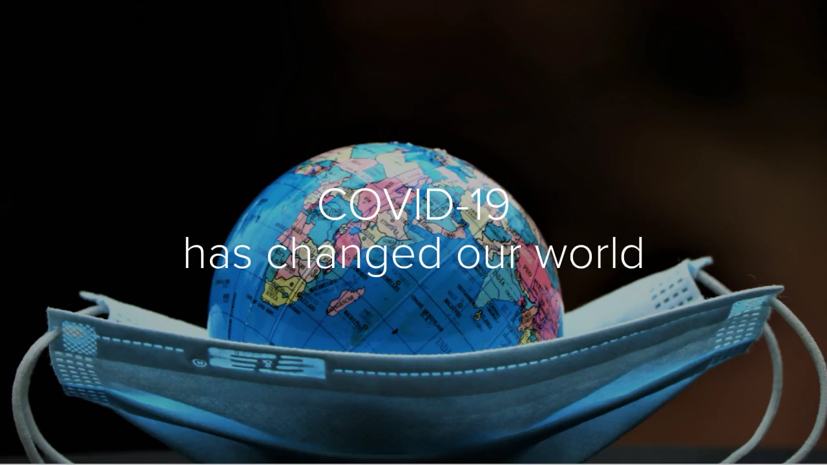
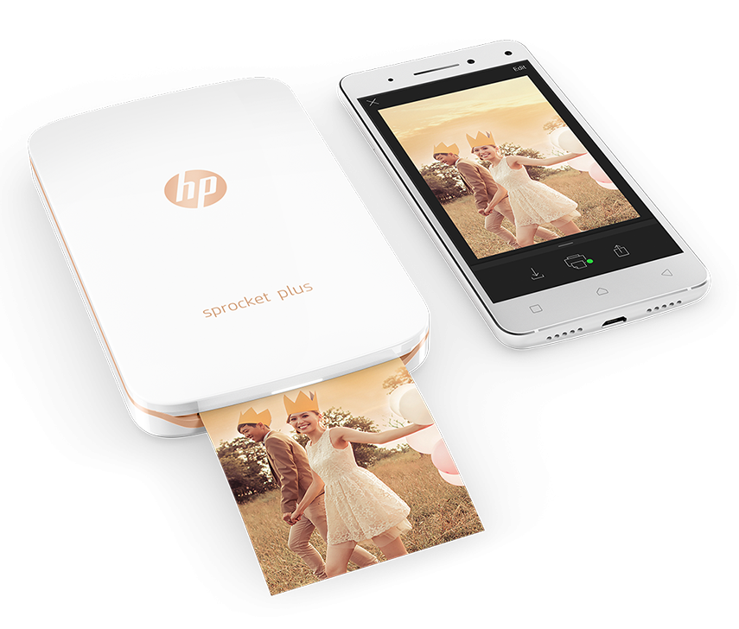
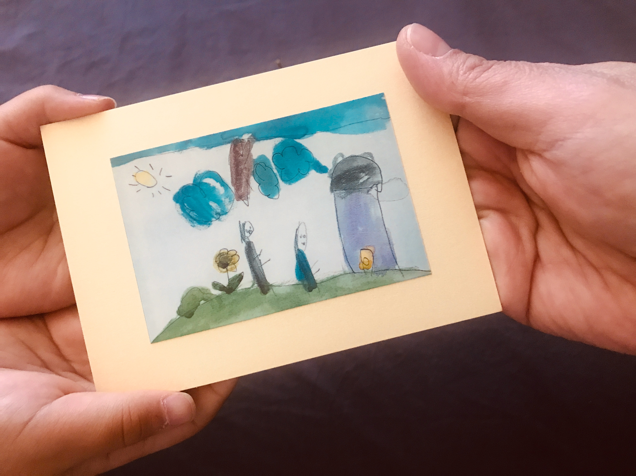
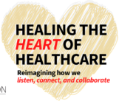
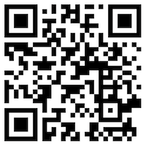
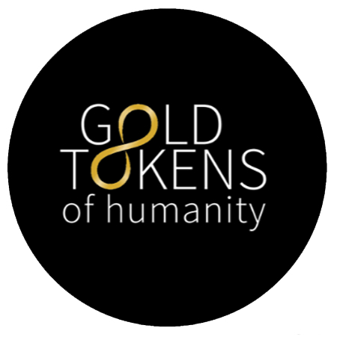
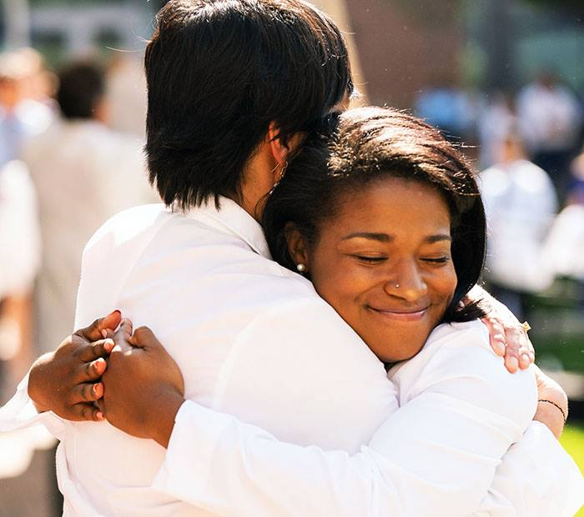

Gold Tokens of Humanity:
Using visual memoirs to reconnect and heal the heart of healthcare during the COVID-19 pandemic
Saori Haigo, PhD, Vikasini Mahalingam, Troy Kincaid, Scott Stuart, PhD,
Jeanie Youngworth, MD, & Steven Lowenstein, MD, MPH
University of Colorado School of Medicine, Aurora, CO USA
Goals & Vision
What are Gold Tokens?
  Patient needs for conversation, community, and recognition outside of the context of their hospitalization
  MS4 led effort to actualize humanism in healthcare by providing visual symbols of connection and camaraderie with patients
  Photos, drawings or paintings that provide comfort to patients
  Designed individually for patients at bedside by medical students following one-on-one conversations with hospitalized patients
  Recognition of core memories or value(s) and providing an opportunity for storytelling actualized into artistic representation
Impact
How to Get Involved
Future Directions
Impact
  Compassionate patient care
  Patients feel valued
  Unification of medical
  student body through
  narrative medicine
  Positive engagement
  with medical teams
  Expansion to DHHA, CHCO, RMR VAMC
  Research on patient and provider experiences for program evaluation
Acknowledgements
  This project is supported by a Chapter Grant to CUSOM GHHS.
  We thank Louisa Tvito, Jordan Coulter, and Vincent Fu for their insights and support.
Notes:
1

