Slide 1
Mission Medical Center
PEAK Project by Ben Fitzgerald, Jake Fox, Katie Raskob

Slide 2
What is Mission Medical?
Mission Medical Center is a free clinic that has been serving the uninsured and underinsured people of Colorado Springs since 2004.
Services:
  Primary Care Clinic
  Dental Clinic
  Pharmaceutical Dispensary
  Behavioral Health Clinic
  Vision Clinic
  Spiritual Companion Ministry
  Independent Living Program
  Food Pantry
Volunteer medical professionals provide the mainstay of care for Mission Medical Center patients.

Slide 3
What is the community need we sought to address?
Identify areas of improvement for Mission Medical Center via the staff, volunteer medical professionals, and patients
QI Project: improvement focused on needs of staff and volunteers
Peak Project: improvement focused on needs of patients
Formal partnership with CUSOM elective allows for continuity and future directions
Notes:
Emphasis on volunteer basis of “staff” so they do not have many resources for evaluation of the Clinic. Really give background for when we interviewed patients in regards to timing with the visit. Talk about the CU elective and intent to form a long-term parternship with MMC.

Slide 4
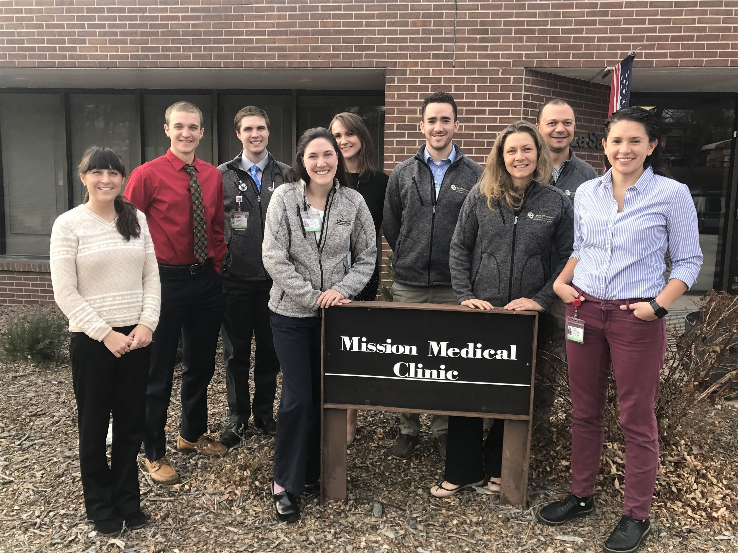
What was our shared goal?
By the due date of our PEAK project (March 16th, 2018), our goal was to complete 20 patient interviews, and from the data ascertained in these interviews develop five potential avenues for improvement at Mission Medical that could improve the patient experience at the clinic.

Slide 5
Patient Interviews
Acquisition of demographic data
Inquiries into patient experiences at Mission Medical, including:
  What do you like most?
  What do you find most difficult?
  What could be better?
  What are your biggest barriers to accessing MM’s resources?
  Where would you go if you did not come to MM?

Slide 6
Results: Overview
Number of Interviews: 22
Interview Time: 3-17 minutes
Mean age: 44
Youngest: 22
Oldest: 64

Slide 7
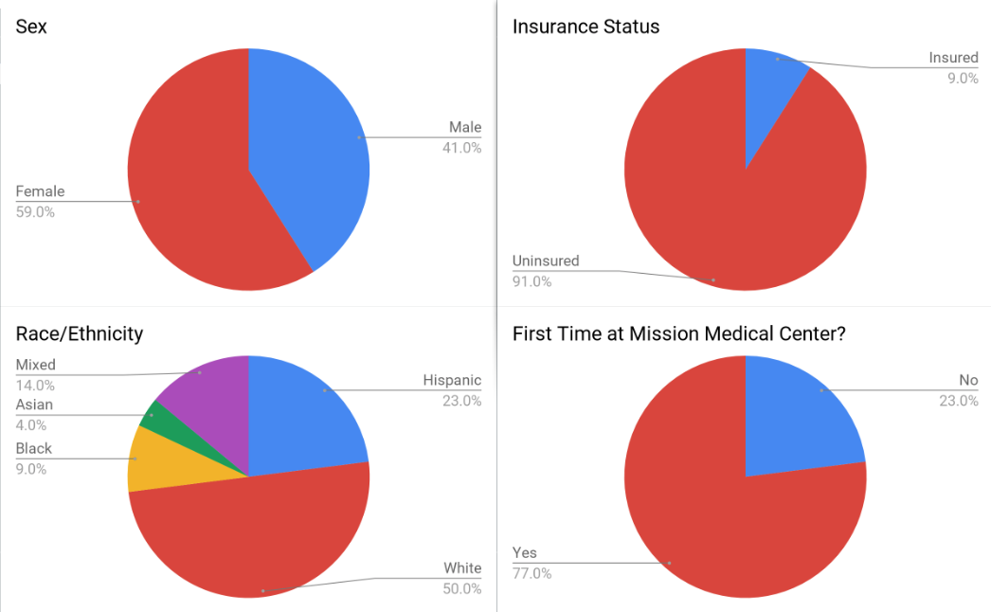
Results: Patient Demographics

Slide 8
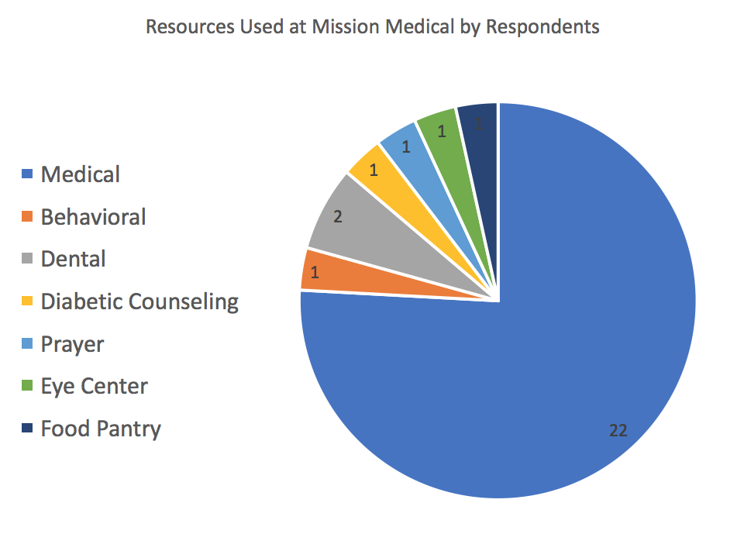
Results: Patient Demographics

Slide 9
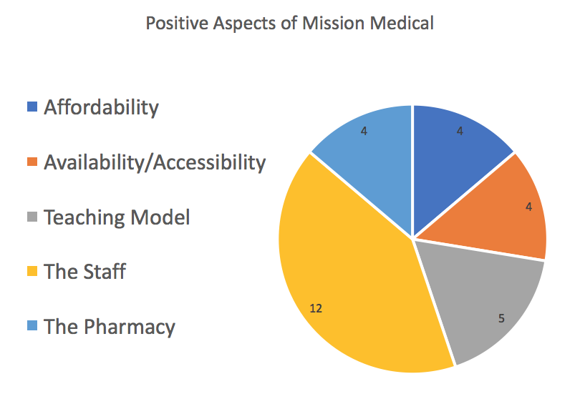
Results: Patient Opinions

Slide 10
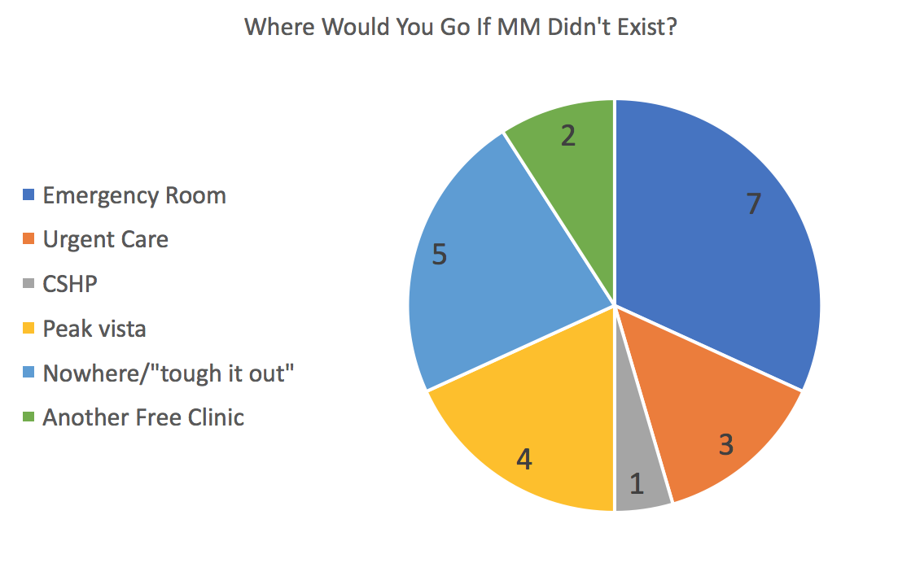
Results: Patient Opinions
Other Positive Aspects of Mission Medical:
-100% would recommend to a friend
-95% had no trouble scheduling visits
-reduced public health cost
Notes:
Animate this slide

Slide 11
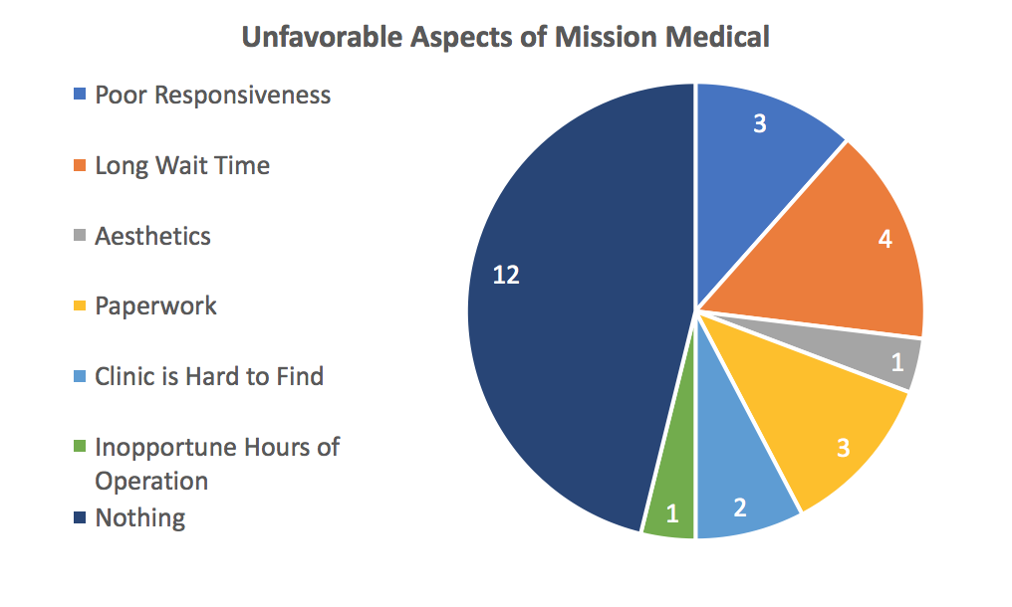
Results: Patient Opinions

Slide 12
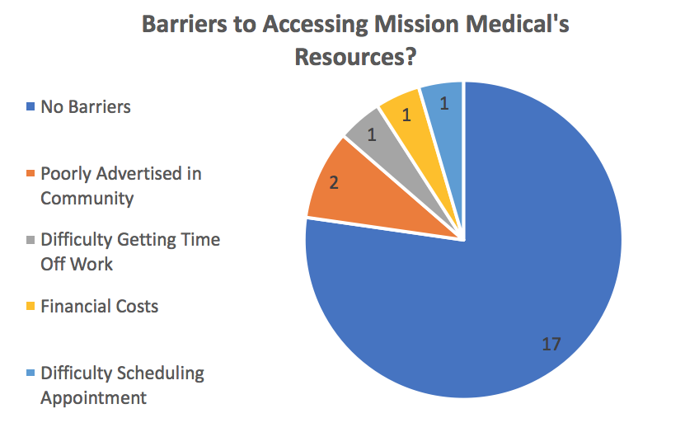
Results: Patient Opinions

Slide 13
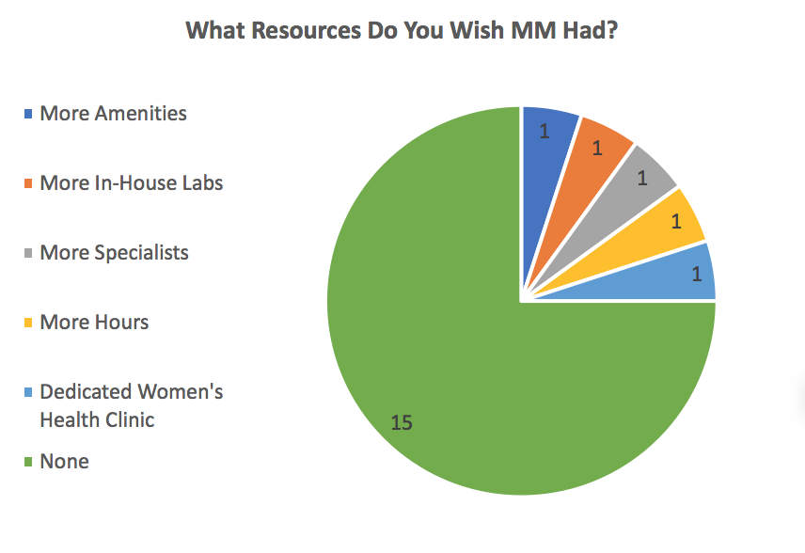
Future Directions

Slide 14
Future Directions
continue QI projects to improve provision of care and provider satisfaction (responsiveness, reduce wait times, streamline paperwork, etc.)
conduct needs assessment on expanding in house labs (e.g. iStat grant?)
improve public awareness of Mission Medical (via advertising, etc.)
More visible information on how to get involved
solicit donations for waiting room amenities, such as a coffee/water dispenser, television, etc.

Slide 15

Reflections
Obstacles:
  Interviewees were primarily first time patients with less experience with MM
  Interviews were only conducted on student run Saturdays
  Synthesizing qualitative data is often difficult
  Difficult to conduct project in third year of medical school

Slide 16
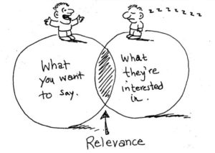
Reflections
Leadership lessons learned:
  Presenting to the MM board of directors showed us that we need to know our audience
  It is very important to have shared goals

Slide 17

Reflections
Prospects for sustainability:
  Future medical student classes will be involved in MMC via the elective and the CSB
  Multiple opportunities to make significant change at MM are available, as our project has identified several potential avenues for further improvement

Slide 18


Acknowledgements
Thanks to Barb, Dr. Goncalves, Holly, and all of the staff and volunteers for their help!
We are excited to continue to grow this partnership with Mission Medical and pursue our shared goal of quality healthcare for uninsured and underinsured patients in Colorado Springs

