Slide 1
Urban Peak PEAK
Robin Harland, Tyler Reinking, and Vivianne Andersen

Slide 2

Our Community Partner...
Mission statement:
To ignite the potential in youth to exit homelessness and create self-determined, fulfilled, lives

Slide 3
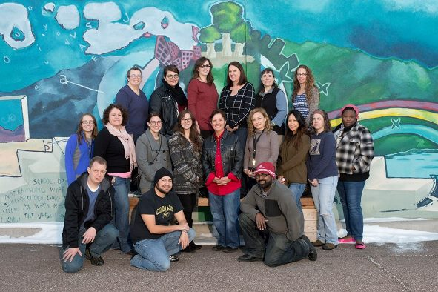
Community Needs We Sought to Address
Health Literacy deficits
Relationships with healthcare personnel
Volunteer services (cooking meals, mostly)

Slide 4
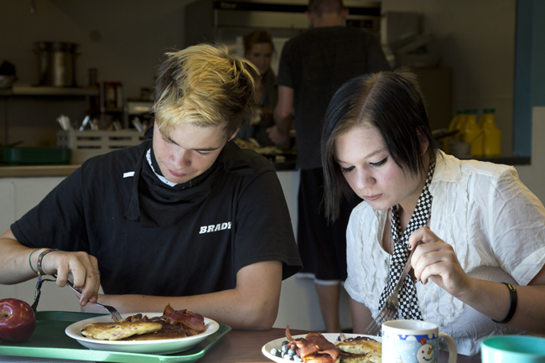
Shared Goals:
Collaborate with Urban Peak to provide
  Education
  Meals
Build relationships with residents

Slide 5
What We Did:
Served dinners to 59 residents and 11 staff members over 4 visits
Facilitated a discussion about health topics to 17 of the residents
  First aid and when to seek treatment
  Exercise, diet, wellness
  Mental Health

Slide 6
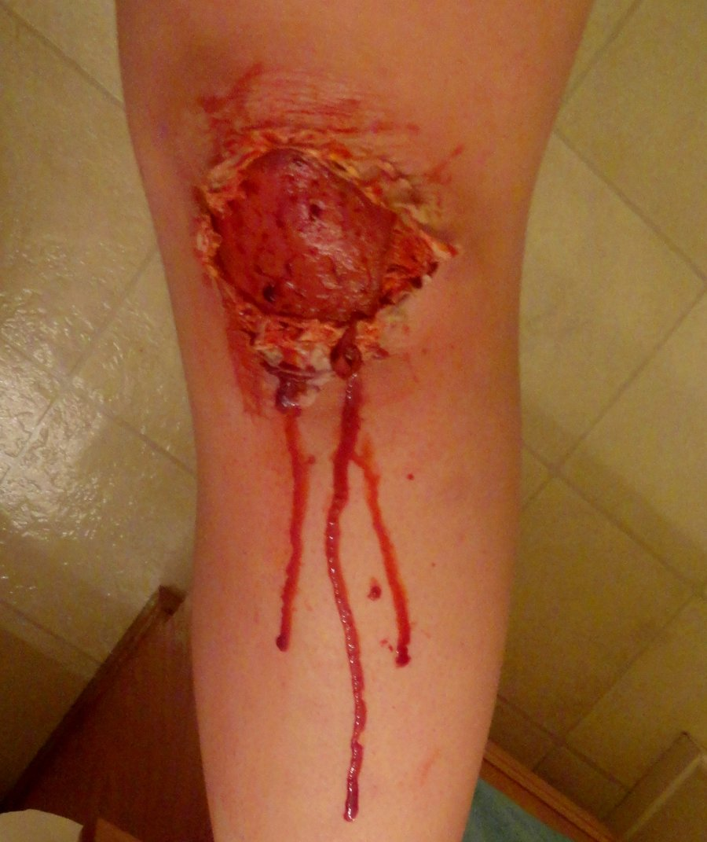
… And your knee looks like this
How do you decide whether to go to the ER?
Notes:
· Dirt still in wound
· Cut by (rusty) metal or soil
· Bites
· Puncture wounds
· Visible bone/tendon
· Profuse/prolonged bleeding

Slide 7
Myth or Reality…..
Grain products (bread, pasta, and rice) are fattening.
You can have a healthy diet and still eat your favorite _____ (sweet, fried food, salty food, etc.)
You should avoid Nuts because they are Fattening
Red meat is bad for your health
Fat is bad for you
“Going vegetarian” will help you lose weight and be healthier.
Choosing foods that are gluten-free will help you eat healthier.
Cooking food in a microwave is just as healthy as cooking in an oven.

Slide 8
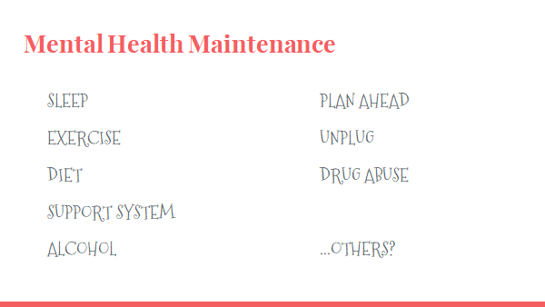

Slide 9
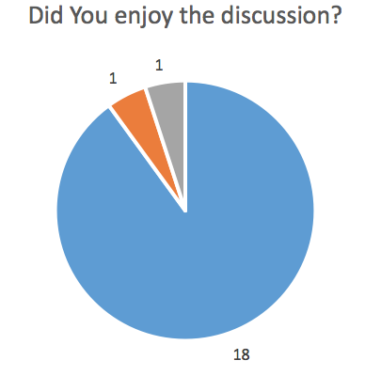
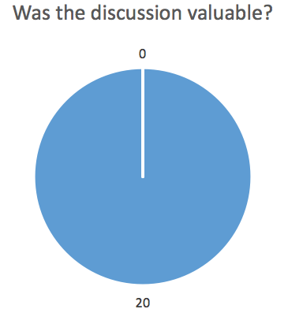
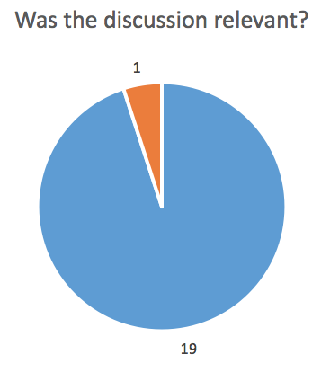
What Clients Told Us:
Yes
No
It was ok

Slide 10
What Interested Clients
Dealing with internal emotions
Eating disorders
Headaches
Self expression
How drugs affect the body
Physical Therapy
Talking to a friend who may be depressed | 8
What MJ/etoh does to body | 8
How to get health care; how to find a doctor; how is UC different from ED | 3
What is diabetes? | 5
What does eating healthy really mean? | 9
Different jobs in healthcare and what it takes to get one? | 5
Stress
Tinnitus
How to determine sickness
Bacteria-antibiotics

Slide 11

Moving Forward...
Establishment of system/curriculum for future CSB PEAK project
Offer resources and relational strength with this community partner
Curriculum could be built upon and adjusted per resident interests
Turnover of residents allows for reuse of powerpoints

