Slide 1
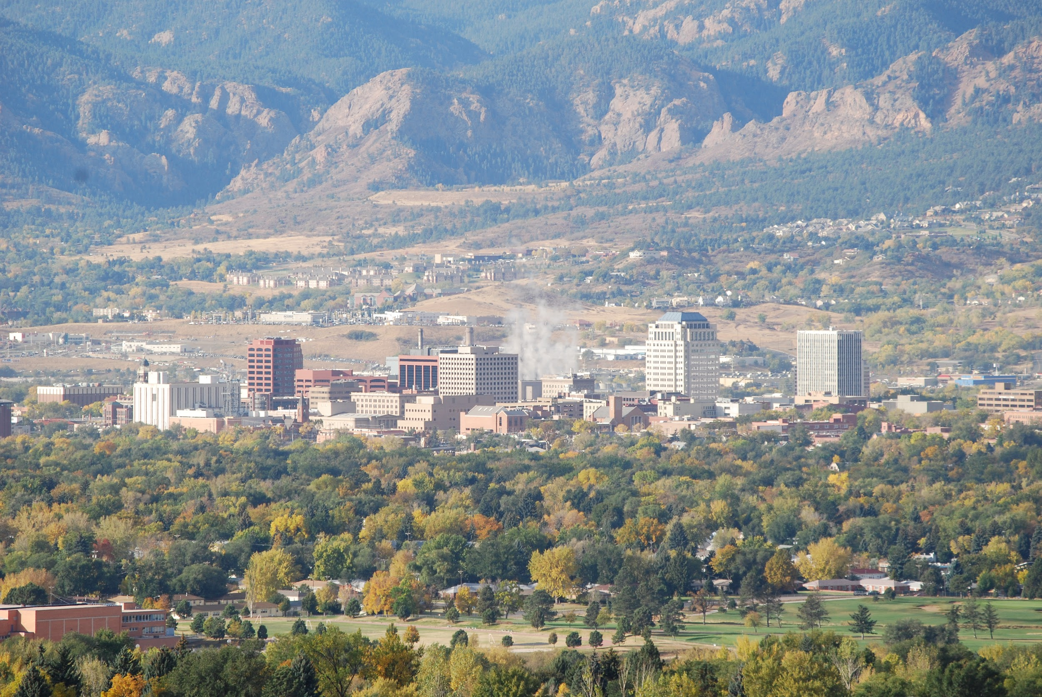
The Springs Rescue Mission
Colorado Springs Branch
University of Colorado, S.O.M
PEAK PRESENTATION
Nikki Bloch
Oluwatosin Adebiyi

Slide 2

To mobilize the community to provide relief, rehabilitation and empowerment services
Notes:
Current Goals: to restructure the organization from a “rescue” to a “stability and transformation” approach
more about community partner - how they accomplish goal and What did you learn by viewing the community from their vantage point?
Homeless -> Stability -> Restoration -> Transformation
~ 400/night

Slide 3


Assets
Resource Center staffed with case managers
Community Partners
  DHS, Aspen Point, Peak Vista, Women’s Resource Agency, etc
Curricula and programs to learn skills &/or promote change
Needs
Assessment of programs/resources
Understanding of the growing older adult population
Connecting guests to healthcare services
page 3

Slide 4
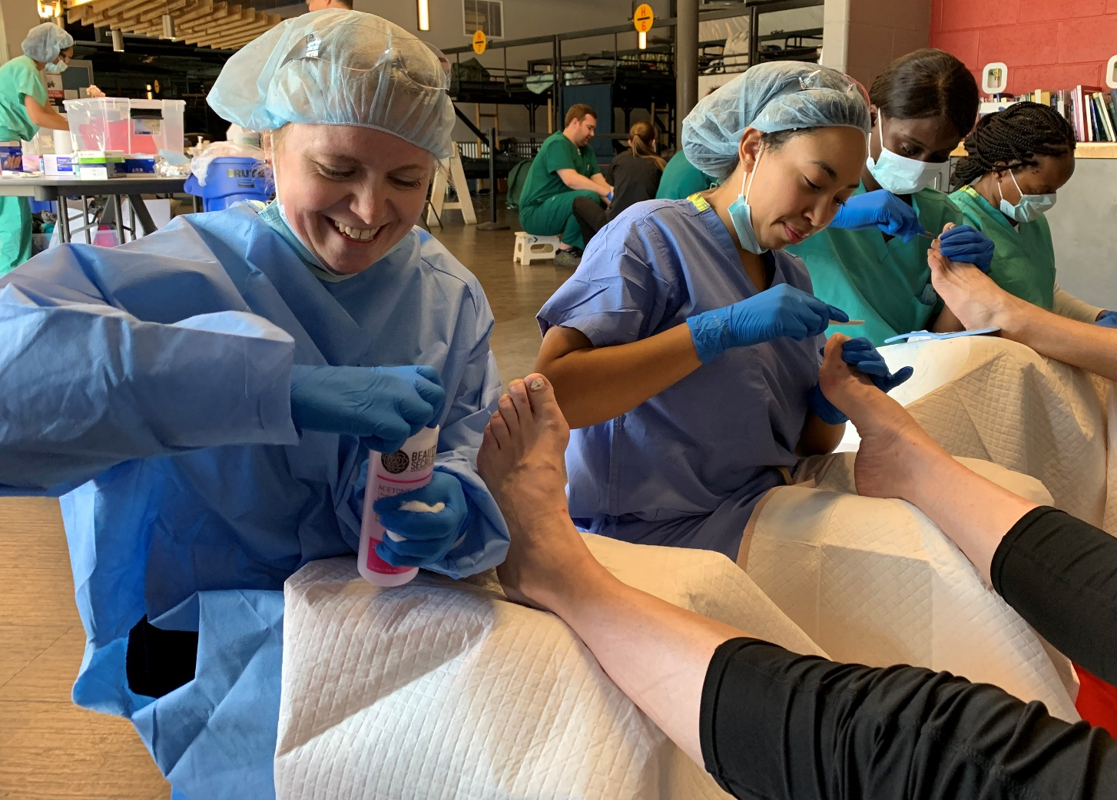


Foot Care Clinic for Adult Homeless Population in Colorado Springs
page 4

Slide 5
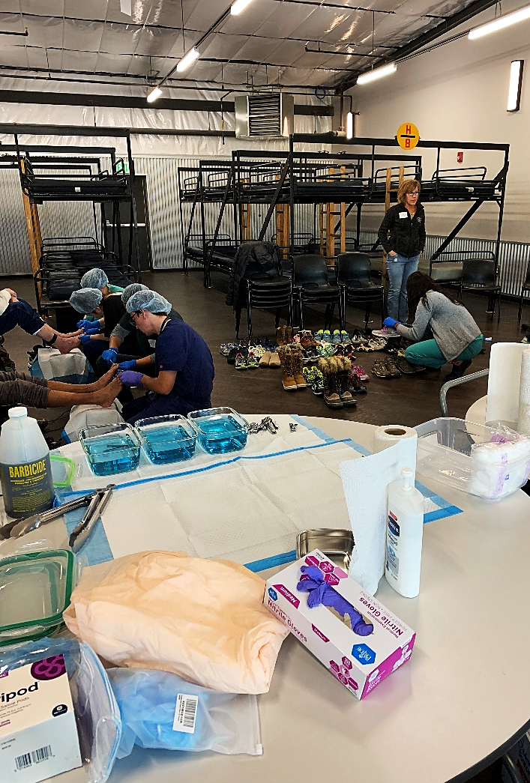
About the Clinic
Objectives
Increase access to basic foot care services for the adult homeless population of Colorado Springs.
Increase referrals and follow-up care for more advanced foot care services.
Provide essential foot care supplies and services to improve comfort and decrease complications from foot pathologies.
Improve empathy of medical students and other health care providers toward people who are homeless.
Notes:
Quarterly, volunteer based clinic held at SRM
Funding: UPL Grant
Shoe drive

Slide 6
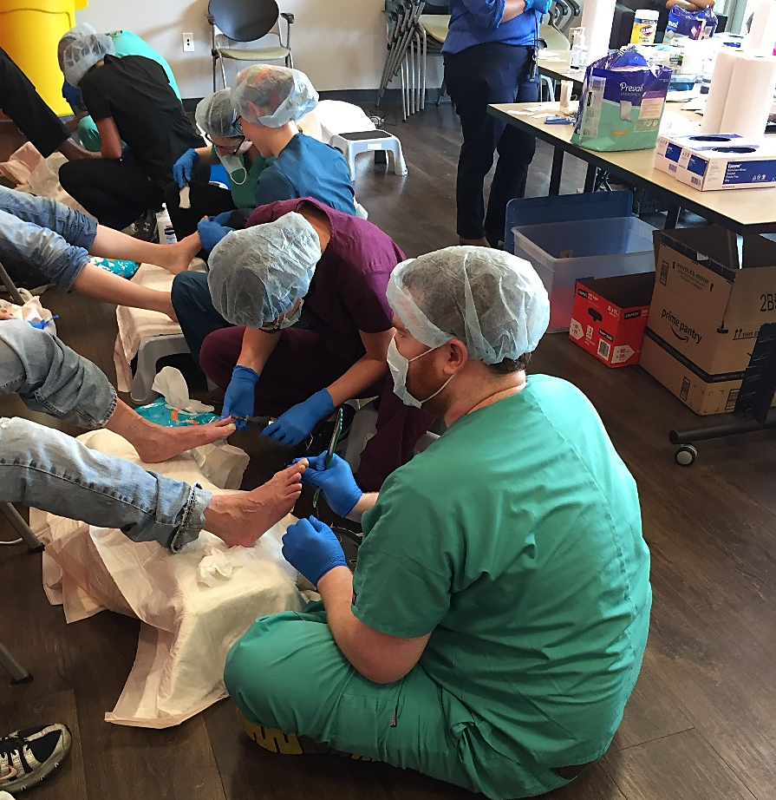
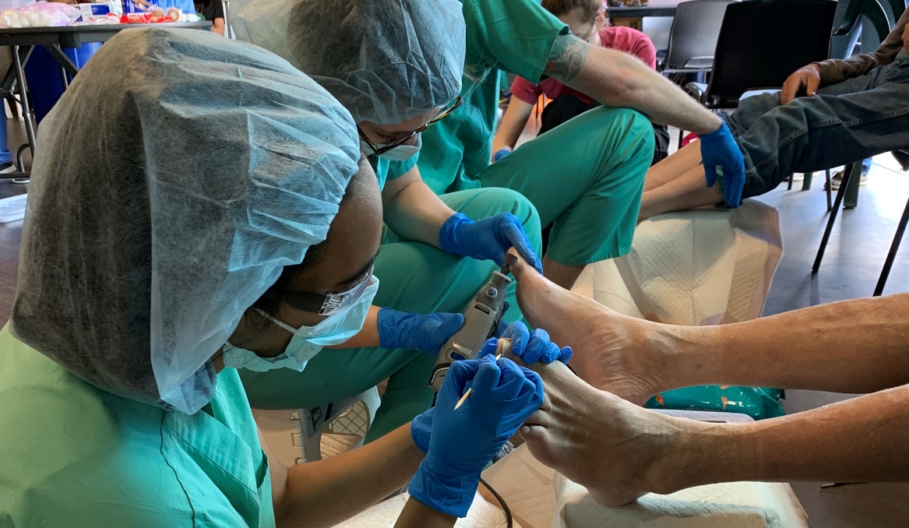
PEAK Project Goals
1. Establish a volunteer base to ensure sustainability of Foot Care Clinic
2. Assess the quality of the Foot Care Clinic to make its stated objectives
Notes:
Outreach to local schools

Slide 7
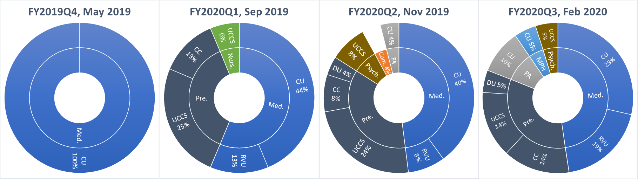
Average of 20 volunteers per clinic
67 newly trained volunteers this year
1 training held at CC
Feb clinic: 71% of volunteers were repeat volunteers
Volunteers
Notes:
Schools:
CC, UCCS, PPCC, CUSOM, RVU, CU PA, Undergrad Alum
-prehealth and preprofessional programs
-mentorship opportunities
Clinical and non-clinical volunteers
-surveys
Shoe drive
Liaisons
-student alumni who have been integral in helping with shoe drive, UCCS student recruitment

Slide 8
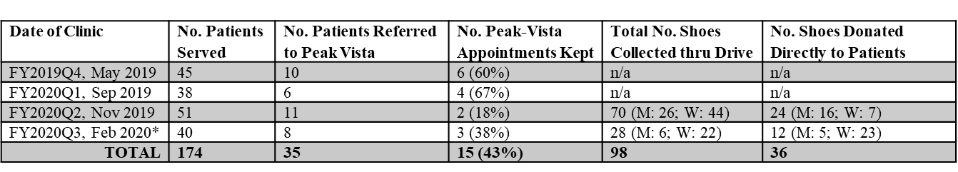
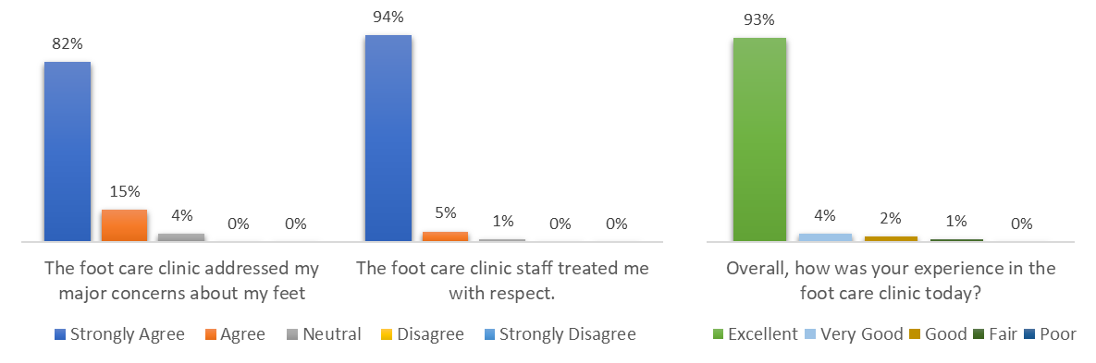
Guests
page 8

Slide 9
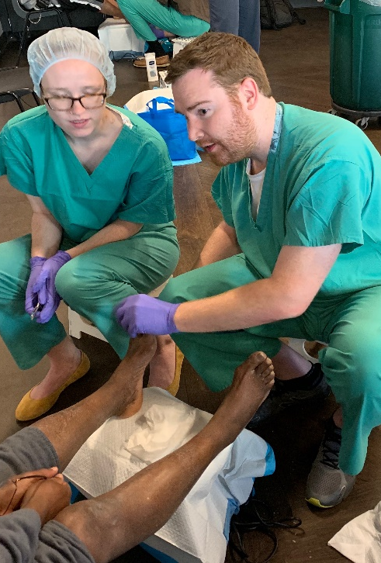
Moving Forward…
Leadership Transition
Volunteers
Expansion
Data!
Notes:
Training MS1 (almost Ms2) leaders
Dual MS4/MS2 leadership roles
-solidifying and furthering volunteer base -> UCCS*, expansion to PPCC
-expansion of clinic?
-more locations? More times? More at the clinic itself?
-who aren’t we reaching and why?
-Data on empathy changes among volunteers
-Data from guests about experiences, about other needs…
-did the program reduce ER visits?
-did the program help patients trust the system more?
-incorporating Tosin’s assessment into the project

Slide 10
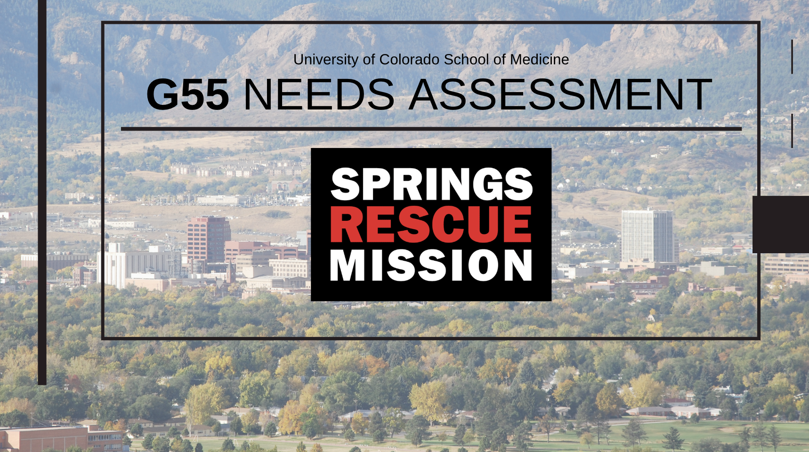

Slide 11
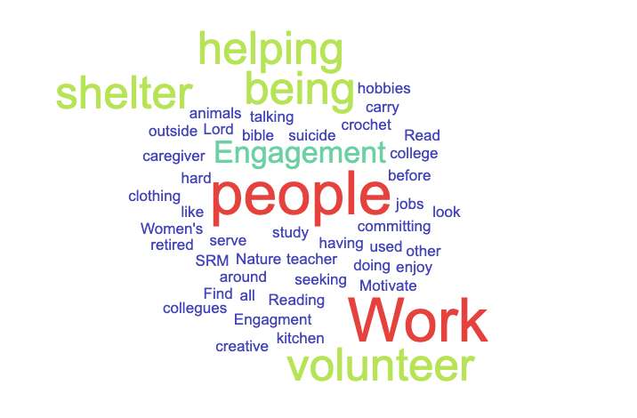

Question # F4 ^{1,4}
Do you currently engage in/participate in activities other than just surviving that make you feel happy and fulfilled?
page 11
Notes:
WORK… work engagement
Bias
‘address’
Age
Phone number

Slide 12
Why G55?₁₋₇
Homeless Needs Assessment for Geriatric Population
Basic Information
Family/Social
Employment9 questions
Legal
Alcohol/Drugs
History of Housing & Homelessness
Medical
Resources
5 questions
Identifier
8 question
4 questions
8 questions
6 questions
9 questions
1 question
28 resources
OBJECTIVES
Identify pathways to homelessness for persons > 55y/o.
Identify areas of need among persons >55y/o experiencing homelessness.
Identify awareness of SRM’s resources.
Identify methods to mitigate currently unmet needs
Open Comments
Notes:
In the general population elderly is defined as >65, where in, so-called geriatric conditions like memory loss, difficulty maintaining ADLs, urinary incontinence are common. Homeless adults aged 50 and older have rates of these chronic conditions similar to or higher than community.
Federally funded points of intervention and county resources aimed at >65
TIMELLINE:
July – October: Knowning SRM
November – Jan: Task Force
Jan: Interns
Feb: Data collection.
Even seniors who have housing.. Managing conditions can be challenging.
Case Managers, Shelter Coordinators, Interns
Questions adapted from
VI-SPDAT
COHMIS
SRM Intake Form
COHMIS – Colorado Homeless Management Information System
The Colorado Homeless Management Information System (COHMIS) is a data system that stores information about homelessness services. The name of the software that stores this data is called Clarity Human Services.
improve coordination of services that support people who are homeless or at risk of homelessness
, data is shared statewide between the four Continuum of Care (CoC) bodies: MDHI (Metro Denver), Pikes Peak (El Paso County) Northern Colorado (Larimer and Weld Counties), and Balance of State (Remaining 54 Counties). Active agencies that participate in COHMIS are listed on
OrgCode Consulting,
Service Prioritization Decision Assistance Tool (SPDAT) has been around in various incarnations for over a decade, before being released to the public in 2010.
VI-SPDAT (Vulnerability Index - Service Prioritization Decision Assistance Tool) is a survey administered both to individuals and families to determine risk and prioritization when providing assistance to homeless and at-risk of homelessness persons.
a pre-screening tool for communities that are very busy and do not have the resources to conduct a full SPDAT assessment for every client. It was made in collaboration with Community Solutions, creators of the Vulnerability Index, as a brief survey that can be conducted to quickly determine whether a client has high, moderate, or low acuity

Slide 13
H3: How long has it been since you lived in permanent stable housing*?
Years since last stable housing | Percent
< 6 m/o | 22%
6 mo - 1 year | 50%
1 year - 5 years | 11%
5 years - 10 years | 11%
> 10 years | 6%
*Non-institutional place you’ve lived
page 13

Slide 14
DEMOGRAPHICS
Notes:
Median age: 62
Per SRM intake and entry on average 60/day > 55
~15 at entry shelter
Remainder at mens/womens shelter = translation

Slide 15
H1: Where do you sleep most frequently?
Notes:
Transitional housing is conceptualized as an intermediate step between emergency crisis shelter and permanent housing.

Slide 16
Self Reported Chronic Medical Conditions
45% reported not taking a medication for a current chronic medical condition that a doctor prescribed

Slide 17
Moving Forward…
Leadership Transition
Case Managers
Community Partners
Data!
Notes:
Representative Data… conducting assessment in July.
Findings to SRM leadership. M.Farmer. Looking at data that already exists. Identify points of intervention
RESOURCES…. Majority report not being aware of resources ~ 27
Goal is to have 70 assessments. Representative of current
Interns who will be here until September. New Interns roll in late July
Case Managers want to use needs assessments for their intake. 1-1 management and connection to resources to clinents who show commitment to transition
Legal
Medical

Slide 18
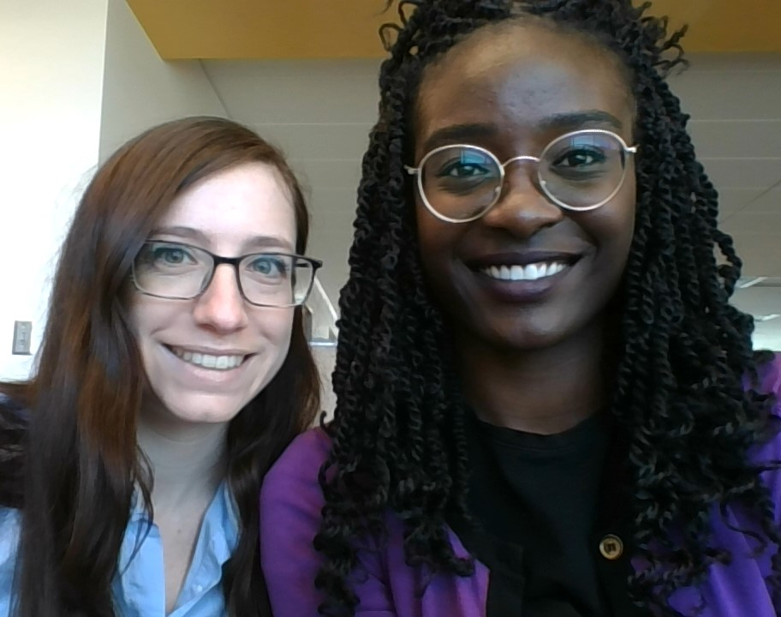
Lessons in Leadership
Delegation
Situational Leadership
Intentionality
Co-Leadership
Fostering Collaboration
Pause, Reassess.

Slide 19
References
Brown RT, Thomas ML, Cutler DF, Hinderlie M. Meeting the Housing and Care Needs of Older Homeless Adults: A Permanent Supportive Housing Program Targeting Homeless Elders. Seniors Hous Care J. 2013;21(1):126–135.
Kushel M. Older homeless adults: Can we do more? Journal of General Internal Medicine. 2012;27(1):5–6.
Lee CT, Guzman D, Ponath C, Tieu L, Riley E, Kushel M. Residential patterns in older homeless adults: Results of a cluster analysis. Soc Sci Med. 2016;153:131–140. doi:10.1016/j.socscimed.2016.02.004
Browning CR, Cagney KA. Moving beyond poverty: neighborhood structure, social processes, and health. J Health Soc Behav. 2003;44:552–571.
Burnam MA, Koegel P. Methodology for Obtaining a Representative Sample of Homeless Persons: The Los Angeles Skid Row Study. Evaluation Review.
Fischer PJ, Shapiro S, Breakey WR, Anthony JC, Kramer M. Mental health and social characteristics of the homeless: a survey of mission users. Am J Public Health. 1986;76:519–524.
Hibbs JR, Benner L, Klugman L, Spencer R, Macchia I, Mellinger A, et al. Mortality in a cohort of homeless adults in Philadelphia. N Engl J Med. 1994;331:304–309
King, Benjamin T., "ASSESSMENT AND FINDINGS OF THE VULNERABILITY INDEX (VI-SPDAT) SURVEY OF INDIVIDUALS EXPERIENCING HOMELESSNESS IN TRAVIS COUNTY, TX" (2018). UT School of Public Health Dissertations (Open Access). 11. https://digitalcommons.library.tmc.edu/uthsph_dissertsopen/11

Slide 20
THANKS & APPRECIATION
The Springs Rescue Mission
SRM clients
BARB LARA
Cori Buterbaugh
Amber Hudson
SRM Case Managers
SRM Interns
PEAK PRESENTATION
Nikki Bloch
Oluwatosin Adebiyi

