Slide 1
Office of Psychological Science and Practice (OPSP)
All Psychologists Meeting: July 20, 2026
Notes:
BEST PRACTICES & ACCESSBILITY STANDARDS:
”Save as” this template before you begin and rename it to the title of your presentation. This way, you will retain a copy of this blank template for future use.
Choose a title slide theme and then delete the other options
To add a new slide go to Insert in the navigation bar > New Slide and click the drop-down arrow to choose from different slide layouts and designs.
For body text keep font size at 18pts or larger. For headers keep font size at 24pts or larger.
For any new image or icon you add please add a description in the alt text. Right click image > click on View Alt Text > type in image description

Slide 2

Welcome!
Agenda
Welcome new faculty
Celebrations and Promotions
Presentation by Dr. Samantha McBride
Announcements

Slide 3

Welcome New Psychology Faculty!
Christine Runyan, PhD (Adult), Visiting Professor
Matthew Stewart, PsyD (CHCO), Instructor
Ashley Griffith, PhD (VAMC), Assistant Professor

Slide 4

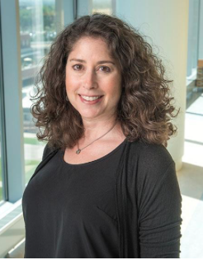
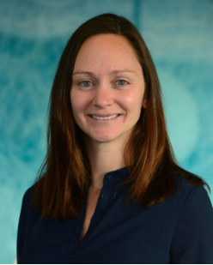
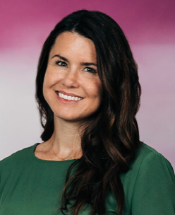
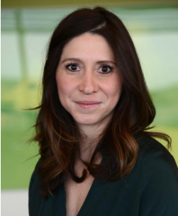
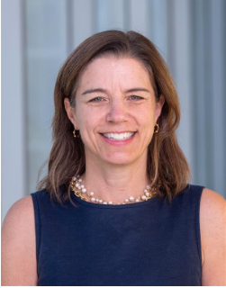
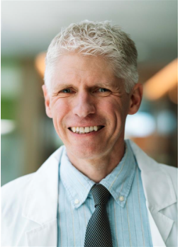
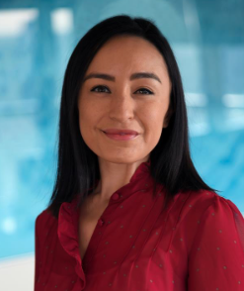
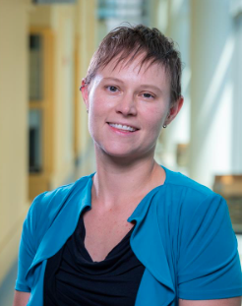
Promotions July 1, 2026
Associate Professor
Elizabeth Chamberlain, PhD
Amelia Ehmer, PsyD
Hollis Karoly, PhD*
Jessica Kenny, PhD
Ruschelle Leone, PhD*
Christine Reinhard, PhD
Jessica Ross, PhD*
Verenea Serrano, PhD
Laura Vargas, PhD*
Michelle West, PhD
*Photo not available
Professor
Audrey Blakeley-Smith, PhD
Joseph Schacht, PhD

Slide 5

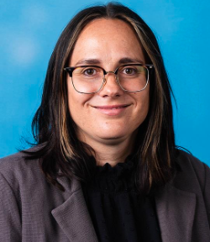
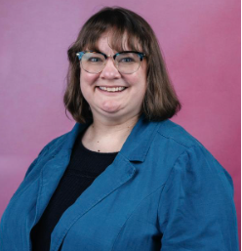
Promotions: Rank Changes July 1, 2026
Assistant Professor
Natalie Finn, PhD*
Kelly Holmes, PhD
Amy Patinella, PsyD*
Julia Palozzi, PsyD*
Marie Rodriguez, PhD*
Leonora Ryland, PhD
*Photo not available

Slide 6
Publications and Presentations
Noa Heiman & Ronnie Carmeli (2026) The Transformative Power of Singular Words, Psychoanalytic Dialogues, 36:3,309320, DOI:10.1080/10481885.2026.2662851
Garver-Apgar CE, Giano Z, Kayser AM and Morris CD (2026) Factor structure and psychometric validation of the Work and Well-being Inventory. Front. Public Health 14:1816119. doi: 10.3389/fpubh.2026.1816119
Jonathan Safer-Lichtenstein, PhD & Mary Troxel's recent research publication: Short Report: Limited Sensitivity and Specificity of the Spanish Social Communication Questionnaire in a Clinic Sample in Quito, Ecuador.

Slide 7
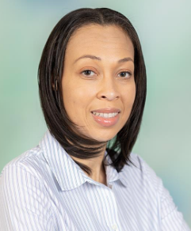

Congratulations!
Congratulations Dr. Brigitte McClellan and Dr. Jessica Kenny on receiving funding associated with the Society of Pediatric Psychology Anti-Racism grant. Funds will support enrichment of the current efforts around OPEN curriculum development and training as well as support growth of the PALSS program.
Congratulations to Kate Hunter and Ayelet Talmi for being our June CU Celebrates Challenge Winners! Both Ayelet and Kate will receive a $25 gift card of their choice.

Slide 8

Celebrations!
Congratulations on being selected for the Exemplary Teaching Award within the Child Psychology Internship and Externship programs! Your expertise with supervising and teaching others is so apparent to everyone who works with you. Congratulations on a very well-deserved award!
Recognized by Laura Judd-Glossy

Slide 9
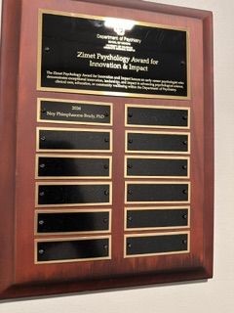
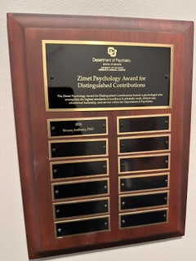
Zimet Wall Plaques
on the wall in the Education Suite

Slide 10

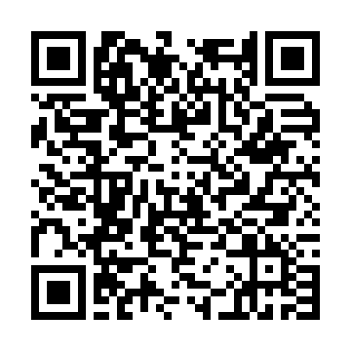
American Psychological Association (APA) Annual Convention
August 6th – 8th 2026, Washington DC
Attending or presenting?
Let us know!

Slide 11
August 6–8 | Washington, DC + Virtual
The Office of Psychological Science and Practice (OPSP) wants to hear from faculty, staff, and trainees about participation and attendance. We will have opportunities to share information about the Department of Psychiatry at the department's exhibitor booth.
If you are planning to attend and/or present at APA this year, please complete the conference participation form by scanning the QR code:
This form will track Department of Psychiatry faculty, staff, and trainee APA participation including attendance and presentations. We will also create a listing of presentations by Department of Psychiatry faculty, staff, and trainees to share before the conference and to celebrate the incredible work being done here.
Please complete the form by Monday July 6, 2026.

Slide 12

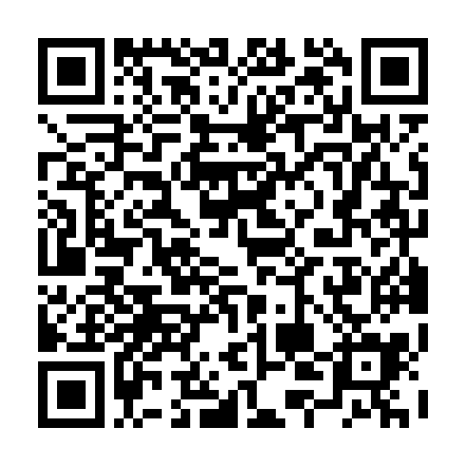
The SfHP Student Advisory Council invites you to participate in the:
Meet and Greet with Health Psychology Training Directors (Internship and Postdoctoral)
Where: 2026 APA Convention in Washington DC at the Marriott Marquis, Salon 10
When: Friday 8/7/2026 from 6:30pm to 7:30pm
Please consider joining us for SfHP's annual DCT Meet and Greet at APA's 2026 Convention! We welcome any representatives from Internship or Post Doctoral programs with Health Psychology tracks/components to attend this social hour and meet with trainees who are preparing to apply for internship or fellowship.
At the start of the hour, training directors will be invited to introduce themselves and their program. The remainder of the event will be relatively casual (e.g., no presentation or panel) and mingling will be encouraged. Snacks and beverages will be provided.
If you will be attending APA and plan to participate in this event,
please RSVP by Friday, July 24th.

Slide 13
Presentation
Dr. Samantha McBride and Krinkle (therapy dog)
Animal Assisted Therapy and EMDR consultation/resources

Slide 14
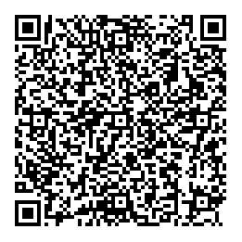
We want your feedback!
Scan the QR code to access a survey re: the OPSP All Psychologists meeting
OPSP Intranet Page
https://olucdenver.sharepoint.com/sites/Psychiatry/SitePages/OPSP.aspx
OPSP website
https://medschool.cuanschutz.edu/psychiatry/offices/office-of-psychological-science-and-practice-main

