Slide 1
CU Addiction Psychiatry Fellowship

Slide 2
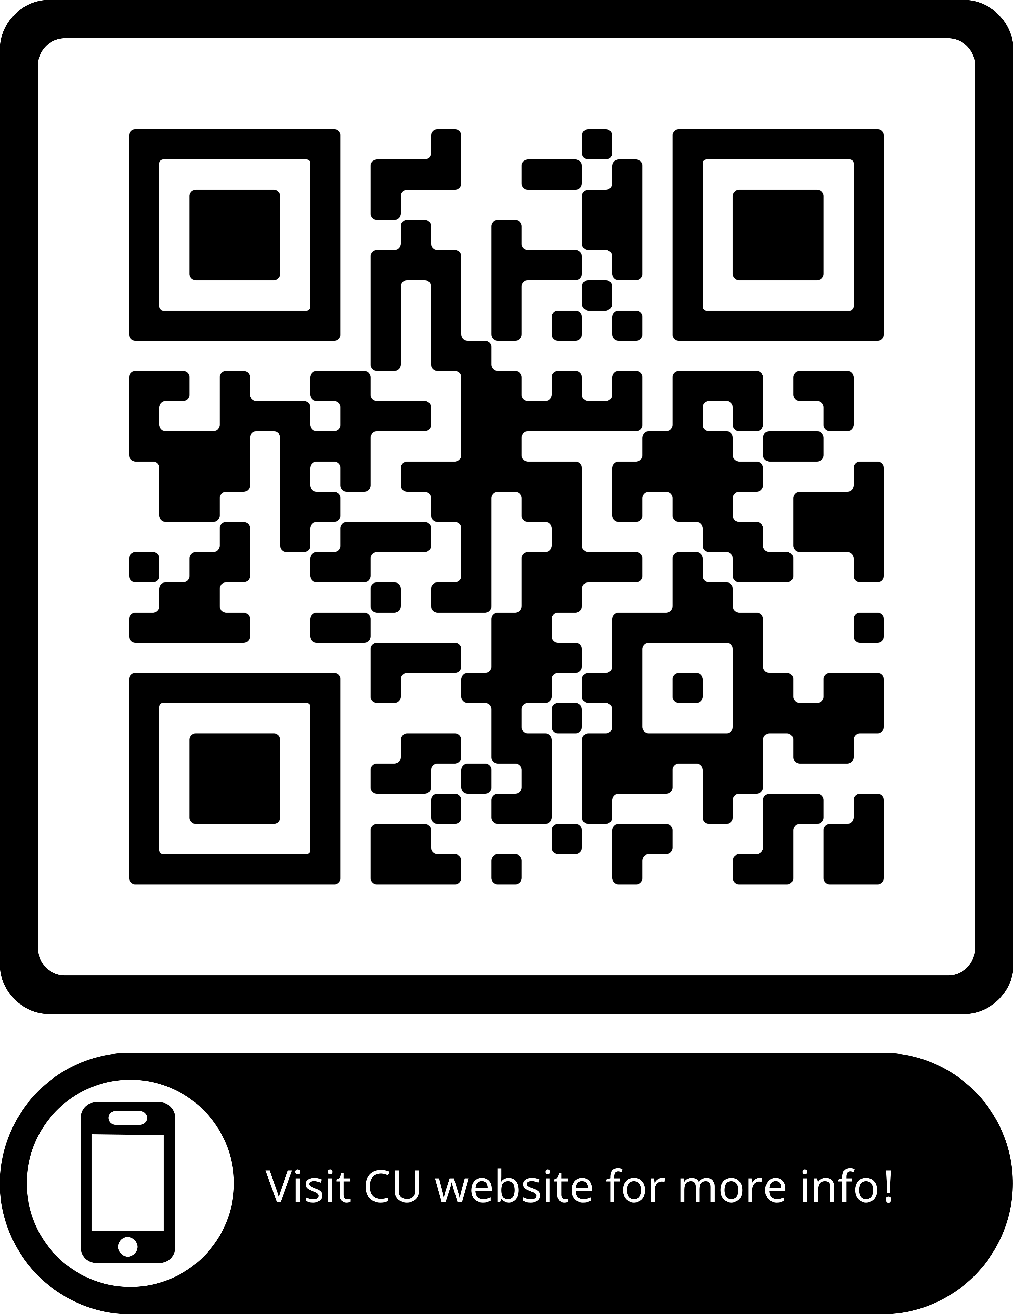
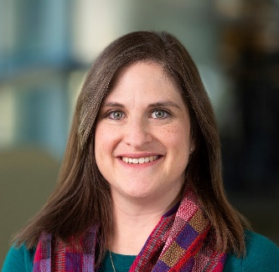
Alexis Ritvo, MD MPH
Alexis.Ritvo@cuanschutz.edu
University of Colorado School of Medicine,
Addiction Psychiatry Fellowship Program Director
Assistant Professor of Psychiatry

Slide 3
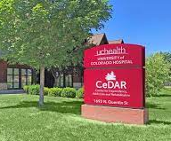
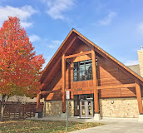
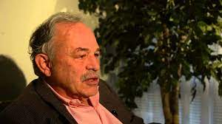

Center for Dependency Addiction and Rehabilitation (CeDAR) https://www.cedarcolorado.org
Jonathan Ritvo, MD
Site supervisor

Slide 4
UCHealth CeDAR Inpatient Residential Treatment (IRT) Schedule
 | Monday | Tuesday | Wednesday | Thursday | Friday
AM | IRT | IRT w/ J.Ritvo | IRT | IRT w/ J.Ritvo | IRT w/ J.Ritvo
PM | IRT | Scholarly Project | Didactics | IRT w/ J.Ritvo | IRT
Can follow patients from IRT to OP on a half day TBD supervised by Dr. Lucas Coppes
~1 weekend per month call requirement (no holidays)= 4 calls during the 4 months

Slide 5
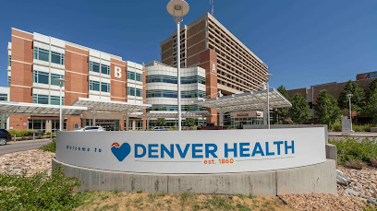
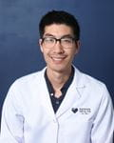
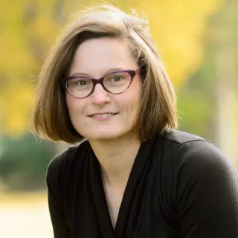
Inpatient Hospital Addiction Consult Service
Dale Terasaki, MD
Julie Taub, MD

Slide 6
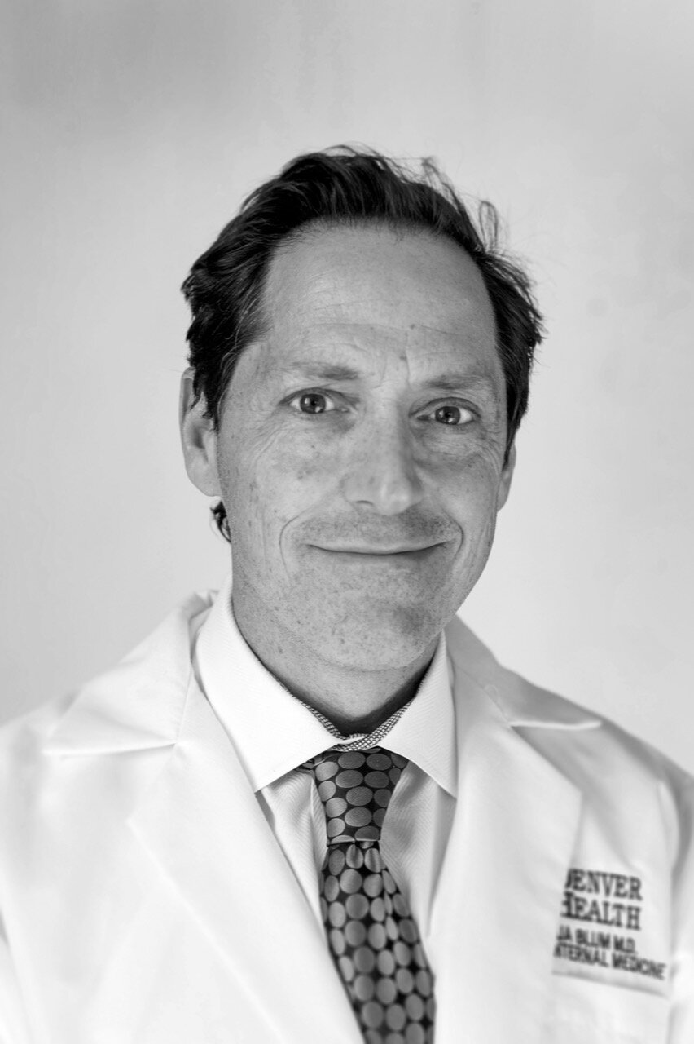
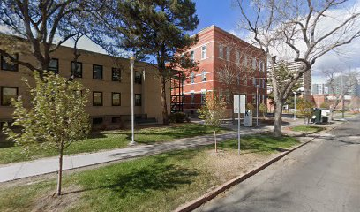
Opioid Treatment Program & Addiction Recovery Center - Pavilion K
Dr. Joshua Blum, Medical Director
Josh Blum, MD
Director of the
OTP Hours of Operation (not clinical hours)
Walk-in intakes for Methadone and Suboxone Opioid Treatment: M-F, present before 5:45 a.m.
Specialty therapy and clinical services: M-F, 6 a.m. - 4 p.m.
Specialty medication dosing: M-F, 5:45 a.m. - 1:15 p.m., Sat-Sun, 6 - 9 a.m.
https://www.denverhealth.org/services/behavioral-health/addiction-services
Notes:
https://www.denverhealth.org/services/behavioral-health/addiction-services/methadone-clinic-opiate-addiction-treatment
https://www.denverhealth.org/services/behavioral-health/addiction-services/recovery-suboxone-treatment

Slide 7

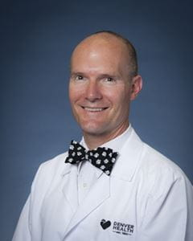
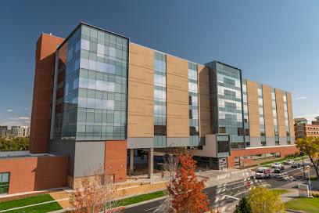
Substance Abuse Treatment, Education and Prevention (STEP) Clinic
for adolescents (<21yo) @ DH Outpatient Medical Center, Pavilion L
Christian Thurstone, MD; site supervisor and medical director
Notes:
https://www.denverhealth.org/services/behavioral-health/addiction-services/adolescent-substance-abuse-treatment
https://drthurstone.com/download-impact/

Slide 8
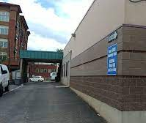
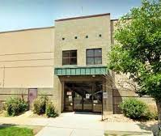
Denver Community Addiction Rehabilitation and Evaluation Services (CARES) for Involuntary Commitment (IC) Evaluations
Notes:
https://bha.colorado.gov/resources/substance-use-commitment

Slide 9
Denver Health (DH) Schedule*
 | Monday | Tuesday | Wednesday | Thursday | Friday
AM | SUD OP Dr. Josh Blum OBHS (Pav K) | Methadone OP Dr. Josh Blum OBHS (Pav K) | SUDS OP Dr. Josh Blum OBHS (Pav K) | Methadone OP Dr. Josh Blum OBHS (Pav K) | Methadone OP Dr. Josh Blum OBHS (Pav K)
PM | Denver Cares (Involuntary Commitment Eval) Dr. Josh Blum 1155 Cherokee St, Denver, CO 80204 | STEP-Adolescent (ACT-MET-CM) Dr. Christian Thurstone^ | Didactics | SUDS OP Dr. Josh Blum OBHS (Pav K) | Scholarly Project
*Addiction CL full-time 2 week experience at either beginning or end of 4 month block
^ May do a few weeks observation of Perinatal Addiction Dr. Kaylin Klie in Women's Care Clinic

Slide 10

https://www.artstreatment.com/our-services/

Slide 11
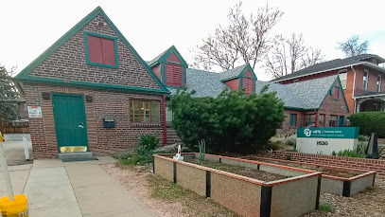
ARTs Parkside Opioid Treatment Program
With Zoran Vukadinovic MD
Notes:
https://www.artstreatment.com/our-services/medication-assisted-therapies/

Slide 12
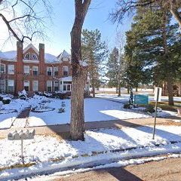
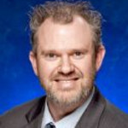
ARTs
Men’s Inspiration Residential
Inspiration for Men provides a supportive environment for men on the journey to a better and healthier life. We offer compassionate care and support throughout the recovery process. We use evidence-based practices to help individuals develop healthy coping skills, change unhealthy behaviors, and become self-sufficient, confident, and productive members of our community.
Treatment plan includes:
  Trauma-informed care
  Individual counseling and evidence-based groups
  Psychiatric evaluation and mental health therapy
  Medication Assisted Treatment, if clinically indicated
  Cognitive Behavioral Therapy with a focus on learning new coping skills
  Communication skills and conflict resolution
  Employment preparation and resume writing skills
  Case Management
  Continuation of care through our outpatient services
  Transitional living options
Jason Sapp, DO
Site Supervisor
Notes:
https://www.artstreatment.com/our-services/men-s-residential/
80-bed Therapeutic Community (TC) that offers long-term, intensive treatment for adult males with chronic substance use disorders, related anti-social behaviors and co-occurring mental health disorders.
Participants learn to be accountable to the TC community through a hierarchical model of treatment stages that reflect increased levels of personal and social responsibility.
Referrals derive from a myriad of sources, including the Colorado Department of Corrections, Community Correction Boards, probation department, and individuals and their family members.

Slide 13
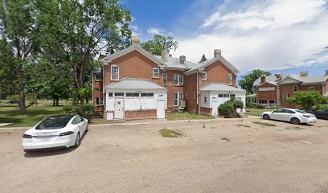
ARTs Synergy
Serves adolescents in Denver Metro Area with substance use, conduct, and other co-occurring psychiatric disorders.
Referrals are accepted from human services, probation and judicial districts, Denver Collaborative, SB94, Division of Youth Services, Medicaid, family, and self-referral
With Christian Hopfer, MD
Notes:
https://www.artstreatment.com/our-services/adolescent-services/

Slide 14

VA Eastern Colorado Health Care System
https://www.va.gov/eastern-colorado-health-care/

Slide 15
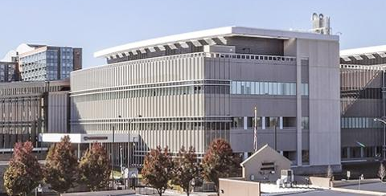
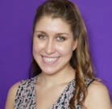
Rocky Mountain Regional VA Medical Center
Katherine Folse, MD
Site Supervisor
Notes:
https://www.va.gov/eastern-colorado-health-care/locations/rocky-mountain-regional-va-medical-center/
We have added a new rotation to our program along with a new site. Our fellows will now rotate at the VA part time for 4 months while also doing 4 months part time ARTS. The VA has many opportunities for our fellows including: outpatient treatment of SUDs. Medication interventions include sublingual and injectable buprenorphine, oral and injectable naltrexone and disulfiram among others, outpatient alcohol withdrawal management program as well as rapid access to buprenorphine products, The clinic provides extensive evidence based psychosocial interventions including intensive outpatient programing, contingency management, peer support, individual therapy, couples therapy CBT for SUD and motivational interviewing to list a few offerings.

Slide 16
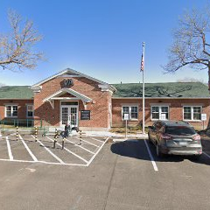
VA Community Resources and Referral Center- Homeless Clinic
with Jenn Starr, MD
Notes:
https://www.va.gov/eastern-colorado-health-care/locations/york-street-va-clinic/

Slide 17
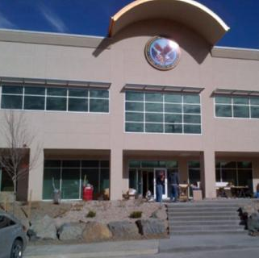
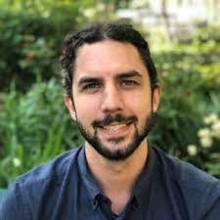
VA Golden CBOC
Dan Defrancisco, MD
Notes:
https://www.va.gov/eastern-colorado-health-care/locations/york-street-va-clinic/

Slide 18
ARTS (Addiction Research Treatment Services) & VA SATP (Substance Abuse Treatment Program)
 | MONDAY | TUESDAY | WEDNESDAY | THURSDAY | FRIDAY
AM | ARTs Peer I (Men's TC) Supervisor: Sakai Location: 3762 W. Princeton Circle, Denver CO, 80236 Phone: 303-761-2885 Time: 8am-12pm | VA SATP (& Detox clinic 9-10a) Supervisor: Katherine Folse 1700 N Wheeling ST Aurora, CO 80045 | VA SATP (& Detox clinic 9-10a) (or Golden CBOC) Supervisor: Katherine Folse (Dan DeFrancisco) 1700 N Wheeling St Aurora, CO 80045 Detox | ARTs Parkside Clinic (Methadone , ?Mobile Methadone) Supervisor: Zoran Vukadinovic Location: 1620 Gaylord Street, Denver CO 80206 Time: 7:30am-11:30pm | ARTs Synergy OP (Adolescent) Supervisor: Christian Hopfer Location: 3680 W. Princeton Circle, Denver CO 80236 Time: 1pm-5pm
 | Lunch break | Lunch break | Grand Rounds | Lunch break | Lunch break
PM | ARTs OTC (Men/Women) Supervisor: Sakai 3804 W. Princeton Circle, Denver CO, 80236 Time: 1pm-6pm 2-3 MST meeting Synergy Outpatient | VA SATP Supervisor: Katherine Folse 1700 N Wheeling ST Aurora, CO 80045 | Didactics (1:30-4:40pm) | VA CRRC Clinic for Homeless Veterans Supervisor: Jennifer Starr 3836 York St, Denver, CO 80205 | Scholarly project

Slide 19


Didactics Highlights
Every Wednesday afternoon in conjunction with the addiction medicine fellows (1:30-3/4p)
Presentations by CU faculty on areas of interest and expertise
Once monthly in person journal club with adjunct faculty Dr. Bryon Adinoff (Editor-in-Chief of The American Journal of Drug and Alcohol Abuse.
Monthly Addiction Psychiatry Advanced Psychotherapy Curriculum from AAAP
High-yield presentations from the National Addiction Medicine Didactic Curriculum (AACAM)
Notes:
https://www.aaap.org/fellowship/addiction-psychiatry-advanced-psychotherapy-curriculum/
https://www.acaam.org/national-addiction-medicine-didactic-curriculum

Slide 20
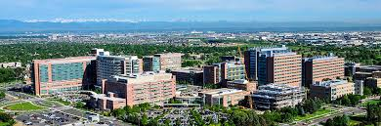
Scholarly Project
Want fellows to pursue at least one line of inquiry and produce at least one deliverable by the end of the academic year
Can take many forms
  Op-ed about advocacy, perspective/editorial, literature review
  QI project
  Grand Rounds
  Conference Poster or Workshop

Slide 21
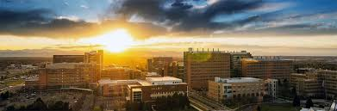
CU GME
PGV Stipend ‘24-’25: $91,623.00 (incr of 17%/$13,437)
  ‘25-26 not yet announced
Benefits
https://medschool.cuanschutz.edu/graduate-medical-education/CUGME-benefits

Slide 22

Denver Metro Area Google map , includes the clinical sites, major university affiliated hospitals, Denver metro neighborhoods as well as some favorite recreational spots
5280 Magazine Best Neighborhoods in Denver https://www.5280.com/neighborhoods/
5280 Magazine Top of the Town: https://www.5280.com/package/top-of-the-town-2023/
Westword: Things to Do In Denver
Notes:
https://www.google.com/maps/d/u/0/edit?mid=17PW7OTUn5xLVVBzDzA_AswC4e_c&usp=sharing
5280 Magazine Best Neighborhoods in Denver https://www.5280.com/neighborhoods/
Magazine 5280 Magazine Top of the Town: https://www.5280.com/package/top-of-the-town-2023/
https://www.westword.com/topic/things-to-do-6206354

Slide 23
Alexis Ritvo, MD MPH
Alexis.Ritvo@cuanschutz.edu
University of Colorado School of Medicine,
Addiction Psychiatry Fellowship Program Director
Assistant Professor of Psychiatry
The Alliance for Benzodiazepine Best Practices
Medical Director (www.benzoreform.org)
Benzodiazepine Action Work Group
Co-Chair (www.benzoaction.org)

