Slide 1
Breaking Barriers: Exploring ADHD Care for Spanish-Speaking Families
Ashlyn Nguyen
The Psychiatry Undergraduate Research Program and Learning Experience

Slide 2

ADHD
Attention Deficit Hyperactivity Disorder
Inattention: difficulty staying on task, sustaining focus
Hyperactivity: moving constantly with excessive fidgeting and restlessness
Impulsivity: difficulty with self-control, may act without thinking
7 million children diagnosed with ADHD in the United States
Notes:
According to the National Institute of Mental Health, ____
Some people with ADHD show just one of these symptoms, while others can show all 3

Slide 3

Background
Non-Latinx children are more often diagnosed with ADHD compared to Latinx children¹
However, Latinx children have similar rates of ADHD symptoms compared with non-Latinx children, suggesting that this population is being underdiagnosed²
A small clinical study found that of those who are diagnosed, minoritized children are less likely to begin and more likely to cease ADHD treatment³
Notes:
Of the 7 million children diagnosed with Attention Deficit Hyperactivity Disorder (ADHD) non-Latinx children are more often diagnosed with ADHD compared to Latinx children¹
However, Latinx children have similar rates of ADHD symptoms compared with non-Latinx children, suggesting that this population is being underdiagnosed²
A small clinical study found that of those who are diagnosed, minoritized children are less likely to begin and more likely to cease ADHD treatment³

Slide 4


Background
Barriers to care may be related to psychosocial concerns, which are identified more often in other-language families than in English-speaking families⁴
Language barriers are another area of exploration, as there are limited studies that investigate interpreter perspectives in a pediatric setting^{5,6}
Project CLIMB (Consultation Liaison in Mental Health and Behavior) provides integrated behavioral health services to children and families in a pediatric primary care clinic

Slide 5


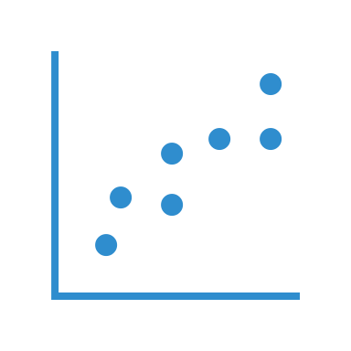
Objectives
1
2
3
Analyze the difference in rates of ADHD diagnosis and ADHD medications prescribed based on language
Analyze correlation between ADHD symptoms and psychosocial barriers
Explore themes that contribute to communication barriers from the interpreter perspective and identify potential solutions

Slide 6
Methods
Visit Data from Electronic Medical Records
Psycho-Social Screener Questionnaire
CLIMB Flowsheet Chart Review
Informational Interview with Spanish Interpreters

Slide 7
Sample
Chart reviews are from 2018-2019 and 2021-2023
Age range: 6-18
Visit type: well child, standard follow up, urgent, etc.
Any child seen with ICD diagnosis codes for ADHD or had ADHD symptoms in medical record (N=999)
Notes:
Chart reviews are from the EPIC electronic medical record system
Participants were youth (N=999) between the ages of 6-18 who received care at the Children’s Colorado Child Health Clinic and had any concerns about ADHD symptoms

Slide 8
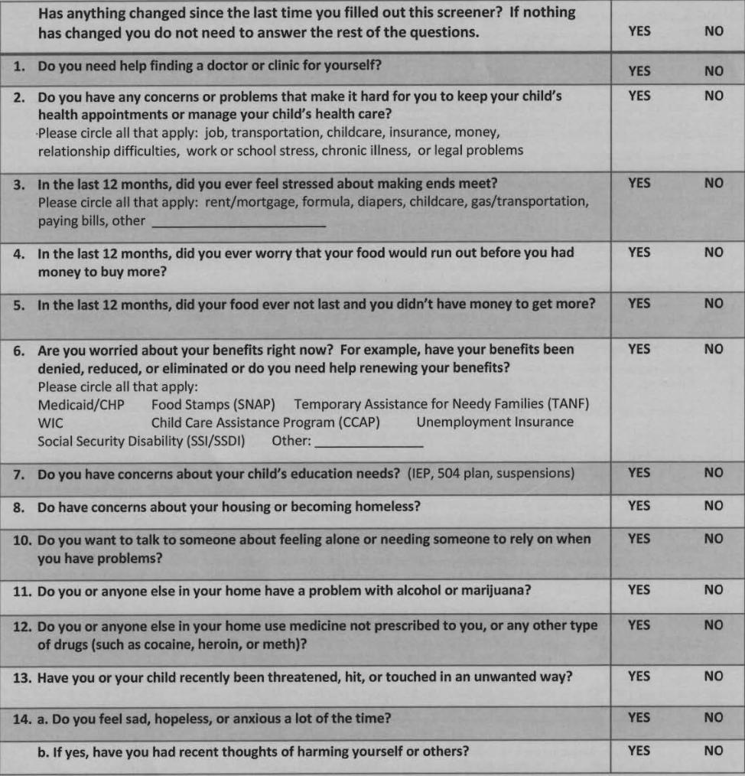
Psycho-Social Screener
3 sections:
Questions 1-8 for family navigation in socioeconomic and educational resources
Questions 10-13 for social work in mental health, substance abuse, or safety
Question 14 for caregiver mental health needs

Slide 9
CLIMB Flowsheet Chart Review
Project CLIMB (Consultation Liaison in Mental Health and Behavior)
Consultation Type
Visit Type
Presenting Problems
Length of Visit
Time Spent in Non-Direct Patient Care
Screening Tool Used
Psychotropic Medication Rx
Consult Language
Type of Interpreter Used
Psychosocial Screener Score
Medical Diagnosis
Recommendations
Program Involvement
Continued Project CLIMB Monitoring?
CLIMB Team Involvement
Medical Complexity Score
Notes:
Chart reviews are from the EPIC electronic medical record system
ADHD diagnosis and prescription rates were based on flowsheets from Project CLIMB

Slide 10
Patients diagnosed with ADHD
N=438
English Speakers
374 (85.39%)
Spanish Speakers
57 (13.01%)
Other Languages
6 (1.37%)
Results: Demographics
Patients prescribed ADHD medication
N=302 (68.95%)
English Speakers
264 (87.42%)
Spanish Speakers
35 (11.59%)
Other Languages
3 (0.99%)
No statistically significant differences were found in rates of ADHD diagnosis to ADHD medication prescribed through CLIMB (p > .05)
Notes:
ADHD diagnosis demographics was analyzed using Chi-Square Tests
No differences in ADHD diagnosis and medication prescription rates through CLIMB
Signifies that CLIMB is doing a good job at initiating medication treatment for patients with ADHD regardless of language

Slide 11
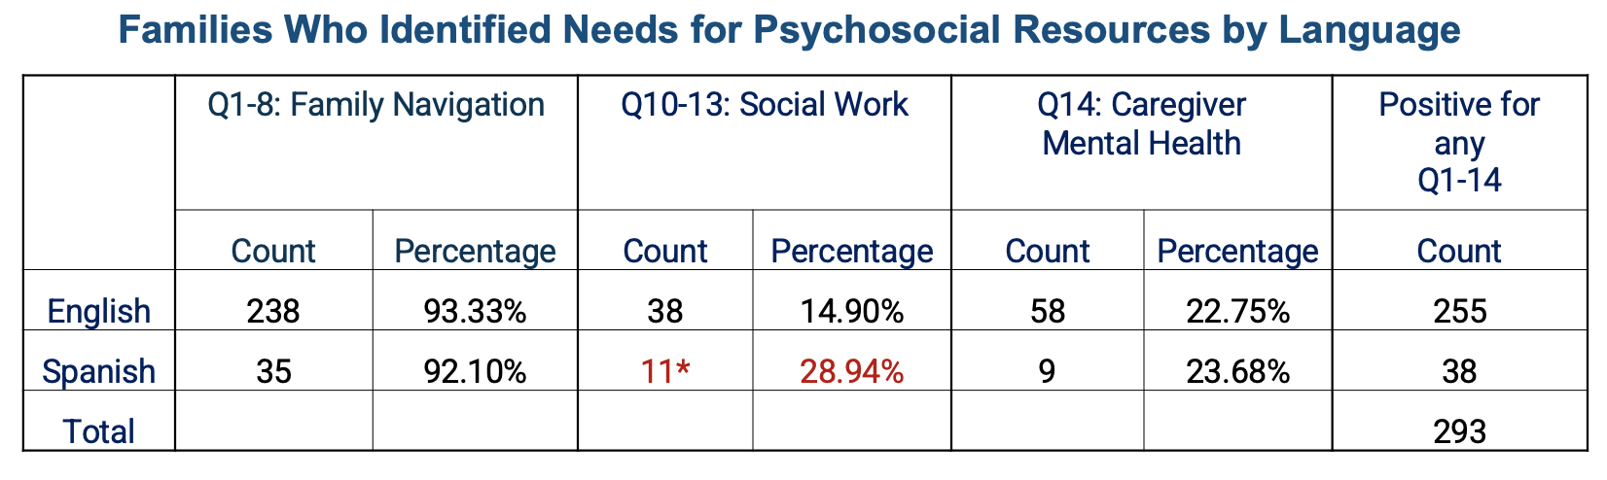
Results: Psycho-Social Screener Analysis
N=293 patients who had any concerns of ADHD symptoms and had positive scores on the psycho-social screener questionnaire
* indicates statistical significance, p = .03
Notes:
Psychosocial screener was analyzed using Chi-Square Tests
Spanish-speaking patients with ADHD symptoms demonstrate a higher need for social work resources than English speakers, but still demonstrate the highest need for family navigation

Slide 12
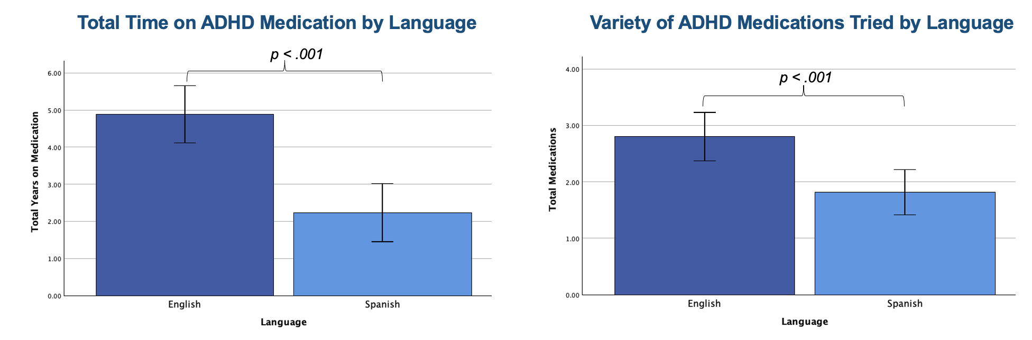
Results: CLIMB Flowsheet Chart Reviews
N=90 Chart Reviews
Disclaimer: Total length of prescription time was measured from first to last prescription date, not accounting for informal pauses from medication
Notes:
Medication use was analyzed using Independent T tests
N=90, Samples include 55 randomly selected English-speaking patients and all 35 Spanish-speaking patients who received ADHD medication
Errors bars represent 95% confidence interval
Both graphs have statistical significance, p(0.001)<0.01
Disclaimer: Total length of prescription time was measured from first to last prescription date, not accounting for informal pauses from medication
Despite similar diagnosis and prescription rates, Spanish-speaking patients take medication for an average of 2.24 years, compared to 4.89 years for English-speaking patients. Additionally, Spanish-speaking patients try an average of 1.82 types of ADHD medications, while English-speaking patients try 2.80 types

Slide 13
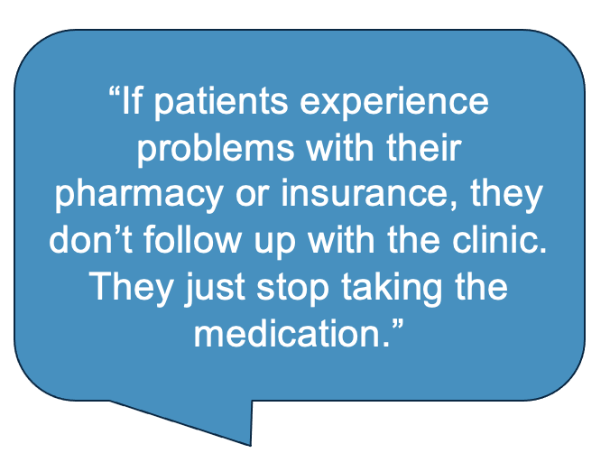
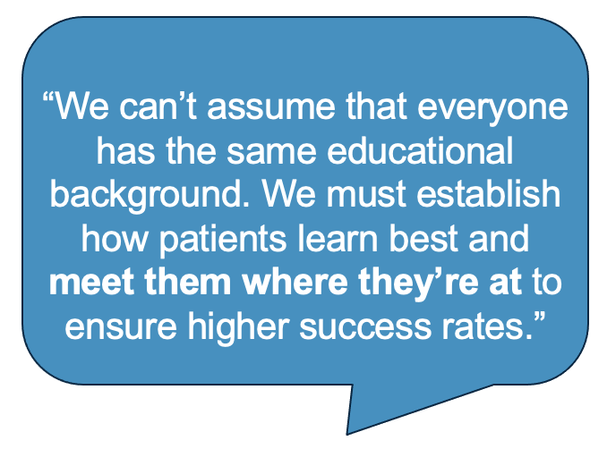
Results: Spanish Interpreter Interview
Common Themes
Patients are hesitant to voice concerns
Cultural misconceptions of life-long medication dependency
Careful word choice
Cultural emphasis on family support
Patients build more rapport with interpreters than with providers
Notes:
This suggests that many Spanish-speaking patients stop medication use when any barriers come up:
Possibly at the first sign of side effects without contacting clinic to try alternatives
National Stimulant shortage may have had a disproportionate impact on Spanish-speaking patients
This could be due to a lack of education on this topic, resulting in fear of medication addiction
Language barriers also contribute to this issue, as patients hesitate to voice concerns⁶

Slide 14




Potential Solutions to Address Barriers
Consistent follow-up with patients to ensure concerns are addressed and they are receiving medication
Ensure that all psycho-social needs from the questionnaire are being addressed
Create simple informational resources about diagnosis and medication for patients and families who have different learning styles in different languages
Leverage interpreters' rapport with patients by having providers regularly consult interpreters for insights

Slide 15
Limitations
Relying on PCP to enter in correct billing diagnosis and distribute psychosocial screener, and CLIMB providers to fill out flowsheets
EPIC Medical Record System and chart reviews don’t accurately reflect if patients pick up medication prescription
Not all families feel comfortable filling out the psycho-social screener, or may not be given it at every appointment
Data only includes first 11 visits per patient

Slide 16



Future Implications
Future studies may include interviews with families about their experiences with ADHD diagnosis and treatment
Compare CLIMB chart reviews with PDMP (Prescription Drug Monitoring Program) to confirm which patients are receiving their medication
Use the interpreters’ insight to create simple informational resources about ADHD to take home and increase health literacy, and analyze changes in how long Spanish-speaking patients stay on medications

Slide 17
Acknowledgements
Special thank you to:
Dr. Kimberly Kelsay, Dr. Celeste St. John-Larkin and Dr. Erika Garcia-Rocha, my PURPLE/CLIMB mentors
Yunliang (Lily) Luo and Shanna Trott, Directors of the PURPLE Program
Cynthia Downing, Mercedes Gordillo, and Yamileth Arteaga, the Spanish Interpreters
Dr. Ron-Li Liaw, Chair of PMHI
Dr. Neill Epperson, Chair of Department of Psychiatry
Dr. Dominic Martinez, Dir. Office of Inclusion and Outreach, CCTSI
Dr. Merlin Ariefdjohan, PURPLE Program Founder and Faculty Advisor
Families and staff in CLIMB

Slide 18
References
CDC. (2024, May 16). Data and Statistics About ADHD | CDC. Centers for Disease Control and Prevention. https://www.cdc.gov/adhd/data/?CDC_AAref_Val=https://www.cdc.gov/ncbddd/adhd/data.html
Rosenberg J, Rosenthal MS, Cramer LD, Lebowitz ER, Sharifi M, Yun K. Disparities in Mental and Behavioral Health Treatment for Children and Youth in Immigrant Families. Acad Pediatr. 2020 Nov-Dec;20(8):1148-1156. doi: 10.1016/j.acap.2020.06.013. Epub 2020 Jun 26. PMID: 32599347; PMCID: PMC7655594.
Kamimura-Nishimura K, Bush H, Amaya de Lopez P, Crosby L, Jacquez F, Modi AC, Froehlich TE. Understanding Barriers and Facilitators of Attention-Deficit/Hyperactivity Disorder Treatment Initiation and Adherence in Black and Latinx Children. Acad Pediatr. 2023 Aug;23(6):1175-1186. doi: 10.1016/j.acap.2023.03.014. Epub 2023 Mar 28. PMID: 36997150; PMCID: PMC10524141.
Herbst RB, Margolis KL, Millar AM, Muther EF, Talmi A. Lost in Translation: Identifying Behavioral Health Disparities in Pediatric Primary Care. J Pediatr Psychol. 2016 May;41(4):481-91. doi: 10.1093/jpepsy/jsv079. Epub 2015 Sep 2. PMID: 26338958.
Hudelson P. Improving patient-provider communication: insights from interpreters. Fam Pract. 2005 Jun;22(3):311-6. doi: 10.1093/fampra/cmi015. Epub 2005 Apr 1. PMID: 15805131.
Tam I, Huang MZ, Patel A, Rhee KE, Fisher E. Spanish Interpreter Services for the Hospitalized Pediatric Patient: Provider and Interpreter Perceptions. Acad Pediatr. 2020 Mar;20(2):216-224. doi: 10.1016/j.acap.2019.08.012. Epub 2019 Aug 22. PMID: 31445969.

Slide 19
Thank You

