Slide 1




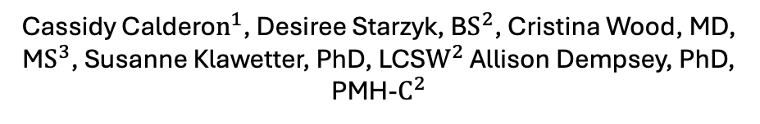
Using Patient and Provider Perspectives to Adapt an Intervention to Prevent Mental Health Symptoms after Cesarean Delivery
Cassidy Caldero$n^{1}$, Desiree Starzyk, B$S^{2}$, Cristina Wood, MD, M$S^{3}$, Susanne Klawetter, PhD, LCS$W^{2}$ Allison Dempsey, PhD, PMH-$C^{2}$
$^{1}$Psychiatry Undergraduate Research and Learning Experience (PURPLE), $^{2}$Department of Psychiatry, Anschutz Medical Campus, $^{3}$Department of Anesthesiology, Anschutz Medical Campus
Notes:
In women’s behavioral health
And connections team

Slide 2

Perinatal Mood, Anxiety, and Trauma Symptoms (PMATS)
Most common complication of pregnancy (1 in 6 pregnancies)
Higher risk for those with Cesarean delivery
2017-2019, suicide was leading cause of maternal mortality
Current models addressing PMATS focus on reactionary rather than preventative approach
Notes:
Some background
If PMATS is left untreated, financial hardship, maternal health complications, poor infant-parent bonding, increased mental health risks in the child, and/or suicide/infanticide could manifest
We want to address symptoms before they appear rather than treating them after they appear

Slide 3
Study Aim
Single 1-hour intervention (BE-OR)
  Prevent PMATS among population of patients with high-risk pregnancies and anticipated Cesarean delivery
  Education on and exposure to Cesarean delivery
Small pilot study (n=20) showed 42% less preoperative anxiety, 40% less postpartum anxiety, and 75% less postoperative opioid use
Goal is implementation to diverse pregnant population and broad range of facilities
Notes:
We will start by educating individual anticipating c section on the procedure, then walk them through the OR and tell them what will happen, hopefully lower the PMATS of individual
Expose to sights, smells, experiences, more on what intervention is
Our team did a trial run research study
Goal is readiness to scale

Slide 4
Brief Exposure Intervention (BE-OR)
Psychoeducation:
Discuss uncertainty and fears, develop schema of what will happen, ultimately reduce PMATS, introduce subjective units of distress scale (SUDS)
Transition to operating room:
Who is in there, what the various equipment is, where baby will go, where partner will wait
Antepartum/admission room:
Readiness procedures and sensations
Procedure preparation:
Sitting on table, placing monitors, simulating numbing medication procedures, “timeout” procedures
Delivery procedure: Sensations of numbing medication and procedure, numbing checks, safety procedures
Post-delivery procedures:
Pain management, holding baby

Slide 5
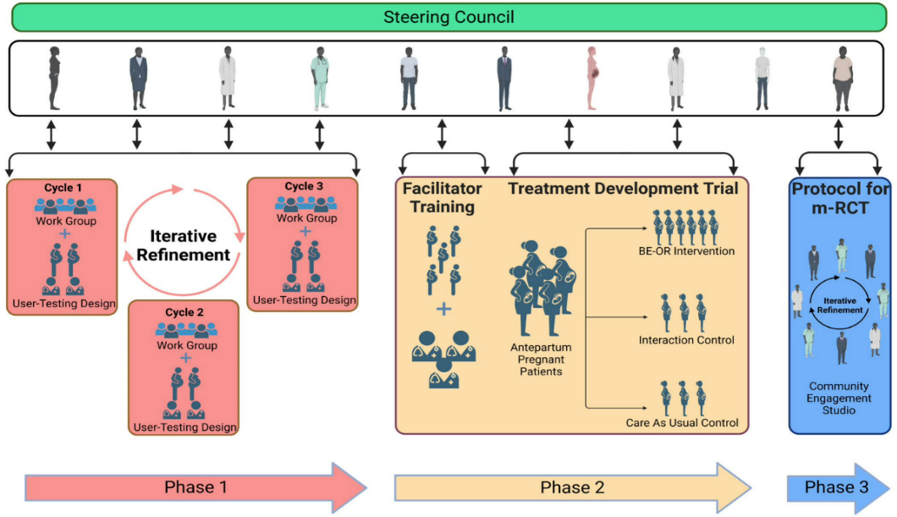
Study Timeline and Phases
Currently in Phase 1 - Cycle 1
Notes:
I will be assisting in Phase 1 Cycle 1 over summer (3-year project)
Funded by national institute of mental health
multi cite trial
Phase 1 aims to gain information on challenges to implementation and strategies to overcome them through revision of intervention and implementation
In phase I we’re taking an implementation science approach to gather information from a range of people involved in the birthing process (patients, their partners, physicians, mental clinicians, etc) through focus groups to learn what needs to be changed to make sure it’s useful for a large population of patients and able to be delivered in multiple hospitals

Slide 6
Methods: Work Groups (Phase 1 - Cycle 1)
Lived Experiences and Community Partner Organizations | Hospital Leadership, Administrators, and Clinicians
Doula/Childbirth Educators | Frontline Providers and Staff
Lactation Support Specialists | Mental Health Specialists
Birthing People | Hospital Administrators
Parenting Partners | Revenue Cycle Managers
Peer Support Networks | Legal and Risk Management
1 hour long
5-minute presentation on BE-OR followed by structured discussion
2 groups with lived experiences and 2 groups with professional experiences
Responses are recorded, transcribed, and qualitatively coded
 | Lived Experiences (N=9) | Professional Experiences (N=8)
Personal Identification / Patient Specialization | LGBTQ+ community (3) Experiencing non-medical factors that affect health (5) Rural/frontier communities (3) Complicated birthing experience (6) Adolescent parents (2) | LQBTQ+ community (4) Experiencing non-medical factors that affect health (7) Rural/frontier communities (4) Complicated birthing experience (6) High-risk pregnancies / newborns (8) Adolescent parents (5) Fertility challenges (6) History of trauma (1)
Gender | Female (5) Not reported (4) | Female (8)
Race | Black / African American (2) White (7) | Black / African American (1) White (6) More than one race (1)
Ethnicity | Hispanic/Latino (2) Not Hispanic/Latino (7) | Not Hispanic/Latino (8)
Notes:
I will be involved in transcribing and coding responses
Workgroups composed of (1) those with lived experiences, parenting partners, and community representatives; (2) front-line clinicians, hospital administrators, and hospital staff.

Slide 7
Methods: User-Testing Design (Phase 1 – Cycle 1)
4 pregnant participants
  Antepartum service at UCH
  Admitted for at least 3 days
  Planned Cesarean delivery
Participate in BE-OR and complete short interview (15 minutes) after
Responses are recorded, transcribed, and qualitatively coded
Notes:
User-testing methodology will assess content and delivery of current BE-OR intervention, evaluate proposed mechanism, and identify alternative mechanisms
During BE-OR implementation, neutral facilitator will document feedback about intervention/implementation provided by providers/participants

Slide 8
Results: BE-OR Feedback
What information do hospitals want when deciding whether to adopt this? | What affects whether this can be implemented? | How does this help the patient/partner? | How to we introduce this to patients so they want to receive the intervention? | What to we need to change in the intervention to make it more helpful to patients? | Who should implement this and how should they be trained? | What do we need to add or change to the protocol to make it safe?
Feasible in workflows | Room and OR availability | Preparedness, reduced uncertainty, empowerment, cognitive framework | Be explicit in what this involves | Handouts for review before/after intervention | Person trained in mental health | OR availability and turnover (no contamination)
Data for patient outcomes (PMATS, opioid use, patient experience) | Staffing | Affects partner’s experience and parent-partner relationship | Acknowledgement for those with medical phobias / previous trauma | Passing along patient preferences to medical team | Dedicated team who uses trauma-informed care | Safety checks for mental health
Data to make hospital look good | Incorporating into existing workflows | Reframes birthing experience | Establish trust using trauma-informed care | Give language to communicate anxiety during intervention and coping strategies |  | Plan for medical/mental health issues during intervention

Slide 9
Results: Valuable Quotes
"Giving a birthing person some control of a situation that you don't necessarily have a lot of control over, I think that I would feel so much better knowing that I had done everything I could do to prepare myself, and that although I didn't have control of exactly how things would go, I had control to attend this intervention. So postpartum, I think I would feel more empowered that I was able to do something to help myself through pregnancy and delivery, and then postpartum feel like I was a little more in control of that."
"For me, anything that causes me anxiety a lot of times it's the unknown. So, I really love that this includes desensitization to numerous senses and being able to do that weeks ahead of a scheduled birth so people can use imagery and really have an idea in their mind of what this very anxiety-provoking situation could look like."
"If we can take one factor out of it for these people and birthing humans that we can just reduce that so they can focus on their baby, they can focus on their healing. There's a lot of aspects to our care, and I think just reducing one of these single factors, which is multifaceted and very vast and challenging, will benefit our patients tenfold."
"For me, it would help reduce trauma symptoms in the postpartum time. Because it really is trauma-informed to give people choice, awareness, instructions ahead of time of what will happen."

Slide 10
Discussion
Participants found the BE-OR helpful in feeling more prepared, decreasing anxiety, and gaining more control over the birthing experience
Participant feedback indicated that staffing, OR contamination, and incorporation into existing workflows were the major obstacles for implementation
Utilization of trauma-informed care was highlighted as one of the most vital aspects of providing patients with the intervention
Participants underlined the importance of having a dedicated team that is trained in mental health to implement the intervention
The data gathered from the 4 work groups and 4 user-testing designs will be implemented into the next portion of the study (Cycle 2)
Notes:
Scale intervention

Slide 11
References
Dennis C-L, Falah-Hassani K, Shiri R. Prevalence of antenatal and postnatal anxiety: systematic review and meta-analysis. The British Journal of Psychiatry 2017;210(5):315-323.
Duea SR, Zimmerman EB, Vaughn LM, Dias S, Harris J. A guide to selecting participatory research methods based on project and partnership goals. Journal of participatory research methods 2022;3(1).
Fitzgerald HE, Hoyt DL, Kredlow MA, et al. Anxiety sensitivity as a malleable mechanistic target for prevention interventions: A meta-analysis of the efficacy of brief treatment interventions. Clinical Psychology: Science and Practice 2021.
Kuo S-Y, Chen S-R, Tzeng Y-L. Depression and anxiety trajectories among women who undergo an elective cesarean section. PloS one 2014;9(1):e86653.
Luca DL, Margiotta C, Staatz C, Garlow E, Christensen A, Zivin K. Financial toll of untreated perinatal mood and anxiety disorders among 2017 births in the United States. American journal of public health 2020;110(6):888-896.
McKee K, Admon LK, Winkelman TN, et al. Perinatal mood and anxiety disorders, serious mental illness, and delivery-related health outcomes, United States, 2006–2015. BMC Women's Health 2020;20(1):1-7.
Smith JD, Li DH, Rafferty MR. The implementation research logic model: a method for planning, executing, reporting, and synthesizing implementation projects. Implementation Science 2020;15(1):1-12.
Uguz F, Yakut E, Aydogan S, Bayman MG, Gezginc K. Prevalence of mood and anxiety disorders during pregnancy: A case-control study with a large sample size. Psychiatry research 2019;272:316-318.

Slide 12
A Special Thanks To…
Dr. Ron Li-Liaw, Chair of PMHI
Dr. Neill Epperson, Chair of Department of Psychiatry
Dr. Dominic Martinez, Dir. Office of Inclusion and Outreach, CCTSI
Dr. Allison Dempsey, Professor, Divisions of Adult Psychiatry and Child and Adolescent Mental Health
Yunliang (Lily) Luo, Director oof PURPLE Program
Shanna Trott, Director of PURPLE Program
Dr. Merlin Ariefdjohan, PURPLE Program Founder and Faculty Advisor
Study participants and families
Connections Program

