Slide 1

The Pressure to Be Perfect:
The Relationship Between
Emotional Environment and Perfectionism
in Eating Disorder Patients
Gabrielle Fabrikant-Abzug¹, Jennifer Hagman M.D.^{1,2}, Mindy Solomon Ph.D.^{1,2}
Pediatric Mental Health Institute, Children’s Hospital Colorado¹;
University of Colorado, Anschutz Medical Campus²
Notes:
INTRODUCE SELF, MENTORS, PROJECT

Slide 2

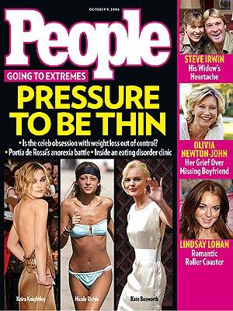

Thin Is In!
Eating disorders (ED) are becoming an increasingly prevalent issue in today’s society
Emotional environment within the family has been shown to be one of the most important risk factors that leads to developing an ED¹
  Criticism
Notes:
Eating disorders are becoming an increasingly prevalent issue - where does this pressure come from?
Family environment - things like hostility, emotional over involvement and, the focus of this study… criticism

Slide 3


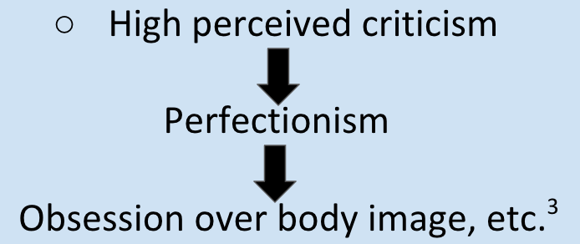
Pressure to Be Perfect
High levels of perfectionism have also been associated with development of an ED²
Few studies have explored the relationship between emotional environment and the child’s level of perfectionism
Notes:
Perfectionistic tendencies are very high in individuals with eating disorders
However… few studies have looked at family environment as related to perfectionism
The one that has found high perceived criticism -> perfectionism -> obessesion over body image, weight, fat, etc.

Slide 4
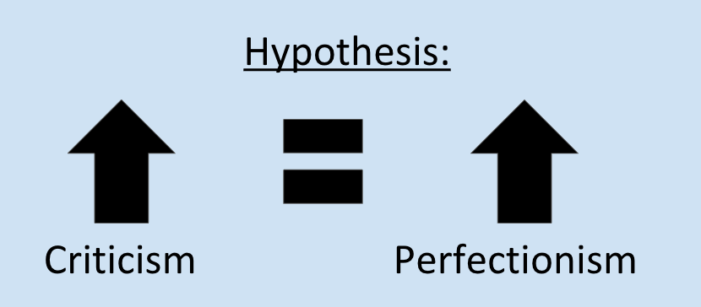
Purpose and Hypothesis
To determine if there is a relationship between emotional environment of the family (measured by criticism) and level of perfectionism within the patient
Notes:
EXPLAIN SLOWLY AND CLEARLY

Slide 5
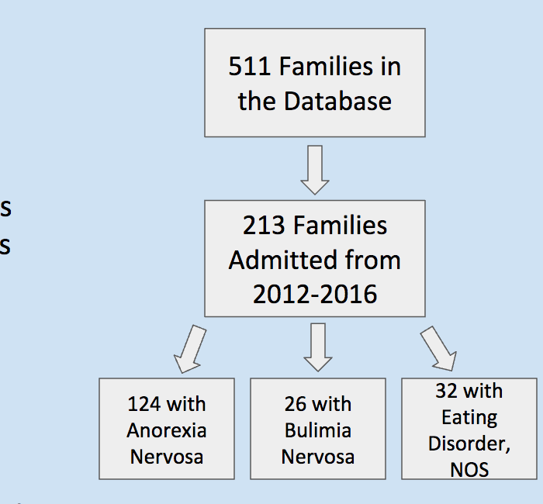
Study Population
213 children
142 mothers
65 fathers
Notes:
Explain diagram slowly and explain EDNOS
Then click and look at children, mothers, and fathers

Slide 6
Data Collection Instruments
Questions on the admissions surveys include:
  The Eating Disorder Inventory, which is a valid, reliable and widely used device that evaluates and scores symptoms associated with eating disorders, including perfectionism
    “I feel that I must do things perfectly or not at all”
    “I hate being less than best at things”
  Questions relating to aspects of emotional environment
Notes:
EDI also scores for things like Drive for Thinness, Body Dissatisfaction, Low Self-Esteem, Personal Alienation, etc. AND perfectionism

Slide 7
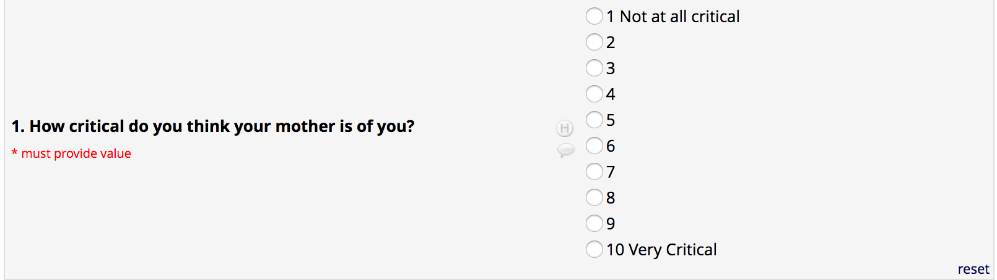
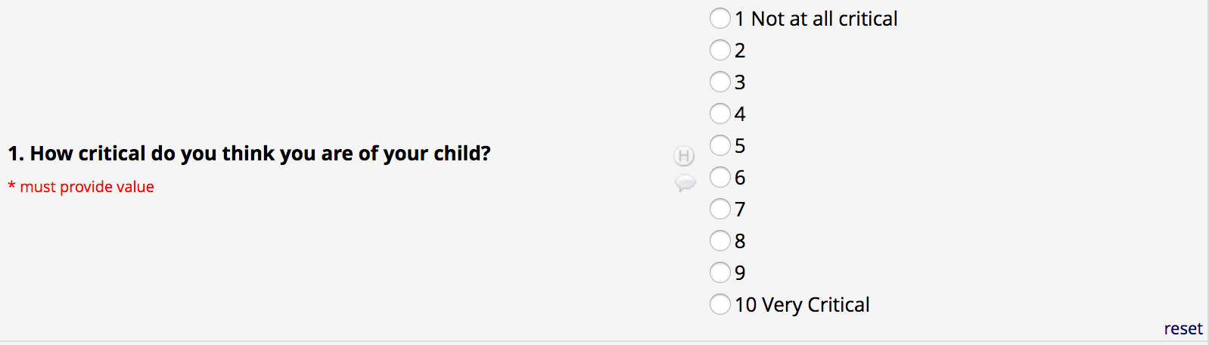
Data Collection Instruments
Question Children Received (Perceived Criticism):
Question Parents Received (Reported Criticism):

Slide 8
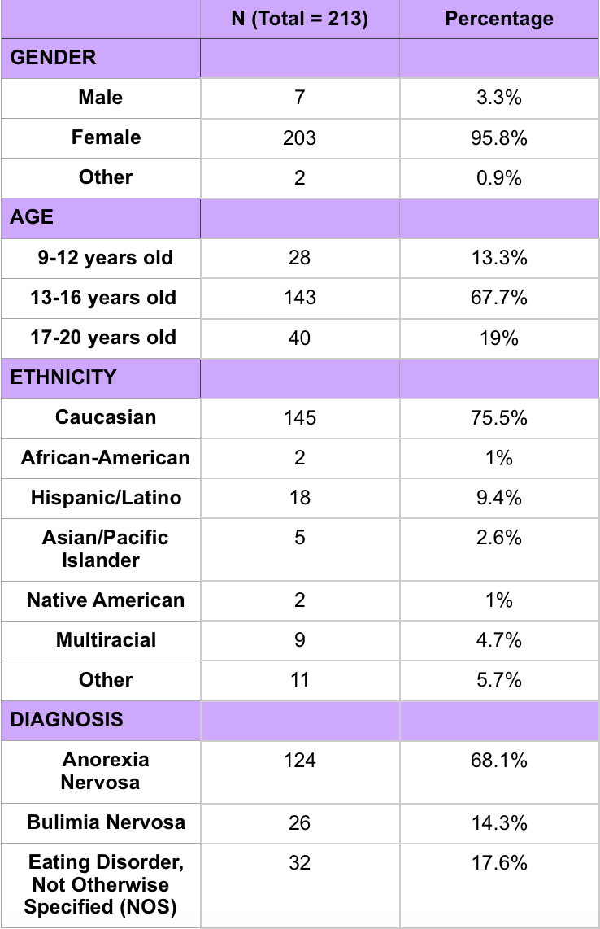
Demographics

Slide 9
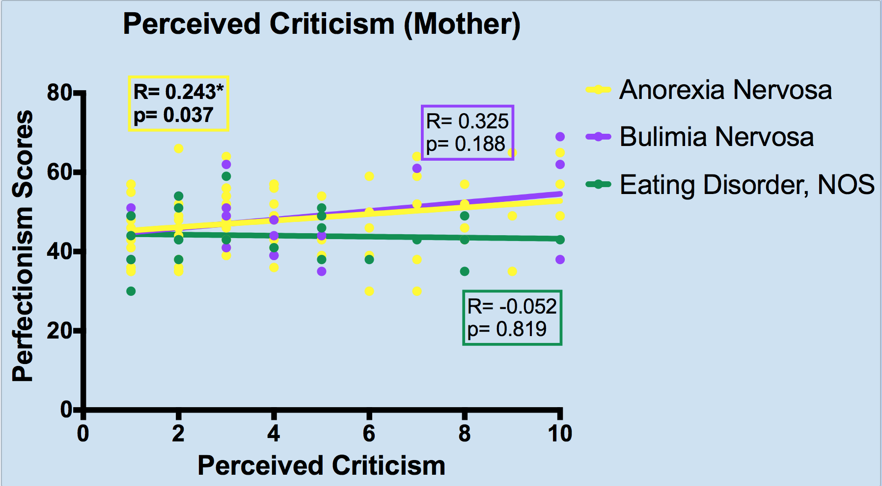
A significant relationship was found between the child’s perceived criticism from the mother and perfectionism scores among those who have Anorexia Nervosa
Notes:
DONT FORGET ARROW!!!
EMPHASIZE WHICH PARENT AND WHICH DIAGNOSIS - YELLOW LINE

Slide 10
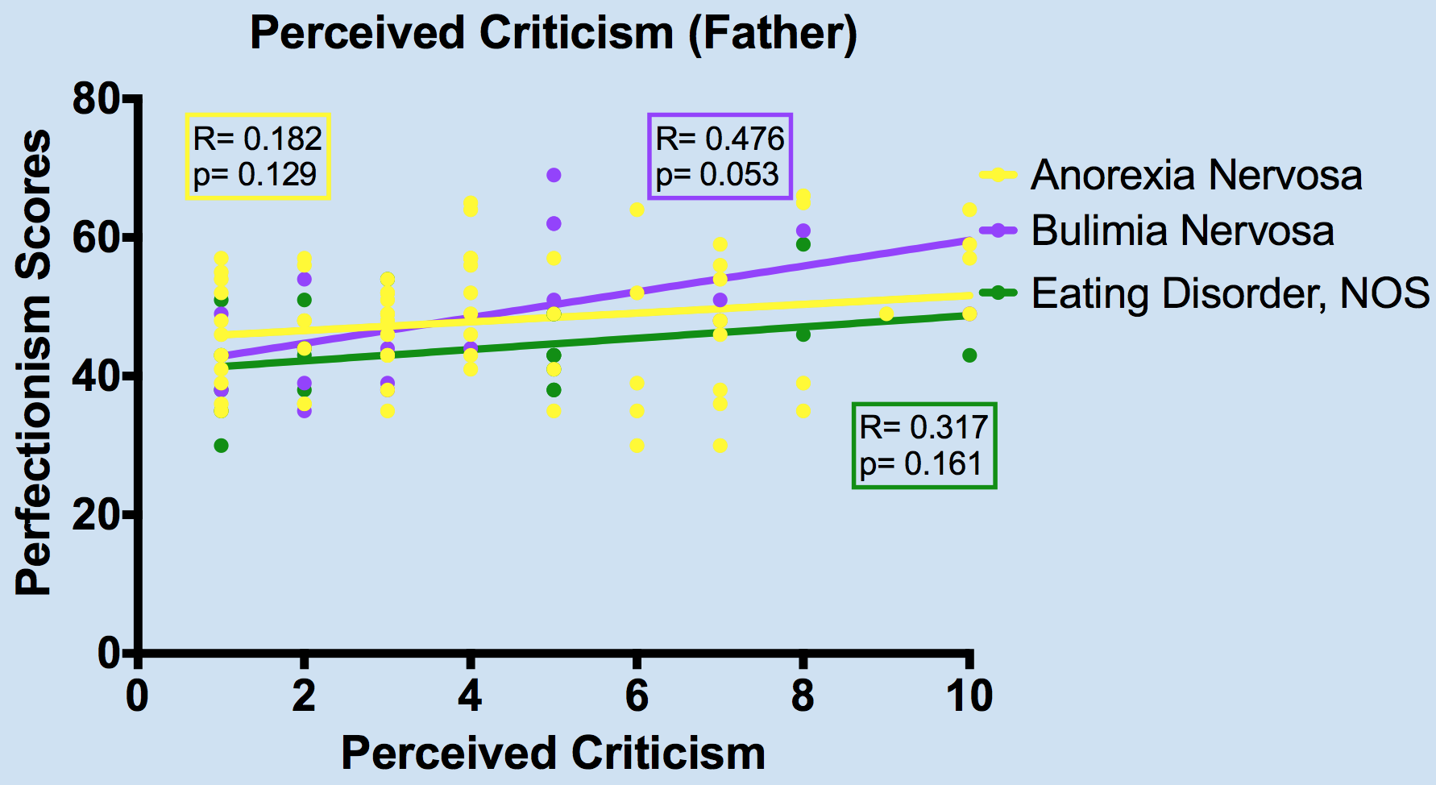
A positive trend near significance was found between the child’s perceived criticism from the father and perfectionism scores among those with Bulimia Nervosa
Notes:
DONT FORGET ARROW!!
EMPHASIZE WHICH PARENT AND WHICH DIAGNOSIS - PURPLE LINE

Slide 11


Key Findings
Level of criticism from different family members may influence the way ED symptoms present in children who are already predisposed to ED
  The relationship between criticism and perfectionism was different depending on which parent and ED diagnosis being evaluated
Notes:
REPEAT HYPOTHESIS
Talk about different personalities of people with different diagnoses
Those with AN are more controlling and obsessive while those with BN are more impulsive and sensation seeking
The results suggest that symptoms may present themselves different depending on relationships with the parent - which parents the child perceives more criticism from

Slide 12

Limitations to the Study
Perfectionism and criticism were measured by self report
Diagnoses were made through an unstructured clinical interview
Subjects were limited to families seeking treatment in higher levels of care at the PMHI in Denver, Colorado (i.e. patients with more severe symptoms)

Slide 13

Future Directions
These results suggest that family dynamics and perfectionistic tendencies may influence the development of EDs
Family involvement in treatment may lead to greater success, which is consistent with previous research
Other risk factors should be further studied
Notes:
Other risk factors: FAMILY ENVIRONMENT (emotional overinvolvement, hostility) and OTHER TRAITS WITHIN THE CHILDREN (Level of depression, anxiety, self-esteem, etc.)

Slide 14

References
Gonçalves, J., Moreira, E., Trindade, E., & Fiates, G. (n.d.). Eating disorders in childhood and adolescence. Revista Paulista De Pediatria : Orgão Oficial Da Sociedade De Pediatria De São Paulo.,31(1), 96-103.
Bardone-Cone, Anna M., Stacy L. Lin, and Rachel M. Butler. "Perfectionism and Contingent Self-Worth in Relation to Disordered Eating and Anxiety." Behavior Therapy, vol. 48, no. 3, 2016;2017;, pp. 380.
Sassaroli, S., et al. "Perfectionism as a Mediator between Perceived Criticism and Eating Disorders." Eating and Weight Disorders - Studies on Anorexia, Bulimia and Obesity, vol. 16, no. 1, 2011, pp. 37-44.
Notes:
These are the references to past research that I used throughout my project and presentation, and if anyone has any further questions please feel free to ask!

Slide 15

Thank you to...
Program sponsors for their generosity in allocating the funds to support the program:
  Dr. Dominique Martinez (CCTSI Office of Diversity and Inclusion)
  Dr. Douglas Novins, and Dr. Jennifer Hagman (PMHI)
Mentors at EDU for all their help:
  Dr. Mindy Solomon, Dr. Jennifer Hagman, and Dr. Helene Simons
Program mentors for their organization and constant support:
  Dr. Merlin Ariefdjohan and Ms. Emmaly Owens
Notes:
ASK FOR QUESTIONS

