Slide 1

Make Your Words Count: Examining Verbal Interactions Between Parents and Adolescents
Hannah Christensen
Mentor: Benjamin Mullin, PhD
Notes:
Hi! My name is Hannah Christensen and I will be a senior this year at Regis University. Before I start talking about the research I did over the summer I wanted to ask you all to raise your hand if you believe your parents might or do have anxiety. And by looking at the show of hands you can see that anxiety is very common.

Slide 2

What is Severe worry?
Characterized by excessive nervousness about situations in one’s life that can cause fear and distress
Often leads to the diagnosis of an anxiety disorder
Notes:
In this study we will be looking at anxiety in terms of severe worry.

Slide 3
Parent’s Role In The Development of anxiety
Anxiety disorders have both biological and environmental factors
The transmission of anxiety orders have been found to be linked within the family, specifically in parents
Research has been targeting what exact part of parent behavior can enhance anxiety in children
This study is looking at how parent-child interactions are related to adolescent worry, specifically the effects of overcontrolling parenting within conversation

Slide 4

WHY Teens?
Previous research has focused on the parent role in child anxiety and not adolescent anxiety
Important because the adolescent age can be very anxiety provoking
  Time of gaining independence
  Finding identity
Notes:
If adolescents are not given the ability to gain independence, when given the chance they might have increased anxiety because of the lack of exposure

Slide 5
Adolescents are over it
Overprotective
Grant children less autonomy resulting in the enhancement of anxiety
Overcontrolling
Reduce their child’s exposure to situations because of their own belief that their child is incapable of handling it
(Moore, Whaley & Sigman, 2004)
Overinvolved
Intrusively involved, leading to negative cognitive styles that induce fear
(Creveling, Varela, Weems & Corey, 2010)
(Moore, Whaley & Sigman, 2004)
Notes:
These are three traits of parents that research has shown can enhance anxiety in children

Slide 6

What does this mean?
Adolescent with Anxiety
Environment
Parent Behavior
Genetic Vulnerability
Parent Anxiety
Parents play a key role in the expression of anxiety in adolescents
Notes:
For an adolescent with anxiety there are many factors that could be causing it. There are both the environmental and biological factors, but also parental factors that are involved.

Slide 7

Why does this Matter?
Previous research has pulled patterns that suggest that parental behavior could cause a child to not develop coping mechanisms to combat anxiety
  Could raise the risk for anxiety disorder
  Cause difficulty maneuvering stressful situations for the child
Notes:
If not given the skills and coping mechanisms to combat anxiety, when put in situations that are anxiety provoking a child might not be able to move past it effectively, thus enhancing their anxiety. So what exact part of parent behavior might be having an effect on adolescent anxiety?

Slide 8
Intolerance of uncertainty
Phenomenon underlying anxiety
It reflects discomfort with ambiguity, and avoidance of situations with uncertain outcomes
Can play an important role in how people react to anxiety provoking situations
Notes:
Previous research shows that intolerance of uncertainty could be playing a vital role in anxiety provoking parental behavior. Intolerance of uncertainty is a…

Slide 9

Characteristics that might Suggest a parent has a high intolerance of uncertainty
  Discourages psychological autonomy
  Expresses fear and worry about teen’s future
  Highlights possibility of failure
  Encourages or emphasizes dependence on parents
Notes:
A parent who exhibits high amounts of intolerance of uncertainty might not expose their child to situations because of their own fear of uncertain outcomes. This could cause distress for the child because they might believe they are incapable and then when presented with a situation have increased anxiety about it.

Slide 10


Who were the participants and What did the they do?
Sample
Day of visit
72 participants
Recruited from Children’s Hospital of Colorado Department of Psychiatry
Scored in the moderate to severe range on the Penn State Worry Questionnaire
Collected demographic data
Administered the Penn State Worry Questionnaire (PSWQ) and Intolerance of Uncertainty Scale (IUS) to both the parent and adolescent
Instructed the parent and adolescent to talk about the adolescent’s future for five minutes
I would like for you to spend the next five minutes talking about [Name] future
Notes:
The prompt they were given was. A prompt that was anxiety provoking for both the parent and adolescent.

Slide 11
What DID I DO?
Linguistic Inquiry and Word Count
Word count calculator
SPSS
Ran Correlations to find the relationship between word count ratio, PSWQ scores, and IUS scores
Express Scribe
Software used to transcribe videos
Word Count Ratio
parent word count
adolescent word count
Notes:
Split apart the parent and adolescent transcriptions. Ratios over one, the parent dominated the conversations. Ratios under one, the adolescent dominated the conversation.

Slide 12



Research Hypothesis
Parent Intolerance of Uncertainty
Higher word count ratio
Higher adolescent Penn State Worry Questionnaire scores

Slide 13
What did I find?

Slide 14
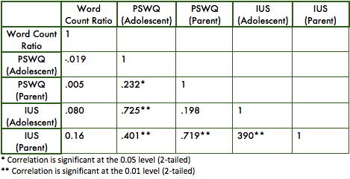
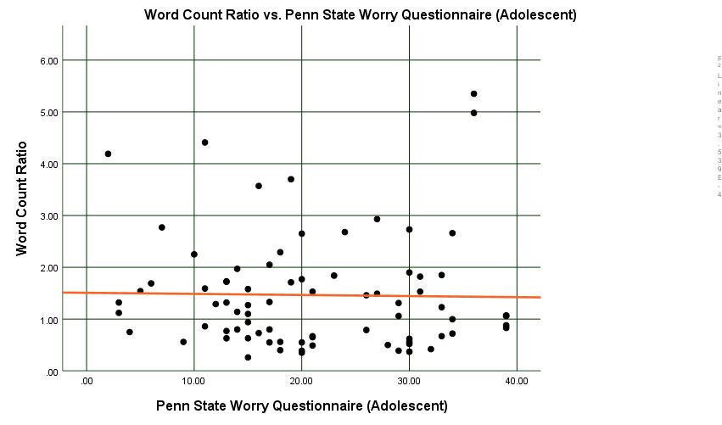
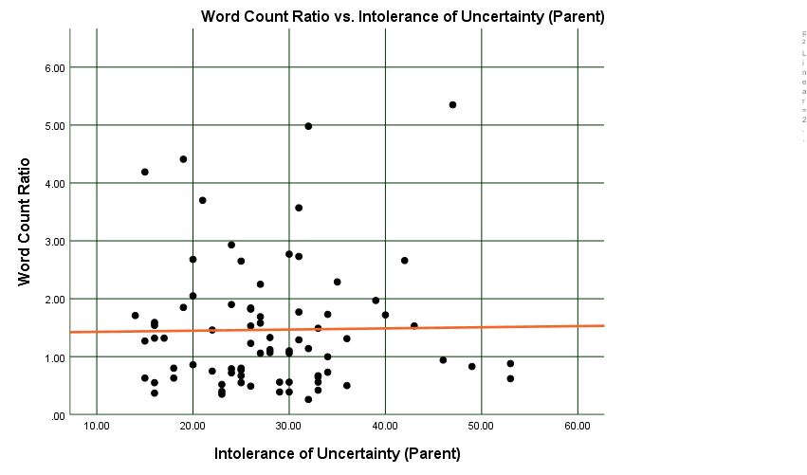
Notes:
There were no significant correlations between either the parent IUS scores or the adolescent PSWQ scores. The trend line was relatively flat which means there were no significant correlations.

Slide 15
Future Directions
Word count was not found to play a definitive factor in either parent IUS scores or adolescent PSWQ scores, more research to be done on how other mechanisms between parent-child interactions play a role in adolescent anxiety
Future research will be looking at how granting of autonomy, criticism, and worry/anxiety of the parent affect adolescent anxiety
This pertains to previous literature that suggests that parent anxiety can enhance child anxiety, in addition to child anxiety enhancing parent anxiety
Notes:
Other mechanisms will be coded using a coding scheme.

Slide 16
Research Hypothesis
Parent Intolerance of Uncertainty
Other mechanisms such as granting of autonomy, criticism, and worry/anxiety
Higher word count ratio
Higher adolescent Penn State Worry Questionnaire scores

Slide 17
Looking at the whole picture
Adolescent Anxiety
Negative Parent Behavior
Parent Intolerance of Uncertainty
Notes:
Instead of just looking at parent intolerance of uncertainty or parent behavior enhancing anxiety in adolescent, we are also going to look at how adolescent anxiety affects parent intolerance of uncertainty and parent behavior. This will give a greater understanding of how parents affect adolescent anxiety, but also how adolescent anxiety affects parents.

Slide 18

Why does this Research Matter?
Parents play a key role in an adolescent’s life
  Research suggests that this can be especially prominent in the expression of anxiety
  Studying the parent role in adolescent anxiety could help both parents and adolescents manage anxiety
  Provide more knowledge on what mechanisms drive adolescent anxiety

Slide 19
Education
Parents
Adolescents
Understand their impact on their child’s anxiety
Understand how their child affects their behavior
How to better help their child with their anxiety
How their parents play a role in their anxiety
How they influence their parent’s behavior
Tools to help manage their anxiety in effective ways

Slide 20
Thank you sponsors!
Special Thanks to: Dr. Ben Mullin
Dr. Merlin Ariefdjohan
Emmaly Perks

