Slide 1

The impact of a virtual training on BCBA reported likelihood and confidence with using differential reinforcement procedures
Brian Melendez and Patrick W. Romani
Department of Psychiatry, University of Colorado School of Medicine
Notes:
Hello everyone
Name is Brian Melendez and
My summer research project looked at: READ TITLE

Slide 2

Introduction
Recent estimates indicate intellectual disability affects between 11.0 – 13.4 per 1,000 children and developmental disability affects between 45.8 – 69.9 per 1,000 children(Anderson et al., 2019)
Autistic individuals exhibit a higher prevalence of problem behavior (self-harm, harm to others, destruction of environment) than their typically developing peers (Liptak et al., 2006).
  12.5 – 20% of autistic individuals engage in severe problem behavior in need of behavioral treatment
Notes:
-The prevalence of neurodevelopmental disabilities, particularly autism spectrum disorder, has been increasing.
Autistic individuals tend to exhibit problem behaviors, such as physical aggression, self-injury, and tantrums more than their neurotypical peers.
Somewhere between 12 – 20% of these individuals engaging in problem behavior will engage in severe problem behaviors in need of behavioral treatment.
-These problem behaviors are those that can lead to injury to self, others, and property.
-It is very important that autistic youth receive the appropriate evidence-based treatment to help them with their problem behaviors.

Slide 3
Introduction
Board-Certified Behavior Analysts (BCBA) are responsible for treating problem behaviors with a two-step model of assessment and treatment (Roane et al., 2016)
  BCBAs conduct what is called a functional behavior assessment which identifies escape from task demands, access to attention, or access to preferred items as the reinforcements for problem behaviors
Notes:
-The individuals who are often responsible for administering treatment to autistic youth are called Board-certified Behavioral analysts or BCBAs
-BCBAs use a two-step model of assessment and treatment that is grounded in applied behavioral therapy
-When BCBAs work with an autistic individual engaging in severe problem behavior, they will complete a functional behavior assessment to identify the causes of problem behavior such as escape from task demands, access to attention, or access to preferred items

Slide 4
Introduction
Board-Certified Behavior Analysts (BCBA) are responsible for treating problem behaviors with a two-step model of assessment and treatment (Roane et al., 2016)
  BCBAs conduct what is called a functional behavior assessment which identifies escape from task demands, access to attention, or access to preferred items as the reinforcements for problem behaviors
  BCBAs then formulate function-based treatments plans to help decrease problem behavior and increase appropriate behaviors (i.e., differential reinforcement)
Notes:
-Using the information from the functional behavior assessment, BCBAs will then implement treatment to replace problem behaviors with a more appropriate response, like communication.
-This process of reinforcing an appropriate response and limiting problem behavior is called differential reinforcement.

Slide 5
Differential Reinforcement (DR)
Differential reinforcement (DR) is considered one of the best treatments to help autistic individuals exhibiting problem behaviors (Lindgren et al., 2020).
  DR with extinction
  DR with extinction and a multiple schedules arrangement
  DR without extinction
Notes:
-Studies and trials would suggest Differential reinforcement or DR is one of the best treatments to manage problem behaviors exhibited by autistic individuals.
-There are three primary variations of differential reinforcement that BCBAs can use to manage problem behaviors.
-These include differential reinforcement with extinction, differential reinforcement with extinction and a multiple schedules arrangement and differential reinforcement without extinction

Slide 6
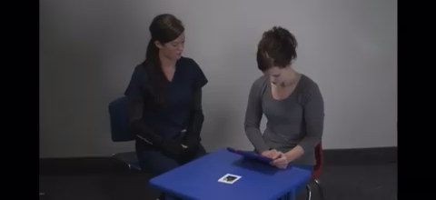
Differential Reinforcement With Extinction
Notes:
-Here is an example of what DR with extinction can look like (PLAY VIDEO)
-In this example of DR with extinction, the therapist allowed access to the iPad once the patient displayed appropriate communication by touching the card. The therapist gives no attention to the problem behavior the patient engaged in which was hitting and snatching.
-In doing so, they differentially reinforce appropriate communication and place the problem behavior on extinction

Slide 7
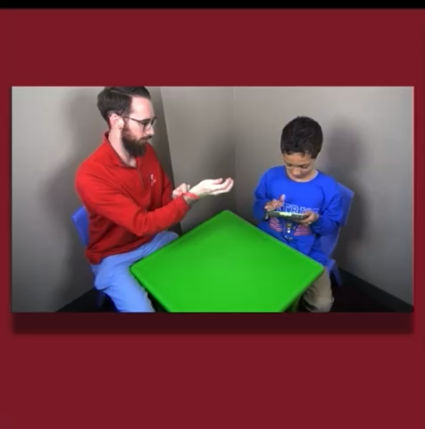
Differential Reinforcement With Extinction and Multiple Schedules
Notes:
-This is an example of DR with extinction and a multiple schedules arrangement. (PLAY VIDEO)
-In this example, the therapist placed a colored wrist band on their arm to signal the availability or unavailability of access to the preferred item which is the iPad.
-The therapist grants the patient the iPad only when the the patient uses appropriate communication and when wristband is set on green which signals the availability of the iPad.
-If problem behavior were to occur, the therapist would provide no reaction thus placing the problem behavior on extinction.

Slide 8





Differential Reinforcement Without Extinction
Less Desired Item
Problem behavior
Patient
Desired Item
Appropriate behavior
“Toy Please”
Notes:
-DR without extinction is very similar to DR with extinction.
-The key difference is that both the problem behavior and appropriate behavior are differentially reinforced
-For example, in the previous videos, the therapist gave no reaction in response to the problem behaviors such as hitting from the patient but in differential reinforcement without extinction, that patient may be given a less desired item instead of the iPad such as another toy.
-This is meant to bias the patient choice so they choose to engage in appropriate behaviors instead of problem behaviors.

Slide 9

Needs Assessment
Colorado BCBAs sometimes deviate from these best practices.
Colorado BCBAs reported moderate confidence with using DR approaches for autistic youth engaging in problem behavior.
Notes:
-BCBAs are responsible for administering best practices treatment, such as DR, to autistic youth in order to treat problem behaviors
-Our lab conducted a needs assessment prior to this study that showed that BCBAs practicing in the state of Colorado sometimes deviate from best practices like DR and instead use less effective treatment approaches.
-Additionally, they reported moderate confidence with using Differential reinforcement for youth engaging in problem behavior.

Slide 10
Research Question
Does a virtual presentation describing the benefits and limitations of these DR approaches change BCBA reported likelihood and confidence with using different forms of DR?
BCBA participates in Virtual Training on DR
Increase in likelihood/confidence using DR
Children receive appropriate treatment
Notes:
-This study aims to answer the question:
-Does a virtual presentation describing the benefits and limitations of these DR approaches change BCBA reported likelihood and confidence with using different forms of DR?
-What that process would look like is; READ GRAPHIC

Slide 11
Method
Participants
  14 BCBAs practicing in Colorado enrolled in study
    11 BCBA data included in this analysis
Setting
  Virtual training took place on Zoom
Materials
  Participants completed surveys using Qualtrics
Notes:
-For our participants there were
-14 BCBAs agreed to participate in this study and answer the questionnaire. We will present the data from 11 participants as they have completed at least the initial survey and one follow-up survey
-Virtual Training took place over Zoom
-Participants completed surveys on Qualtrics

Slide 12
Procedures
Participants Enroll in Training
Participants were emailed Zoom Invitation for virtual training and the Qualtrics survey assessing confidence/likelihood
The training lasted 2 hours
Participants Answer Survey Questionnaire
Participants Complete Training
Participants complete the survey shortly after completing training and once more 3 months later
One hour of didactic training and one hour of discussion
Notes:
Upon enrolling in the continuing education series, the research team emailed the participants Zoom links for the online virtual training and the Qualtrics survey assessing their confidence and likelihood.
The training lasted two hours with one hour dedicated to a didactic training on DR and one hour dedicated to a group discussion.
Participants then answer the Qualtrics survey that assesses their confidence and likelihood of using DR shortly after receiving the training and once more 3 months after receiving the training giving us a total of 3 assessment periods with that being the initial survey they answered before training, shortly after, and three months after receiving the training.

Slide 13
Dependent Variables
Participants rated the likelihood and confidence of using treatment approaches according to a 0 – 10 likert-type scale.
  0 5 10
  Not at all Likely Somewhat Likely Completely Likely
Notes:
Participants rated the likelihood and confidence of using the treatment approaches according to a 0 – 10 likert-type scale Where 0 indicates not at all likely to use DR or not at all confident using DR and 10 indicating very likely to use DR or very confident using DR.
This same question format was used to asses confidence and likelihood for all three differential reinforcement methods

Slide 14
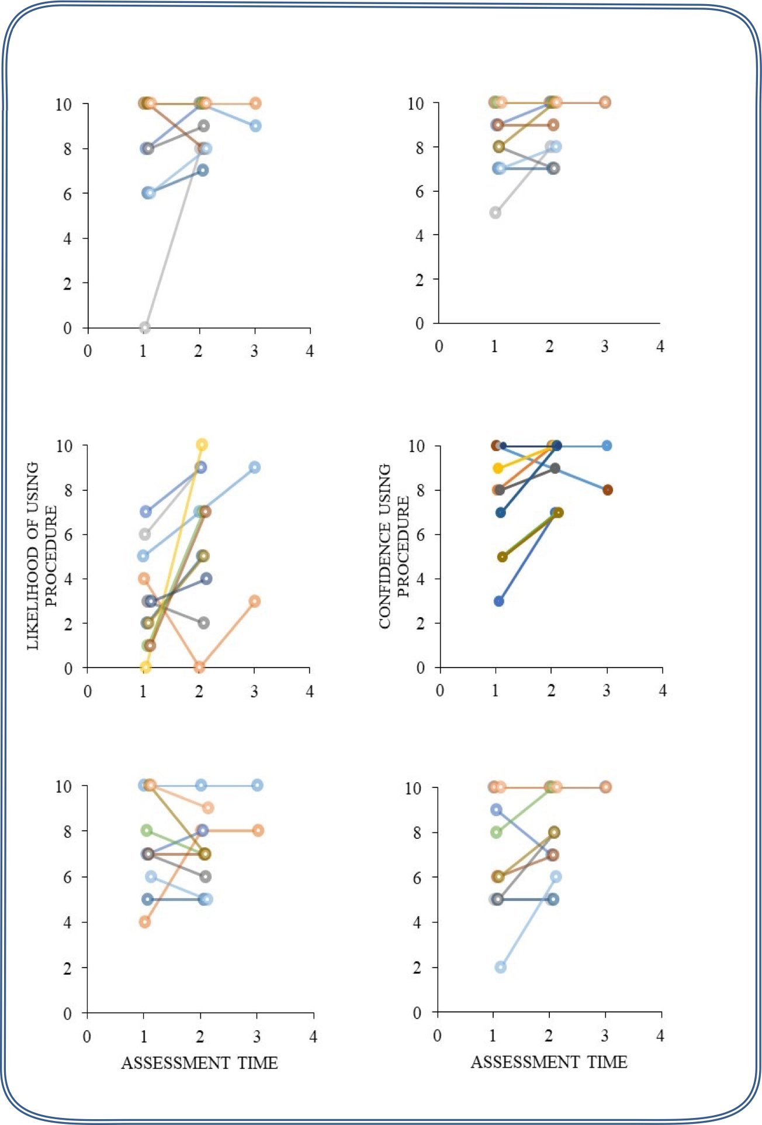
Results: DR WITH Extinction
ASSESSMENT TIME
ASSESSMENT TIME
Assessment time 1: Before training
Assessment time 2: Shortly after receiving training
Assessment time 3: 3 months after receiving training
Notes:
-Here are the participants responses plotted out
-each line represents each participants responses across the three survey times
-X axis represents the survey time and the y indicates their likelihood and confidence measures they answered on the likert type scale question.
-For Differential reinforcement With extinction, participants reported an average of 3.13 at time 1, 6.12 at time 2, and 9 at time 3 for the likelihood they would use it in practice.
-With respect to confidence, the participants reported an average confidence using this procedure as 7.73 at Time 1, 9 at Time 2, and 9 at Time 3.
-This is where we see the most noticeable changes in both likelihood and confidence

Slide 15
Results: DR Within a Multiple Schedules Arrangement
CONFIDENCE USING
PROCEDURE
LIKELIHOOD OF USING
PROCEDURE
Notes:
-For the likelihood of using DR with extinction and a multiple schedules arrangement, participants reported an average likelihood of 7.52 at Time 1 and 7.26 at Time 2 and 9 Time 3.
-With respect to confidence, the participants reported and average confidence of 6.9 at Time 1, at 7.93 at Time 2, and 10 for Time 3.

Slide 16
Results: DR WITHOUT Extinction
CONFIDENCE USING
PROCEDURE
LIKELIHOOD OF USING
PROCEDURE
ASSESSMENT TIME
ASSESSMENT TIME
v
Notes:
-For the likelihood of using DR without extinction, participants reported an average likelihood of 8 at Time 1, 9.09 at Time 2, and 9.5 at Time 3.
-With respect to confidence, they reported an average confidence of 8.45 at Time 1, 9 at Time 2, and 10 at Time 3

Slide 17
Discussion
Results
  Participants rated increased likelihood and confidence of using DR with and without extinction after the virtual training.
  DR with extinction showed the largest change in likelihood of being used and confidence.
  There was a small decrease in likelihood of using DR within a multiple schedules arrangement while confidence showed an increase.
  Implications of these results are positive
BCBA participates in Virtual Training on DR
Increase in likelihood/confidence using DR
Children receive appropriate treatment
Notes:
-Participants averages across the three survey periods suggest the virtual training on differential reinforcement increased their measures of likelihood and confidence for differential reinforcement with and without extinction with DR with extinction showing the largest increase for both likelihood and confidence.
-Interestingly, DR with extinction and a multiple schedules arrangement showed a decrease in likelihood while an increase in confidence still occurred.
-This could be due to BCBAs feeling confident in implementing this treatment after receiving training while also feeling like the treatment strategy may not be appropriate for their current clients.
-The implications of these results are positive
-if we consider the graphic shown earlier, increased measures of likelihood and confidence with using DR treatments can result in autistic youth receiving the appropriate evidence-based treatment to help them with their problem behaviors

Slide 18
Limitations and Future Directions
Limitations
  Attrition
Future Directions
  These findings are not consistent with the literature on didactic training improving reported use of healthcare procedures
    Reasons for this may be that the virtual training for this study included a one hour period for questions and discussion
    The training also occurred in a small group setting
Follow-up is required to assess if reported increased confidence and likelihood impacts practice and patient outcomes
Notes:
The current study is not without its limitations. One limitation of our study was attrition. That is, not all participants completed the assessments at the various time points. Future research might consider other ways of encouraging study participation over a lengthy period.
Future directions based on this study include investigating the mode of training delivery.
-The results of this study differ a bit from results published in similar studies. That is, other studies have shown didactic trainings may not improve reported use of healthcare related procedures.
-We think that two possible explanations for our increased confidence and likelihood measures could be that the virtual training incorporated 1 hr of didactic presentation and 1 hr of discussion.
-Additionally, the training occurred in a small group setting.
Finally, we believe future research should attempt to understand whether the reported increase in likelihood and confidence led to actual change in patient care. Our results on increased likelihood and confidence show intention for BCBAs to change healthcare procedures by using DR treatment methods but more research is required to see if they actually implement these changes and how that effects patient outcomes
Our research team is currently designing procedures in order to look at this.

Slide 19

Acknowledgments
PURPLE Faculty
Dr. Patrick Romani

Slide 20
Thank you!

