Slide 1
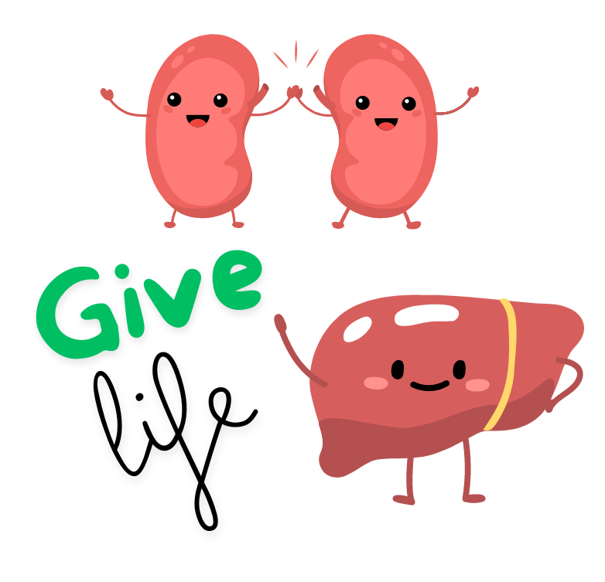

Psychological Motivators and Barriers in Living Organ Donation
Sydney Naibauer
Mentor: Rachel A. Davis, MD

Slide 2
Introduction
  In 2019, 4,925 people died while waiting for an organ in the United States [1].
  <15% of organ donations in the US were from living donors in 2020 [2].
        22% of kidney transplants were from living donors in 2023
        6% of liver transplants were from living donors in 2023
  Most donations from living donors are directed donations to family members or friends.
  People may also donate to anonymous recipients (non-directed donation) through some transplant centers.

Slide 3
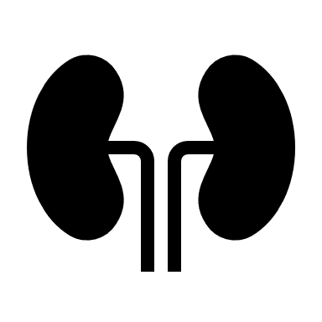

Introduction
  As of 8/12/24, there were 104,036 transplant waiting list candidates [3].

Slide 4

Objective 1
Evaluate participants’ willingness to consider becoming living organ donors under different circumstances.

Slide 5
Objective 2
Determine which factors are perceived as more motivating and which are perceived as more discouraging to living organ donation and potential associations with willingness to donate.

Slide 6
Methods: Survey Design
34 Questions: demographics, awareness, perspectives, altruism scale
Participants spun a wheel for a prize
348 participants completed the survey on the CU Anschutz Medical Campus
65 participants completed 28 optional questions for the interpersonal reactivity index (IRI), an assessment of empathy

Slide 7
Altruism Scale
Altruism facet of a personality inventory (HEXACO PI-R)
Average of 4 questions scaled from 1-5

Slide 8
Demographics

Slide 9
Demographics
Ages ranged from 18-70, with an average of 30

Slide 10
Methods: Statistical Analysis
Analysis of data performed using SPSS.
Wilcoxon signed rank tests compared paired responses for different scenarios.
Kruskal-Wallis tests were used to compare scores and levels for three groups defined by willingness to donate non-directed (yes, maybe, no).

Slide 11
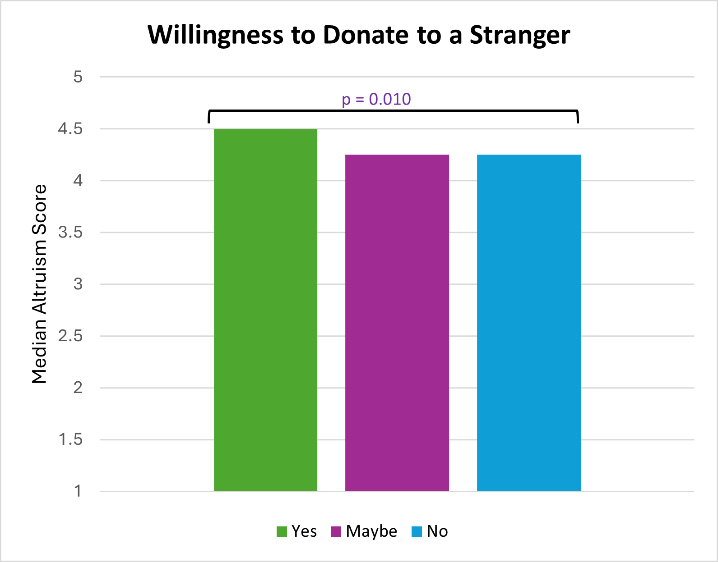
Results: Willingness to Donate
53% of participants said yes to considering donating to a loved one.
22% of participants said yes to considering donating to a stranger.
Higher altruism for participants who said yes to anonymous donation

Slide 12
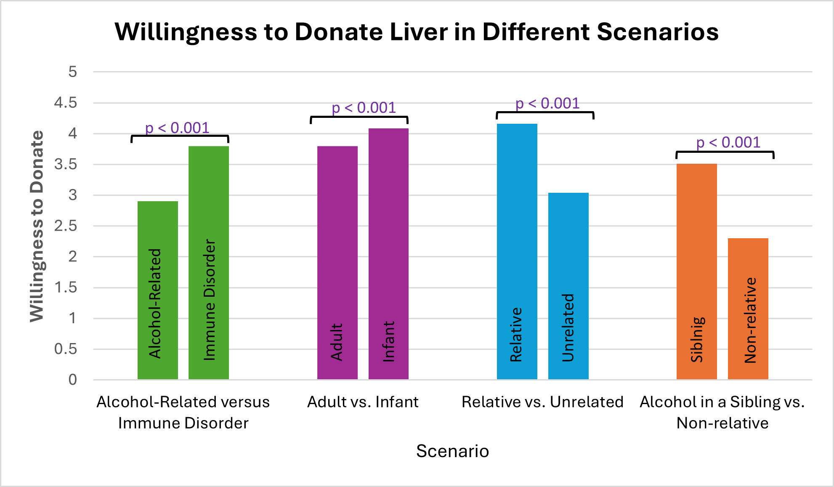
Results: Willingness to Donate

Slide 13
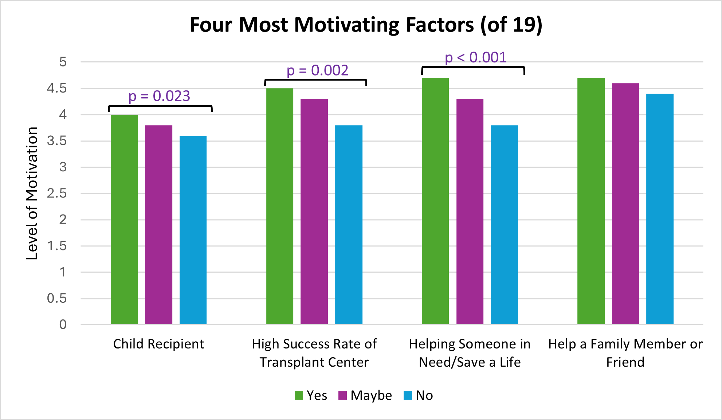
Results: Motivating Factors
Notes:
A lot of p-values: what is the point? What do they mean?

Slide 14
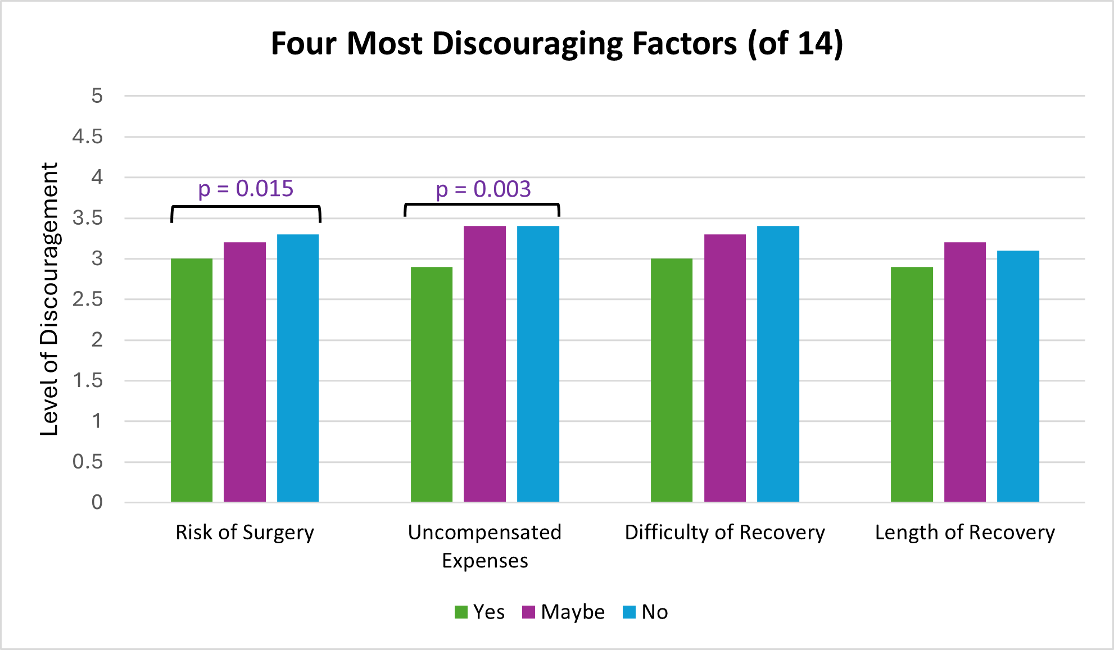
Results: Discouraging Factors

Slide 15
Interpersonal Reactivity Index
A one-way ANOVA compared IRI results by willingness to donate non-directed (yes, maybe, no).
    Results were not statistically significant (p > 0.05).
    No relationship between empathy and willingness to donate non-directed
Statistically significant relationship between participant willing to fill out the optional IRI questions and altruism (p < 0.001)

Slide 16


Discussion: Willingness and Circumstances
Willingness to consider living organ donation was higher than expected for both loved ones (53%) and strangers (22%)
More likely to donate to recipients with characteristics:
Immune Disorder
Alcohol-Related Liver Disease
Infant
Adult
Relative
Non-Relative
Sibling with Alcohol-Related Liver Disease
Non-Relative with Alcohol-Related Liver Disease

Slide 17
Discussion: Motivating and Discouraging Factors
Strongest Motivators:
Child Recipient
High success rate of transplant center
Helping someone in need/save a life
Help a family member or friend
Strongest Discouragers:
Risk of surgery
Uncompensated expenses
Difficulty of Recovery
Length of Recovery
Notes:
People willing to donate to a stranger generally found motivating factors more motivating and discouraging factors less discouraging than people who said no to donating

Slide 18
Discussion: Motivating and Discouraging Factors
People who answered ‘yes’ to consider non-directed living donation had:
  Higher levels of motivation than those who said ‘no’ for 3 of the top 4 factors.
  Lower levels of discouragement than those who said ‘no’ for 2 of the top 4 factors.

Slide 19
Future Implications
Additional research could examine the perspectives of other populations on living organ donation.
  Surveys are planned for distribution at tattoo shops in Denver so results can be compared to those from the medical campus sample.
Results may be used to guide development of educational and recruitment materials.

Slide 20
References
[1] Lewis A, Koukoura A, Tsianos GI, Gargavanis AA, Nielsen AA, Vassiliadis E. Organ donation in the US and Europe: The supply vs demand imbalance. Transplant Rev (Orlando). 2021 Apr;35(2):100585. doi: 10.1016/j.trre.2020.100585. Epub 2020 Oct 11. PMID: 33071161.
[2] The Lancet Gastroenterology Hepatology. Removing barriers to living organ donation. Lancet Gastroenterol Hepatol. 2021 May;6(5):335. doi: 10.1016/S2468-1253(21)00104-7. PMID: 33857439.
[3] Organ Procurement & Transplantation Network. (2018). Data - OPTN. Hrsa.gov. https://optn.transplant.hrsa.gov/data/

Slide 21
Acknowledgements
  Special thank you to:
  Dr. Ron-Li Liaw, Chair of PMHI
  Dr. Neill Epperson, Chair of Department of Psychiatry
  Dr. Dominic Martinez, Dir. Office of Inclusion and Outreach, CCTSI
  Dr. Rachel A. Davis, primary mentor
  Dr. Tyler Branagan, co-investigator
  Dr. Susan Mikulich-Gilbertson, co-investigator
  Dr. Stephanie Lehto, co-investigator
  Yunliang (Lily) Luo, Director PURPLE Program
  Shanna Trott, Director PURPLE Program
  Dr. Merlin Ariefdjohan, PURPLE Program Founder and Faculty Advisor

Slide 22
Recovery from Donation
Typical surgical risks from major surgery
  Liver:
      Stay in hospital for up to 1 week after (or more)
      Liver regrows to normal size in 2 months, most can return to normal activity
  Kidney:
      Most kidney donors recover in the hospital for 2-5 days before heading home
      6-8 weeks to fully heal. During this time, you shouldn't lift anything heavier than about 10 pounds

Slide 23
Financial Burden from Donation
Recipient’s insurance covers donor’s medical expenses
  May not cover follow-up expenses from additional treatment or complications
  Doesn’t cover lodging, childcare, lost wages
Living donors legally can’t get paid for donating
The National Living Donor Assistance Center may provide financial support for travel, lodging, meals, other non-medical expenses for 90 days after surgery
Some donors have trouble getting, affording, or keeping health, disability, or life insurance
  Premiums can increase
  If you don’t have insurance, serving as a donor can be considered pre-existing condition if you try to get insurance later

