Slide 1


Bridging the Gap: School based mental health and student outcomes
Children's Hospital Colorado Pediatric Health Institiute
Children's Hospital Colorado Pediatric Health Institiute
Mentors: Ellen Stern and Elizabeth Freudenthal
University of Colorado Anschutz Medical Campus

Slide 2
Background

Slide 3

Student outcomes can be proximal or distal, across skills, behaviors, and attitudes, all measured and observed on an individual scale.
For example:
- proximal behavior would include observations of a student doing an instructed task
- a distal skill would include course grades, or performance on broad, standardized tasks.

Slide 4

After the COVID-19 Pandemic, youth anxiety and depression rates have doubled.
School based mental health systems have become a critical point of access for youth experiencing mental health issues.
Schools can recognize early or current symptoms, as they manage students for most of their day.

Slide 5
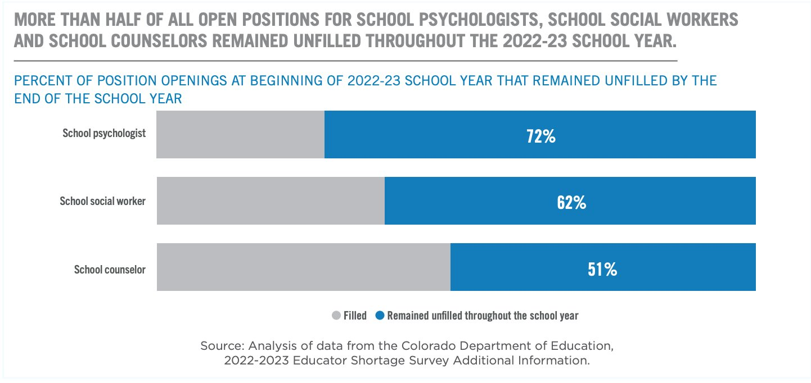

Slide 6
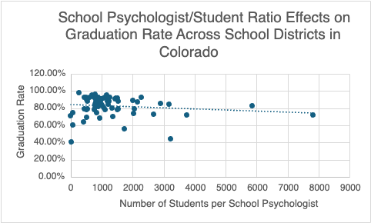
The graph illustrates the correlation between school psychologists and graduation rates.

Slide 7
Project Aim:
To investigate the barriers of implementing school based mental health systems and its effect on youth by analyzing student outcomes.

Slide 8

If school psychologists are too difficult to administer, what other initiatives are available?

Slide 9
Methods- Legislation

Slide 10
Nationwide Initiatives
Greenlights Grant Initiative
Navigation and resource point for school safety grant processes.
Ensures equitable federal funding.
Raises awareness of school safety.
TCHATT Program (Texas)
Delivers free telemedicine for students to identify and assess mental health needs
Provides access to mental health services.
Allows students into care instead of waiting months to access a service provider.
Addresses stigma around mental health.

Slide 11
Nationwide Initiatives
Wellness Checks In School Programs Act (Illinois)
Implements wellness checks to identify students grades 7-12, including school districts with high percentage of Medicaid and referrals.
Establishes a referral process for immediate intervention for students identified as having a behavioral health issue that requires intervention.
Bipartisan Safer Communities Act
BSCA emphasizes proactive crime prevention strategies, community engagement, and partnerships between law enforcement agencies and local organizations.
Provides resources and support to strengthen law enforcement capabilities.
Highlights the importance of accessible mental health and substance abuse treatment to address underlying issues contributing to criminal behavior.

Slide 12
COLORADO
Children's System of Care
Serves as the single point of access to address the behavioral health needs of children and youth in Colorado, regardless of payer, insurance, and income.
I Matter
Colorado House Bill 21-1258: Provides access to mental health and substance use disorder services for youth.
Addresses needs that may have resulted from the COVID-19 pandemic.

Slide 13
Why does this matter?
Medicaid Disenrollment Crisis
Flaws in connecting patients with insurance despite qualification leaves providers uncompensated and patients without necessary treatment.
  During COVID-19, state agencies were required to provide coverage, regardless of eligibility.
    After COVID-19, a significant number (~30%) of qualified members lost coverage.

Slide 14
Methods- Survey

Slide 15
Healthy Kids COlorado Survey (HKCS)
26% of youth reported persistent feelings of sadness or hopelessness in the past year (decrease from 40% in 2021).
11% of youth seriously considered suicide in the past year (decrease from 17% in 2021).
19% of youth could fire a loaded gun without adult permission in less than an hour.

Slide 16
Methods- Literature Review

Slide 17
Children with externalizing symptoms in elementary school tend to have worse outcomes in life. The internalizing symptoms only increased into adulthood.
Academic improvement in students has been linked to services that support social emotional functioning, whether that be prevention or therapy.
Students who excel in social and behavioral areas targeted by SEL (social emotional learning) programs scored higher on the Washington Assessment of Student Learning (WASL) than students with high levels of substance use, attention problems, depression, and antisocial behavior.

Slide 18

Results

Slide 19
Mental health and student outcomes has shown to be a bidirectional relationship.
If schools center student engagement across social and emotional learning, schools may perform better academically, which in turn can reward them with more funding.
Funding is an obstacle across schools and legislation.
School districts hesitate to implement programs for a variety of reasons, including trust in continuous funds, delegation of program requirements, and grant processes.
Ex. Greenlights Grant Initiative, TCHATT Program

Slide 20
The data for expulsion/suspension available did not include title 1 or at-risk schools, but instead separated by gender, race/ethnicity, or ELL, special needs, or 504 statuses.
Because education data was restricted and often had missing or unrelated info, it was difficult to correlate school psychologists and similar access points to students' academic success.
Limitations

Slide 21
Future Implications/NEXT STEPS

Slide 22

Expand student success outside of academic outcomes.
Invest in early prevention strategies, fostering healthy relationships with caregivers, trusted adults, and the community.
Increase access points for youth, including school psychologists, counselors, and social workers.
Remove barriers to care, regardless of income or insurance providers
Create healthy environments for youth, promoting safe discussions surrounding mental health.
Implement better frameworks between legislative, political, and educational systems.

Slide 23
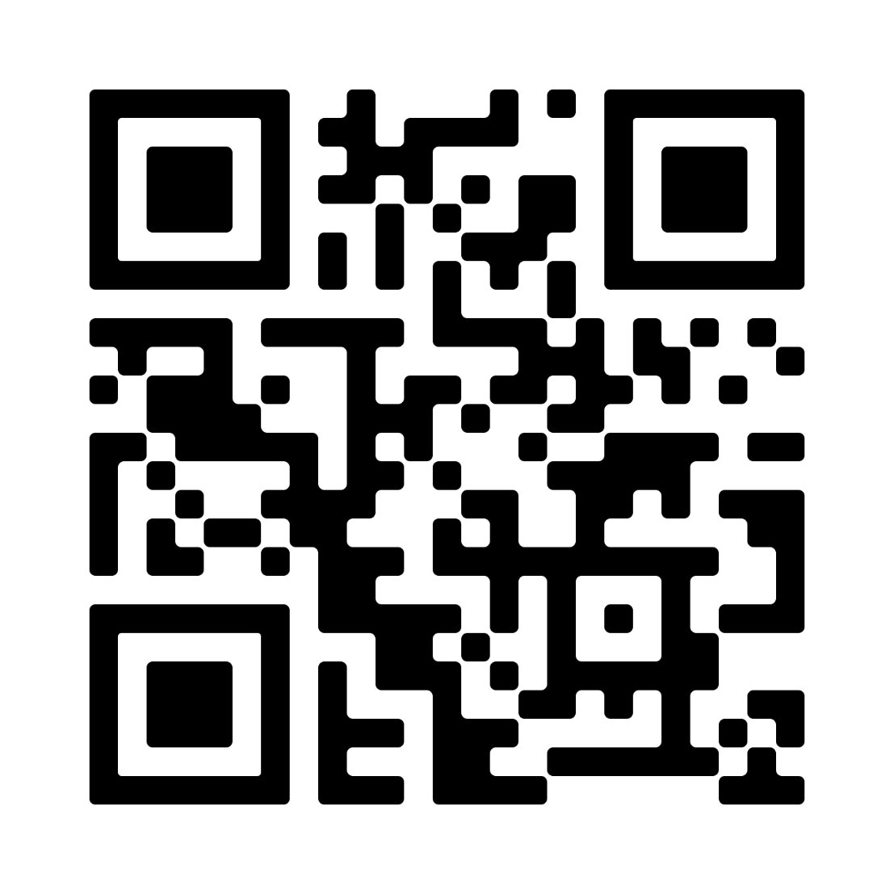

REFERENCES

Slide 24

SPECIAL THANKS TO:
Dr. Ron-Li Liaw, Chair of PMHI​
Dr. Neill Epperson, Chair of Department of Psychiatry​
Dr. Dominic Martinez, Dir. Office of Inclusion and Outreach, CCTSI​
Ellen Stern, Director of Government Affairs​
Elizabeth Freudenthal, Senior Medicaid Consultant ​Yunliang (Lily) Luo, Director PURPLE Program​
Shanna Trott, Director PURPLE Program​
Dr. Merlin Ariefdjohan, PURPLE Program Founder and Faculty Advisor

