Slide 1


The Heart of Healing: ​
Evaluating the Effectiveness of a Perinatal IOP
COMIRB #: 24-1364
Tsenaat Hadgu¹​
Sarah Nagle-Yang, MD²; Karen Longenecker, MA, LCSW, IECMH-E​²
The Psychiatry Undergraduate Research Program and Learning Experience (PURPLE)¹​
Department of Psychiatry, University of Colorado Anschutz Medical Campus²
Notes:
Perinatal Intensive Outpatient Clinic (IOP)

Slide 2


PMADs
Perinatal Mood and Anxiety Disorders (PMADs) is a diagnostic term used to refer to a range of mental health diagnoses experienced during pregnancy and up to a year postpartum.
Mood: Depression, Postpartum psychosis, Bipolar
Anxiety: OCD, Generalized Anxiety Disorders, PTSD
Notes:
Includes prenatal and postpartum diagnoses

Slide 3

Prevalence of PMADs
PMADs are the most common complication of pregnancy.
An estimated 15–21% of pregnant and postpartum women experience PMADs¹
Women are more likely to suffer from mood disorders during the perinatal period than any other time in their lives²
Notes:
Factors such as a person’s socioeconomic background, income, or race profoundly impact the likelihood of developing PMADS and the likelihood of receiving the care and treatment.
Why is this important? Because culturally the experience of PMADS is paradoxical. Pregnancy and motherhood are culturally framed as times of fulfilment & joy, hence creating the expectation that women should naturally be happy and content during this period. This societal narrative can be incredibly isolating for women experiencing PMADs, as they may feel shame or guilt for not living up to these expectations.
Failing to address this paradox means that many women suffer in silence, without receiving the support and treatment they need.

Slide 4


Risk Factors
Suicide
Attachment to baby
Diagnosis of PMADs increases risk factors for suicidality in the perinatal period, with depression as the most common diagnosis¹.
Death due to suicide is a leading cause of maternal mortality, accounting for 20% of maternal deaths, making maternal suicide deaths even more common than obstetrical causes of death
PMADs often result in the reduced emotional availability of the mother.
In addition to this, it can also lower a mother’s confidence in her maternal role, leading to feelings of inadequacy.
Notes:
Baby attachment: My mentor always told me there is nothing known as a baby, it is always a baby AND… its caregiver. In the words of Dr Donald Winnicott (paediatrician and psychoanalyst): Whenever one finds an infant one finds maternal care and without maternal care, there would be no infant.
PMADs often result in reduced emotional availability of the mother. Depression, for instance, may cause a mother to feel detached, overwhelmed, or disinterested, making it difficult for her to respond to her baby’s cues. Consequently, this can interfere with the bonding process and the development of a secure attachment.
In addition to this, PMADS may also lower a mother’s confidence in her maternal role leading to feelings of inadequacy. These feelings can cause withdrawal from interactions with the baby contributing to a hinderance in the construction of a secure attachment style.

Slide 5
Intervention: Perinatal Intensive Outpatient Program (IOP)
A Perinatal IOP is designed to help individuals experiencing moderate to severe mood or anxiety challenges during the perinatal period.
At the Perinatal IOP in Women’s Behavioural Health and Wellness (WBHW), the program was developed as a 6 week intervention where intensive therapeutic support is given 3 days per week, 3 hours each day, in person at the clinic. This includes group therapy, parenting support and caregiver-infant interventions.
The Perinatal IOP is designed to promote secure attachment between parent and child using evidence-based parenting programs.
Notes:
An Intensive Outpatient Program (IOP) is designed to offer more intensive care than standard outpatient therapy.

Slide 6

Study Objective
To evaluate the effectiveness of the WBHW Healthy Expectations Perinatal IOP in decreasing mental health symptoms in pregnant and postpartum patients
Notes:
Women’s Behavioural Health and Wellness (WBHW)

Slide 7

Methodology
Design: Mixed methods, pre/post-test design.​
​Participants: A convenience sample of patients who completed the Perinatal IOP at WBHW was used, N=8. From which n=4 were interviewed. ​
​Data Collection & Analysis: Quantitative and qualitative data were integrated through data triangulation to compare findings.
A thematic analysis was conducted on the interviews and weekly measures of GAD-7 & PHQ-9 scores were tracked pre/post- and during intervention and analysed using a Paired T-test. Average measures tracked on a linear plot.
Notes:
Self-reported measures:
GAD-7: used as a screening measure of anxiety symptoms
PHQ-9: used as a screening measure of depression symptoms

Slide 8
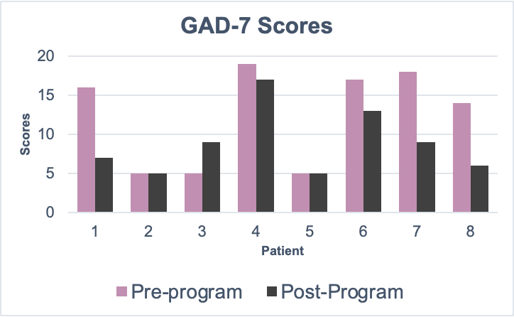
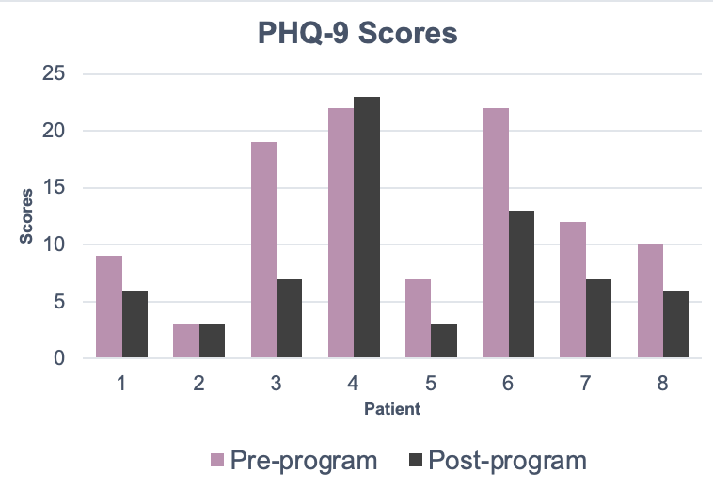
Quantitative Results
This bar graph shows the comparison between the pre-and post-Perinatal IOP of the GAD-7 scores.
This bar graph shows the comparison between the pre-and post-Perinatal IOP of the PHQ-9 scores.
General decrease in both GAD-7 & PHQ-9 scores across the weeks
Notes:
GAD-7 Plot:
The improvement is particularly notable in most patients, but there were outliers present. Patients 2, 3 and 5 depict an increased or unchanged score post-intervention than pre-intervention.
PHQ-9 Plot:
The improvement is particularly notable in most patients, but there were outliers present. Patients 2 and 4 depict an increased or unchanged score post-intervention than pre-intervention.
When looking at both plots, there is a decrease in scores following the intervention, which suggests a positive impact on mental health symptoms.

Slide 9
Results & Key Findings
There was no statistical significance between measure averages pre- and post-intervention (p> 0.05).
A general decrease in weekly GAD-7 and PHQ-9 average scores was noted on the line graph.

Slide 10

Qualitative Results
Thematic analysis was undertaken of the interviews (n=4). From which 3 major themes were highlighted:
  Enhanced coping skills
  An increased awareness of ACEs and how they inform parenting
  An enhanced baby attachment

Slide 11

Reduced anxiety due to the coping skills learned, which aided in managing everyday tasks.​
The immediate use of both emotion-focused and problem-focused coping strategies during a crisis, which helps them feel better prepared to manage their life circumstances.
Theme 1:Enhanced coping skills
“I am in a better mind space, I used to shut down and now I can manage better”
“..every time I am in crisis I use this (skills learned) to cope”
“My confidence in myself and my ability to cope with difficult situations has improved”
“(for the coping skills I don't currently use) I keep in my back pocket”
Notes:
EFC: Breathing
PFC: Asking for support

Slide 12
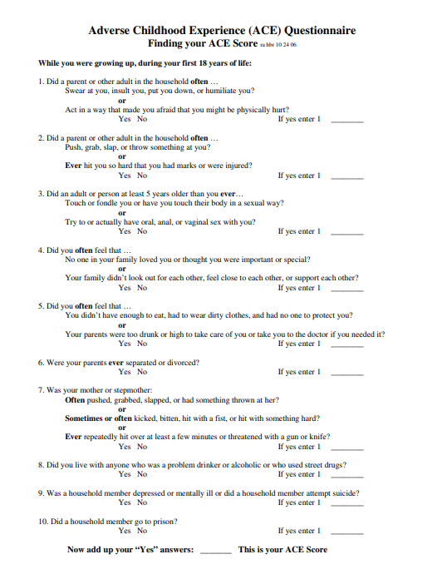

Gained insight into how ACEs affect perinatal mental health.
Sharing experiences of ACEs among group members led to greater personal reflections on patterns.
Recognized the intergenerational transmission of trauma and expressed a desire to break that cycle.
Theme 2:An increased awareness of ACEs and how they inform parenting
“I don't want my child to grow up the way I did,... I want to break the generational curse”
“At least we knew we weren't alone (in our childhood trauma experiences)”
“It healed me first, ... made me realize I didn’t want to do the same mistakes (own parents made on her)”
*ACEs: Adverse Childhood Experiences
Notes:
Adverse Childhood Experiences (ACEs) are stressful or traumatic events that can happen to children between the ages of 0 and 17. ACEs questionnaire is a 10-item measure used to measure 10 types of childhood trauma, including abuse, neglect, and other adverse experiences. Studies found that people with higher ACE scores are more likely to develop health problems later in life, such as heart disease, cancer, diabetes, and depression.

Slide 13

Increased maternal sensitivity in understanding cues and responding, as a result of the Circle of Security® curriculum.
Improved confidence in parenting.
Theme 3:Enhanced baby attachment through support
I understand him more, how a baby has cues, and how I can meet his needs
“..gave me insight into my baby. I was clueless prior to this and was worried about how I would interact and understand my baby, so this gave me a lot of knowledge.
“Helped me understand who I am which helped me realize a lot of things, (specifically how) it is my child who will benefit from this more than me”
Notes:
The Circle of Security® is based on the underpinning that children must be supported emotionally at all stages of their emotional journeys

Slide 14
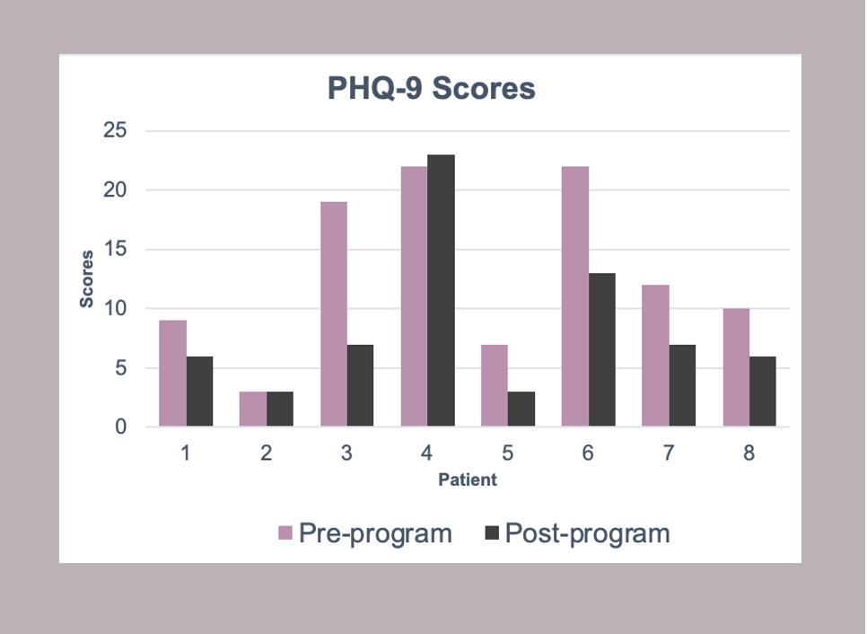
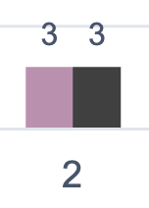
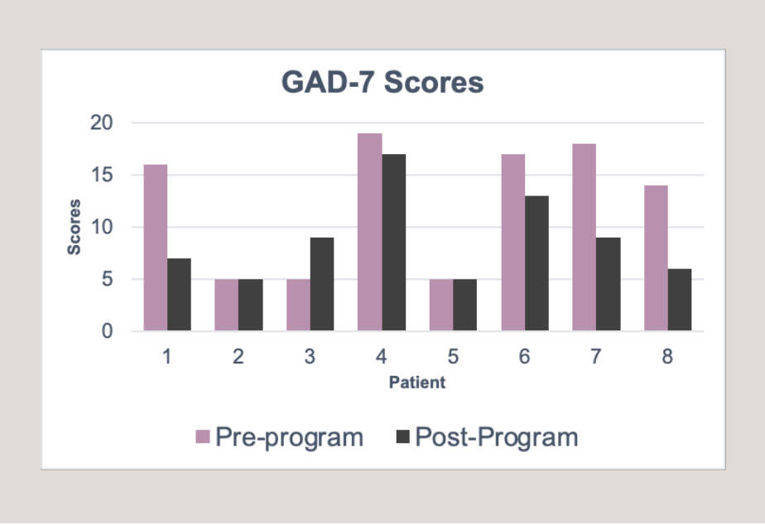
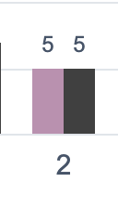
Discussion
Limitations:
There was an underreporting of scores, which made it harder to reflect the difference. This was seen from how scores didn’t match clinical assessment, where patients present with a higher acuity and express it, but their scores are not reflective of this.
    For example: Pt 2, dx: MDD & GAD
Since the GAD-7 & PHQ-9 were part of the treatment plan used to track impact, patients often declined causing inconsistencies in data.
Notes:
MDD: Major Depressive Disorder
GAD: Generalized Anxiety Disorder
PHQ-9 Depression scale:
0–4: None to minimal depression, and the patient may not need treatment
GAD-7 Anxiety scale:
5-9: Mild risk
A patient has the right to refuse their course of care, which is based on the ethical principle of autonomy
*Pt 4 had a very high ACE score, with 3 comorbid diagnoses, was pregnant while in the program and did not want to take medication. The lack of adequate treatment during pregnancy affected the pt scores. The most powerful intervention was meds, as advised by the therapist and psychiatrist, but pt opted out.

Slide 15


Future directions
The IOP was designed as a 6-week program, though participants in this study most either expressed a desire to extend or did extend their time in the program. As a result, program leadership has increased the duration of the IOP curriculum to 8 weeks. Future Quality Improvement (QI) studies should consider the impact of this change.
Future research should also use a larger sample size to improve the power of the study hence increasing generalizability.
Follow-up assessments should be undertaken to depict the long-term impact of the intervention and provide a more comprehensive insight into its effectiveness.

Slide 16

Special Thanks to the Perinatal IOP Team!

Slide 17

Acknowledgments
Dr. Ron-Li Liaw, Chair of PMHI
Dr. Neill Epperson, Chair of Department of Psychiatry
Dr. Dominic Martinez, Dir. Office of Inclusion and Outreach, CCTSI
PURPLE Coordinators:
      Yunliang (Lily) Luo
      Shanna Trott
      Dr. Merlin Ariefdjohan

Slide 18


Questions
References

