Slide 1

Confirmation of positive screening for autoantibodies: how urgent and what tests to use?
Kimber Simmons, MD MS
Assistant Professor of Pediatrics

Slide 2
Case of AW
3-year-old with intermittent thirst, urination, stomachaches and diarrhea (not worsening)
Mom “Googled” symptoms and became concerned for type 1 diabetes
Mom requested type 1 diabetes antibody testing
Screening Results
GADA +
IA-2A +

Slide 3
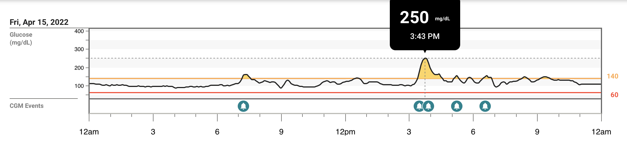
Case of AW Continued
Made appointment with a pediatric endocrinologist
  Given sample CGM
  CGM prescribed to patient pharmacy
Mom inserted CGM and started to watch numbers

Slide 4
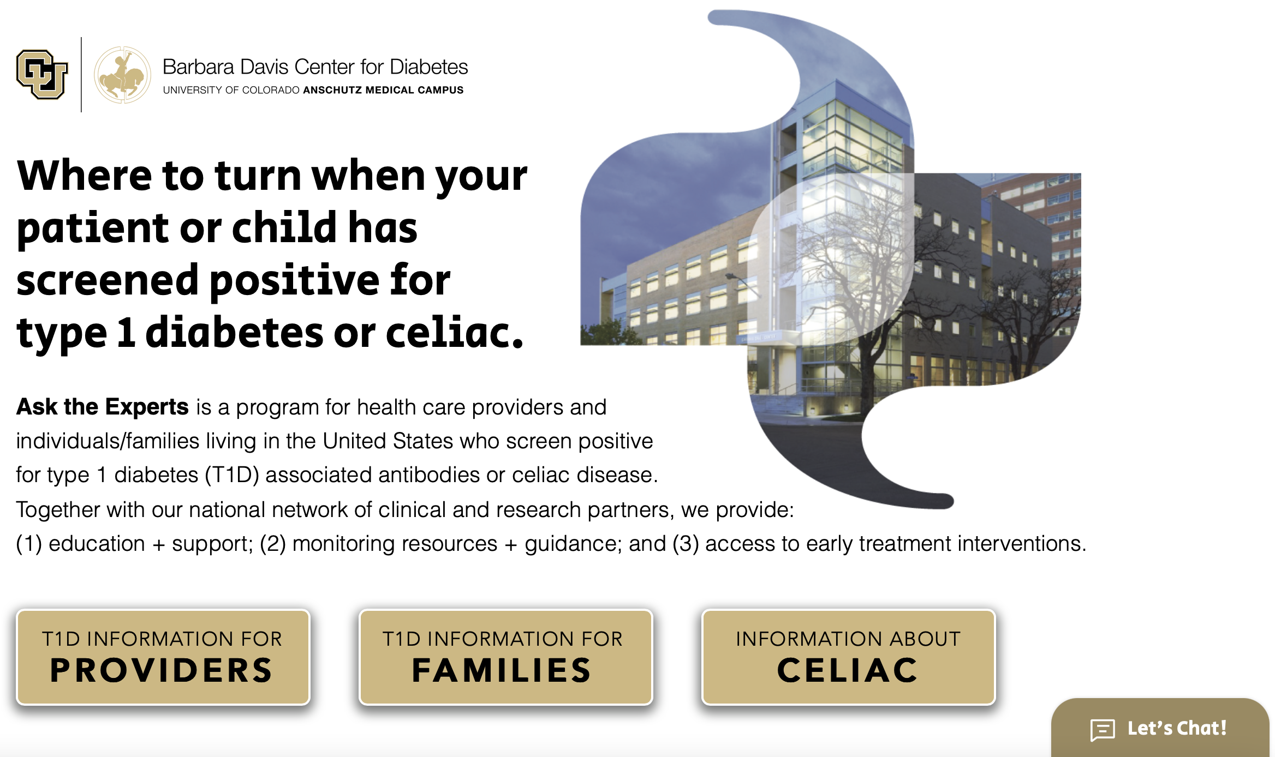
Case of AW Continued
Mom was concerned, confused and didn’t know where to turn
Mom “Googled” type 1 diabetes stage 2 and then contacted Ask the Experts via web for more information
Ask the Experts results:
HbA1c: 5.1%
RBG: 83 mg/dl
Negative GADA, IA-2A, IAA, ZnT8A

Slide 5
High Concordance of Screening and Confirmation Islet Autoantibody Tests is Important to Limit Confusion and Burden for Patients and HCPs
Participants screened at commercial and consumer-based laboratories
Confirmation by RBA and ECL assays at the BDC Islet Autoantibody Laboratory when possible given IASP results and history as reference laboratory for DAISY, TEDDY and TrialNet
  Confirmation completed through TrialNet, ASK, clinical orders
Screening and confirmation results concordant 32% of the time. (unpublished data)
Variable specificity of tests and sample collection among laboratories may impact concordance.

Slide 6
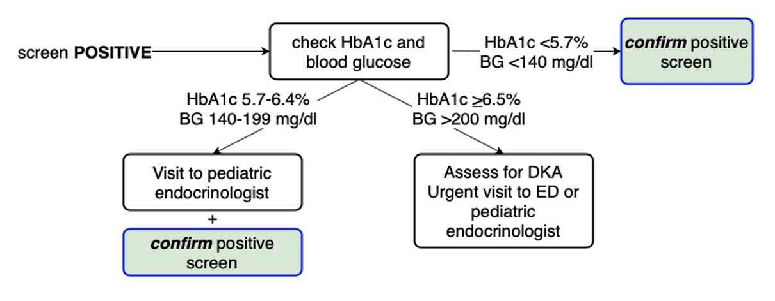
Confirmation of Islet Autoantibody Results is a Critical Part of Diagnostic Evaluation
DIAGNOSIS AND NECESSARY TREATMENT
*
*
assess for
symptoms

Slide 7
Referral to HCP for Diagnosis Should Follow Positive Medical Screens
REFERRAL TO HCP
SCREENING
DIAGNOSIS AND NECESSARY TREATMENT
Presumptive identification of unrecognized disease by application of tests, examinations or other procedures
Not intended to be diagnostic
T1D Test: islet autoantibodies

Slide 8
Islet Autoantibody Confirmation Test
Should have high specificity – people who are not at high risk for T1D do not test positive
  Specificity should be supported by data from IASP
  IASP 2020 – stored serum samples from 12 stage 2 T1D, 38 stage 3 T1D and 50 healthy controls
 | GADA | IA-2A | ZnT8A | mIAA
Sensitivity, median | 78% | 72% | 73% | 47%
Specificity, median | 99% | 99% | 99% | 99%
Specificity, range | 94-100% | 83-100% | 83-100% | 79-100%

Slide 9
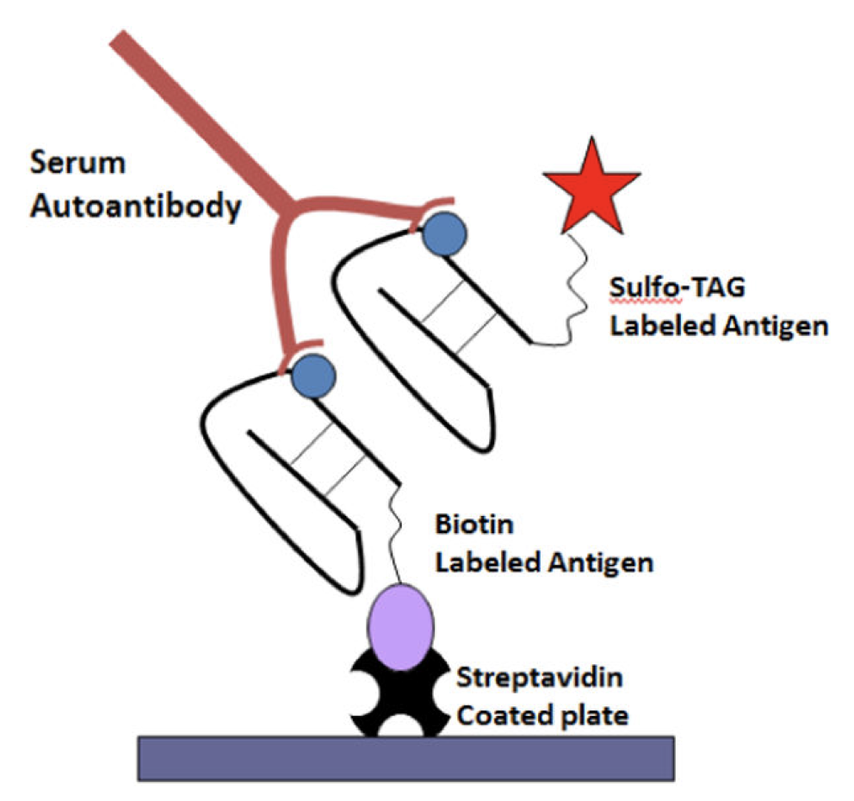
Islet Autoantibody Confirmation Test
Should have high positive predictive value – people who test positive for high risk for T1D develop T1D
  TrialNet Study is ongoing
Should be able to discriminate between low-affinity and high-affinity antibodies

Slide 10

ECL Assay Separates Predictive (high-affinity) from Non-Predictive Antibodies
Cumulative incidence of T1D
Children Screening Positive for a Single Islet Autoantibody by RBA Assay
Years since seroconversion

Slide 11

Concordance of Screening and Confirmation Islet Autoantibody (IAb) Results in ASK
138 screened + for >2 IAb
  89% (n=123) confirmed + for >2 IAb
  94% (n=129) confirmed + for >1 IAb
150 screened + for a single high-affinity IAb (ECL)
  85% (n=128) confirmed + for a single Iab
Inter-assay variability (~5-10% at BDC) and time from screening to confirmation impact concordance
Unpublished Data

Slide 12
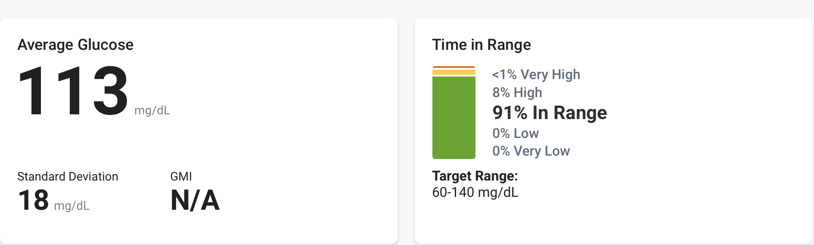
What should the follow-up plan be for AW?
Does she have dysglycemia?

Slide 13
CGM Average Blood Glucose
AVG BG
99+7
95
103+8
SD
16+3
18
17+3
¹6-11 years
²2-8 years
³1-6 years
¹Sundberg et al., DTT, 2018. ²Shaw et al., JCEM, 2019. ³DeBose, Steck et al., J Endo Soc, 2022.

Slide 14
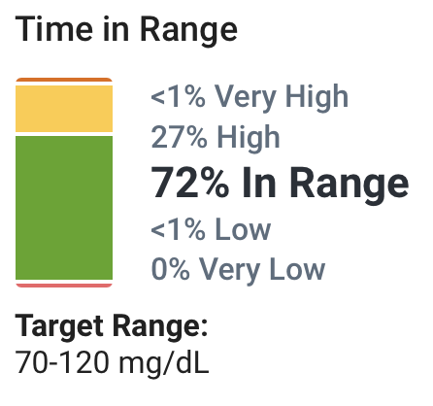
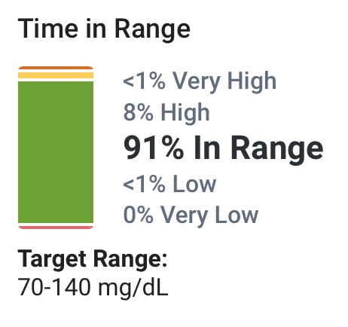
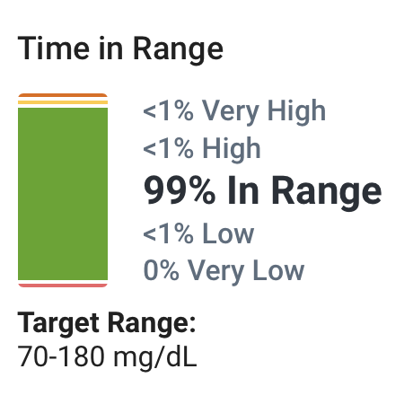
CGM Time in Range with Varying Cut-Offs
16-11 years
²2-8 years
³1-6 years
90%
85%
86%
97%
89%
96%
---
<1%
0.14%
¹Sundberg et al., DTT, 2018. ²Shaw et al., JCEM, 2019. ³DeBose, Steck et al., J Endo Soc, 2022.

Slide 15
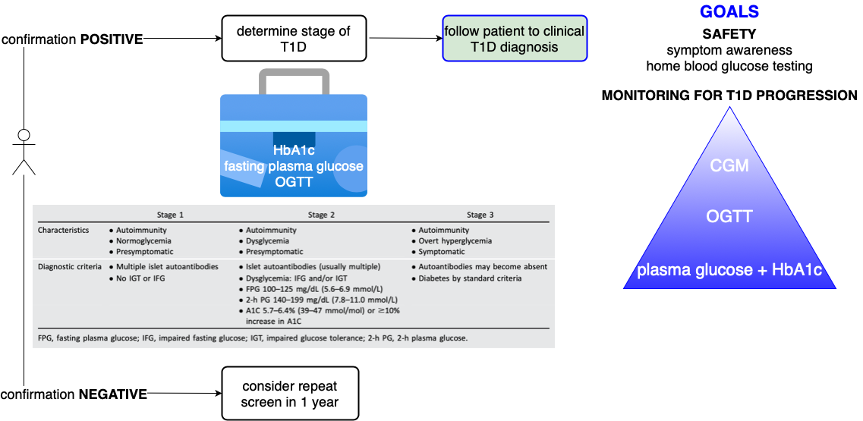
Learning from Our Case . . .
DIAGNOSIS
FOLLOW-UP
CONFIRMATION?
RULE OUT T1D?
FOLLOW UP PLAN?
STAGE T1D?
CGM Wear Guidance?

Slide 16



What were the potential barriers?

Slide 17
Ask the Experts Aims to Identify and Address Barriers Through Education and Hands On Support
LOCAL
MONITORING
REMOTE
MONITORING
HYBRID
Enroll in ASK follow-up research study
Offer trainings
Access to web-based, downloadable resources
Access to CGM as needed
Glucometer with remote data capabilities as needed
Support via member log-in on website (in development) or e-mail

Slide 18

Conclusions
Diagnostic testing should be done as soon as possible after a positive screen
Confirmation testing is a necessary and important part of the post-screening diagnostic work-up
Screening tests that are highly sensitive and specific are important for improving concordance with confirmation tests and optimizing patient and HCP experience
Confirmation tests should have very high specificity and ideally a high positive predictive value
Training and support for healthcare providers seeing patients who screen positive for islet autoantibodies is essential.

Slide 19
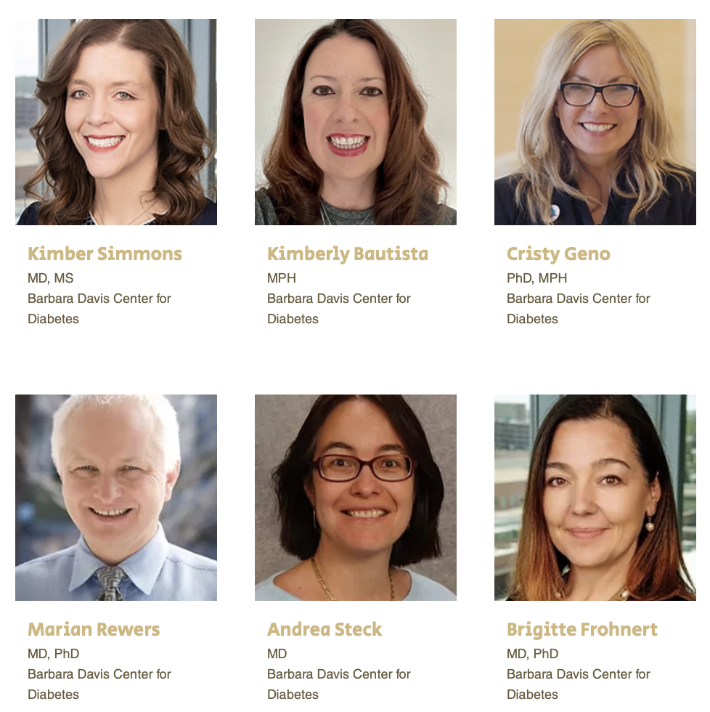
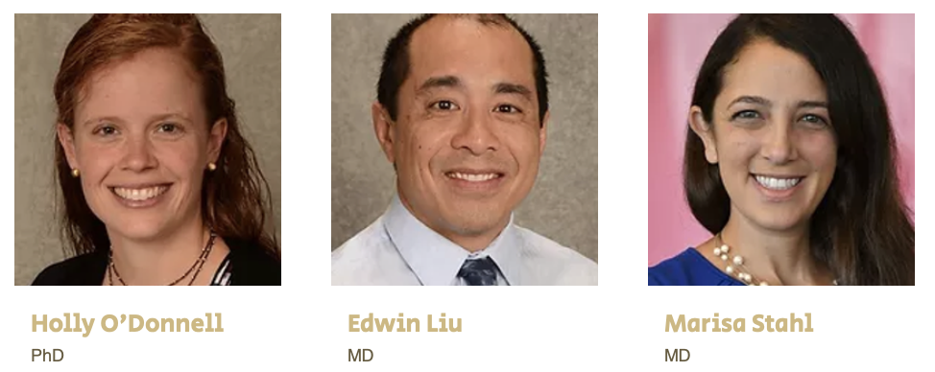

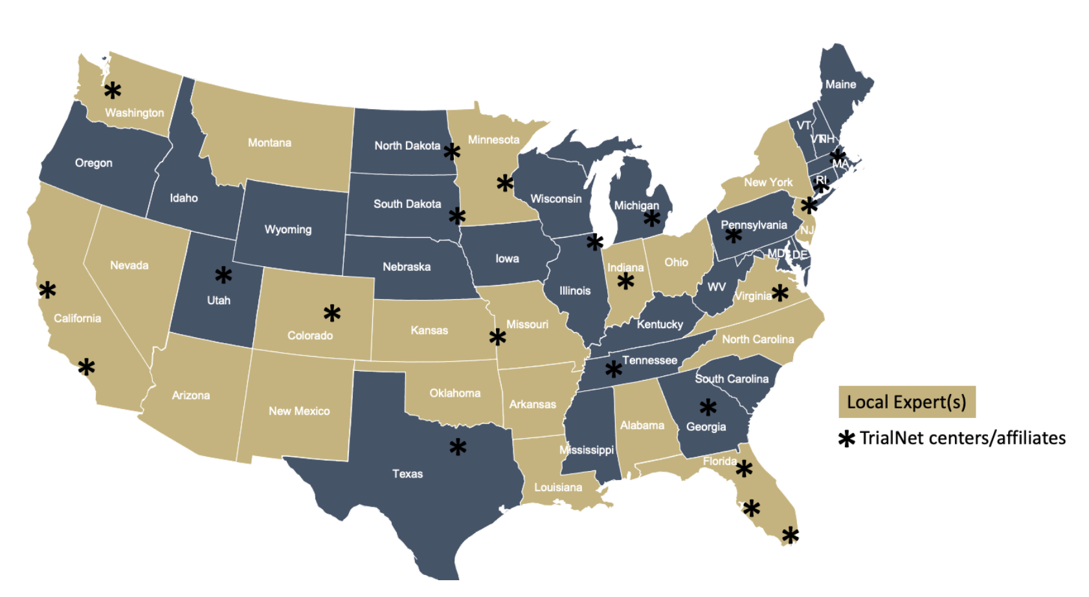

Thank You!
Ask the Experts Team
Funder
Collaborators
“Expert” Healthcare Providers and Patients
Screening/Monitoring Programs:
ASK, CASCADE, PLEDGE, TrialNet

