Slide 1
The value of CGM in predicting progression to clinical T1D
Andrea Steck, MD
5th Childhood Diabetes Prevention Symposium
11/11/2022

Slide 2

CGM during Progression to stage 3 T1D (DAISY)
23 Ab+ subjects with available longitudinal CGM data
8 progressed to T1D at a median age of 14 yrs (median follow-up 18 yrs)
Baseline HbA1c between progressors and nonprogressors was 5.8 vs 5.3% (p=0.053)
Progressors were more likely to have impaired baseline OGTT (88% vs 13%, p=0.001)
Steck et al, Diabetes Care 2014
Steck et al, JCEM 2019

Slide 3
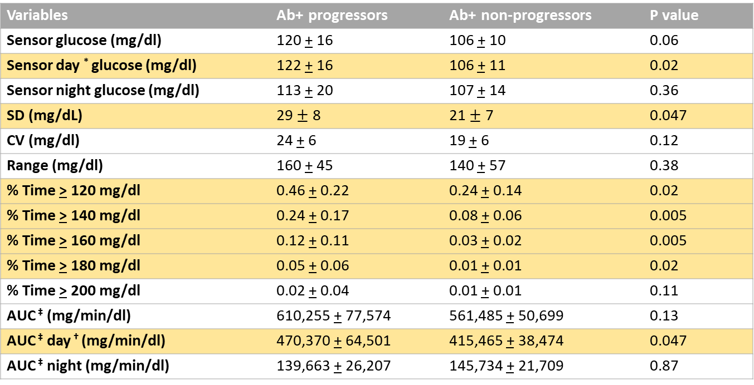
CGM measures of glycemic control and variability
Variables | Ab+ progressors | Ab+ non-progressors | P value
Sensor glucose (mg/dl) | 120 + 16 | 106 + 10 | 0.06
Sensor day * glucose (mg/dl) | 122 + 16 | 106 + 11 | 0.02
Sensor night glucose (mg/dl) | 113 + 20 | 107 + 14 | 0.36
SD (mg/dL) | 29 $±$ 8 | 21 $±$ 7 | 0.047
CV (mg/dl) | 24 + 6 | 19 + 6 | 0.12
Range (mg/dl) | 160 + 45 | 140 + 57 | 0.38
% Time > 120 mg/dl | 0.46 + 0.22 | 0.24 + 0.14 | 0.02
% Time > 140 mg/dl | 0.24 + 0.17 | 0.08 + 0.06 | 0.005
% Time > 160 mg/dl | 0.12 + 0.11 | 0.03 + 0.02 | 0.005
% Time > 180 mg/dl | 0.05 + 0.06 | 0.01 + 0.01 | 0.02
% Time > 200 mg/dl | 0.02 + 0.04 | 0.01 + 0.01 | 0.11
AUC ‡ (mg/min/dl) | 610,255 + 77,574 | 561,485 + 50,699 | 0.13
AUC ‡ day † (mg/min/dl) | 470,370 + 64,501 | 415,465 + 38,474 | 0.047
AUC ‡ night (mg/min/dl) | 139,663 + 26,207 | 145,734 + 21,709 | 0.87
*Day: values between 6am and midnight
‡ AUC: area under the curve, calculated by the trapezoidal rule

Slide 4

ROC analyses for prediction of T1D
 | AUC (95% CI) | P value
% time above120 | 0.80 (0.57-1.00) | 0.009
% time above140 | 0.85 (0.62-1.00) | 0.003
% time above160 | 0.85 (0.63-1.00) | 0.002
% time above180 | 0.79 (0.58-1.00) | 0.008
% time above200 | 0.70 (0.46-0.93) | 0.10
Receiver operating characteristic (ROC) curves were generated to compare area under the curve (AUC) of different CGM metrics for T1D prediction

Slide 5
Sensitivity, Specificity, PPV and NPV for different CGM variables
Index | cutoff | PPV | NPV | Sensitivity | Specificity
% time > 120 | 36% | 0.714 | 0.812 | 0.625 | 0.867
% time > 140 | 18% | 1.000 | 0.883 | 0.750 | 1.000
% time > 160 | 6% | 0.833 | 0.824 | 0.625 | 0.933
% time > 180 | 2% | 0.714 | 0.813 | 0.625 | 0.867
% time > 200 | 0.2% | 0.546 | 0.813 | 0.750 | 0.667

Slide 6
CGM profiles of DAISY subjects with <10% time and >10% time above 140mg/dl
TA 140 4%
TA 140 18%

Slide 7
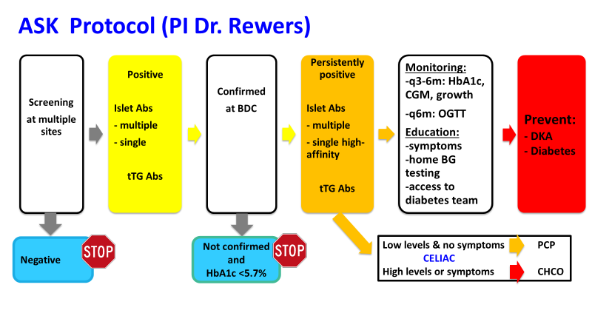

Slide 8
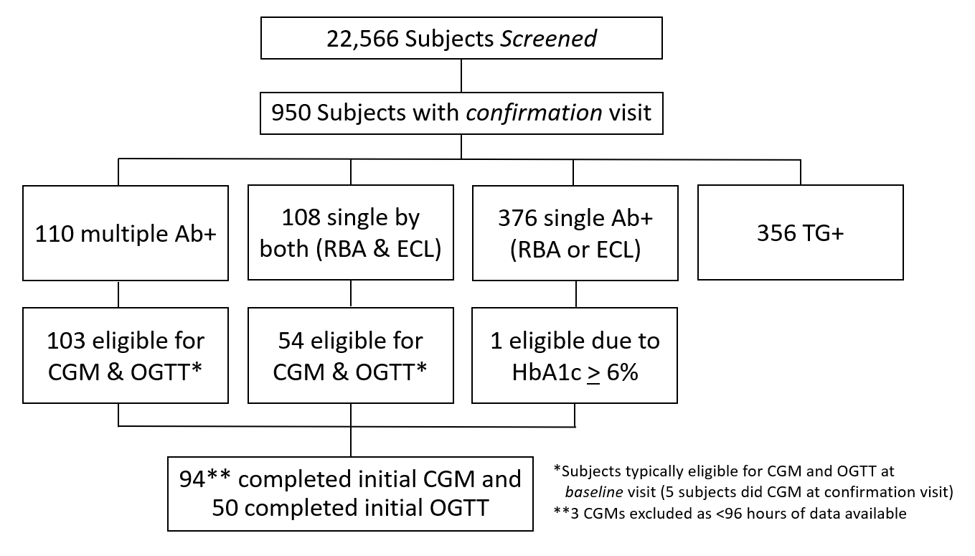
ASK screening and monitoring program flowchart

Slide 9
CGM data in ASK study
91 children persistently islet Ab+ (median age 11.5 y, 48% non- Hispanic White, 57% female) with a baseline CGM
Of these, 16 (18%) progressed to clinical diabetes
Baseline HbA1c was higher in progressors versus non-progressors 5.6 vs 5.2%
Receiver operating characteristic (ROC) curves were generated to compare the area under the curve (AUC) of different CGM metrics for T1D prediction
Performance of T1D prediction by ROC analyses showed AUC of > 0.89 for both individual (TA140, SD and MAGE) and combined CGM metric models
Unpublished data
Steck et al, Diabetes Care 2022

Slide 10
Characteristics of Ab+ ASK participants
Variables | Ab+ non-progressors (n=75) | Ab+ progressors (N=16) | P-value
Age at baseline (yrs), median (IQR) | 11.7 (8.1-14.5) | 10.5 (6.8-13.2) | 0.40
Age at first Ab+ (yrs), median (IQR) | 10.8 (7.7-13.4) | 10.0 (5.9-13.0) | 0.59
Female, N (%) | 44 (58.7) | 8 (50) | 0.52
Non-Hispanic white, N (%) | 35 (46.7) | 9 (56.3) | 0.49
First-degree relative, N (%) | 14 (20.9) | 4 (25.0) | 0.74
Antibody status, n (%): Single Ab+ Single by both (RBA and ECL) Multiple Ab+ | 0 (0) 23 (31) 52 (69) | 1 (6) 2 (13) 13 (81) | 0.048
BMI z-score, median (IQR) | 0.63 (-0.64-1.3) | 0.28 (-0.27-0.97) | 0.86
HbA1c, %, n (%) | 5.2 (5.1-5.4) | 5.6 (5.2-5.9) | 0.005
HbA1c > 5.7%, n (%) | 4 (5.5) | 6 (46.2) | 0.0006
OGTT, n (%): Abnormal/impaired OGTT Normal OGTT | 0 (0) 14 (100) | 1 (33) 2 (67) | 0.18
Follow-up time (months), median (IQR) | 6.6 (2.6-11.9) | 4.5 (0.9-9.7) | 0.56

Slide 11
Variables | AUC (95% CI) | P value
HbA1c | 0.75 (0.57-0.93) | 0.006
% time > 120 mg/dL (6.7 mmol/l) | 0.81 (0.66-0.96) | <0.0001
% time > 140 mg/dL (7.8 mmol/l) | 0.89 (0.75-1.00) | <0.0001
% time > 160 mg/dL (8.9 mmol/l) | 0.88 (0.74-1.00) | <0.0001
% time > 180 mg/dL (10 mmol/l) | 0.88 (0.76-0.99) | <0.0001
% time > 200 mg/dL (11.1 mmol/l) | 0.81 (0.68-0.94) | <0.0001
SD | 0.89 (0.79-0.98) | <0.0001
CV | 0.84 (0.74-0.93) | <0.0001
MAGE | 0.90 (0.82-0.99) | <0.0001
MODD | 0.86 (0.75-0.97) | <0.0001
% time above140 and SD | 0.90 (0.77-1.00) | <0.0001
% time above140 and CV | 0.91 (0.79-1.00) | <0.0001
% time above140 and MAGE | 0.91 (0.79-1.00) | <0.0001
% time above160 and SD | 0.90 (0.78-1.00) | <0.0001
% time above160 and CV | 0.91 (0.80-1.00) | <0.0001
% time above160 and MAGE | 0.91 (0.80-1.00) | <0.0001
% time above180 and SD | 0.90 (0.80-1.00) | <0.0001
% time above180 and CV | 0.90 (0.81-0.99) | <0.0001
% time above180 and MAGE | 0.92 (0.83-1.00) | <0.0001
SD and CV | 0.88 (0.75-1.00) | <0.0001
SD and MAGE | 0.91 (0.82-1.00) | <0.0001
CV and MAGE | 0.90 (0.82-0.99) | <0.0001
ROC analyses for
prediction of T1D
MAGE: mean amplitude of glycemic excursions
MODD: mean of daily differences

Slide 12
Sensitivity, Specificity, PPV and NPV for different CGM metrics
Model Source | Cut-offs | Sensitivity | Specificity | PPV | NPV
HbA1c | 5.5 % | 43.8% | 89.3% | 46.7% | 88.2%
% time > 120 mg/dL (6.7 mmol/l) | 37.3% | 68.8% | 94.7% | 73.3% | 93.4%
% time > 140 mg/dL (7.8 mmol/l) | 10% | 87.5% | 90.7% | 66.7% | 97.1%
% time > 140 mg/dL (7.8 mmol/l) | 15% | 68.8% | 98.7% | 91.7% | 93.7%
% time > 160 mg/dL (8.9 mmol/l) | 3.5% | 81.3% | 90.7% | 65.0% | 95.8%
% time > 180 mg/dL (10 mmol/l) | 1.9% | 68.8% | 96.0% | 78.6% | 93.5%
% time > 200 mg/dL (11.1 mmol/l) | 0.3% | 62.5% | 94.7% | 71.4% | 92.2%
SD | 20 | 81.3% | 81.3% | 48.2% | 95.3%
CV | 16 | 81.3% | 65.3% | 33.3% | 94.2%
MAGE | 37 | 68.8% | 90.7% | 61.1% | 93.2%
MODD | 19 | 75.0% | 80.0% | 44.4% | 93.8%
Steck et al, Diabetes Care 2022

Slide 13
Cox proportional hazards models for individual CGM metrics with AUC of 0.88 or above for diabetes prediction by ROC analyses
: TA140
: TA160
: TA180
5%
7%
9%
80%
73%
83%
: SD
: MAGE
6%
12%
Development of diabetes by:
A: time spent >140mg/dl (TA140)
B: time spent >160mg/dl (TA160)
C: time spent > 180mg/dl (TA180)
D: standard deviation (SD)
E: mean amplitude of glycemic excursions (MAGE)
60%
64%

Slide 14
Dot-plot charts for progressors and non-progressors for these same CGM metrics with AUC of 0.88 or above
TA140
TA160
TA180
SD
MAGE
Dot-plot charts for:
A: time spent >140mg/dl (TA140)
B: time spent >160mg/dl (TA160)
C: time spent > 180mg/dl (TA180)
D: standard deviation (SD)
E: mean amplitude of glycemic excursions (MAGE)

Slide 15

TrialNet CGM data
Three groups of relatives were evaluated:
  - Individuals with ≥ 2 Abs and an abnormal OGTT (Stage 2 T1D) (n=42)
  - Individuals with ≥ 2 Abs and a normal OGTT (Stage 1 T1D) (n=53)
  - Individuals with negative Abs and normal OGTT (n=10)
Selected CGM metrics improved the prediction of clinical (Stage 3) diabetes, in particular:
  - percentage time spent ≥140 mg/dL
  - percentage time spent ≥160 mg/dL
The presence of a dysglycemic state identified by CGM metrics improves risk stratification in relatives of T1D patients including those with a normal OGTT
Unpublished data

Slide 16
TrialNet CGM Measures
Glucose variability measures:
SD, CV, MAGE, MODD,
DySF (Dynamic Stress Factor),
CONGA (continuous overall net glycemic action)
Unpublished data

Slide 17
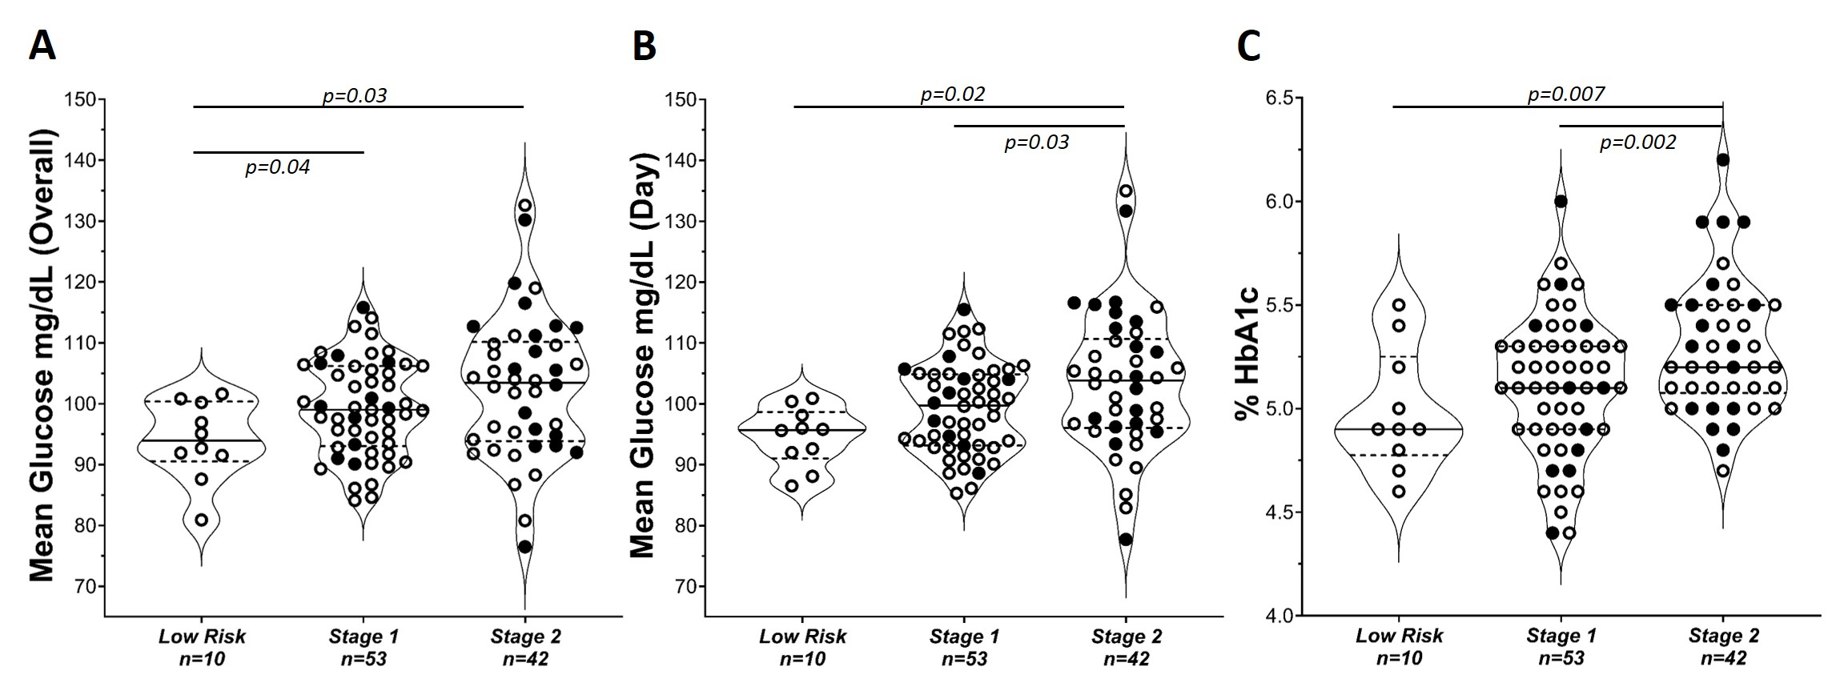
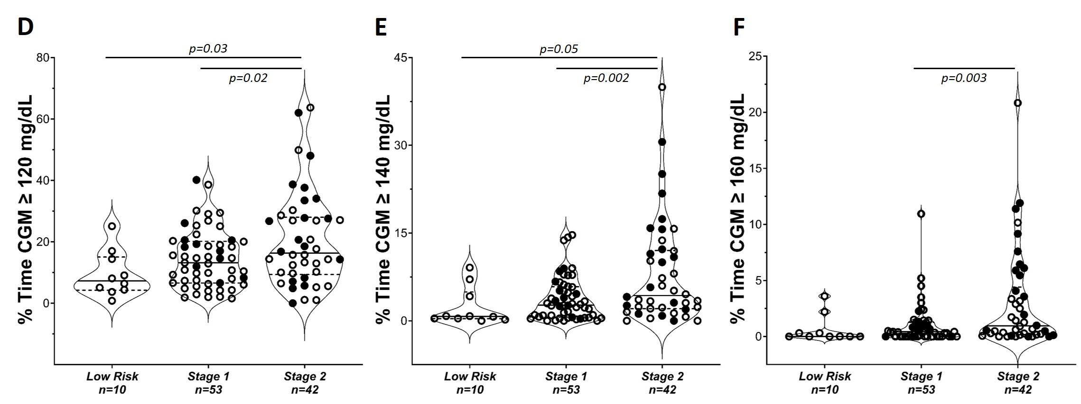
Low Risk, Stage 1 and Stage 2 participants
mean glucose
day mean glucose
HbA1c
A: Overall mean glucose
B: Day mean glucose
C: HbA1c (%)
D: time spent >120mg/dl
E: time spent >140mg/dl
F: time spent > 160mg/dl
TA120
TA140
TA160
Unpublished data

Slide 18
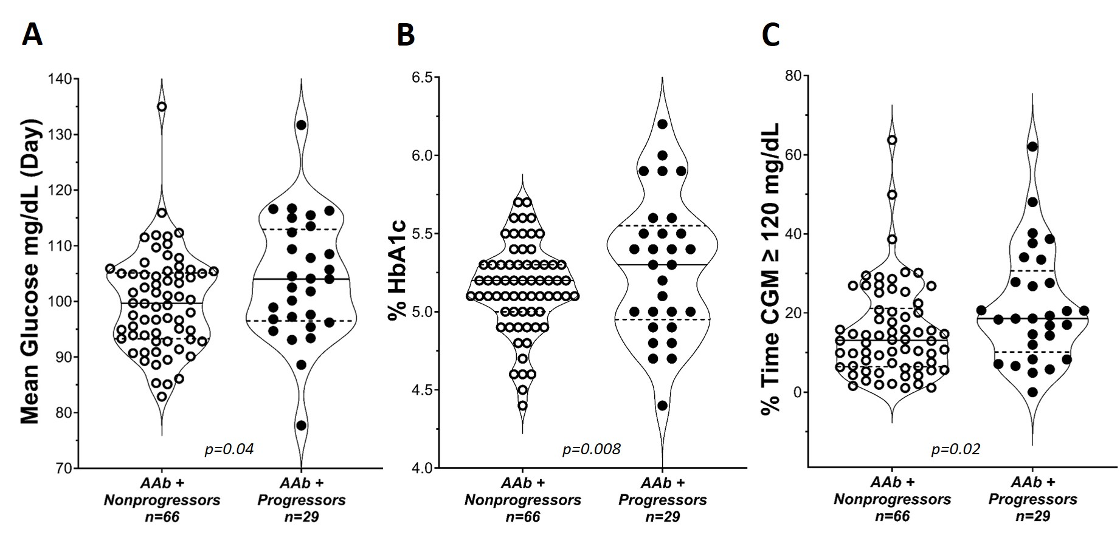
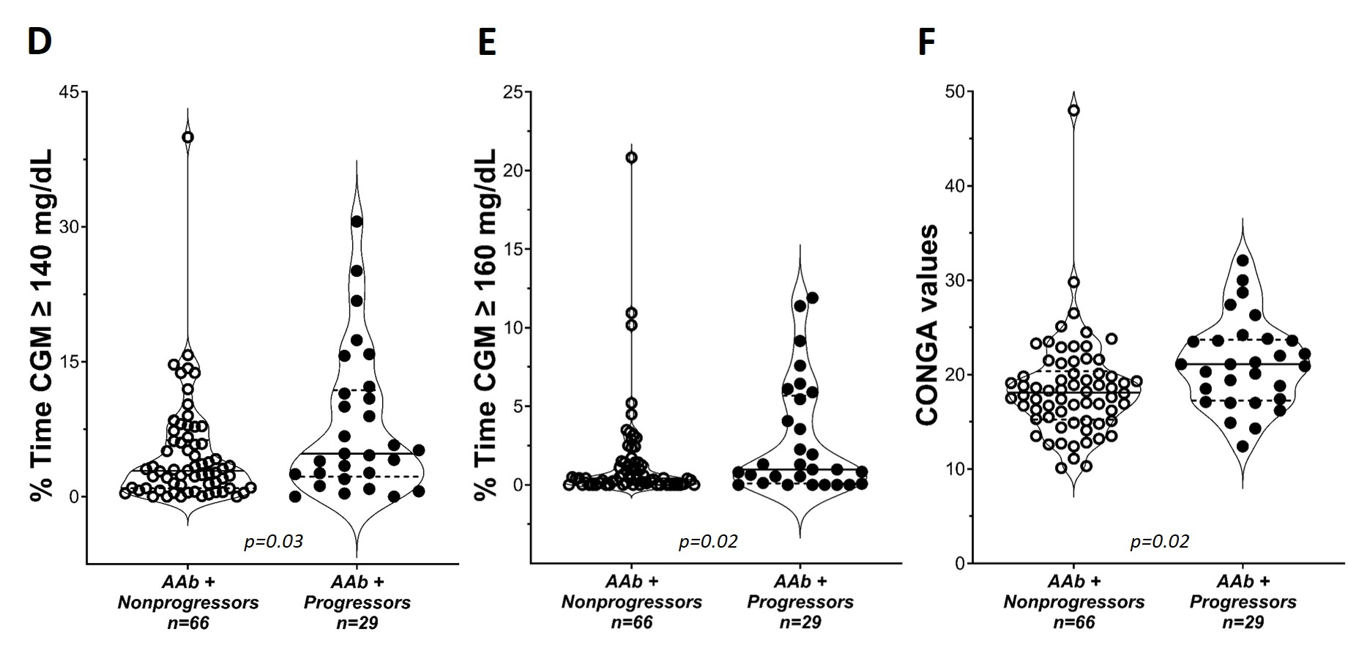
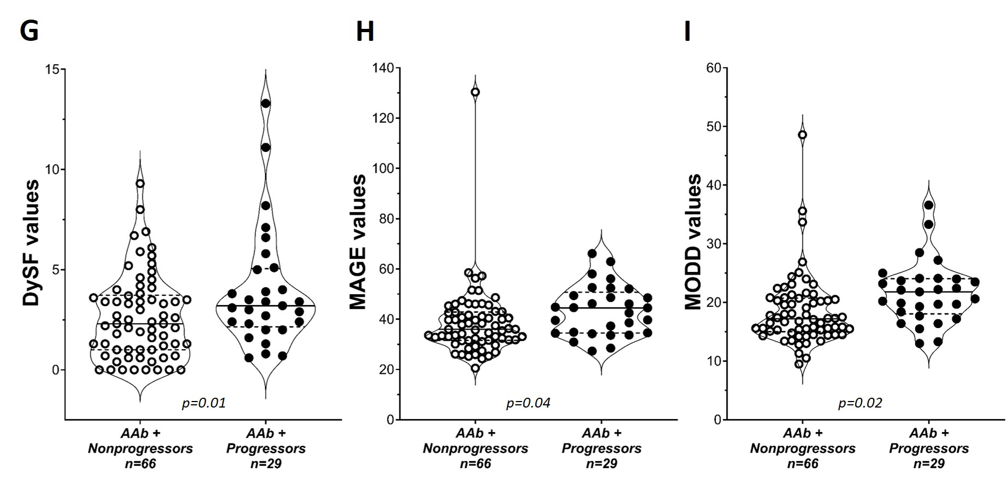
Aab+ nonprogressors vs AAb progressors
A: Mean glucose
B: HbA1c (%)
C: time spent >120mg/dl
D: time spent >140mg/dl
E: time spent > 160mg/dl
F: CONGA
G: DYSF
H: MAGE
I: MODD
Unpublished data

Slide 19
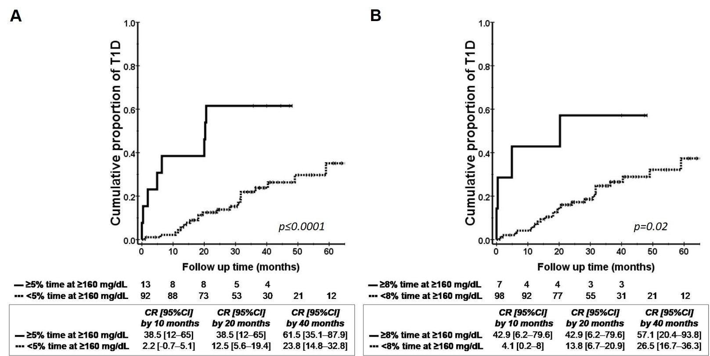
Life table analysis with time spent ≥ 160 mg/dL Glucose
TA160 5%
TA160 8%
Unpublished data

Slide 20
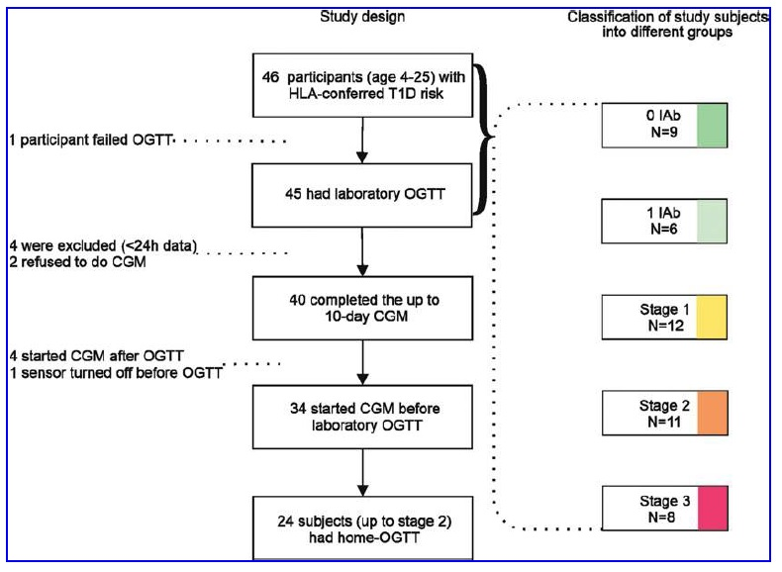
DIPP CGM and OGTT data
Staging (1–3) done at baseline visit based on IAbs and lab OGTT
Kontola et al, Diabetes Technology & Therapeutics 2022

Slide 21
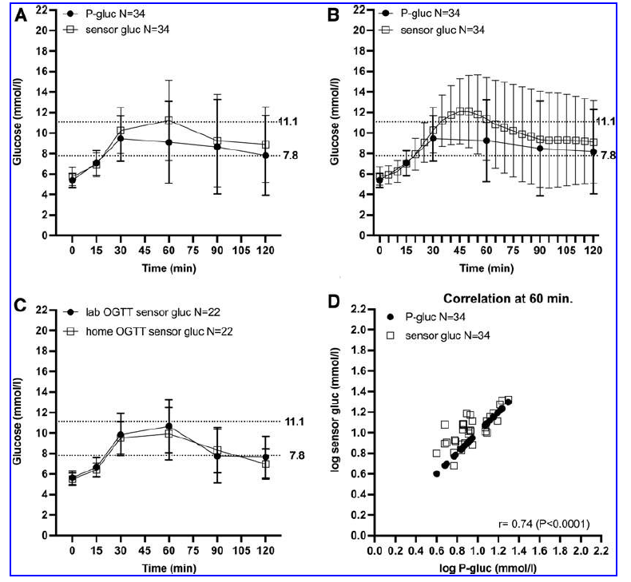
Comparison of plasma & sensor glucose during OGTT
200 mg/dl
140 mg/dl
A: 6 SG values
B: all 25 SG values
C: SG values during
lab/home OGTT
D: Pearson correlation
of plasma and SG at
60-min time point

Slide 22
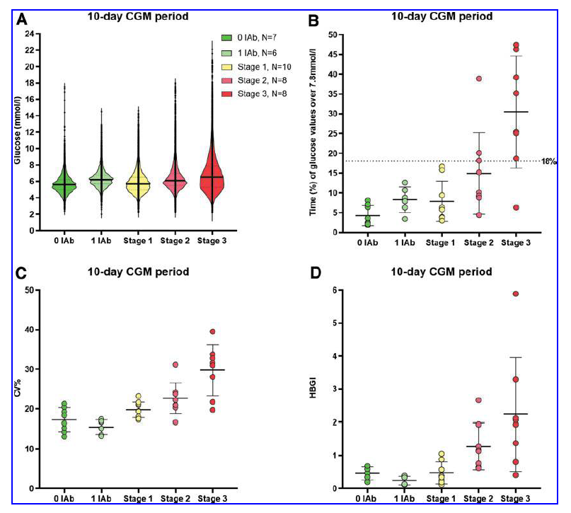
CGM in individuals with & without IAbs (1 & 0 Ab) and at stages 1–3 of T1D
18% time above 140 mg/dl
108 mg/dl
A: glucose
B: TA140
C: CV
D: HBGI, high blood
glucose index
(measure of SG
variability)

Slide 23
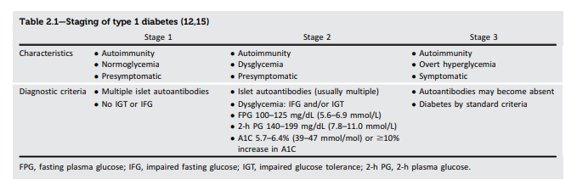
Current T1D Staging
Standards of Medical Care in Diabetes, Diabetes Care 2022

Slide 24
Discussion
Stage 1 T1D | Stage 2 T1D | Stage 3 T1D
Should multiple Ab status be confirmed? Should this be confirmed in a CLIA approved laboratory? | Add CGM criteria (TA140 > 20%)? OGTT: add ≥200mg/dL at 30, 60 or 90 min? HbA1c: remove >10% increase | Divide into 2 Substages: 3a: asymptomatic 3b: symptomatic

Slide 25










Acknowledgments
ADA

