Slide 1
Experiences for the
DAISY/TEDDY/ASK Cohorts
Michelle Hoffman, RN Patricia Gesualdo, RN, MSPH Kimberly Bautista, MPH
Research Instructor Senior Research Instructor Research Instructor
Notes:
Thank you Judy

Slide 2
Experiences from Follow-Up
Case Review
Challenges and Successes
  DAISY: Michelle Hoffman
  TEDDY: Tricia Gesualdo
  ASK: Kim Bautista
Lessons Learned
Notes:
We'll be reviewing 2 cases from each study, talk about the challenges and successes and provide a review of the lessons learned at the end. Each study has unique perspectives, challenges and insights, The experience from one study to the next is helping to develop the most effective mechanisms and study protocols to meet family needs, research needs and the integration with the community as a whole.

Slide 3
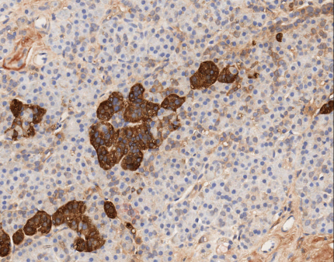


Development of islet autoimmunity and T1D
DAISY 1993-2022
N=2,547 n=236 n=112
Genetic
susceptibility
Confirmed persistent islet autoimmunity (IA):
insulin, GAD₆₅, IA-2, or ZnT8 autoantibodies at least twice on consecutive visits 3-6 months apart
Clinical
Diabetes
ADA / WHO
Notes:
3
DAISY is the oldest of the studies starting in 1993. Most of you have seen this slide before. We have followed subjects up to 30 years of age.
DAISY set the stage being the first study to develop protocols to follow subjects long term.
The Long term follow-up has resulted in many great successes, children and in particular young adults having knowledge of T1D and their risk has resulted in the prevention of DKA in the vast majority of our participants, and resulted in the appropriate diagnosis and treatment in our older subjects.
The two cases I’m going to present may not be typical of "childhood diabetes’ but I picked them to illustrate that:
1) islet autoantibodies can develop after age 15
2) T1D diagnosed in young adults starts as islet autoimmunity during childhood
Current f/u 462 338 AB neg 124 AB +

Slide 4

Case Review #1: FDR, MAB+
Male enrolled at birth
HLA DR X/X (low risk)
Non-Hispanic White
Dual participant DAISY/ TrialNet (Oral Insulin arm)
Diagnosis:
Age 20.5
In Clinic RG 167 asymptomatic
A1c 6.9
Referred to BDC Young Adult Clinic
Home glucose testing (HGT) X 1 week
Random glucoses >200
Developed decreased energy, increased thirst
Notes:
First case is a FDR we've followed him from birth. ( Mother and Sister had type 1 at the time of his participation. Mom diagnosed age 31, sister diagnosed age 4
He was a dual participant in both DAISY and TrialNet
He was officially diagnosed at age 20.5
At his last research visit his glucose was 167, with an A1c of 6.9, he was completely asymptomatic, A1c was not part of approved criteria for diagnosis at this time so along with consultation with the TrialNet PI, he was referred to theBDC Young Adult Clinic.
The family did home glucose tests over the next week showing frequent glucoses greater than 200 and within the week he developed decreased energy and increased thirst. Insulin treatment was then started.

Slide 5
DATE | GAD | IAA | IA-2 | ZnT8 | RG | A1C
12/18/96 | -1.017 | 30 | -0.002
5/21/97 | 0.026 | 37 | 0.001
9/3/97 | -0.014 | 24 | -1.012
9/9/98 | -0.035 | 12 | -0.002
Yearly | Neg | Neg | Neg
10/28/11 | 0 | 0.007 | 0 | -0.009
12/27/12 | 483 | 0.004 | 416 | -0.004
5/31/13 | 609 | 0.006 | 357 | -0.001 | 95 | 5.6
9/20/13 | 356 | 0.003 | 296 | -0.001 | 77 | 5.5
12/20/13 | 197 | 0.004 | 320 | 0.006 | 96 | 5.8
3/14/14 | 214 | 0.007 | 353 | -0.004 | 99 | 5.9
7/22/14 | 168 | 0.015 | 324 | 0.017 | 81 | 5.5
10/20/14 | 207 | 0.014 | 339 | 0.031 | 104 | 5.9
2/6/15 | 217 | 0.011 | 396 | 0.014 | 72 | 5.5
6/12/15 | 175 | 0.016 | 295 | 0.086 | 97 | 5.9
10/13/15 | 165 | 0.021 | 393 | 0.13 | 80 | 5.7
12/22/15 | 126 | 0.002 | 376 | 0.032 | 102 | 5.8
3/21/16 | 219 | 0.004 | 645 | 0.054 | 89 | 6.0
6/20/16 | 105 | 0.007 | 255 | 0.089 | 94 | 6.1
9/8/16 | 104 | 0.007 | 315 | 0.021 | 167 | 6.9 *
Notes:
This graph indicates the history of his autoantibodies, It shows, the date of the visit, the autoantibodies tested, GAD, IAA, IA-2 and ZnT8, random glucose and A1c.
AB neg until the age of 16.86
He became persistently multiple AB + in both DAISY and TrialNet. He was then seen in clinic every 3-6 months. His A1c was showing some dysglycemia but He had Normal glucoses and OGTT's which are on the next slide.
The September 2016 visit showed the A1c of 6.9 which prompted the referral to the Young Adult Clinic.

Slide 6

OGTT results CGM results
DATE | -10 | 0 | Average -10/0 | 30 | 60 | 90 | 120 | A1c | Status
12/20/13 | 95 | 96 | 96 | 142 | 139 | 136 | 110 | 5.4 | Normal
7/22/14 | 93 | 88 | 91 | 162 | 160 | 132 | 112 | 5.6 | Normal
CGM 2/6/15 | 84 | 84 | 84 | 138 | 170 | 162 | 111 | 5.5 | Normal
6/12/15 | 94 | 90 | 92 | 146 | 114 | 133 | 139 | 5.6 | Normal
12/22/15 |  | 102 |  |  |  |  | 119 | 5.8 | Stage 2
6/20/16 |  | 92 |  |  |  |  | 128 | 6.1 | Stage 2
DATE 2/6/15 CGM
% in Target (140): 96
% in Hyperglycemia (140): 1
2 Peaks > 200: 0
Notes:
Here are the OGTT and CGM results, All show normal fasting and 2 hour glucose results. One OGTT coincided with the only time he was successful wearing a CGM which was essentially normal.
Once He was being randomized into the Oral Insulin arm of TrialNet, OGTT data only shows 2 point OGTT's, results were not shared with participant.
I do not have the specific information regarding his randomization.

Slide 7
Challenges Successes
Protocol: CGM difficulties, dual participation
Life Complexity: busy life, scheduling difficulty
Avoidance: Home glucose testing
Staff Support/Trust in Research: Persistence in contact attempts​, clinician consistency
Knowledge: Accurate risk perception, fam hx T1D
Access to study: Lived locally throughout study
Tools to Monitor: HGT supplies
Notes:
The Challenges identified with this family were minimal
CGM's were attempted multiple times with various complications, poor capture, technical issues and he played multiple sports and didn't want to wear a CGM during these times.
Coordinating DAISY and TrialNet plus medical visits for the sibling created some scheduling issues
He was pretty avoidant to doing home glucose testing.
The successes were influenced by.
The family embraced research were very knowledgeable about T1D and his risk.
Clinician Consistency was very important.
They Visits were every 3-6 months but we also had frequent check in's regarding home glucose testing, utilizing phone calls, texts and e-mail.
They lived in the area transportation was not an issue, he lived at home the entire time.
We provided all supplies needed for HGT.

Slide 8
Case Review #2: FDR, MAB+
Female
HLA DR 4/4 (moderate risk)
Non-Hispanic White
Refused dual participation DAISY/TrialNet
Diagnosis:
Age 22.3 y
Moved home post-graduation
Parent noted symptoms immediately
  Weight loss, polydipsia, polyuria, decreased energy
  Home glucose 460
ER glucose 485, A1c 12.2
No DKA
Notes:
Our second case is also a FDR she began participating at age 3.
She was diagnosed at age 22.3. She refused to participate in any other studies except DAISY.
Subject moved home post college graduation and her mother noted symptoms of weight loss, polydipsia, polyuria and decreased energy although the subject denied having any sypmtoms. Mom had testing supplies the home glucose was 460 she then called us, The family had moved to Florida and they did not have a PCP, with a glucose >400 plus symptoms we recommended they go to the ER. In the ER the glucose was 485 with an A1c of 12.2 she was not in DKA.
in the ER she did admitted to having symptoms for about a month. Attributed symptoms to the stress of finals.

Slide 9
DATE | GAD | IAA | IA-2 | ZnT8 | RG | A1C
8/18/00 | -0.008 | -0.003 | 0.004 | -0.002
8/10/01 | -0.012 | -0.01 | -0.003 | 0
8/22/02 | -0.035 | -0.005 | -0.009 | -0.001
10/3/03 | 0.062 | -0.015 | 0.005 | 0.001
12/13/03 | 0.026 | -0.007 | -0.003 | 0.001 | 78 | 5.2
6/25/04 | -0.048 | 0.001 | -0.002 | 0.02 | 86 | 5.5
6/17/05 | 0.091 | -0.005 | -0.036 | -0.002 | 101 | 5.2
9/9/05 | 0.299 | 0.001 | -0.002 | -0.002 | 107 | 4.9
4/21/06 | 0.477 | 0.001 | -0.015 |  | 56 | 5.3
12/1/06 | 0.224 | 0.002 | -0.013 | -0.005 | 99 | 5.4
6/13/07 | 0.579 | 0.001 | 0.001 | 0.005 | 105 | 5.7
1/18/08 | 0.543 | -0.003 | 0.019 |  | 89 | 5.2
12/1/08 | 0.234 | 0.004 | -0.002 |  | 100 | 5.7
9/2/09 | 0.25 | 0.003 | 0.006 |  | 127 | 5.6
8/4/10 | 343 | 0.002 | 175 | 0.001 | 115 | 5.7
12/20/10 | 360 | -0.005 | 228 |  | 92 | 5.6
3/17/11 | 376 | 0.001 | 145 |  | 90 | 5.4
7/29/11 | 292 | 0.001 | 206 | 0.006 | 98 | 5.3
11/4/11 | 310 | 0.003 | 200 | -0.007 | 81 | 5.7
4/24/12 | 256 | -1.001 | 235 | -0.005 | 92 | 5.7
8/3/12 | 250 | -0.002 | 174 | -0.006 | 108 | 5.6
2/15/13 | 376 | 0.004 | 385 | 0.002 | 72 | 5.6
7/19/13 | 226 | -0.002 | 353 | -0.002 | 112 | 5.6
3/30/15 | 127 | 0.001 | 209 | -0.003 | 102 | 5.6
8/7/15 | 121 | 0.001 | 165 | 0.004 | 99 | 5.7
4/29/16 | 155 | -0.003 | 195 | -0.007 | 115 | 6.0
12/20/16 | 78 | -0.004 | 148 | 0.002 | 99 | 6.1
Notes:
First autoantibody appeared age 6, she became persistently positive age 8 and then multiple antibody positive at age 13. She was seen every 3-6 months in DAISY.
Unfortunately her increase in A1c coincided with her moving out of state for college. She refused any long distance blood draws, and would only check blood sugars when home for breaks, all were reportedly WNL.

Slide 10
Challenges Successes
Family Dynamics:
  Difficult relationship with diabetic parent, Transition from parent-directed participation to independent
Personal:
  Body image disturbance
  Denial/invincibility
Protocol Adherence: Refused OGTTs/CGMs, home glucose testing
Life change: Move out of state, refused long distance participation
Family Dynamics: Maternal Involvement
Staff Support/Trust in Research: Relationship with staff, Social Work and dietician involvement
Tools to Monitor: Provided testing supplies, frequent reminders to test
Notes:
The Challenges with this family were substantial.
She had a difficult relationship with Diabetic parent, which influenced her perception of type 1 diabetes. This parent had developed complications and didn't support research.
The subject was resistant to the idea of diabetes so once she was living independently, her participation essentially stopped.
She was very involved with theatre and body image was paramount. This in combination with difficult relationship with parent set up the need for the engagement with BDC Social Work and a dietician which was successful. Although she continued to firmly believe she would never be diagnosed.
She refused OGTT's or to wear a CGM and would only do home glucose testing when home with mom.
The successes were influenced by strong maternal involvement.
They did develop close relationships with staff members and embraced additional help from social work and dieticians. We provided all home glucose testing supplies and did frequent phone, text and e-mail reminders.
This case highlights the challenges of following subjects through different stages of age and development. Moving from the more structured guidance of parents and home, to college and work can contribute to decreased participation.
It takes a lot of effort to maintain engagement after the subjects become more independent.
Of note: She has since embraced her diagnosis, she currently works at Disney World and has become a champion of T1D, she openly wears her CGM and pump and eagerly t/a diabetes and tries to be a positive roll model. Thank you, and next is Tricia and the TEDDY study.

Slide 11
8676 enrolled n=895 n=438
1368 enrolled (Colorado) n=130 n=79
Notes:
CITATION
The Environmental Determinants of Diabetes in the Young (TEDDY) Study: Study Design. The TEDDY Study Group. Pediatric Diabetes. 2007 October; 8: 286–298. doi: 10.1111/j.1399-5448.2007.00269.x (PubMed ID: 17850472)

Slide 12

Visit Type | Visit Date | GAD | IA-2 | IAA | RBG | A1C
3 month | 8/10/2007 | 0.013 | -0 | 0
6 month |  | 0.001 | -0 | -0
9 month | 2/23/2008 | 0.003 | -0.01 | 0
18 month | 1/5/2009 | -0 | 0.006 | 0.003
21 month | 3/6/2009 | -0 | 0 | 0.017
30 month | 12/7/2009 | 0.114 | 0.046 | 0.05 | 101 | 5.1
33 month | 2/23/2010 | 204 | 25 | 0.039 | 103 | 4.9
36 month | 5/17/2010 | 402 | 53 | 0.057 | 98 | 5.1
39 month | 9/13/2010 | 302 | 54 | -0 | 105 | 5
42 month | 12/6/2010 |  |  |  | 90 | 4.9
4.25 year | 9/12/2011 | 296 | 166 | 0.057 | 86 | 5
5 year | 5/21/2012 | 283 | 288 | 0.015 | 82 | 4.9
6 year | 7/2/2013 | 194 | 422 | 0.02 | 90 | 5.1
7 year | 4/24/2014 | 100 | 220 | 0.011 | 82 | 5.3
7.25 year | Did not complete
7.5 year | Did not complete
7.75 year | Did not complete
8 year | 7/6/2015 | 45 | 280 | 0.013 | 136 | 7
Post dx | 9/14/2015 | 71 | 236 | 0.035 | 319 | 7.8
Case Review #1
8yo FDR female
IAA+ at 21months
6-12 month gap between visits
No OGTTs; home glucose unknown
At Dx: HbA1c 7, no symptoms/No DKA

Slide 13
Case Review #1
Challenges
Behavioral:
Needle phobia
Generalized anxiety disorder/OCD
Family:
2 young children in TEDDY
Parents work full-time
Study protocol:
Infrequent TEDDY visits
Travel to BDC
Successes
  Staff Support: consistency/persistence
  Family: Probable intuition at dx
  Tools to Monitor:
  Pediatrician involvement

Slide 14

TEDDY Case Review #2
16 yo male: GP
Long distance protocol
Withdrew at 3 years
Re-enroll at 14.5 years
  GAD and IAA +
Completed TEDDY at 15 years
Enrolled in TEDDY Grad
Current HbA1C 5.7

Slide 15
Visit Date | Visit Type | GAD Result | IA-2 Result | IAA Result | ZnT8 Result | RBG | A1C
12/27/2006 | 3 month | 0.015 | -0.005 | -0.003
3/7/2007 | 6 month | 0.004 | 0 | 0.004
6/8/2007 | 9 month | 0.003 | -0.001 | -0.002
9/8/2007 | 12 month | 0.011 | -0.001 | 0.001
12/15/2007 | 15 month | -0.001 | -0.002 | -0.002
3/3/2008 | 18 month | -0.002 | -0.001 | 0.001
6/9/2008 | 21 month | 0.004 | -0.002 | 0.001
9/6/2008 | 24 month | 0.006 | -0.002 | 0.002
12/6/2008 | 27 month | -0.003 | -0.002 | -0.001
2/28/2009 | 30 month | -0.001 | -0.001 | 0.001
6/13/2009 | 33 month | 0 | 0 | 0
9/19/2009 | 36 month | -0.007 | -0.001 | 0.002
3/18/2021 | 14.5 year | 490 | 0 | 0.012 | 0.001 |  | 5.4
6/16/2021 | 14.75 year | 613 | 0 | 0.013 | -0.003 | 69 | 5.4
10/22/2021 | 15 year | 372 | 0 | 0.012 | 0 |  | 5.6

Slide 16
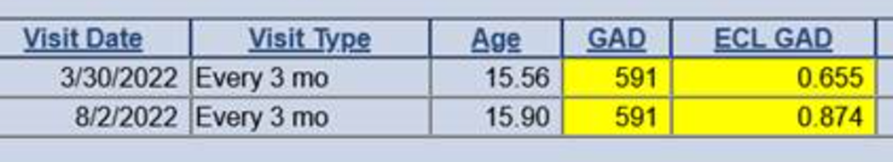
Visit Date | Age | GAD | IAA | ZnT8 | A1c
3/30/2022 | 15.56 | 591 | 0.01 | -0.002 | 5.7
8/2/2022 | 15.90 | 591 | 0.007 | -0.001 | 5.7

Slide 17
Case Review #2
Challenges
Location: Lives in Michigan: LDP lab
Study protocol:
11 year gap in participation
Underestimation of risk
Minimal connection to TEDDY Staff
“I've never met anybody from the TEDDY program”
No interest in TrialNet
Family:
Teenager
Sibling now AB+
Successes
Study protocol:
Ab testing before the 15 year visit
Family:
Involved parents
Sibling tested in ASK and AB+; referred to ASK the Experts
Notes:
11 year gap in study participation
Underestimation of risk (Mom and Child)
Minimal connection to TEDDY Staff
“I've never met anybody from the TEDDY program”
No interest in TrialNet

Slide 18



Autoimmunity Screening for Kids (ASK)
Education and Monitoring
Denver, Colorado
Sponsors:
Patten-Davis Foundation
Notes:
Hello everyone, thank you for your attention today. I am Kimberly Bautista the study coordinator for the ASK Education and Monitoring Follow-up study. I think it's important to point out, as you've already heard from Michelle and Tricia, that when we are asking people with complex lives to participate in our research, it’s not always easy to follow the ideal protocols we have developed. Oftentimes, this means we need to adjust our protocols to support families with monitoring activities that are achievable for them especially with a diverse population like we have in the ASK study. I’m going to review a couple cases from the ASK study who illustrate the importance of this approach.

Slide 19
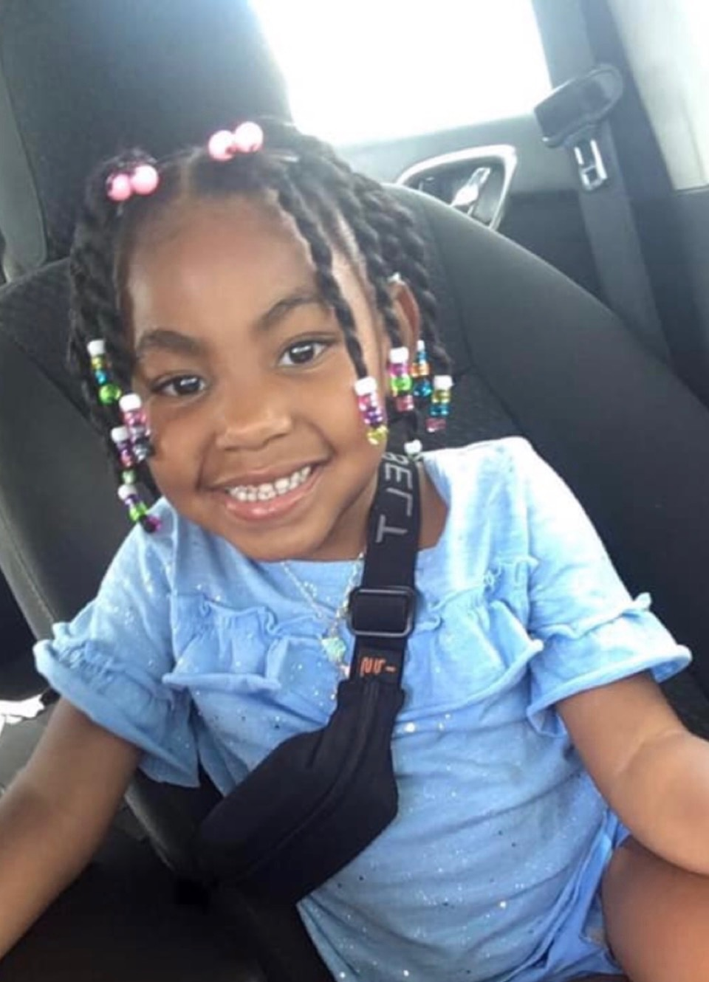
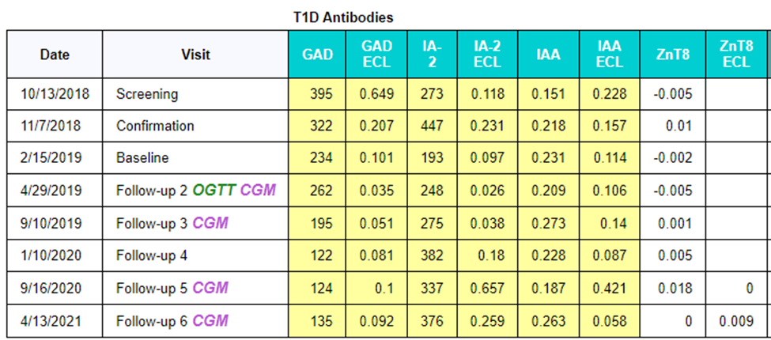
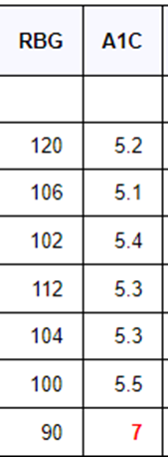

Case Review #1
GP, MAB+
Demographics
  African American, female, screened at DH East Side clinic
Screened at the age of 2y9m and DX at 6y3m
DX Info: 4/2021, HbA1c 7.0%, home BG 319, no sx, no DKA
Notes:
This child joined us at the young age of 2y9m in late 2018 and was diagnosed about 3.5yrs later with an A1c of 7.0, a BG of 319, no sx and no DKA. You can see from this table of clinic visits that the family was very engaged with the study, understood risk of developing T1D, including the risk of rapid progression to diagnosis. They understood the importance of monitoring with clinic visits every 3-6m to prevent complications at onset including participation in home glucose testing, OGTTs and CGM wears.

Slide 20
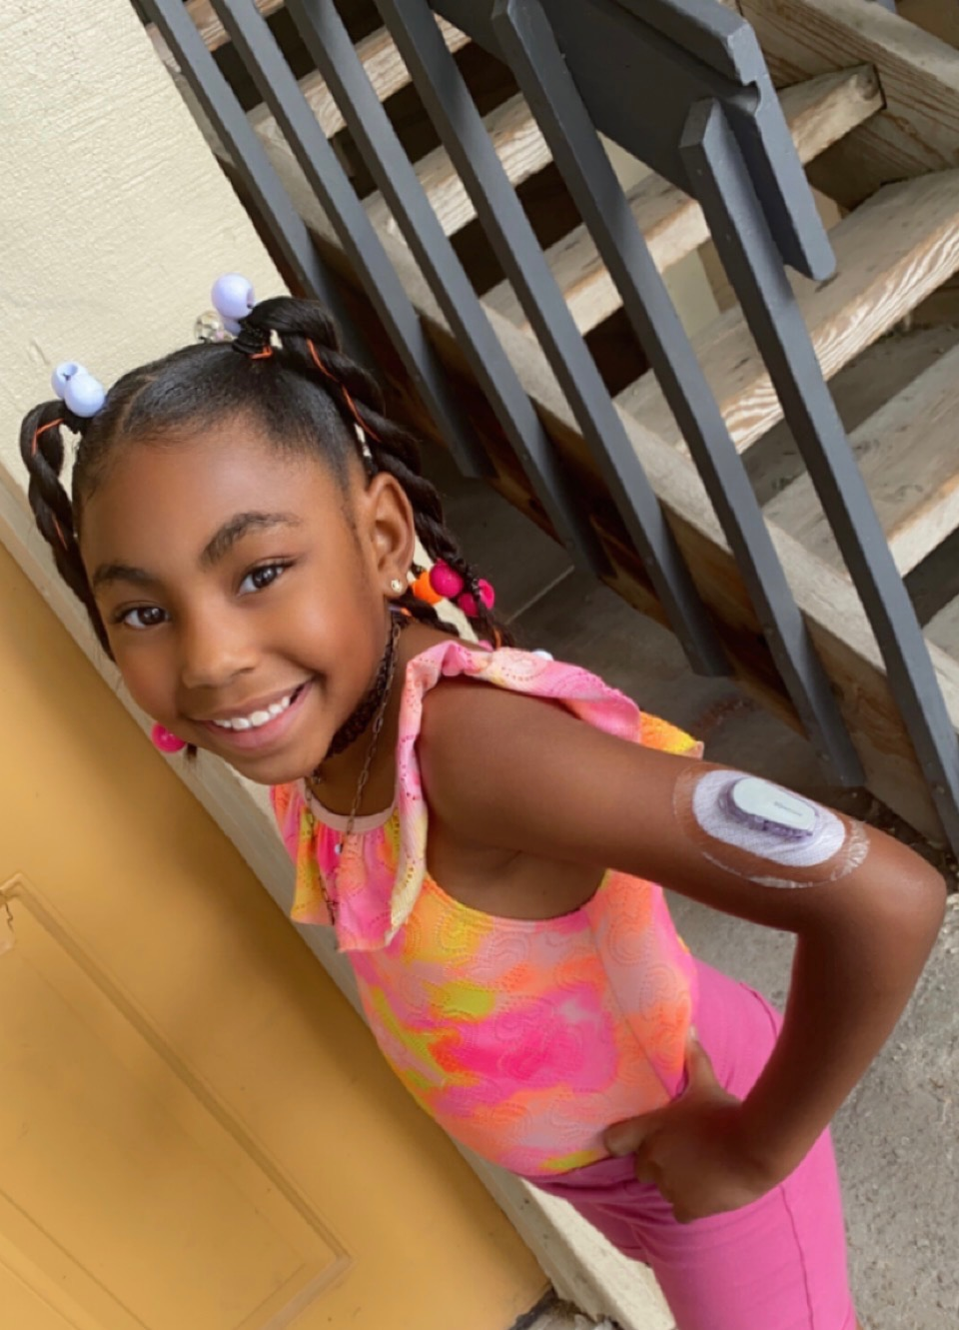
OGTT, CGM & A1c Results
Date | Protocol | Result | Fasting BG | 2h BG | Time >140 | Peaks ≥200 | Average glucose | A1c
Apr 2019 | OGTT clinic |  | 93 | Failed
May 2019 | CGM | Normal |  |  | 0.8% | no | 100 | 5.4%
Sept 2019 | OGTT home |  | Failed | Failed
Sept 2019 | CGM | Normal |  |  | 1.9% | no | 99 | 5.3%
Sept 2020 | CGM | Impaired |  |  | 14.1% | no | 120 | 5.5%
Apr 2021 | CGM placed, started insulin | Dx Stage 3 |  |  |  |  |  | 7.0%
#Refused future OGTTs
Notes:
However, despite the parents being supportive of all research activities the child had a lot of anxiety and fears regarding the blood draws. At the Apr/2019 visit we attempted a clinic OGTT but the child became very upset during the IV placement. This lead to a failed OGTT, the little girl vomited after glucola consumption. We had the family attempt a home OGTT about 5 months later but this failed as well because she experienced severe diarrhea after starting glucola consumption . On the other hand, CGM was well accepted and effective in detecting dysglycemia 7 months before overt hyperglycemia and diagnostic A1c of 7%. She wasn’t symptomatic at the time of dx.
Did they test/see abnormal BGs at home? She would test BGs periodically but not regularly. or was she just lucky to have ASK visit in April 2021 when we found his A1c of 7%? We were lucky that she started responding to contact attempts and came in for CV.
Was the BG of 102 in ASK clinic in Apr 2019 fasting? The 102 was by glucometer, the hemocue was 93 which is the number we report to the family.
Do we know his fasting BG before failed home OGTT? No, it wasn’t recorded by the MOC.
Slide #3 shows CGM in April 2021 – was it done? Results? The CGM was done but we couldn’t use the data b/c she started insulin.

Slide 21
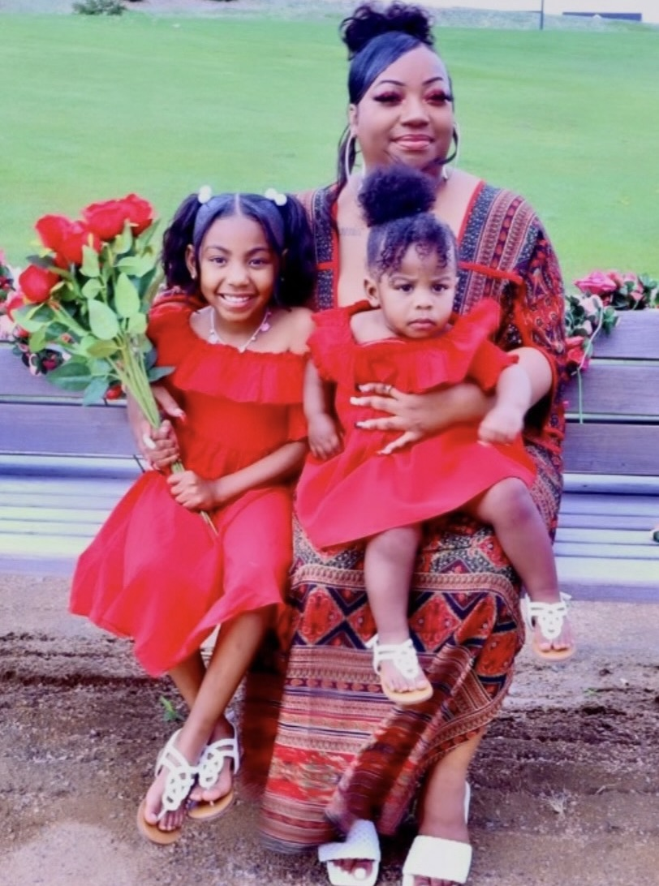
Challenges
Behavioral: Blood draw anxiety/needle phobia
COVID: Unresponsive
Life Change: New baby=non-adherence to HGT
Successes
Staff Support/Trust in Research: Persistence in contact attempts​, clinician consistency
Knowledge: Accurate risk perception​
Action: Response to contacts/timing​
Notes:
Challenges:
COVID: Periods of time unresponsive to contact attempts during COVID era
Life change: In between Sep/2020 visit w/impaired CGM MOC had a new baby Dec/2020 about 4 months prior to dx which led to challenges with HGT and responding to contact attempts
Successes:
Trust in Research/Health care: Developed trust in clinician which supported the MOCs belief regarding the importance of monitoring
Tools to Monitor: Received glucometer and home glucose teaching, completed OGTTs & CGMs
Knowledge: Received educational materials on T1D signs and symptoms so knew when to reach out
Action: Responded to contact attempts when it mattered most
Coordination of Care: Had given permission to enter note in Epic

Slide 22
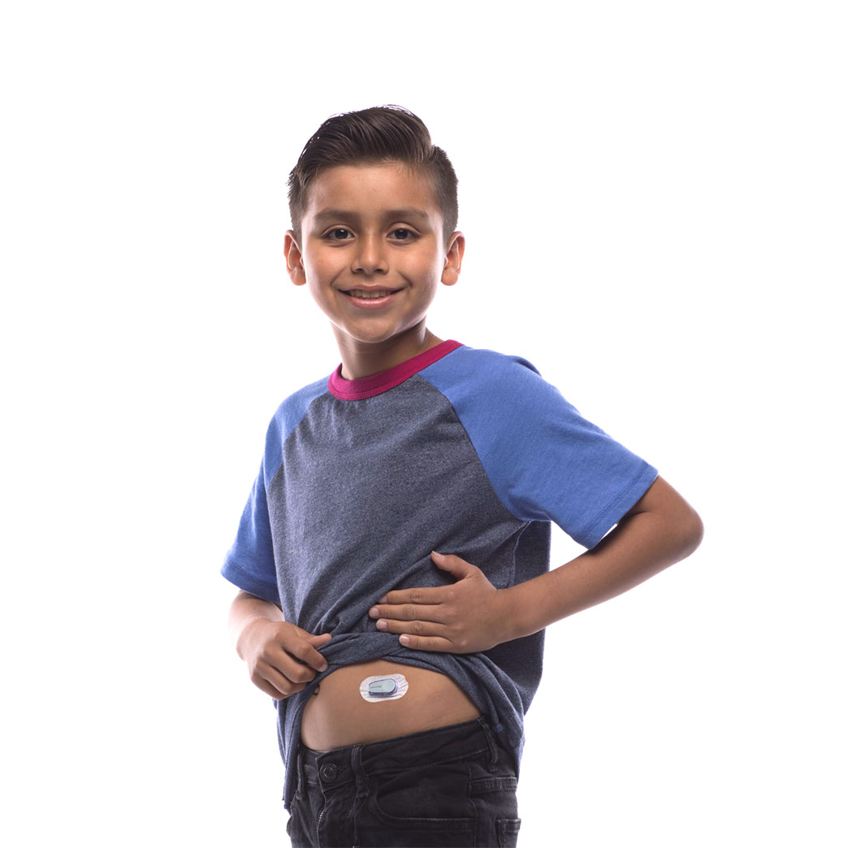
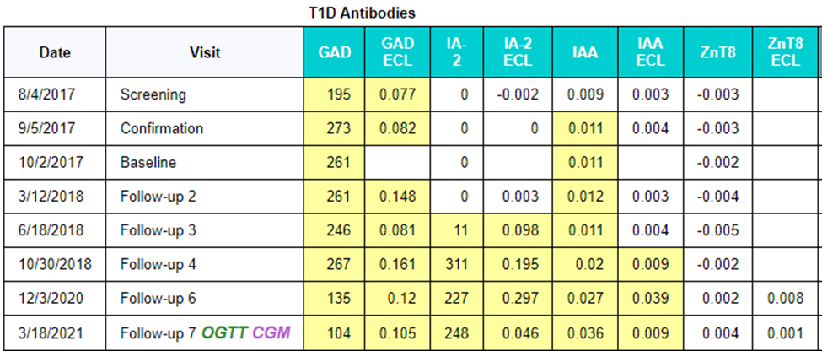
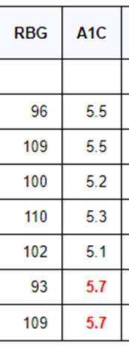

Case Review #2
GP, MAB+
Demographics
  Hispanic, male, screened at CHC South
Screened at the age of 8y10m and DX at 10y5m
DX Info: 4/2021, HbA1c 5.7%, home BGs 229 & 277, polyuria and polydipsia , no DKA, COVID at time of dx so dx completed via telemed
*Came in for a clinic visit Jan/2019, refused bd, but wore CGM
Notes:
This child joined our study at the age of 8y10m and was diagnosed about 2.5yrs later at 10y5m with an A1c of 5.7, BGs in the 200s, sx, no DKA. He had COVID at the time of dx so his visit was completed via telemed. You can see from his result table that the child was seeing us pretty regularly up until the October/2018 visit and then we didn't see him for one year due to some big life changes for the family. Not shown here, we did see him in Jan/2019 and the child agreed to wear a CGM if he could skip the blood draw. We weren't able to do OGTTs and CGMs for most of his participation due to extreme anxiety/fears regarding blood draws/needles.

Slide 23
OGTT, CGM & A1c Results
Date | Protocol | Result | Fasting BG | 2h BG | Time >140 | Peaks ≥200 | Average glucose | A1c
Jan 2019 | CGM | Normal |  |  | 10% | No | 116 | BD skipped, no A1c
March 2021 | OGTT | Impaired | 106 | 152 |  |  |  | 5.7
March 2021 | CGM | Impaired |  |  | 33.9% | Yes | 137 | 5.7
Notes:
After the 1-year break in active participation when we saw him in December/2020 his phobias had improved and he was now under guardianship of his maternal gma. He did a great job with his blood draw. The child and his grandma were re-taught the home glucose testing protocol and were very receptive to the importance of consistent testing. At the following visit in March/2021 his A1c was elevated so they agreed to OGTT and CGM which revealed dysglycemia and further encouraged regular blood glucose testing which is what eventually led to detecting stage 3 diagnosis with BGs in the 200s.

Slide 24
Challenges
Behavioral: Blood draw anxiety/needle phobia
Family Dynamics: Parental substance abuse and domestic violence
Life Change: Parent incarcerated
Successes
Staff Support: Persistence in contact attempts​/Clinician Consistency
Family: Mat GMA became guardian
Tools to Monitor: Home glucose teaching
Knowledge: Accurate risk perception
Action: HGT adherence
Notes:
Challenges:
Behavioral: Child had extreme anxiety which made blood draws, home glucose testing and OGTTs very difficult
Family Dynamics: Parents were both substance abusers and FOC was physically abusing child
Life Change: MOC became incarcerated so didn’t see participant for 2 years.
Successes:
Staff Support: Persistence in contacting guardians to communicate importance of monitoring. Eventually contacted new guardian, mat GMA
Trust in Research/Health Care: Guardian developed trust in clinician which supported the belief in the importance of monitoring
Tools to Monitor: Received glucometer and home glucose teaching and mat GMA was compliant with testing
Knowledge: Received T1D educational materials on signs and symptoms so knew when to reach out
Action: Responded to contact attempts when it mattered most and tested BGs regularly including during illness w/COVID
Coordination of Care: Had given permission to enter note in Epic

Slide 25
Lessons Learned
Each study has informed the next
Guided development of large-scale screening and monitoring efforts
Important to keep reaching out using various methods
Meet families where they are, to discover what monitoring activities are most feasible for them.
Even when we think families aren’t “hearing” us, they are...
Staff trained and experienced in early T1D monitoring
Notes:
Important to keep reaching out using various methods, phone, text, email etc.
Meet families where they are at and discover what monitoring activities are feasible for them
Even when we think families aren’t “hearing” us, they are..
Review symptoms and importance of glucose testing on a regular basis because this is what will be important for the family to remember when they need to take action to keep their child safe. All in an effort to reach the goal of no DKA at onset.

