Slide 1


T1D screening studies in Finland: BABYSCREEN and DIPP
Riitta Veijola
Professor of Pediatrics
University of Oulu and Oulu University Hospital
Oulu, FINLAND
Barbara Davis Center for Diabetes
November 11, 2022

Slide 2
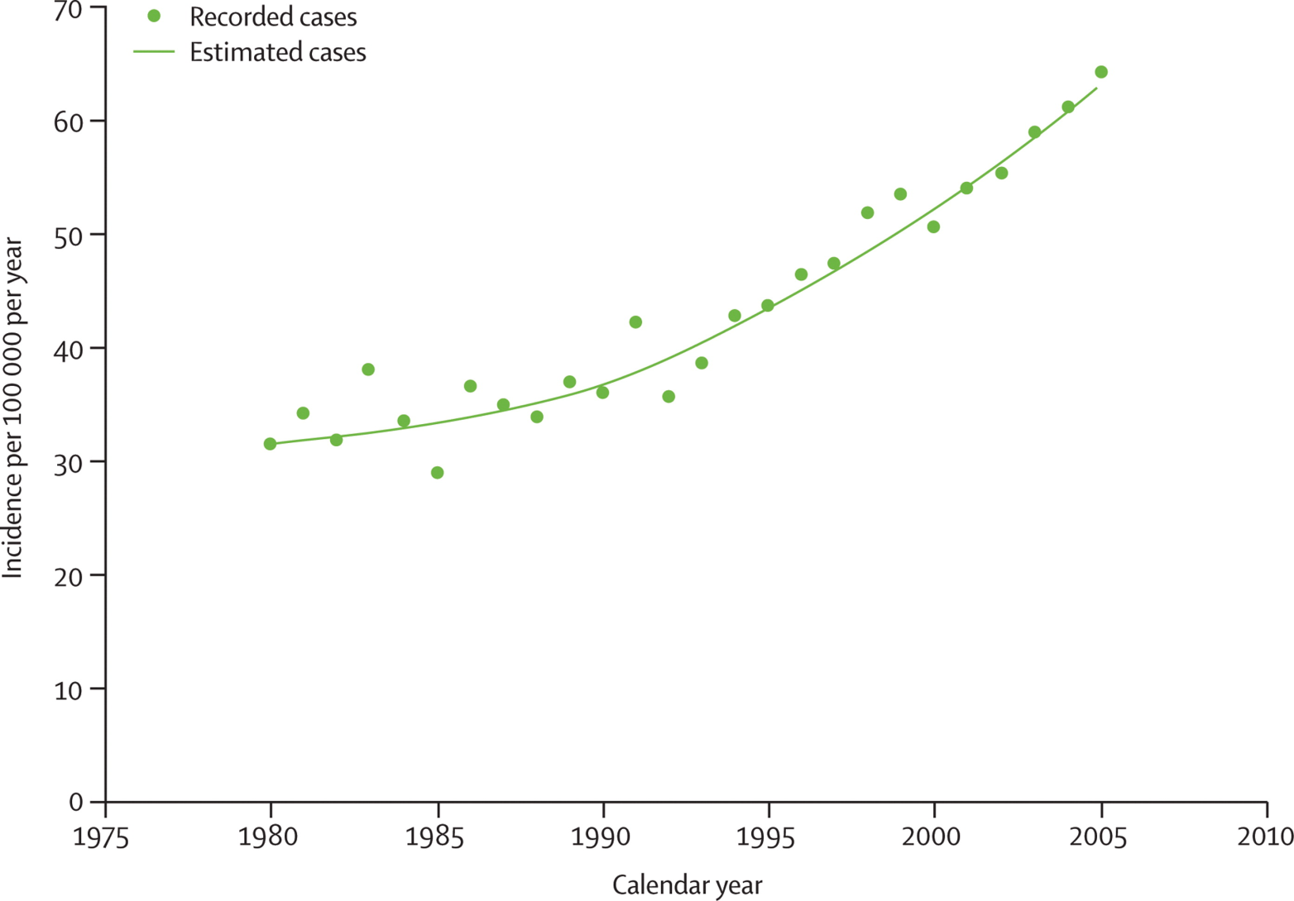
Incidence of type 1 diabetes in Finland 1980-2005
10 737 new cases (children <15 yrs) over a period of 26 years
64.2/100 000/yr
31.4/100 000/yr
0.9% of 15-year-old children have T1D in Finland !
Harjutsalo et al. 2008

Slide 3
BABYSCREEN - AIMS
SCREENING PHASE
- to identify at birth children with genetic susceptibility to type 1 diabetes
(T1D) and/or celiac disease (CD)
FOLLOW-UP PHASE
- to identify children who develop T1D and/or CD-associated autoantibodies
- to diagnose T1D and/or CD early
- to decrease diabetic ketoacidosis in T1D at disease manifestation and other
health problems associated with these diseases
Courtesy by Mikael Knip
Notes:
This slide must be visually presented to the audience AND verbalized by the speaker.

Slide 4
BABYSCREEN - APPROACH
TARGET POPULATION: children born in Helsinki University Hospital (≈13,000/year)
SCREENING PERIOD: Dec 2018 – Jun 2021 (31 months)
  Cord blood HLA class II genotype
  9,807 newborns screened
25% eligible for follow-up (susceptibility for T1D, CD or both)
DISEASE-ASSOCIATED AUTOIMMUNITY at age 12, 24 and 36 months
  T1D: IAA, truncated GADA (tGADA), IA-2A, ZnT8A. If positive for multiple (≥2) autoantibodies: OGTT, if a diabetic OGTT is confirmed (=T1D), referral to a pediatric endocrine unit
  CD: tissue transglutaminase antibodies (tTGA). If tTGA positive, endomysium antibodies (EMA) also analyzed. If both tTGA and EMA positive, referral to pediatric gastroenterology unit
Courtesy by Mikael Knip
Notes:
This slide must be visually presented to the audience AND verbalized by the speaker.

Slide 5
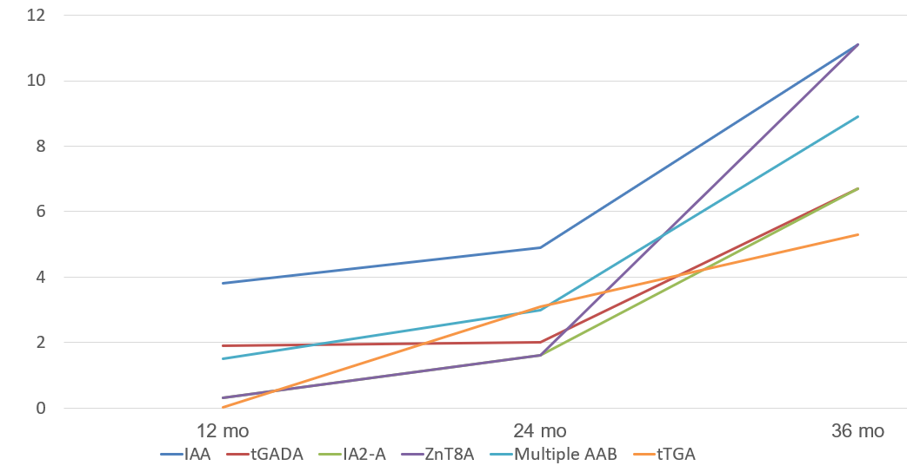
BABYSCREEN – IAb and tTGA at 12, 24, and 36 mo
Courtesy by Mikael Knip

Slide 6
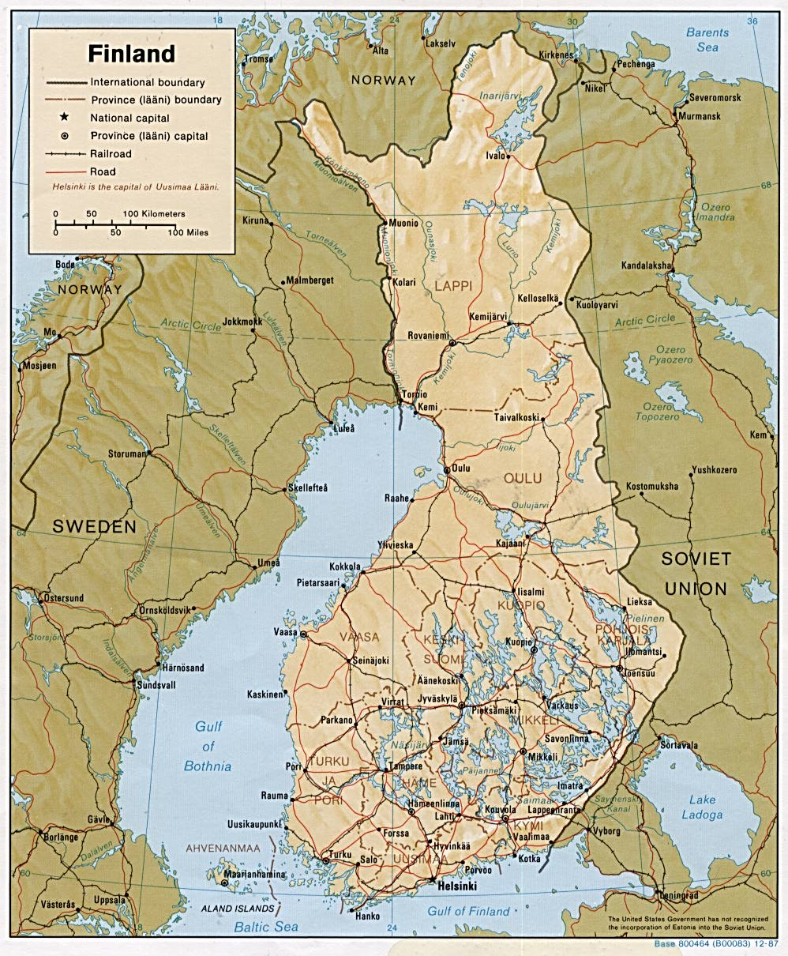
The Finnish Type 1 Diabetes Prediction and Prevention (DIPP) Study
1994-2022
  Ongoing newborn recruitment
  Ongoing follow-up
Three Clinical Study Centers
  Oulu, Turku and Tampere
  Delivery hospital
    Cord blood sample collection
    Consent for genetic screening
  DIPP study center
    Genetic screening result communication
    Consent for regular follow-up up to age 15
      Clinical data collection
      Islet autoantibody monitoring
Screening from cord blood
  HLA-DRB1-DQB1 genotyping
NORWAY
OULU
SWEDEN
RUSSIA
TAMPERE
TURKU

Slide 7
Postnatal follow-up – DIPP Novum
9.4% of all newborns eligible according to the current HLA criteria
~70% of eligible children participate in follow-up
16 postnatal visits in the basic protocol since 2019
  3, 6, 9, 12, 15, 18, 21, 24, 30 and 36 months
  4, 5, 6, 9, 12 and 15 years
islet autoantibodies measured at each visit
  IAA, GADA, IA-2A and ZnT8A
  if positive, visits scheduled every 3 months
  if positive, p-gluc, HbA1c, OGTT, IVGTT performed
serum stored at each visit
PBMC and plasma collected
CGM from the age of 2 years

Slide 8
Status of the DIPP Study Aug 17, 2022
DIPP newborn screening for class II HLA genotype since 1994
>250,000
Screening ongoing
~8000/yr
Data and samples 1994-2022:
24,662 unique subjects
20,640 A-children, followed from birth
4,022 B-children, siblings
~10 samples per child
~ 700 eligible/yr
HLA eligible (9.4%)
Invited for follow-up
~ 500 new children
starting follow-up/yr
Current DIPP follow-up cohort
n~6000 children
Confirmed positivity for ≥ 1 islet autoantibodies n=1473
Confirmed positivity for ≥ 2 islet autoantibodies n=870
Progressed to T1D n=682

Slide 9
Islet autoantibodies in the DIPP participants: IAA, GADA, IA-2A, ZnT8A
Positivity for ≥1 islet autoantibody
  A+B children included
  maternally transferred antibodies excluded
  n=2103, if no confirmation required
  n=1473, if confirmed in the next consecutive visit within 2-14 months
Confirmed positivity
  by age 1 year: n=151
  by age 2 years: n=487
  by age 5 years: n=991
  by age 10 years: n=1340

Slide 10
New IAb+ and T1D cases in DIPP
New IAb+
in A children
Newly diagnosed T1D in A children

Slide 11
  DIPP Study: Islet autoimmunity starts very early
  7165 children with HLA risk genotype.
  Median follow-up time was 7.7 years from birth (IQR 7.7-7.9).
  Seroconversion peaked at the age of 1 year.
  Young age (<2yr) at seroconversion was associated with development of multiple autoantibodies and rapid progression to diabetes.
A
n=1320
any islet autoantibody positive
B
n=184
all children who developed T1D
Parikka et al. Diabetologia 2012

Slide 12
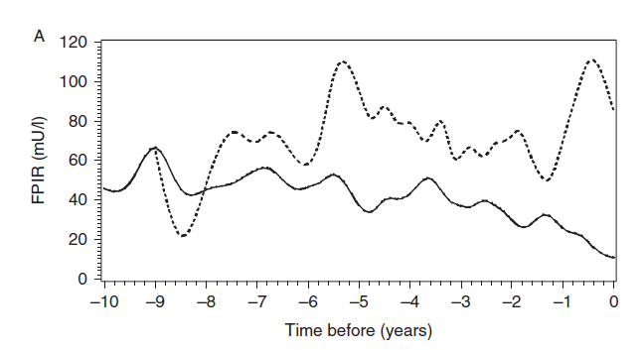
Decline in first phase insulin response during progression to T1D in DIPP children
ICA only (dotted) vs. multiple autoantibodies
DIPP Study
Koskinen et al. European Journal of Endocrinology 2016

Slide 13
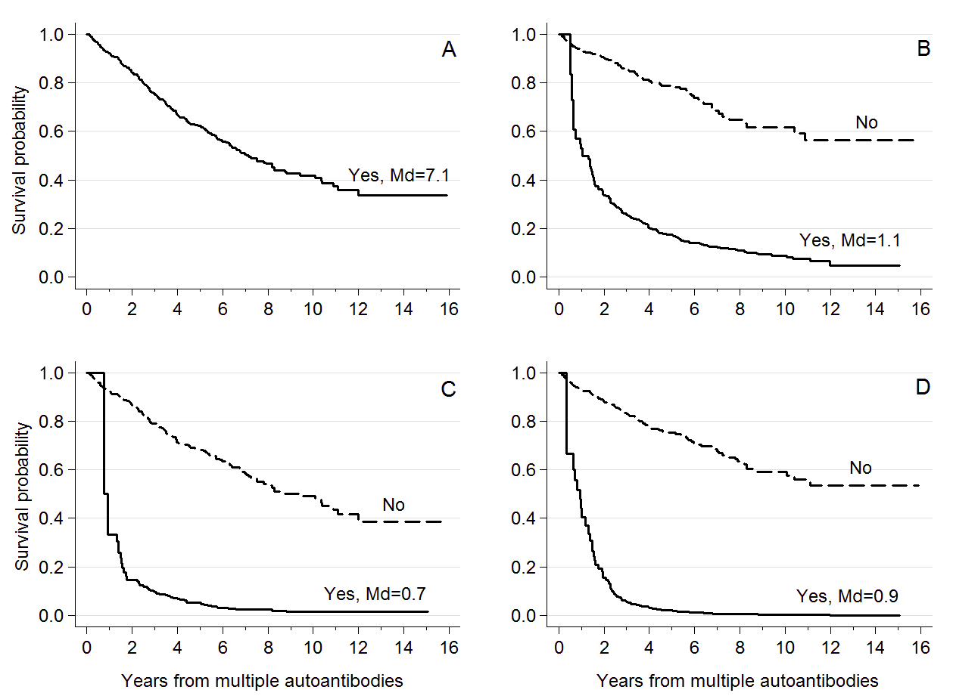
HbA1c Predicts Time to Diagnosis of Type 1 Diabetes in Children at Risk
Multiple autoantibodies
10% rise in HbA1c
10% rise in HbA1c + additional rise
HbA1c ≥5.9% twice
Helminen et al. Diabetes 2015

Slide 14
Participation in the DIPP Study decreases the frequency of DKA at diagnosis
517 children diagnosed with T1D in Oulu University Hospital in 1997-2014:
 | No HLA screening N=229 | No increased HLA risk N=81 | Increased HLA risk, no follow-up N=48 | Increased HLA risk, follow-up N=159 | p value
DKA pH<7.30 % (95% CI) | 22.7 (17.2-28.2) | 26.3 (16.7-35.9) | 23.4 (11.3-35.5) | 5.0 (1.6-8.4) | <0.001
Severe DKA pH<7.10 % (95% CI) | 4.4 (1.7-7.1) | 6.3 (1.0-11.6) | 4.3 (0-10.1) | 0.6 (0-1.8) | 0.098
Hekkala et al. Pediatric Diabetes 2018

Slide 15






Acknowledgements
Children and families participating in the DIPP Study
DIPP staff in the clinical study centers and laboratories
DIPP Steering Committee and DIPP Investigators
Funding
Academy of Finland
JDRF, USA
Helmsley Charitable Trust, USA
University Hospital Funds in Oulu, Turku, and Tampere
Foundation for Pediatric Research, Finland
Alma och KA Snellman Foundation, Finland
The Diabetes Research Foundation, Finland

Slide 16
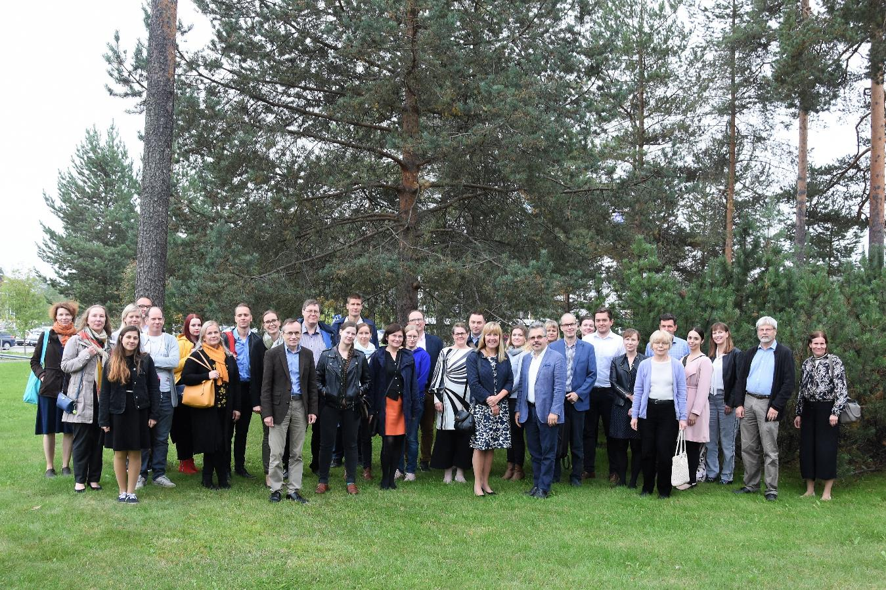
DIPP Steering Committee & Collaborators 2019

Slide 17
Data until 17.8.2022. A+B subjects included Maternally transferred autoantibodies excluded Category by confirmed autoantibody result | Max combination at seroconversion, confirmed Each subject in only one category Number of subjects | Max combination during follow-up, not confirmed. Positivities can be at different visits Each subject in only one category Number of subjects
IAA only | 443 | 451
GADA only | 509 | 443
IA2A only | 79 | 75
ZnT8A only | 51 | 54
IAA+GADA | 150 | 128
IAA+IA2A | 24 | 59
IAA+ZnT8A | 17 | 24
GADA+IA2A | 60 | 73
GADA+ZnT8A | 14 | 38
IA2A+ZnT8A | 6 | 10
IAA+GADA+IA2A | 52 | 207
IAA+GADA+ZnT8A | 14 | 39
IAA+IA2A+ZnT8A | 12 | 41
GADA+IA2A+ZnT8A | 26 | 80
IAA+GADA+IA2A+ZnT8A | 16 | 381
Altogether | 1473 | 2103

