Slide 1

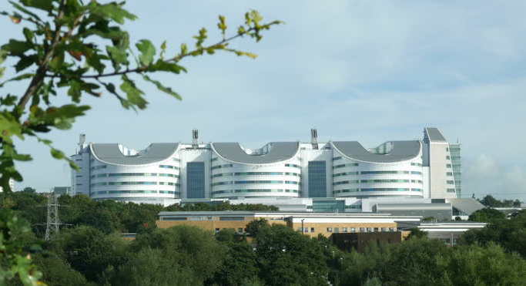
Screening for type 1 diabetes
The ELSA study
Parth Narendran
Professor of Diabetes Medicine
University of Birmingham
The Queen Elizabeth Hospital Birmingham

Slide 2
Issues in establishing an early surveillance programme for T1D in the UK
FDR General Population
TrialNet
INNODIA ?
ADDRESS 2

Slide 3



EarLy Surveillance for Autoimmune Diabetes
ELSA 1
ELSA
General population
Age 3-13
Families n=30
Stakeholders n=20-30
Focus groups schools n=10-20
September 2021 – December 2022
Children n=20,000
Aged 3-13 years
March 2022 – February 2025
Acceptability Acceptability and feasibility
Notes:
ELSA – Early Surveillance for autoimmune diabetes. Emerging themes from qual work- can discuss in q and a. Major push for WDD. Benefits of early detection and access to prevention trials.

Slide 4
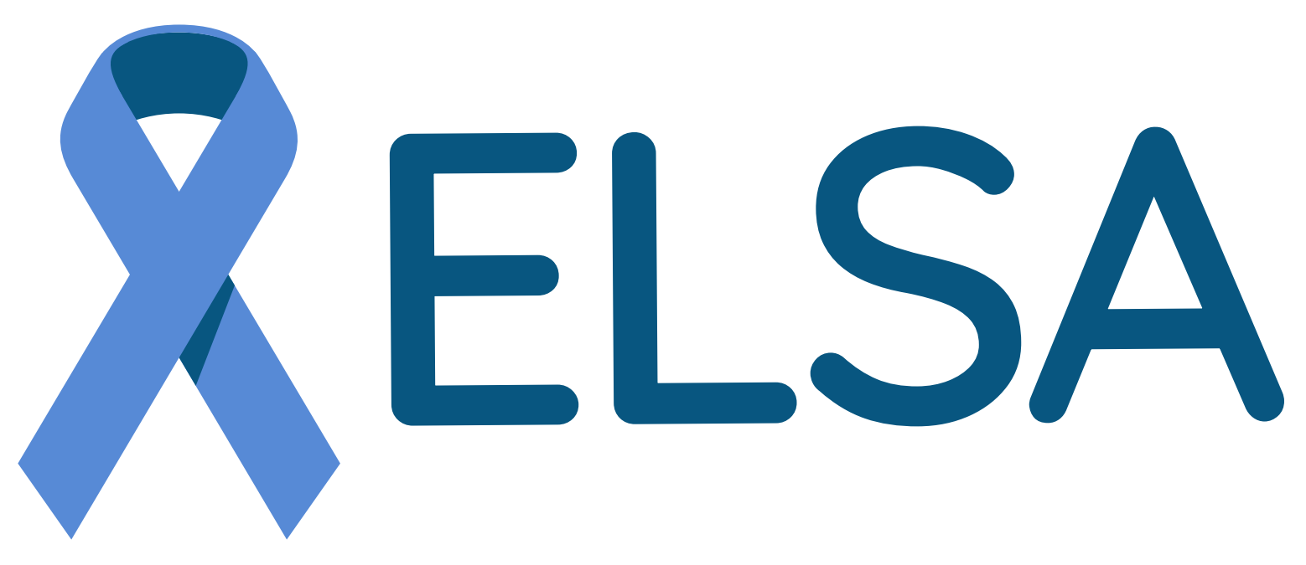


Research objectives
Understand the perceptions and acceptability of families in the UK to be involved in a surveillance programme for early T1D, to establish how they would want to be informed and participate, and how any barriers to recruitment and participation can be addressed.
Determine the best approach to recruitment through examining the feasibility of a variety of approaches.
Understand the views of health care professionals, school staff and other stakeholders involved in the testing programme.

Slide 5
General practices
‘Piggy backing’
e.g. vaccine programme
Home testing
Community hubs
Schools
Community Nurses

Slide 6
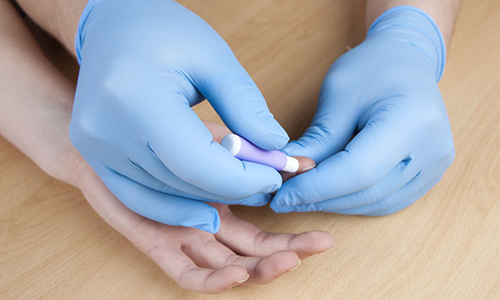

Dried blood spot card collection

Slide 7
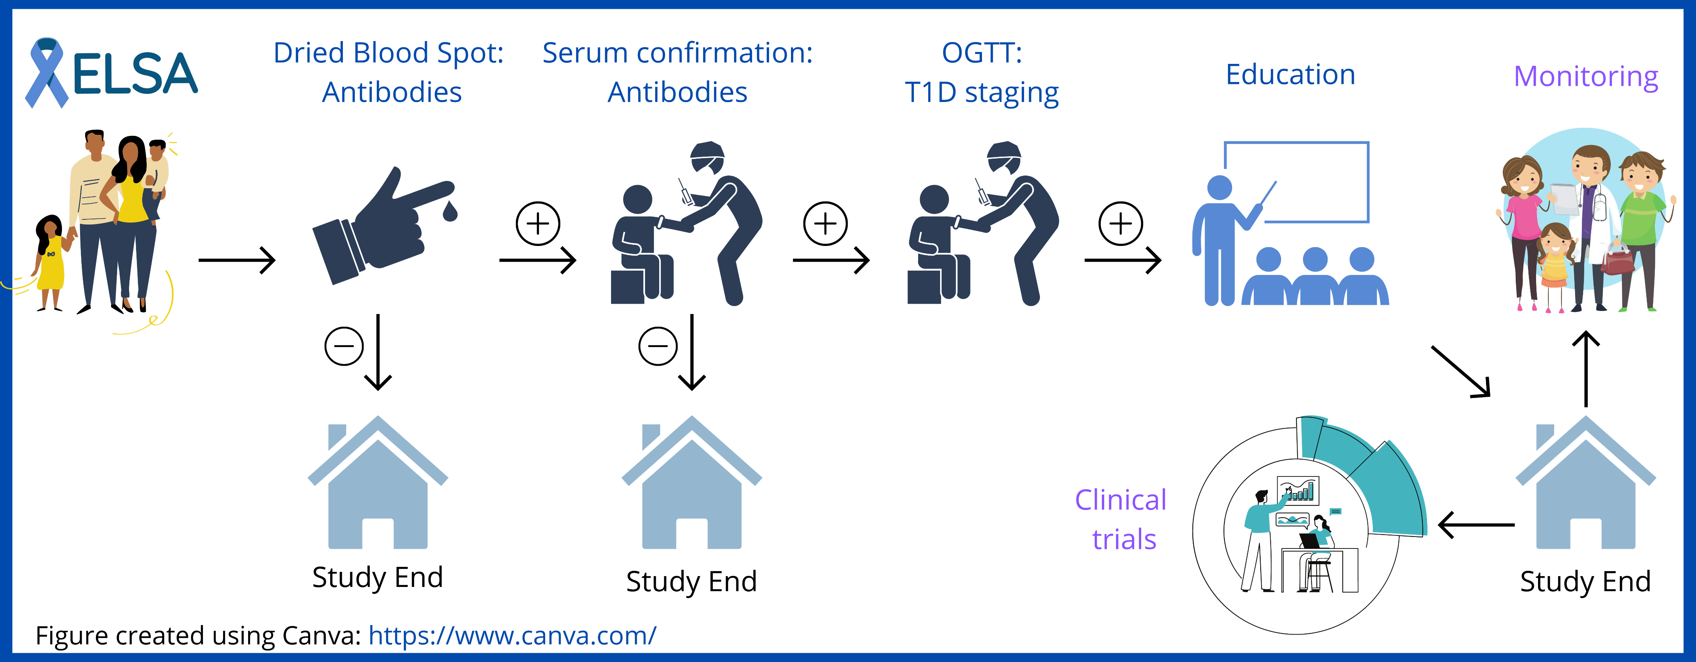
Antibody testing: IAA, IA-2A, GAD, ZnT8

Slide 8
The ELSA Study
ELSA screening programme
1Ab
positive
≥2 Ab
Positive
Negative
Stage 1
Stage 2
Stage 3
Clinical service
Education
Further research
Qualitative
Future studies
INNODIA
INNODIA
Natural History studies
Future trials
Prevention trials
T1D Consortia
Notes:
FU important because majority screened positive will not be stage 3 – and will need fu to support a transition into diagnosis
Large and growing pool of people at risk who can be offered prevention studies – the 54 we are going to identify in ELSA is not ging to power any meaningful study
Data sharing to ensure we have outcomes
For those not wanting the FU in INNODIA (6monthly OGTT difficult for some families) – oxford team are offering a light touch less entensive FU which may be more appealing

Slide 9
30 Families who did not wish to participate in T1D risk testing
Families who participated in T1D risk testing
10 Stakeholder professionals
30 Families with antibody negative children
30 Families with antibody positive children
Qualitative research
Qualitative research
Qualitative research
Qualitative research
Analysis
Analysis
Analysis
Analysis
Co-production workshop 1
Co-production
workshop 1
Co-production
workshop 1
Co-production workshop 1
Fresh set of families of children age 3-13
Co-production workshop 2
Fresh stakeholders
Co-production workshop 2
Fresh set of families of children age 3-13
Co-production workshop 3
Fresh stakeholders
Co-production workshop 3
FINAL ANALYSIS

Slide 10

Expected numbers
Recruitment: July 2022 – February 2025
ELSA Study process | Expected Numbers
DBS screened | 20,000
DBS positive | 200-300
Serum positive - 1Ab positive | 80 (0.4%)
Serum positive - ≥2Ab positive | 60 (0.3%)
OGTT stage 1-2 | 54
OGTT stage 3 | 6
Notes:
Sites that have come on board-map.

Slide 11

Timeline
2023 – Extension to regional community sites
14th November 2022 - national roll-out of ONLINE RECRUITMENT
- supporting school and GP recruitment
September 2022 - Social media in the West Midlands
- Onboarding paediatric CRFs
August 2022 – Beta version (n=18)
28th July 2022 - ELSA launched with the Commonwealth games
Dec 2021-Dec 2022 ELSA 1 – qualitative work
Notes:
Gantt – timeline - WDD, expanding to community sites

Slide 12
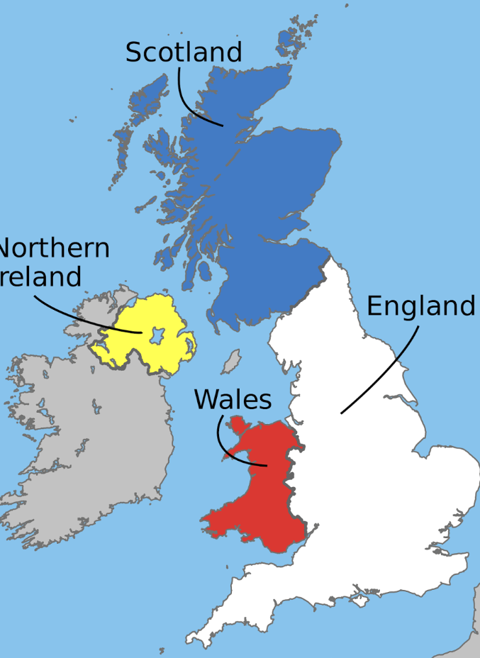

National launch – World Diabetes Day
14th November 2022

Slide 13

Beyond 14th November 2022
https://www.nativve.com/

Slide 14



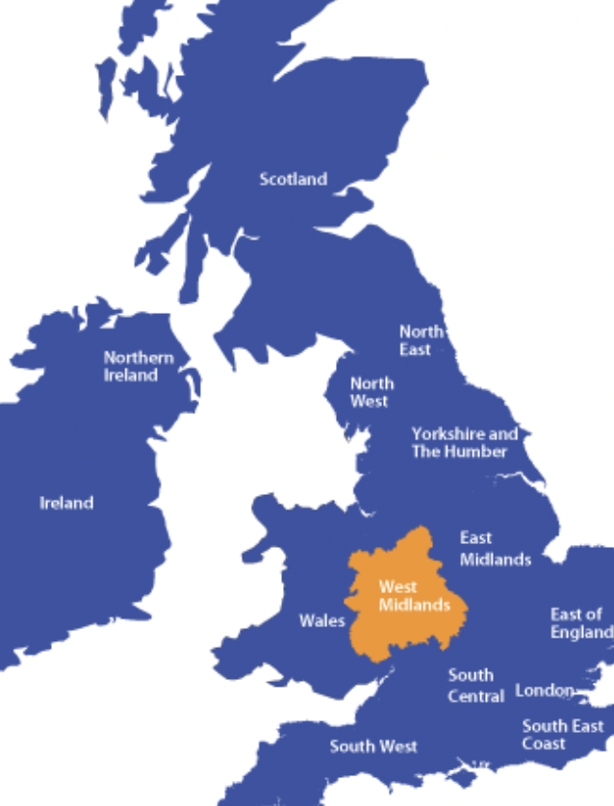
17th November 2022

Slide 15

Nov – Dec 2022: Childhood Immunisation clinics

Slide 16

Community Connexions - BCHC
Community Listening events – underserved groups
ELSA team attended the event for Syrian refugees to speak about the ELSA Study
Qualitative work with families undertaken to explore thoughts on screening
The Community Connexions will be engaging with the Afghani, Pakistani, Pushto and Romanian communities at a school next week, where ELSA team would again get an opportunity to give a talk around the study and make people aware of its importance.

Slide 17
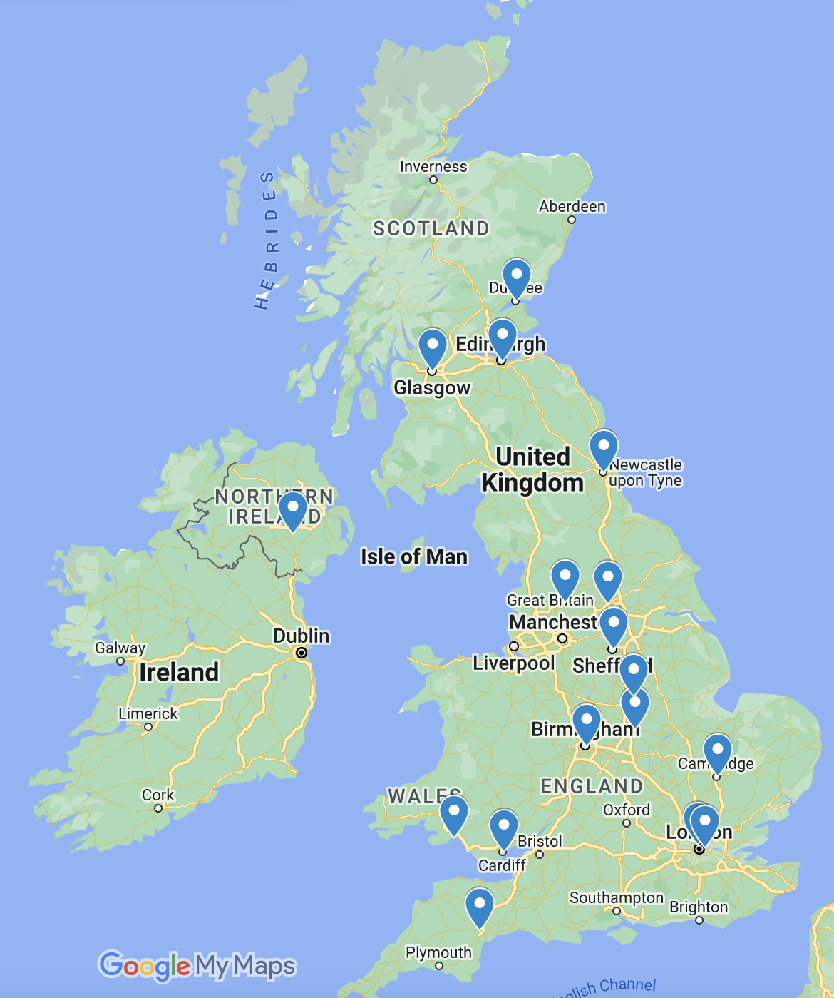
ELSA
Paediatric
Clinical
Research
Facilities
Confirmatory venous
OGTT
INNODIA

Slide 18
Summary
Preventative therapies and screening programmes are emerging for T1D
Need to understand acceptability and feasibility of screening in the UK
The ELSA study incorporates qualitative and co-production work, with a UK testing and monitoring programme for T1D, to understand and address the barriers to screening and explore the most effective routes to recruitment

Slide 19
ELSA Study Team
University of Warwick:
Joanna Garstang Community paediatrician
Felicity Boardman Professor in medicine ethics and society
Matthew Randell Masters candidate
University of Cardiff:
Colin Dayan Professor of Diabetes
University of Bristol:
Kathleen Gillespie Professor of Diabetes
Birmingham Community Healthcare
Christine Burt
Fatima Zakia
Urfan Siddiqi
Richard Mendelsohn, Chief Medical Officer
Research First:
Gail Heritage, Hollie Wagg, Naomi Campton, Joe Humphries, Nadege Haouidji-Javaux, Andy Knight, Linda Gardner, Alex Balckwell, Shula Murphy
PPI Co-applicants
Christine Gardner
Clair McGarr
Amanda Lepley
Morph and Nativve
All the parents and families who have contributed to this study
University of Birmingham:
Parth Narendran Professor of diabetes medicine
Tim Barrett Professor of Paediatrics
Sheila Greenfield Professor of Qualitative Research
Alex Richter Professor of clinical immunology
Ian Litchfield Qualitative Research Fellow
Lauren Quinn Doctoral fellow
CIS:
Tim Plant CIS Laboratory Manager
Sian Faustini Research fellow
Frank (Hin Fai) Research technician
Madeeha Hoque Research technician
NIHR/CRN
David Shukla GP and Clinical Research Specialty Lead
Trevor Allen Research Delivery Manager, Diabetes
Emma Goodwin Early Contact Research Support Officer
Jessica Graysmark CRN
Pam Devall Research delivery manager primary care
Julie Timmins Senior Research Nurse
Elizabeth Hinks Research facilitator
Carly Tibbins PPI Engagement Officer
Ella Thompson Practice Manager
Paediatricians:
Renuka Dias Consultant Paediatrician, BCH
Rajeeb Rashid Consultant Paediatrician, Glasgow
Notes:
Need to add:

Slide 20



Online: elsadiabetes.nhs.uk
Email: elsa@contacts.bham.ac.uk
Twitter: @elsadiabetes
Thank you for listening
Any questions?

Slide 21
ELSA Beta version
July – October 2022
Population: Families recruited by invitation
Location: West Midlands
Intervention: Home testing
 | Recruitment
EOI (n) | 58 families
Consented (n) | 33 children (1-3)
DBS Negative (n) | 18
DBS positive (n) | 1

