Slide 1
5th Childhood Diabetes Prevention Symposium
General Population Screening for T1D
Reports from Ongoing Screening Programs
PrIMeD (Precision Individualized Medicine for Diabetes)
Stephen S Rich, PhD, FAHA
University of Virginia
November 11, 2022

Slide 2
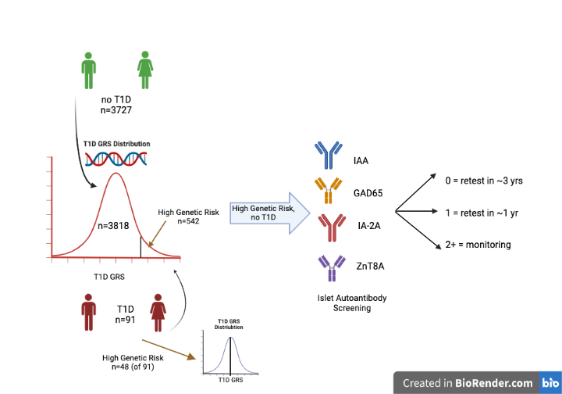
PrIMeD Study Design, Concept and Initial Results

Slide 3
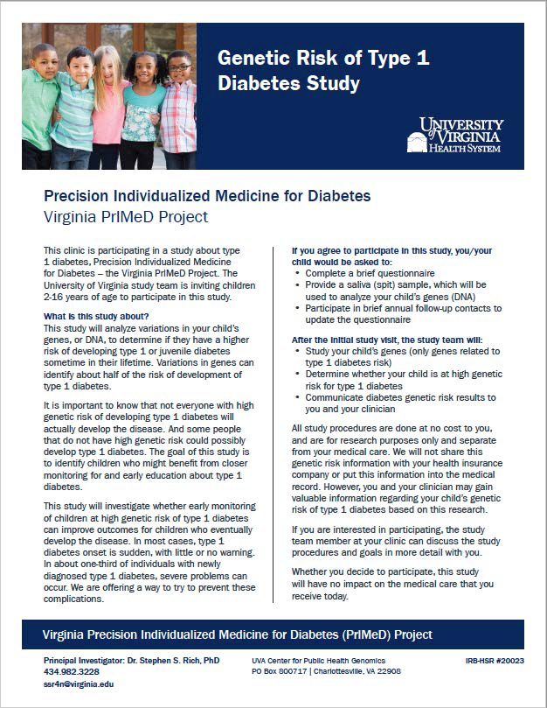
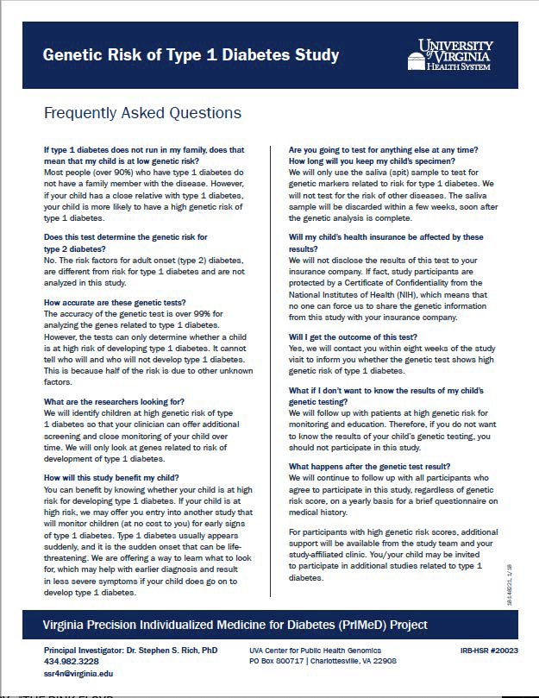

Slide 4
Frequency of PrIMeD Participants by T1D GRS
Not High (n=3276, 85.8%) High (n=542, 14.2%)

Slide 5
T1D GRS by Age at Ascertainment
High = red; Low = blue

Slide 6
HLA and non-HLA contribution to T1D GRS
(restricted to the 542 with “high” T1D GRS)

Slide 7
T1D GRS association with Age at Onset (n=91)
(HLA only, Panel A; non-HLA, Panel B)

Slide 8
Summary and Conclusions
Implementation of a T1D community screening for genetic risk at multiple sites
Cost prohibitive (CRCs in pediatric waiting rooms)
Collection of consent, medical history, saliva (DNA) also could be home-based
Screening for islet autoantibodies not successful (5.7% of those eligible)
  COVID-19, restriction from hospital setting, exposures, travel
  Post-COVID-19, issues related to blood collection at hospital/clinical laboratory
Follow-up of participants difficult (55% completed) due to movement, incorrect information), with wo participants (0.095%) developed T1D during follow-up
How to follow participants who move out of health care coverage?
DNA processing, testing inexpensive; islet autoantibody testing made home-based, cost-effective?
Education and communication key components for early detection

