Slide 1
T1Detect: Update and Briefing
Esther Latres, Ph.D. VP, Research
Anastasia Albanese-O’Neill, Ph.D., APRN, CDCES, Director, Community Screening and Clinical Trial Education
Campbell Hutton, MPH, Vice President, Advocacy

Slide 2
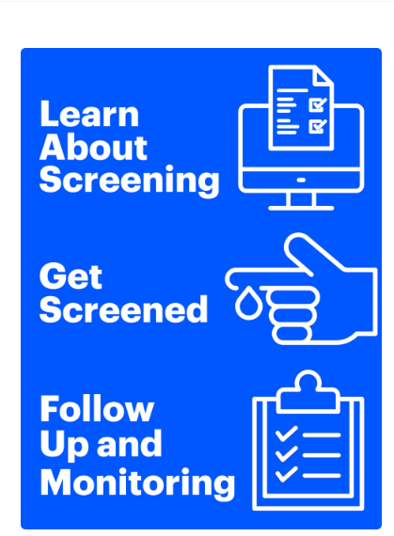
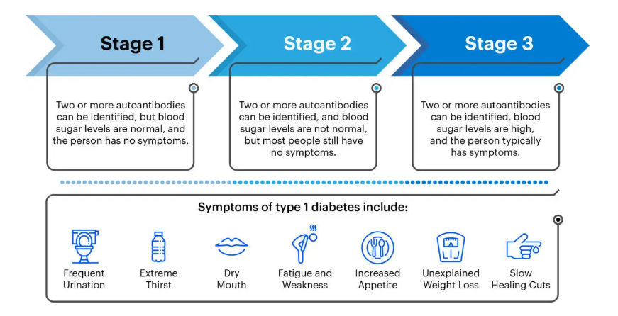
What is T1Detect?
An Education and Awareness Program on T1D Risk Screening and Monitoring

Slide 3
- Reduce incidence of diabetic ketoacidosis (DKA) at- diagnosis
- Identify individuals for T1D prevention or disease modifying therapy clinical trials
- Provide monitoring support and education
T1Detect Guiding Principles

Slide 4


JDRF’s Screening Strategy
T1Detect
Research
Outreach & Education
Health Policy
Building Evidence for the Feasibility and Acceptability of Screening and Monitoring in the Clinical Setting
Emphasize on monitoring, awareness and education
Affordable access to T1D Screening, monitoring and Cure Therapies

Slide 5




JDRF Research Priorities
JDRF has funded over $82M since 2012​ in screening portfolio- With an additional $205M in leverage​
Global Universal Screening
Disease Modifying Therapies
Cell Therapies
Improving Lives
Training of
Researchers and Clinicians

Slide 6
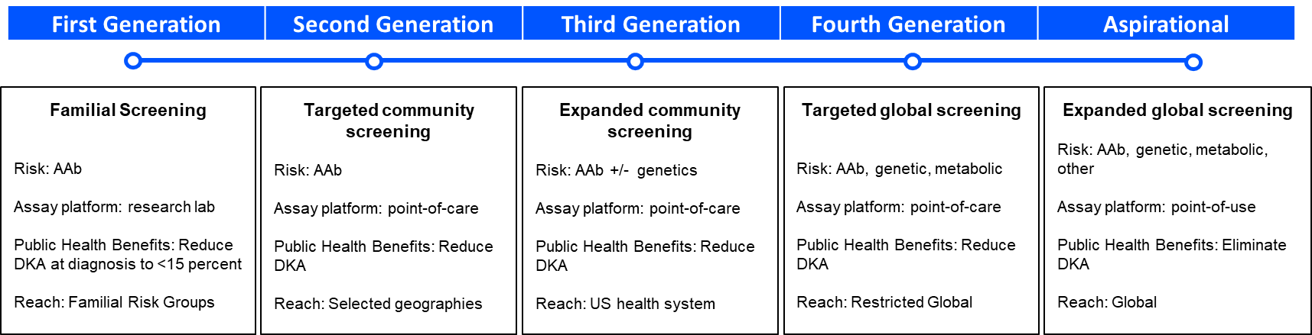
How do we get there?
JDRF’s Screening Roadmap
TrialNet
TEDDY
INNODIA
ASK
DIPP
Fr1DA
Fri1DA-olin
INNODIA (EU, UK)
ELSA (UK)
ADIR (Israel)
GPS (Australia)
T1D1/IBM
TrialNet
(Enable Biosciences)
Psychological
RTI

Slide 7

JDRF Research Goal: Universal Population Screening
Short-term Goal Expanding Familial Screening
~1.4 million Americans live with T1D
~20,000 people are screened for T1D autoantibodies annually via the research pathway
~250,000 individuals have been screened in the research setting
~5 million first degree relatives of individuals with T1D in the U.S.

Slide 8

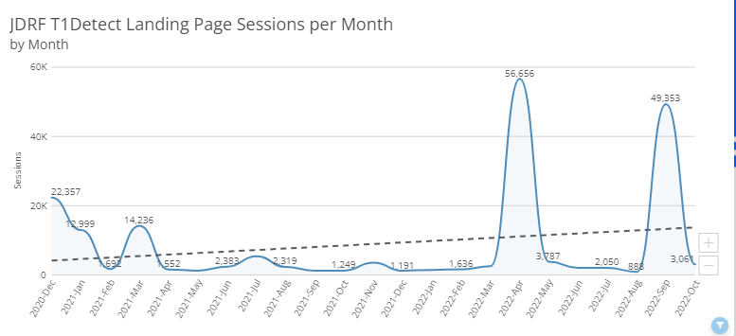
T1Detect: Progress and Impact
To date, JDRF has reached around 7.2 million people through our integrated marketing approach to promote the T1Detect program since its launch in December 2020.
250,000 unique visits to our T1Detect Program Page

Slide 9






T1Detect Program Tactics
Educate Healthcare Professionals
Educate JDRF Staff, Volunteers, and the T1D Community
Expand Clinical Pilots to Diverse Populations
Enhance Online, Digital, and Print Resources
Drive Consensus Monitoring Guidelines

Slide 10







JDRF will collaborate to improve the participant journey through screening and monitoring process
Ongoing Evaluation and Engagement
Get Screened
Why Screening Matters
Create Individualized Monitoring Plan
Review Results with HCP
Identify Best Pathway

Slide 11





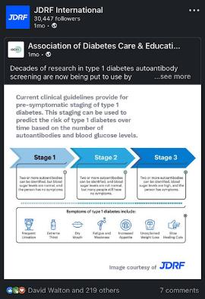
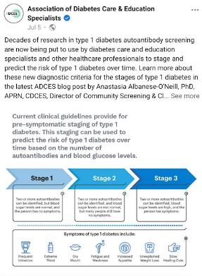

Healthcare Professional Education
2022-2023 Activities:
Symposia, CME, and other opportunities at Scientific Meetings
Strategic Partnerships
Exploring “Tweetorials”

Slide 12

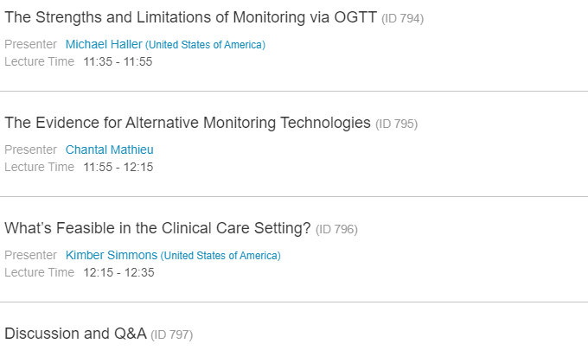
Upcoming Symposium
February 25, 2023
11:30 AM to 1 PM CET

Slide 13
T1Detect Program Tactics
Educate Healthcare Professionals
Educate JDRF Staff, Volunteers, and the T1D Community
Expand Clinical Pilots to Diverse Populations
Enhance Online, Digital, and Print Resources
Drive Consensus Monitoring Guidelines

Slide 14


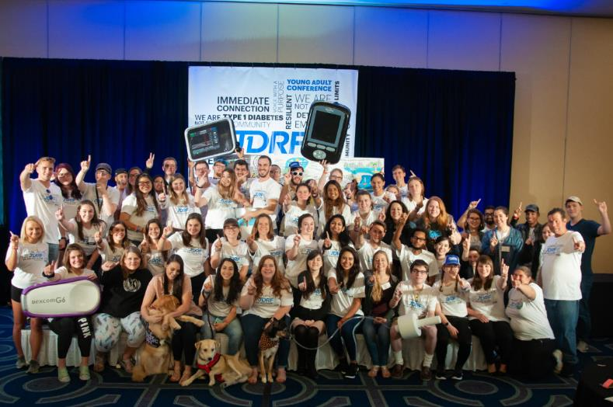
Staff, Volunteer, Constituent, and T1D Community Education
JDRF
Lunch
&
Learn
Internal Lunch and Learn Events
Virtual TypeOneNation Summit (10/6)
Educational Track at In-Person TypeOneNation Events
Expanded presence at CWD FFL
Notes:
Children w diabetes friends for life

Slide 15
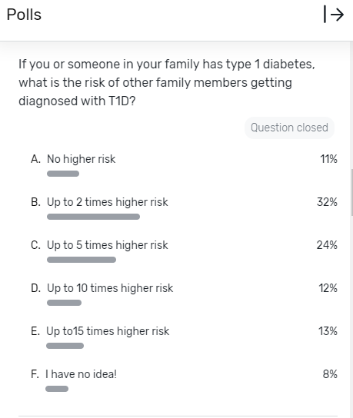
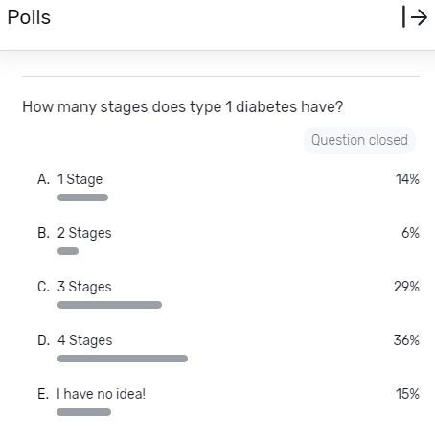
Examples of Learning Needs in the T1D Community
Notes:
T1Nation October 128 attendees -

Slide 16
T1Detect Program Tactics
Educate Healthcare Professionals
Educate JDRF Staff, Volunteers, and the T1D Community
Expand Clinical Pilots to Diverse Populations
Enhance Online, Digital, and Print Resources
Drive Consensus Monitoring Guidelines

Slide 17
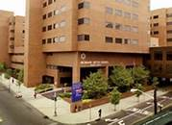

Expand Pilot Clinics to Reach Diverse and Underserved Populations
University Hospital affiliated with Rutgers University Newark, NJ
Staffing Support: Bilingual Patient Navigator
Subsidized test kits
Patient facing education materials in English/Spanish
Local JDRF chapter Support
Monitoring support and connect to research
Adams County Health Clinic Council, ID
Staffing Support: None
Subsidized test kits
Patient facing education materials
Remote monitoring support via Ask the Experts, connect to research
Activated 2 pilot sites in FY22
Identified additional sites for FY23, currently activating
Exploring Staffing Models
Testing Patient Facing Materials

Slide 18
T1Detect Program Tactics
Educate Healthcare Professionals
Educate JDRF Staff, Volunteers, and the T1D Community
Expand Clinical Pilots to Diverse Populations
Enhance Online, Digital, and Print Resources
Drive Consensus Monitoring Guidelines

Slide 19
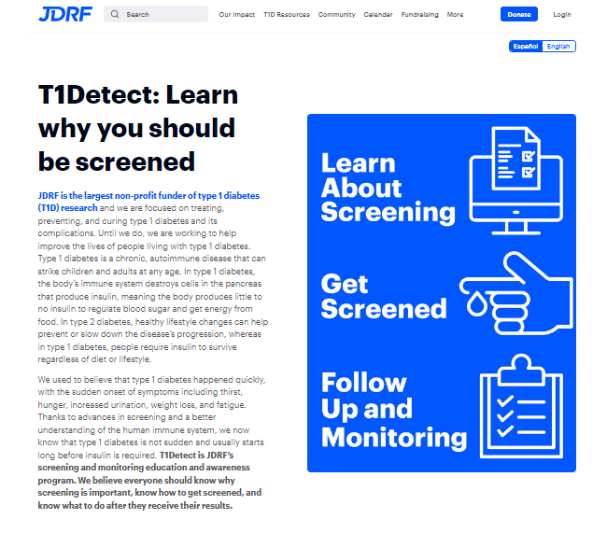

Enhance Online, Digital, Multimedia and Print Resources
Improved Digital Communication
  Website content and design
  Videos (online and in-clinic placement)
  Direct emails and Newsletters
  Print Resources
  Patient-facing materials in English and Spanish

Slide 20
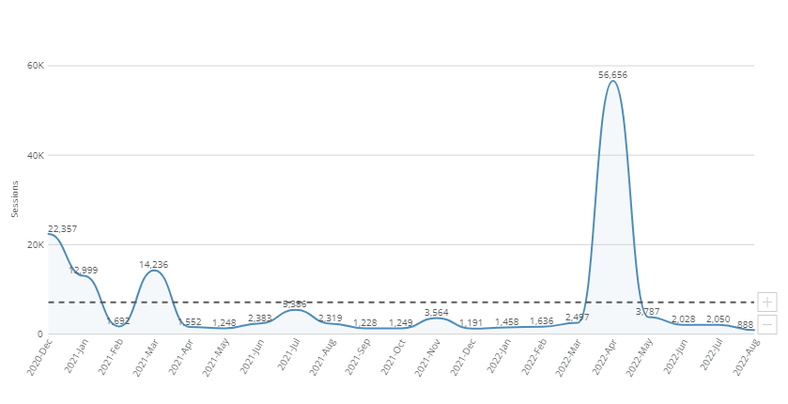
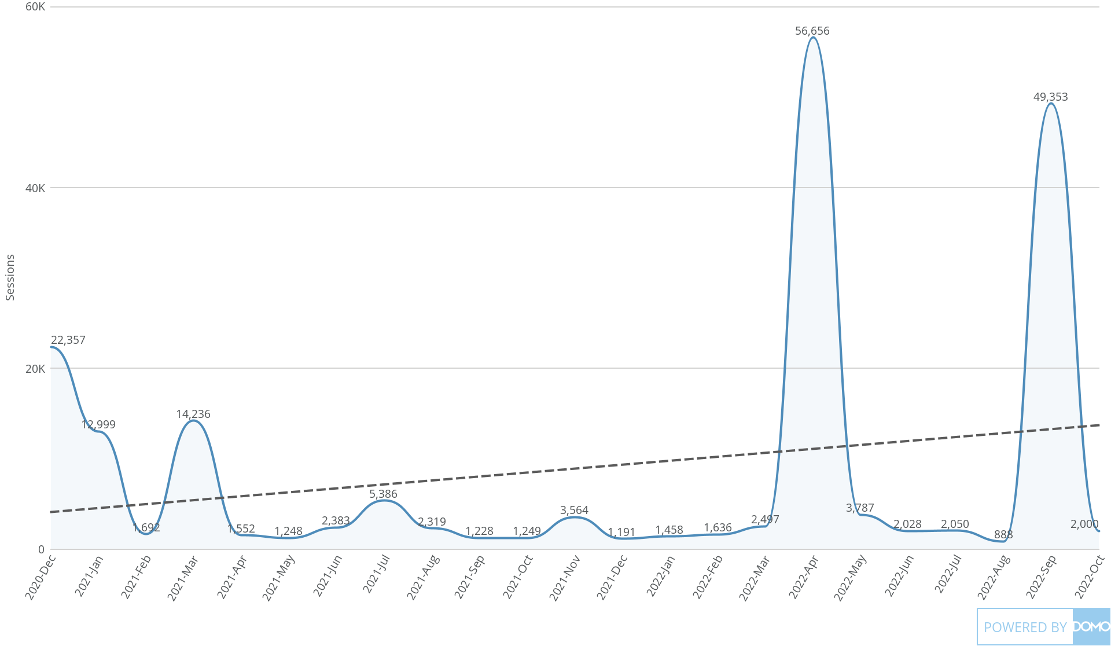
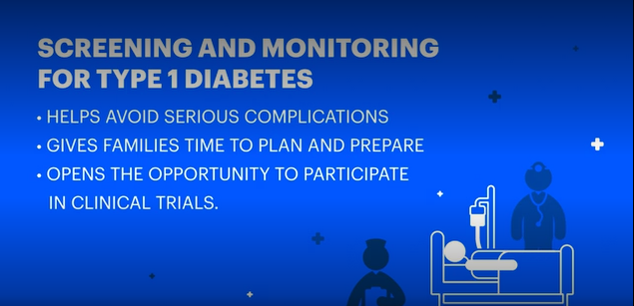

Successful marketing, social media, and influencer campaigns have driven significant traffic to JDRF’s T1Detect webpage
Record-breaking 56K pageviews in April and September 2022
JDRF.org/T1Detect

Slide 21
T1Detect Program Tactics
Educate Healthcare Professionals
Educate JDRF Staff, Volunteers, and the T1D Community
Expand Clinical Pilots to Diverse Populations
Enhance Online, Digital, and Print Resources
Drive Consensus Monitoring Guidelines

Slide 22
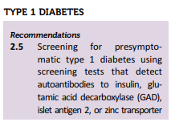
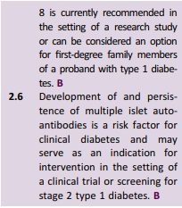
Clinical Guidelines Target for Expanded Monitoring:
ADA Medical Standards of Care in Diabetes

Slide 23
T1D Risk Screening: Summary
Expansion of general population screening in the US and outside the US through current and additional initiatives studies to provide research evidence or data in support of universal screening
Inclusion of screening, education, awareness and monitoring in T1Detect and other with Research and Advocacy efforts
Ensure all ages, ethnicities and geographies are screened and monitored to enable curative therapies
Exploit ML-AI tools enhance effectiveness of risk prognostication (age, genetics, etc.) and deploy in T1Detect
Monitoring guidelines are urgently needed

