Slide 1





Staged Newborn Screening for Common Childhood Diseases –
the Combined Antibody Study for Celiac And Diabetes Evaluation (CASCADE) Study
Hagopian W, Oram R, Killian M, Crouch C,
Meyer J, Roy S, Llewellyn M, Bender T,
McCall C, A Singh, Thompson J

Slide 2
Disclosures
CASCADE is funded by an unrestricted grant from Janssen Pharmaceuticals to my Institute
Dr. Hagopian receives no equity, honoraria, fees nor salary directly from Janssen
Neither Janssen nor Dr. Hagopian own any Intellectual Property used in CASCADE prediction strategies

Slide 3
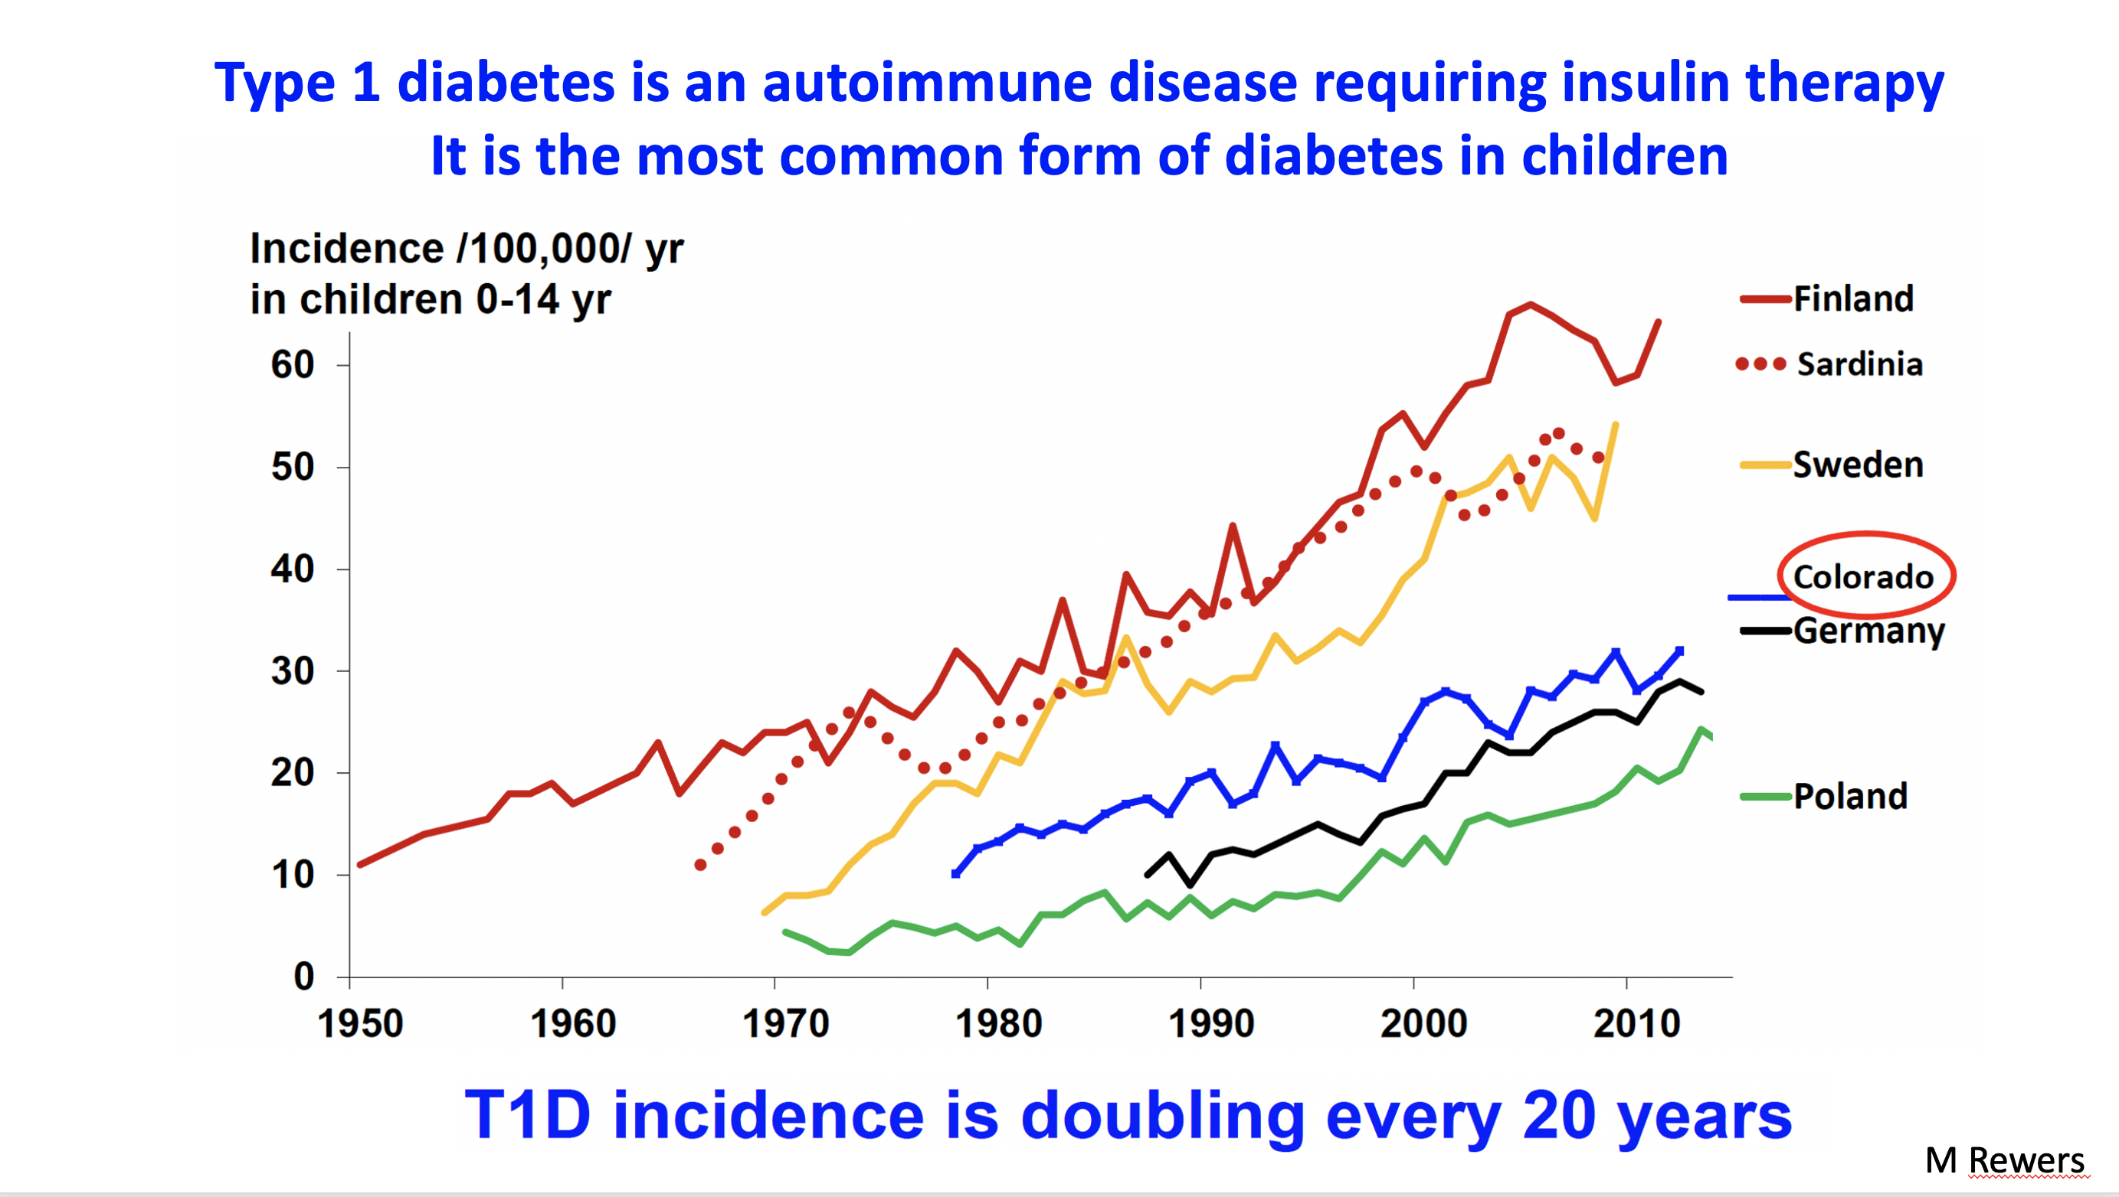

Slide 4
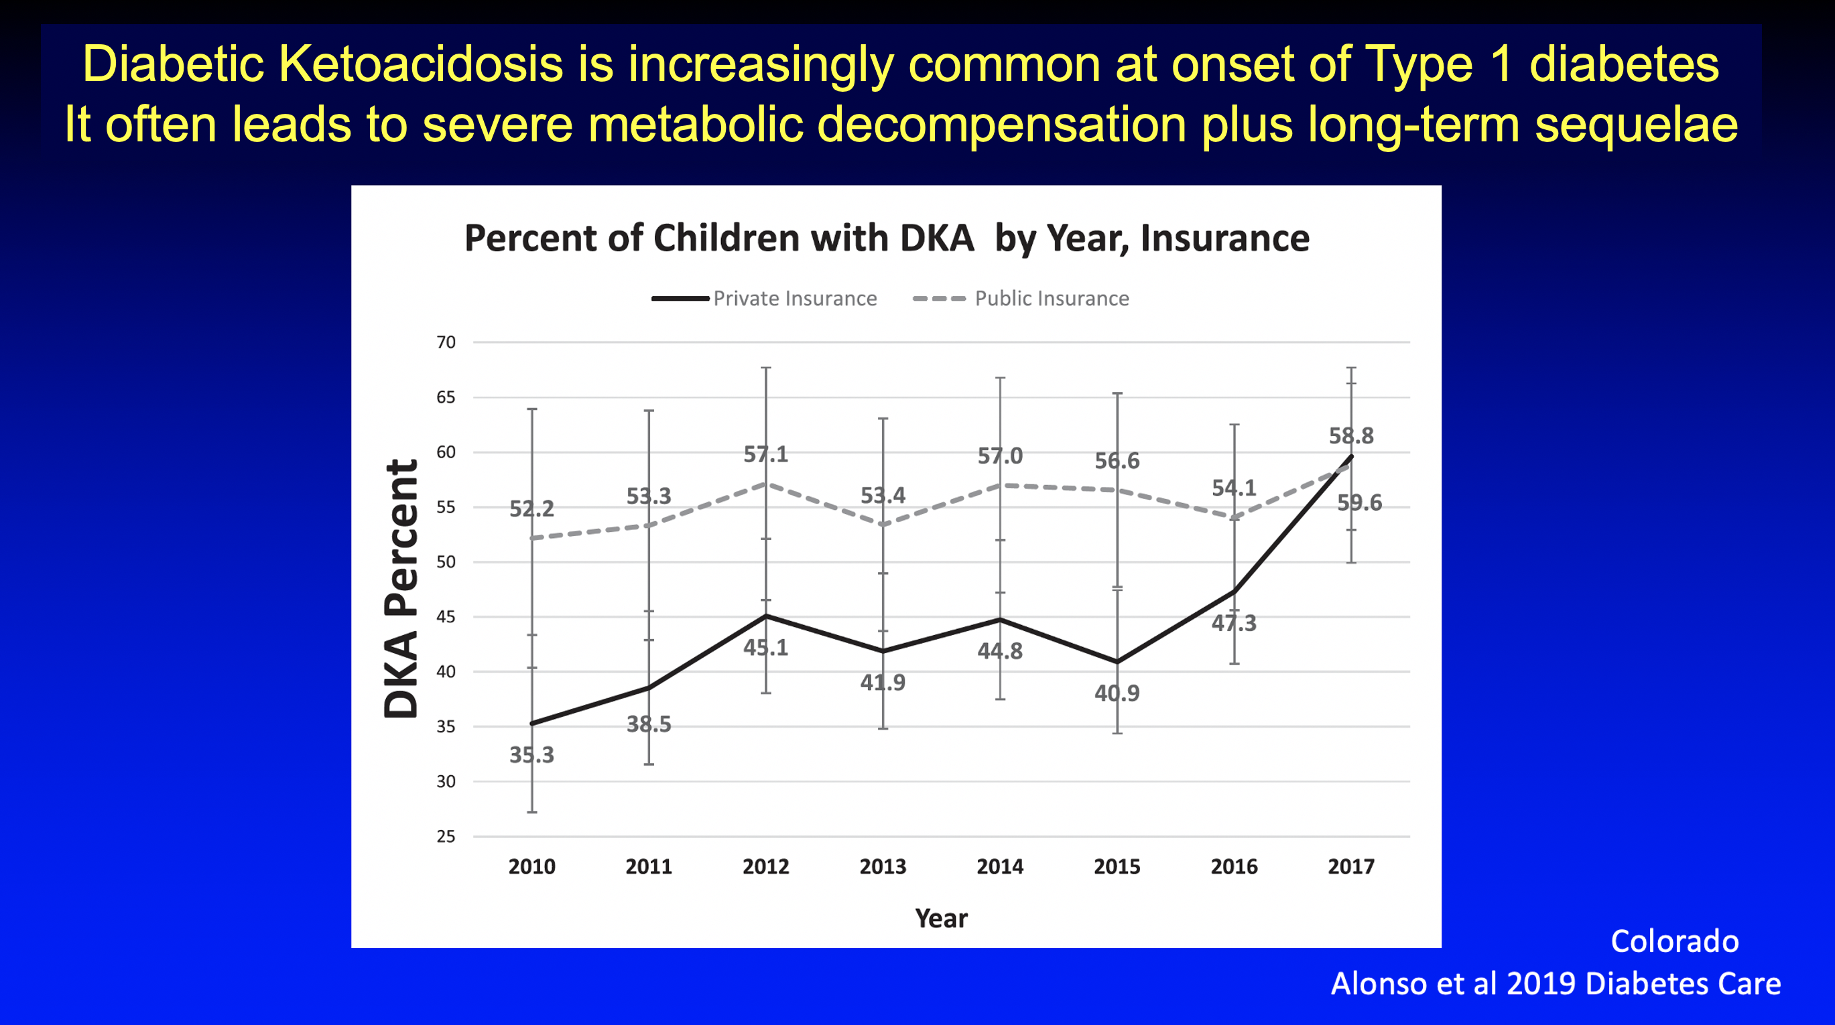

Slide 5
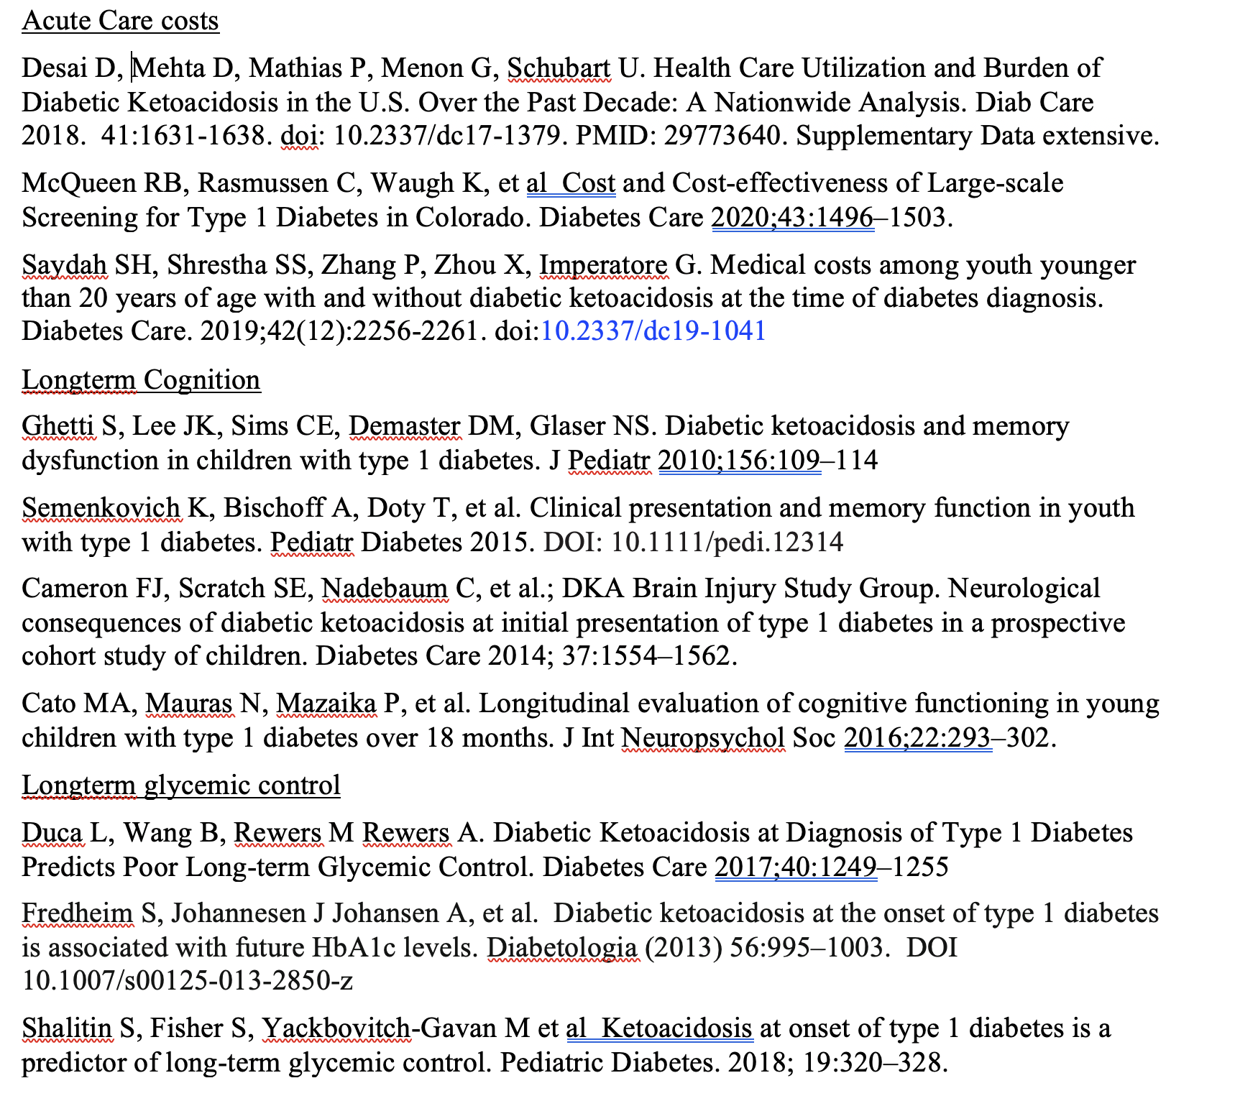
Building an evidence base
DKA sequelae avoided
Severe illness and rare deaths
Cost of DKA treatment
Possible decreased cognition
Long-term worsened glycemia
Cost-benefit ratio
positive when DKA treatment
and dysglycemia both considered
McQueen et al Diab Care 2020

Slide 6
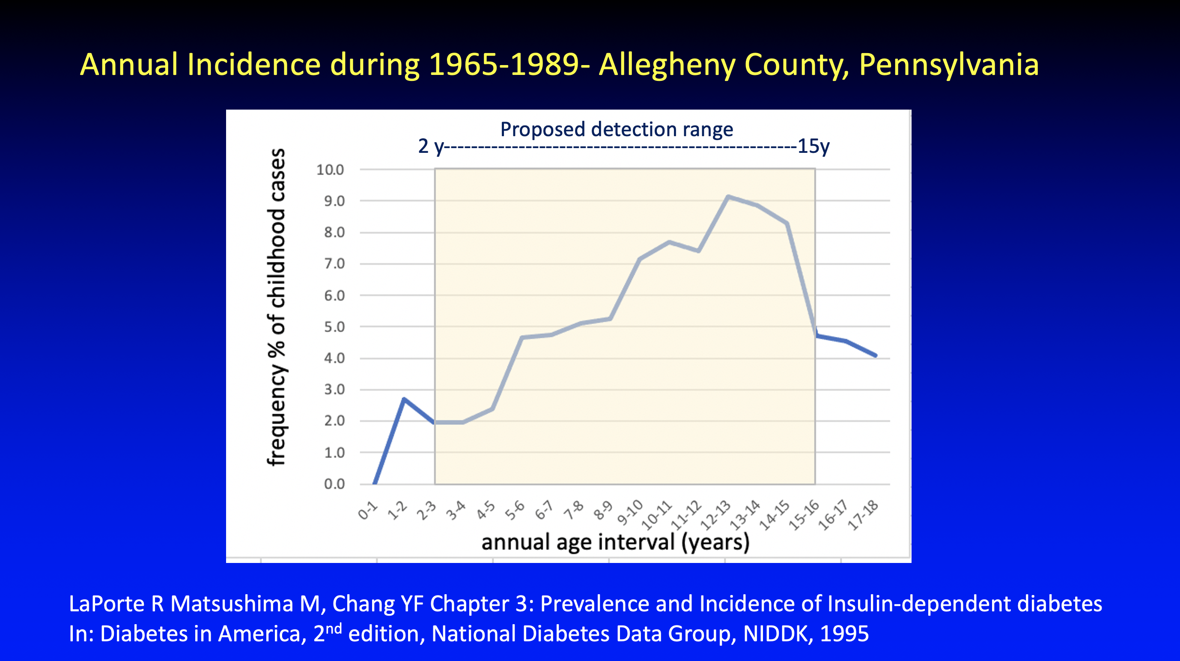

Slide 7
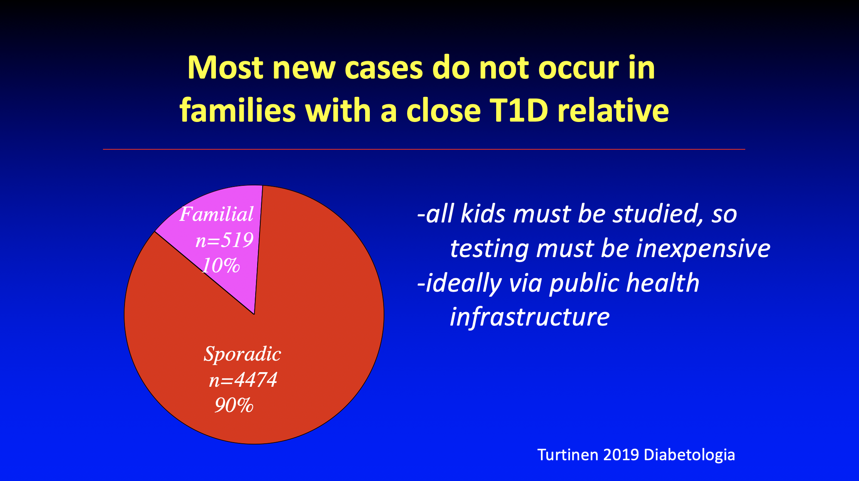

Slide 8
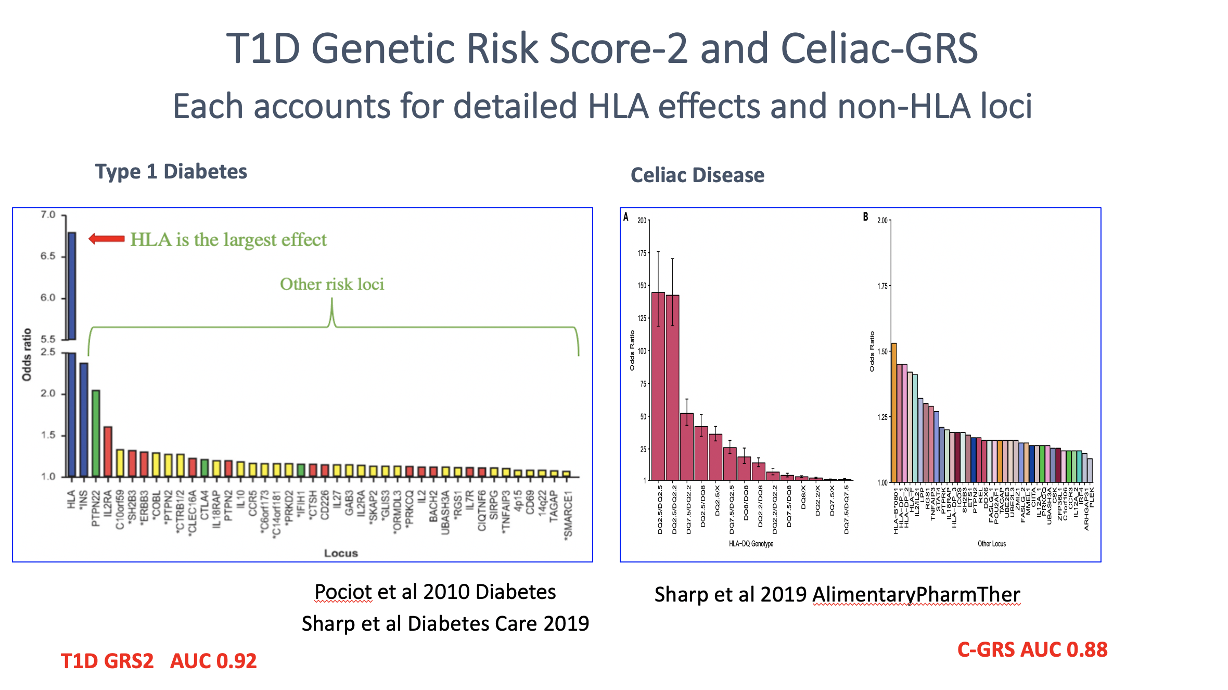

Slide 9
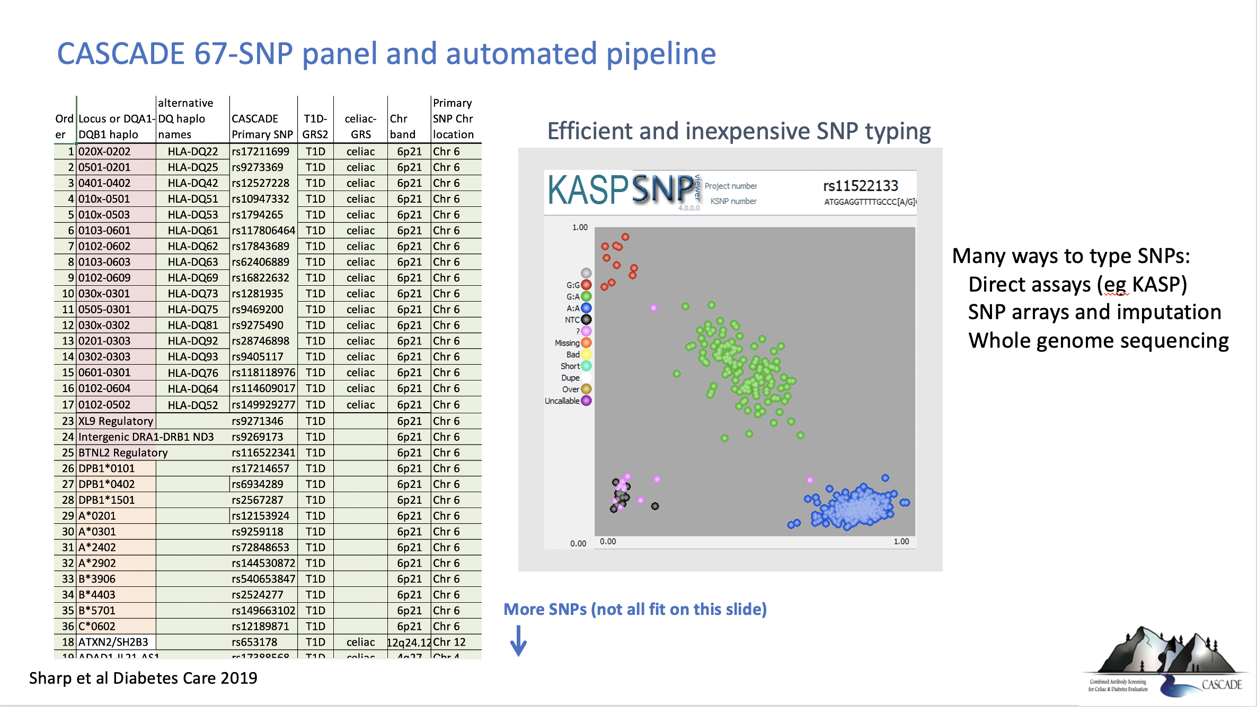
Direct assays like KASP (now)
Whole genome sequence (future)

Slide 10
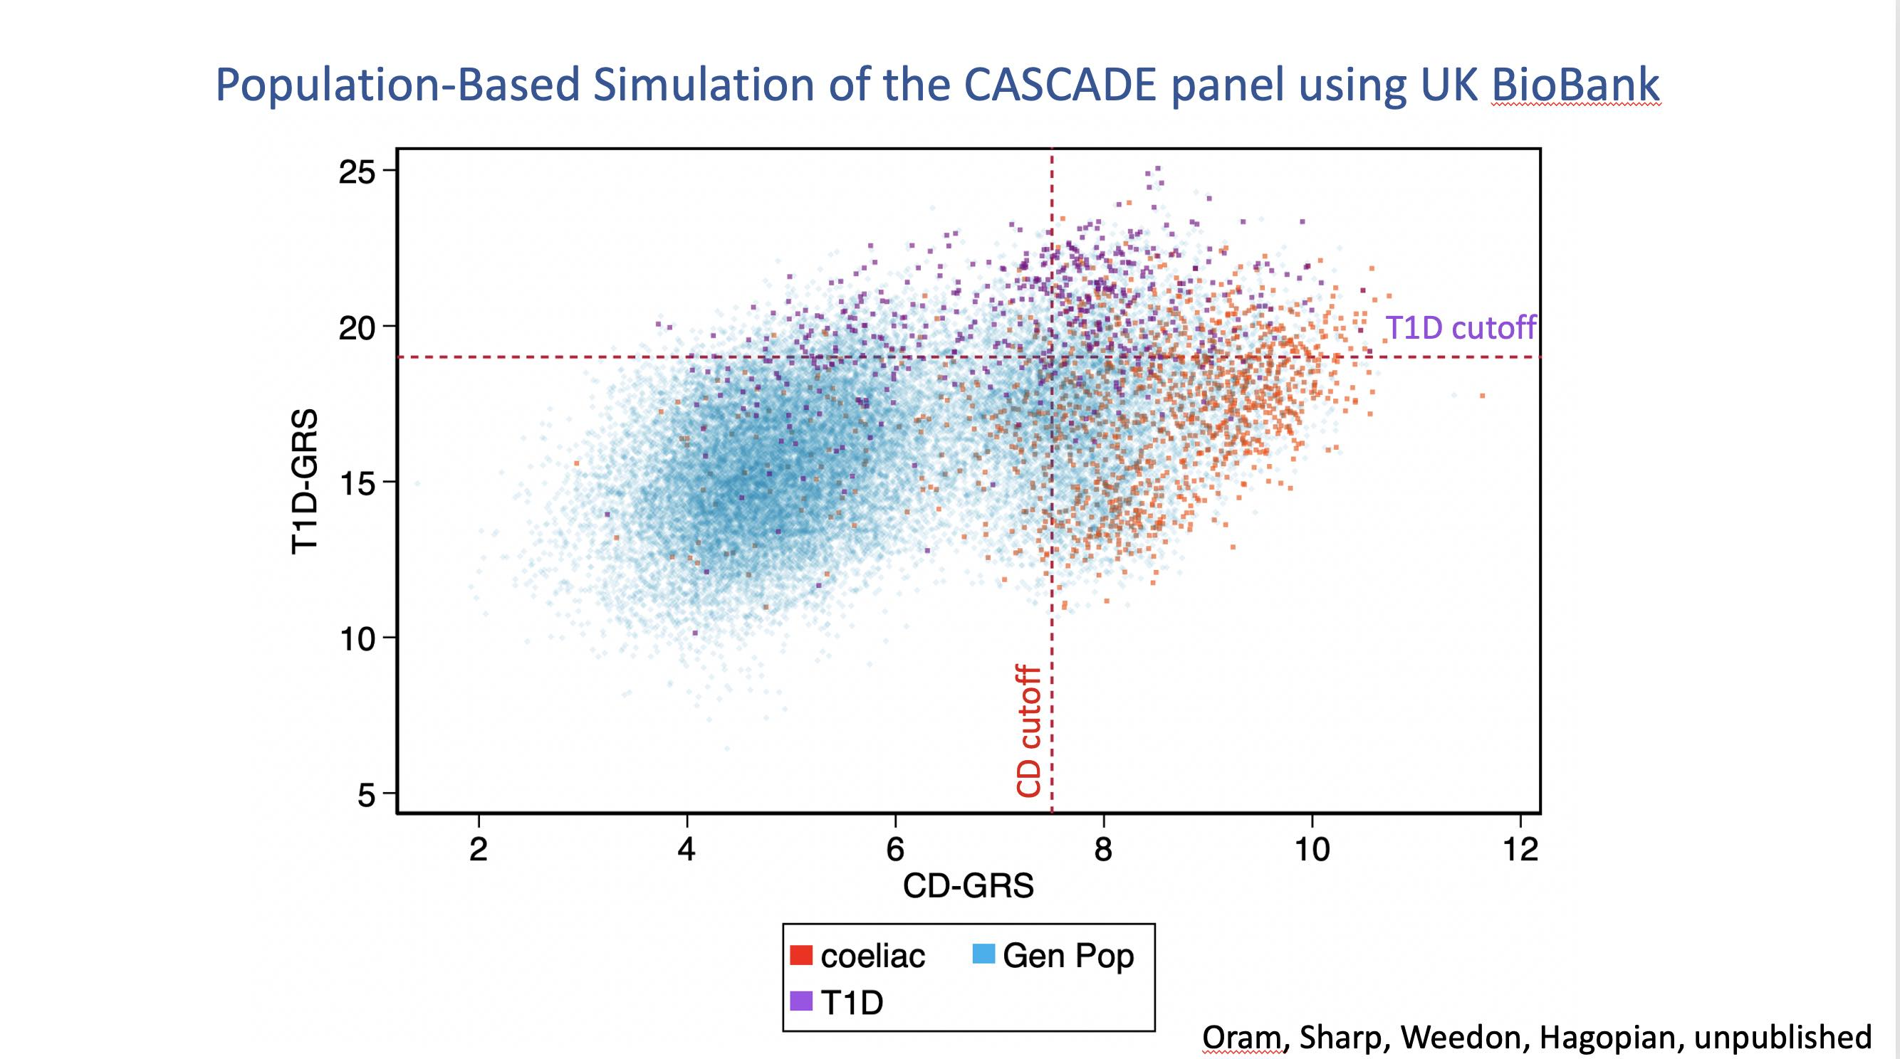

Slide 11
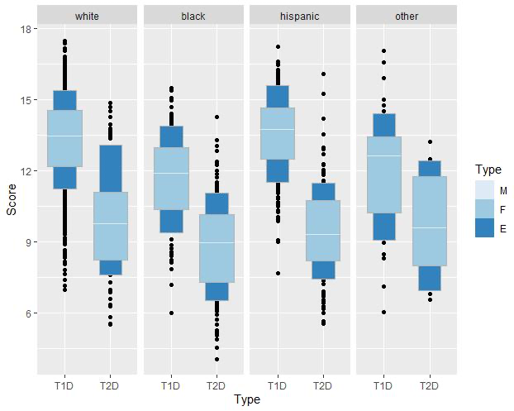

T1D GRS2 robustly detects T1D risk in US children of many ancestries
Medians
Fourths
Eighths
SEARCH Study
Oram et al 2022 Diabetes Care

Slide 12
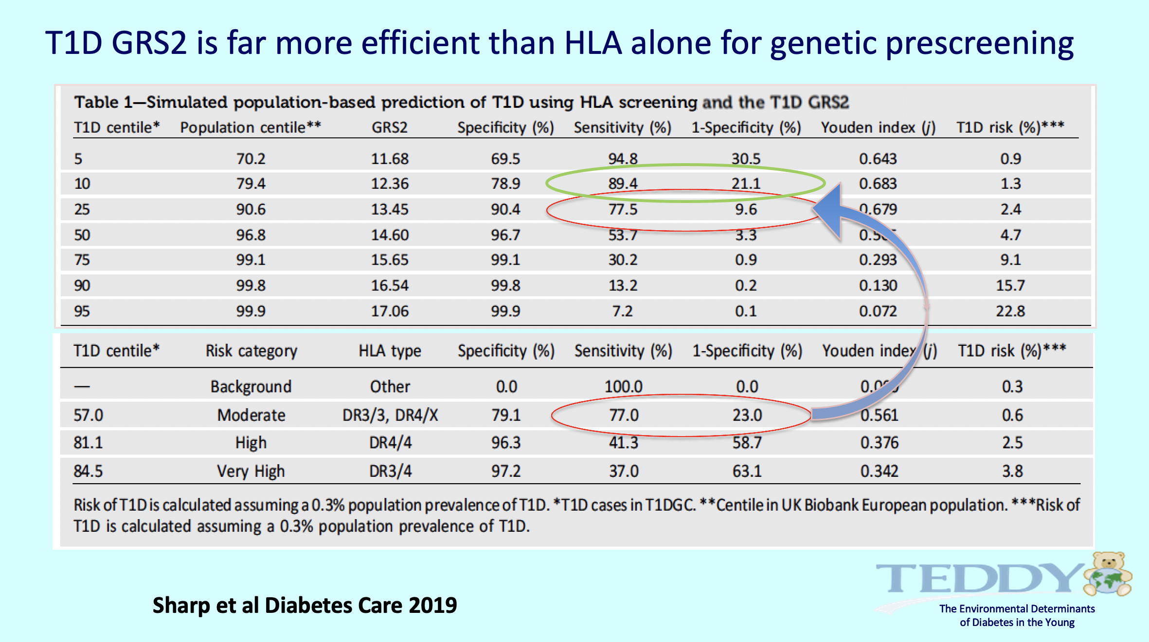

Slide 13
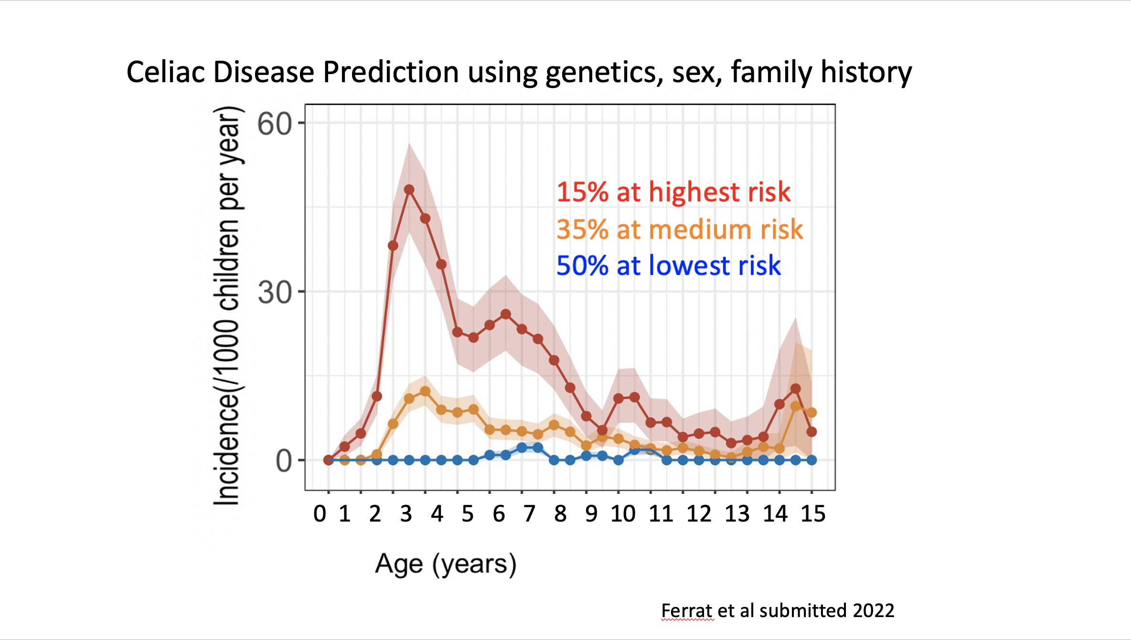


High risk
Medium risk
Low risk

Slide 14
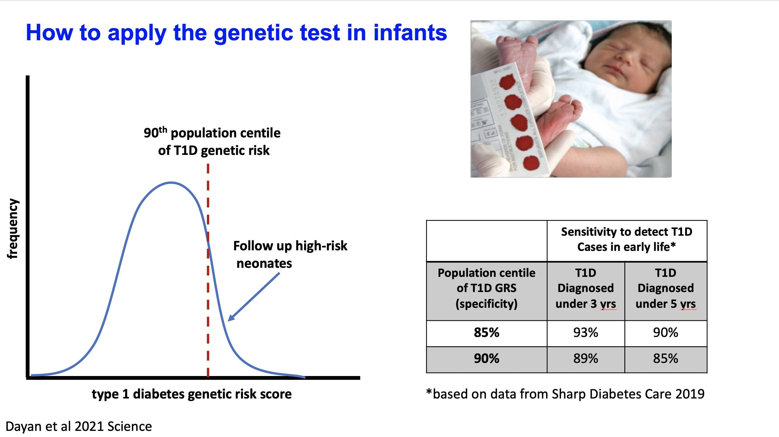

Slide 15
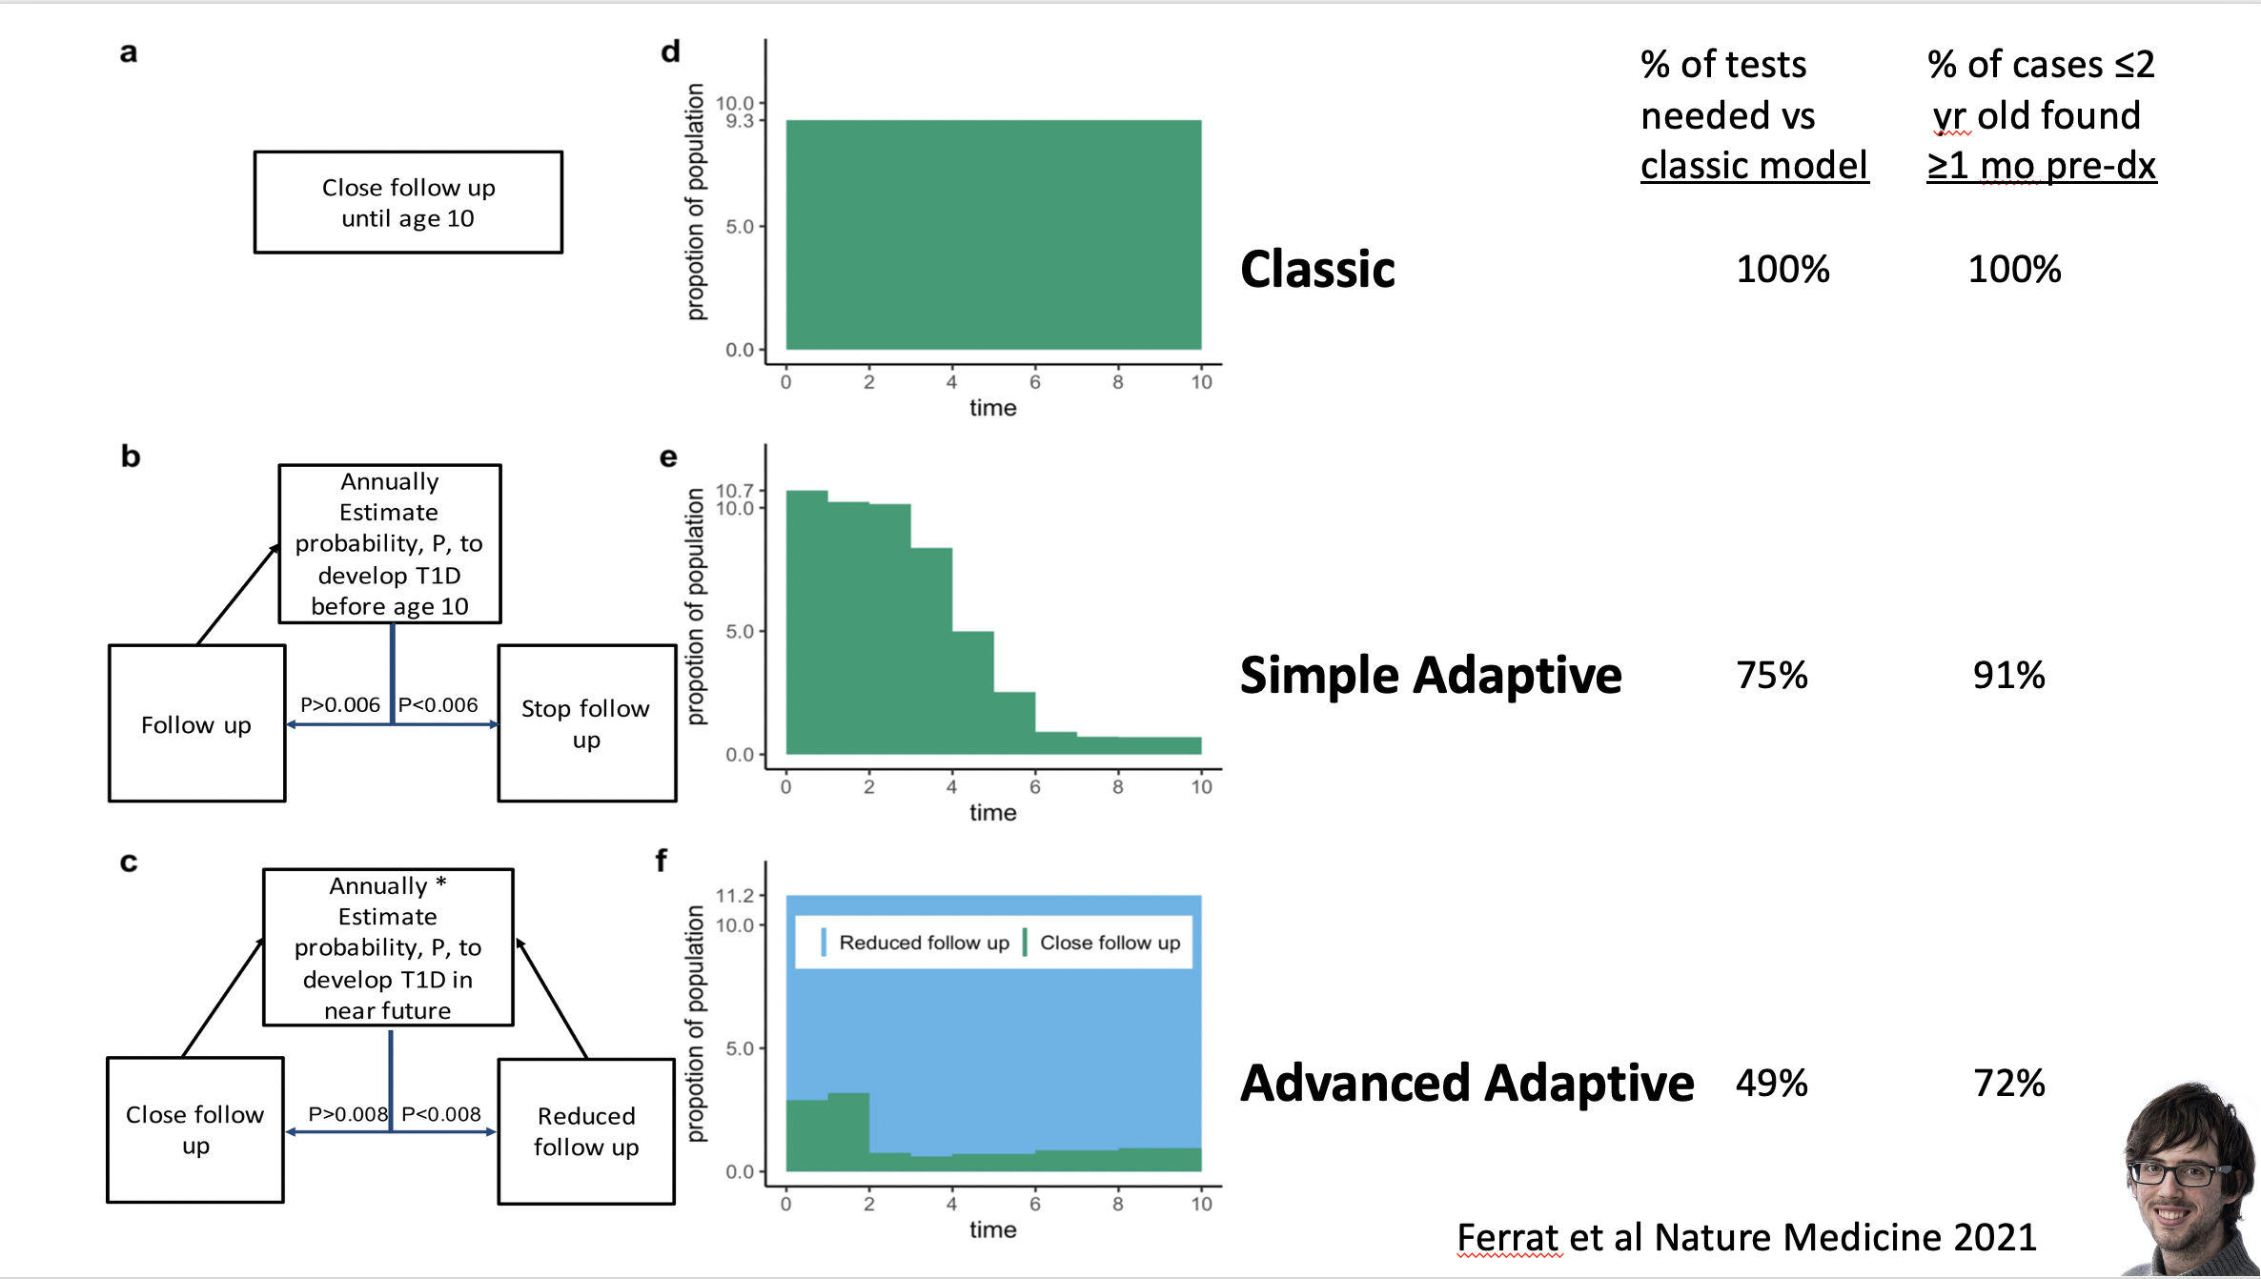

Slide 16
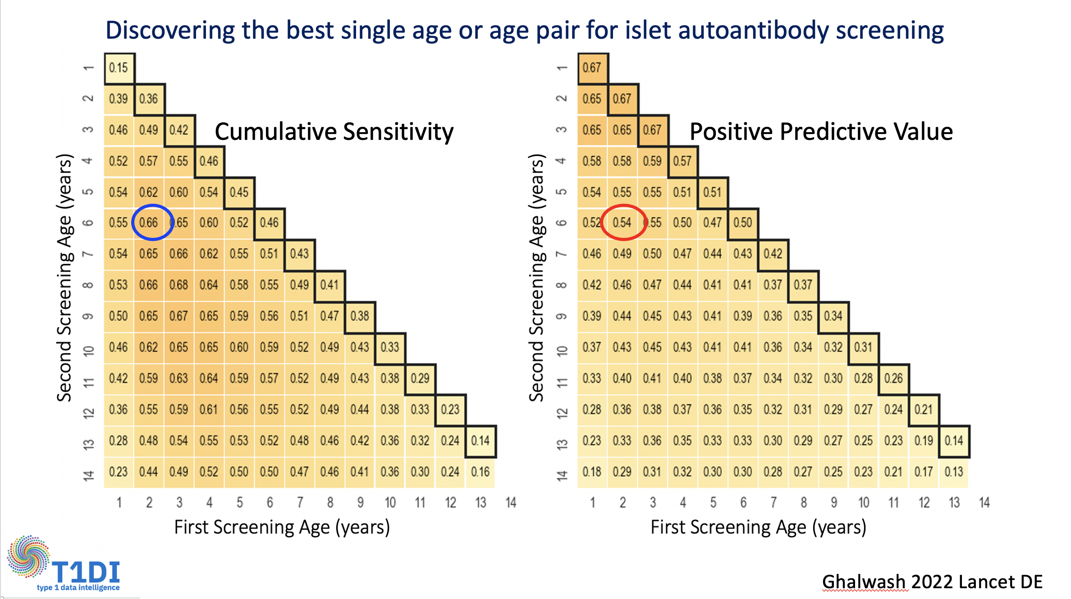

Slide 17
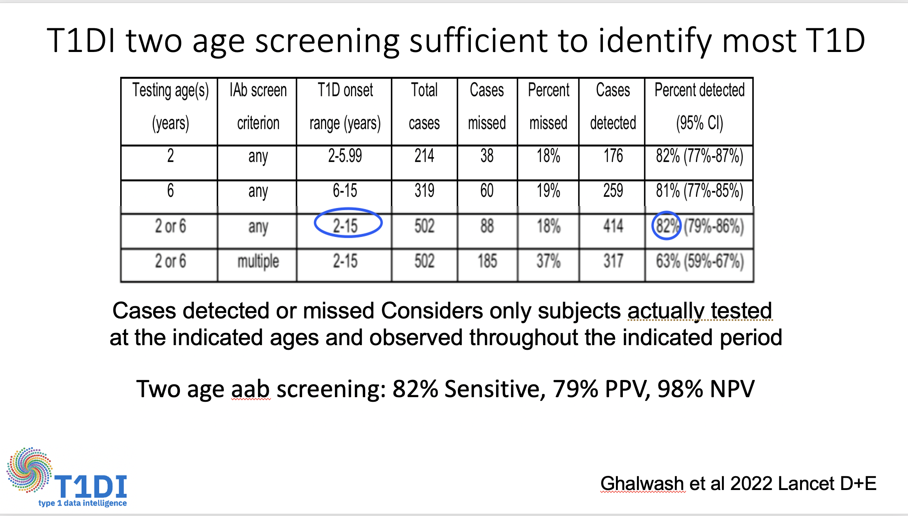
2 and 6
2 and 6

Slide 18
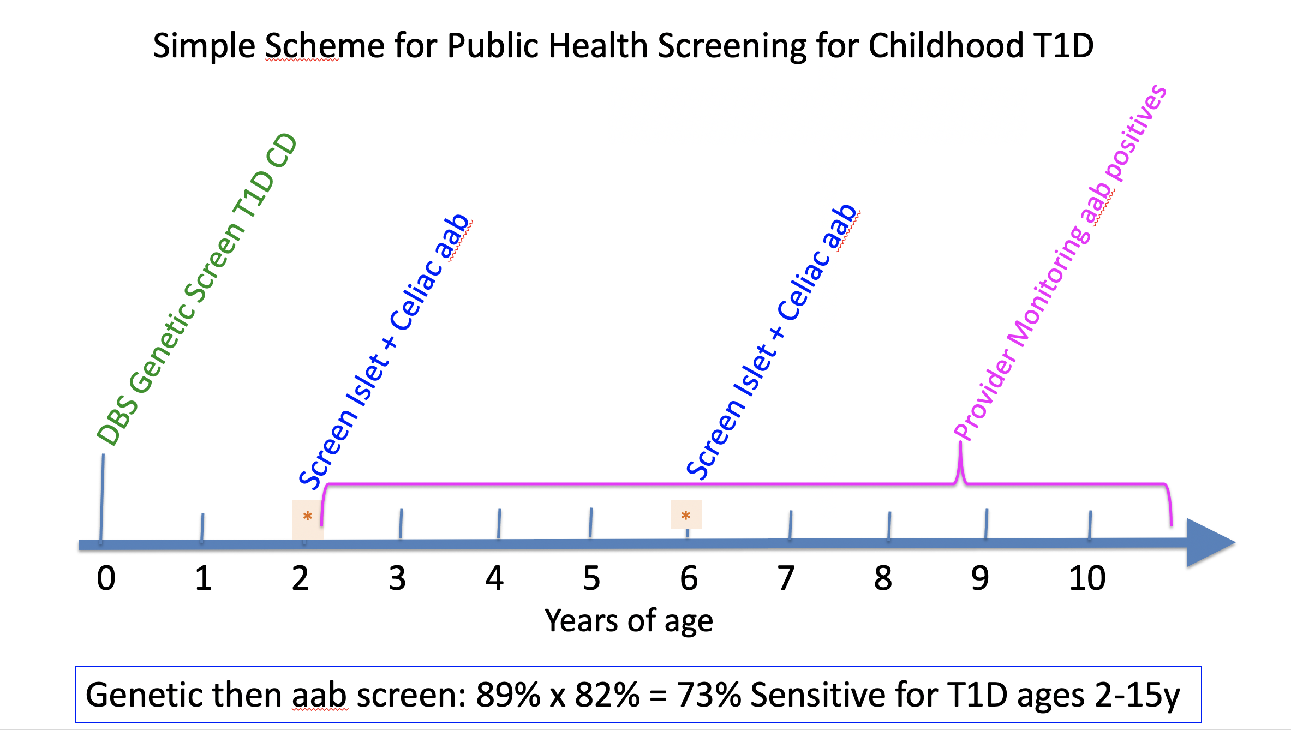
Simple Scheme for Public Health Screening of Childhood Type 1 Diabetes

Slide 19
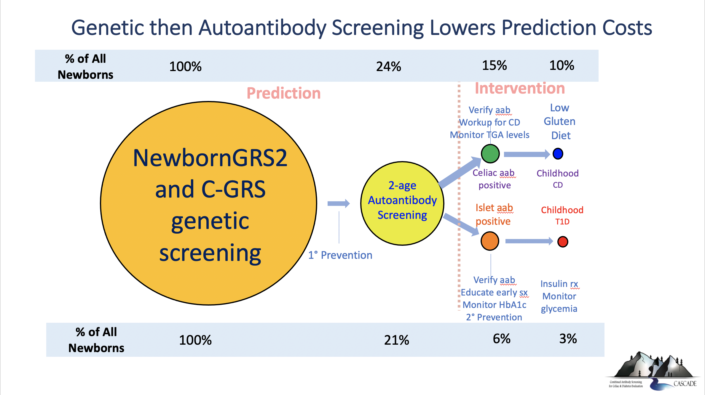
% of All Newborns
100%
24%
1.5%
1.0%
Celiac Disease
Type 1 diabetes
% of All Newborns
100%
21%
0.6%
0.3%

Slide 20
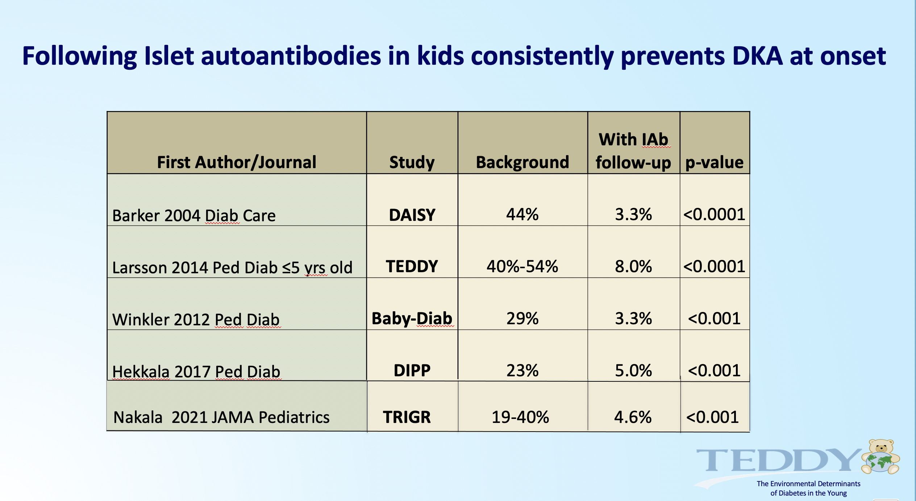

Slide 21
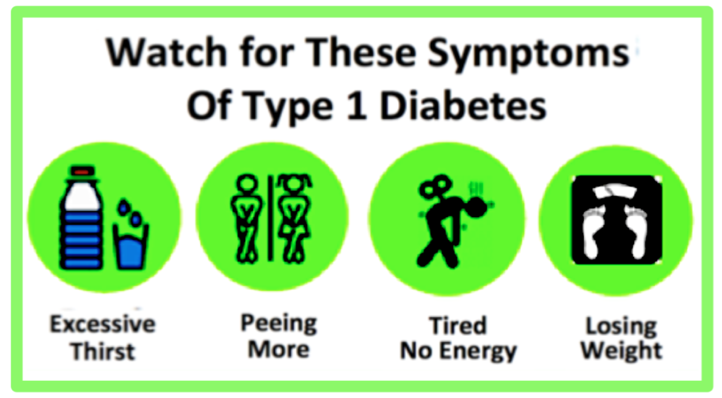

Educating parents and providers of kids with islet aab is the key to preventing DKA
When child is islet aab positive, educate parents to address illnesses or symptoms early
Educate providers (or parents) to check blood glucose with any illness to detect T1D early

Slide 22
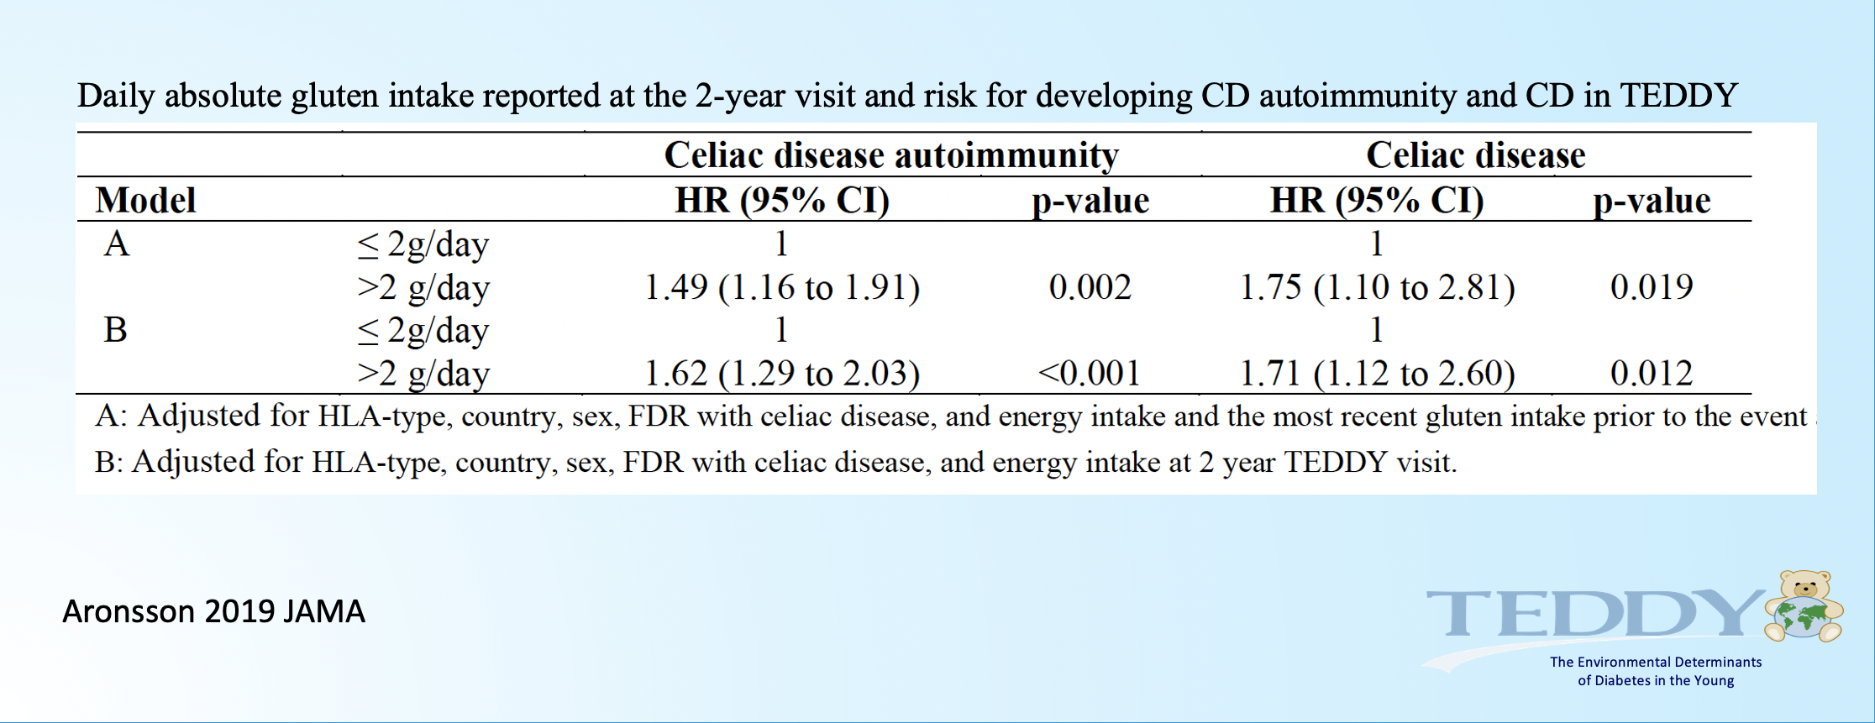
In addition to effectively treating celiac disease with a gluten-free diet, a
low-gluten diet in those with genetic risk might avoid future celiac autoimmunity

Slide 23
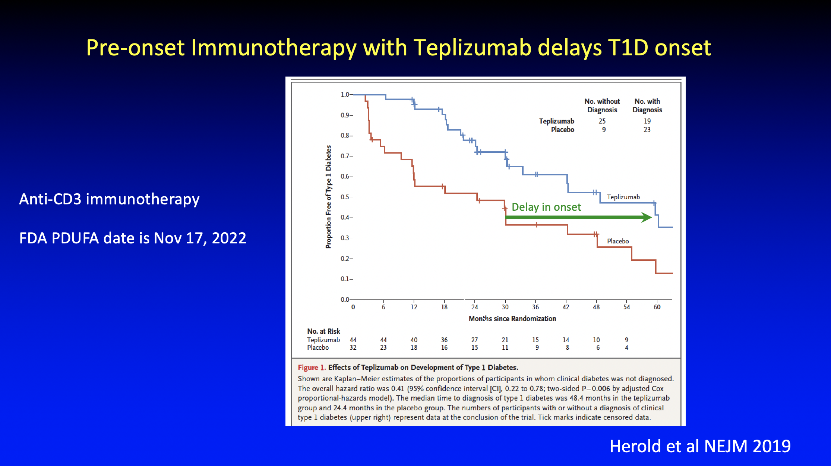

Slide 24
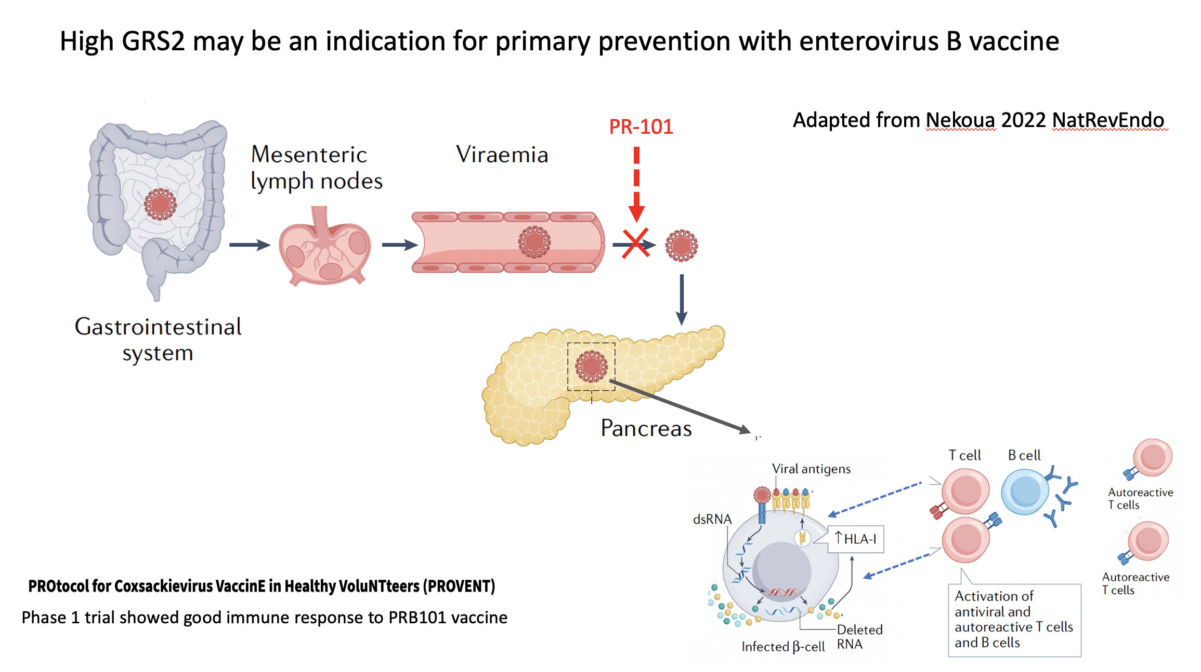

Slide 25
Conclusions
Newborn screening via genetic risk scores followed later by islet autoantibody testing detects most childhood type 1 diabetes
Efficient combined prediction of T1D and Celiac Disease
Cost-effective at 73% sensitivity for T1D by age 15
Requires sampling 20% of children at ages 2 and 6, which is logistically challenging
Effective T1D interventions available now, with prevention potential in the near future

Slide 26

