Slide 1

Strategies to Increase Engagement
Holly O’Donnell, PhD
Assistant Professor of Pediatrics
Barbara Davis Center for Diabetes

Slide 2
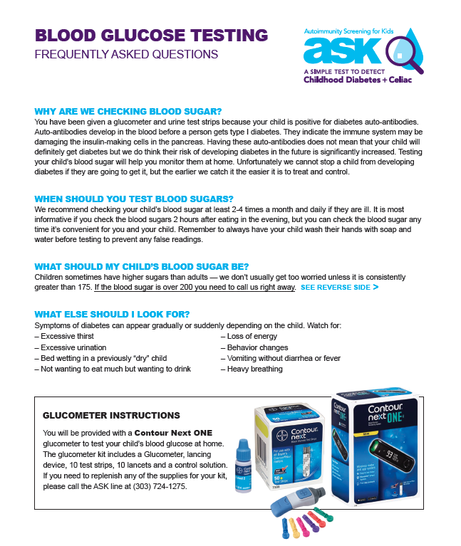

Why don’t they listen to us?

Slide 3

The Role of Psychology in Screening Studies
Cognitive – Risk Perception
Emotional – Anxiety
Behavioral

Slide 4

ASK Protocol
Screening at multiple sites
Persistently positive for multiple or single high- affinity islet autoantibody
Monitoring: SMBG, HbA1c, CGM, OGTT, growth
Education: symptoms SMBG diabetes team
Positive
Confirmed
at BDC
Prevent:
- DKA
- Diabetes
Negative
Not confirmed and
HbA1c <5.7%

Slide 5

Awareness of T1D
Increasing public awareness and understanding of type 1 diabetes

Slide 6
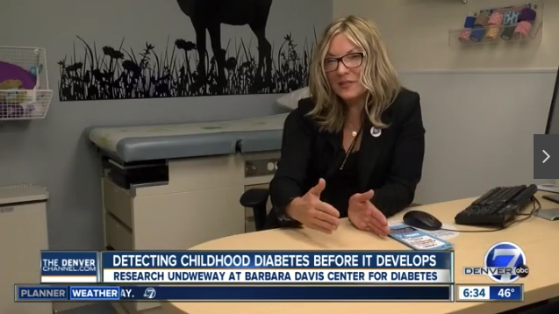
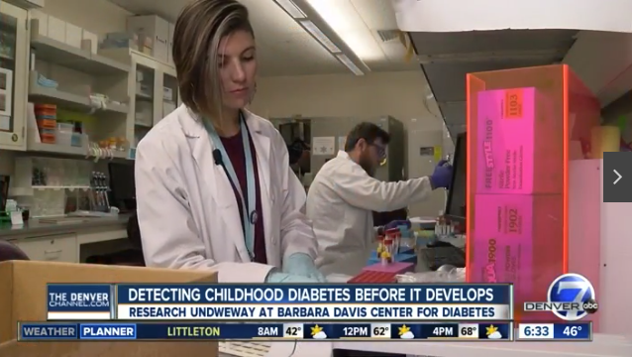
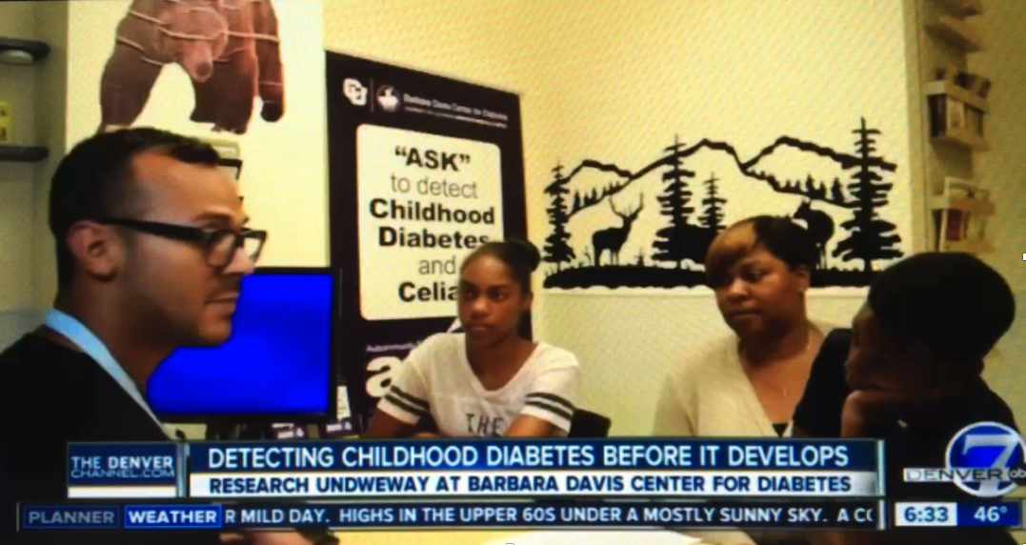
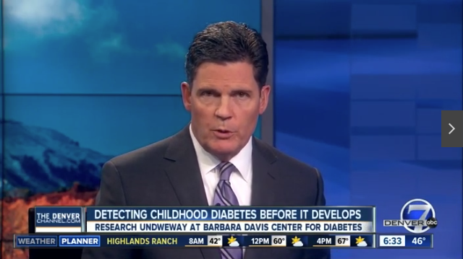
Increasing Awareness:
Media Coverage

Slide 7
Awareness of T1D:
Common misconceptions about T1D
Nobody in my family has it
It is uncommon in non-whites
My child is very active and not obese
Teenagers/ young adults progress slowly to overt diabetes
Nothing can be done until there are symptoms

Slide 8

Increasing Awareness: PCPs
General information about ASK goals and protocol
Answers to provider’s FAQs
  My patient brought me these results….
  Is there anything else I should know?
  Should I be ordering any follow-up labs?
  How can my other patients get screened?

Slide 9

Recruiting & Retaining Diverse Sample
Recruiting and retaining:
  Racial and ethnic minorities
  Individuals with fewer years of formal education

Slide 10
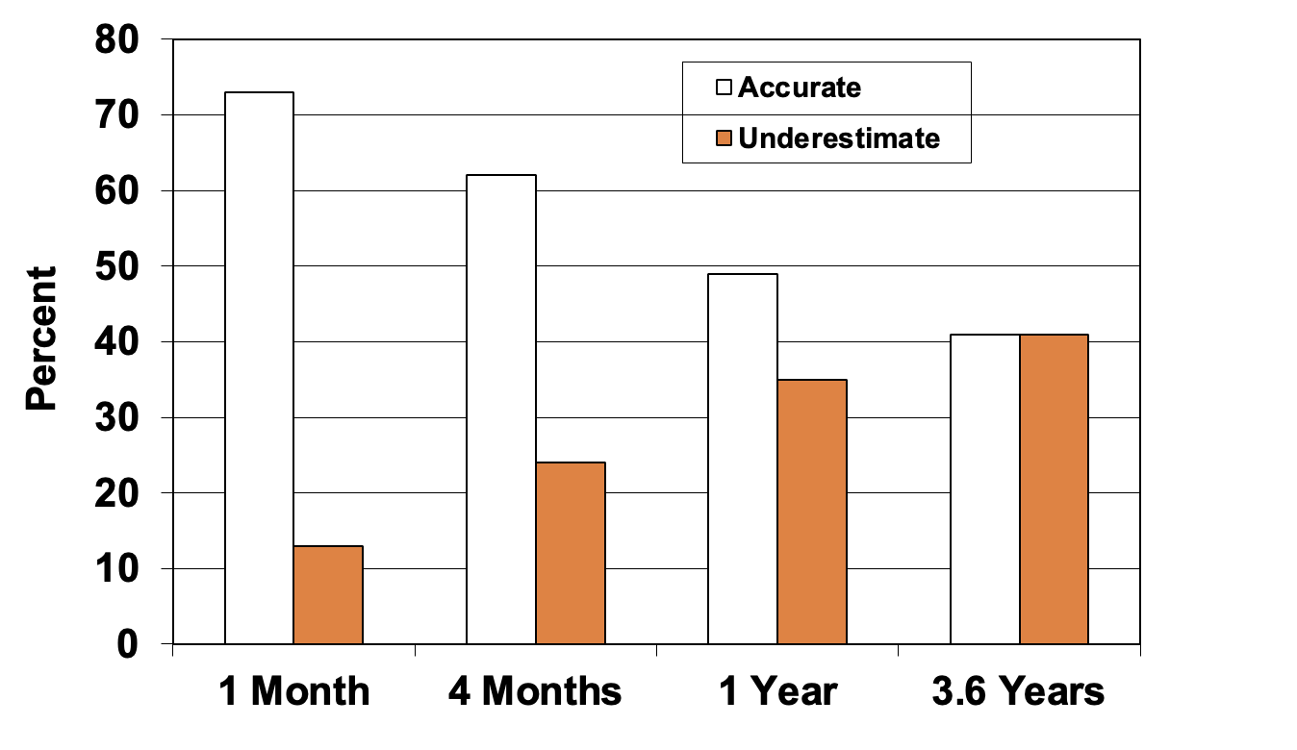
Understanding Risk
Assessing risk perception accuracy and strategies for communicating effectively
Data from The PANDA Study.
Image courtesy: Suzanne Bennett Johnson, PhD

Slide 11
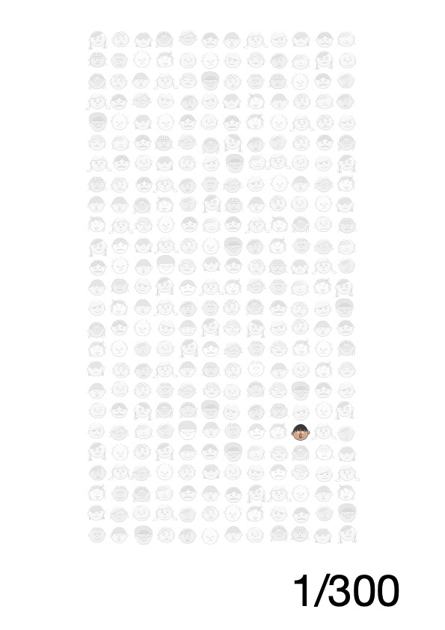


Slide 12

Anxiety
Assessment and intervention for high anxiety and stress associated with protocol or risk status

Slide 13
Participant Motivators & Barriers
Protocol
 | Protocol | Family/Participant
Reasons for Withdrawal | Blood draw Protocol too demanding Logistical barriers (e.g., transportation) | Too busy Overwhelmed/stressed Did not want to be reminded of child’s risk
Reasons for Engaging & Factors Associated with Increased Adherence | Helping science learn about T1D Having someone watch my child for T1D Getting antibodies & access to prevention studies | Maternal satisfaction with study Staff consistency

Slide 14

Strategies: Team Level
  DO
  Educate
  Use humor
  Engage in non-procedural talk (keep medical materials “out of sight, out of mind”)
  Use distraction, encourage relaxation
  Reinforce positive behaviors (e.g., “taking deep breaths,” or “sitting still”)
  BE HONEST!
  AVOID
  Reassurance (“you’re fine”)
  Criticism
  Apologizing to child
  Society of Pediatric Psychology, 2008

Slide 16
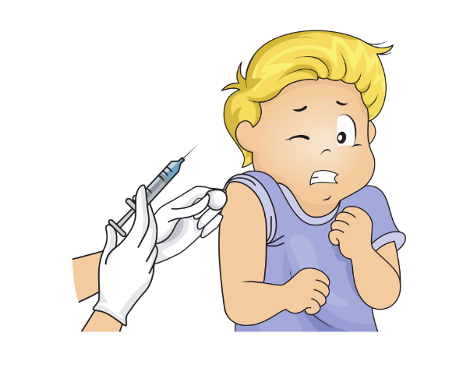


Strategies: Individual Level
Worries
Severe
Needle Phobia

Slide 17
Support for Families in Screening & Monitoring Programs
Highest Level: Psychological support to address anxiety and sources of stress; targeted interventions for those with inaccurate risk perception
Targeted: Staff education to reduce distress with blood draws; staff consistency; flexible protocol adaptations; assisting families with logistical barriers; consistent & supportive communication strategies
Universal: Increasing knowledge and awareness of T1D, thoughtful design of programs/studies, recruitment materials to target specific populations

