Slide 1

Anette-Gabriele Ziegler
Institute of Diabetes Research, Helmholtz Munich,
Forschergruppe Diabetes der Technische Universität München am Klinikum rechts der Isar

Slide 2
Type 1 diabetes is described in stages
Genetic predisposition
Immune activation
Stage 1
Stage 2
Stage 3
Long-standing diabetes
> 50 susceptibility genes
≥ 2 islet autoantibodies
≥ 2 islet autoantibodies
Dysglycemia
WHO diagnosis
Opportunities for prevention

Slide 3
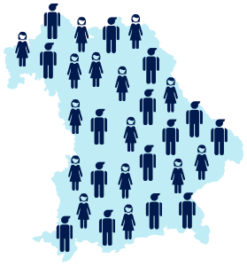
Public health screening for islet autoantibodies
Capillary blood
In cooperation with > 600 primary care pediatricians in Bavaria, Germany
483 children
(0.3 %)
Since 2015:
170,609 participants;
Age 1.75 – 10.99 years
with multiple islet autoantibodies
Ziegler, JAMA 2020;
Raab, BMJ open 2016
Ziegler, Diabetes Technol Ther 2016

Slide 4
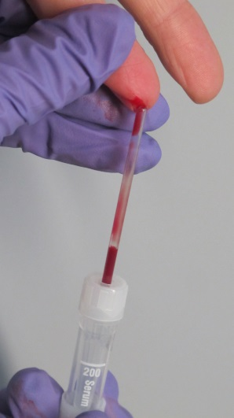
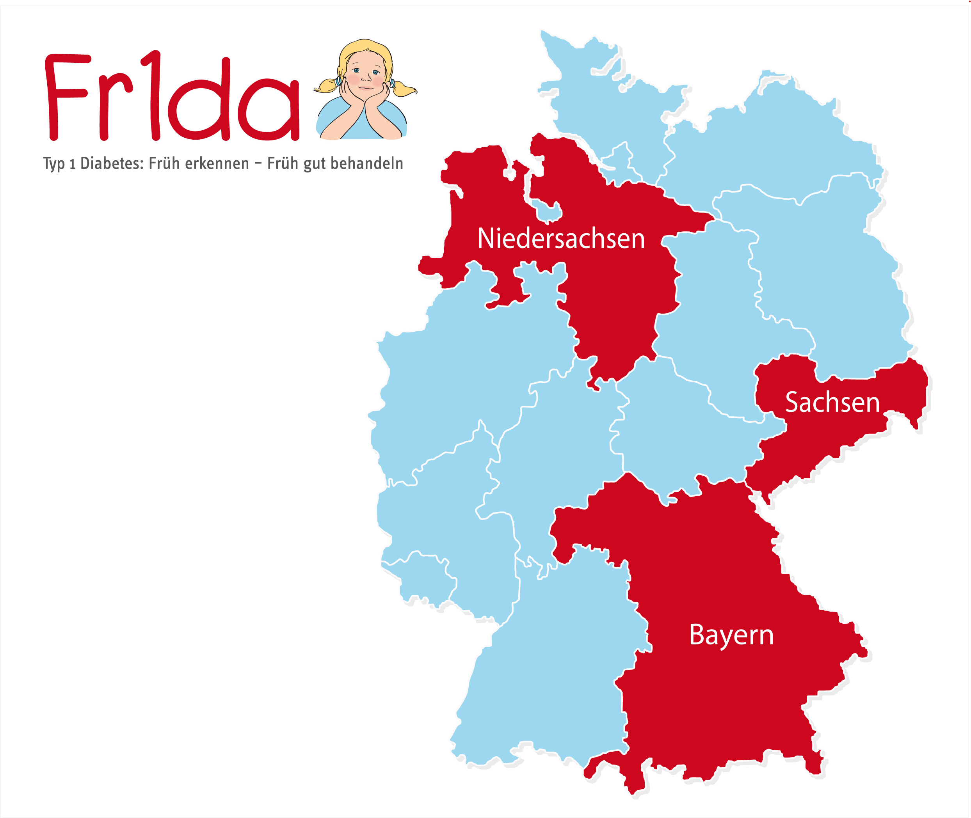
Approach:
From 2015: capillary blood, age 2-6 years, 1 screen
From 2020: capillary blood, age 2-10 years, 2 sreens
3 Screen – ELISA RSR
3 islet autoantibodies in one test: GADA, IA-2A, ZnT8
> 98th centile
IAA, GADA, IA-2A, ZnT8 by RBA
≥ 2 islet Abs+ > 99th centile
2nd venous blood draw requested
Confirmed ≥ 2 islet Abs+ > 99th centile
Early (pre-symptomatic) stage type 1 diabetes
Metabolic staging by oral glucose tolerance test
Raab etw al, BMJ Open 2016
Ziegler et al, Diabetes Technol Ther 2016
Amoroso et alm Acta Chem 2016

Slide 5

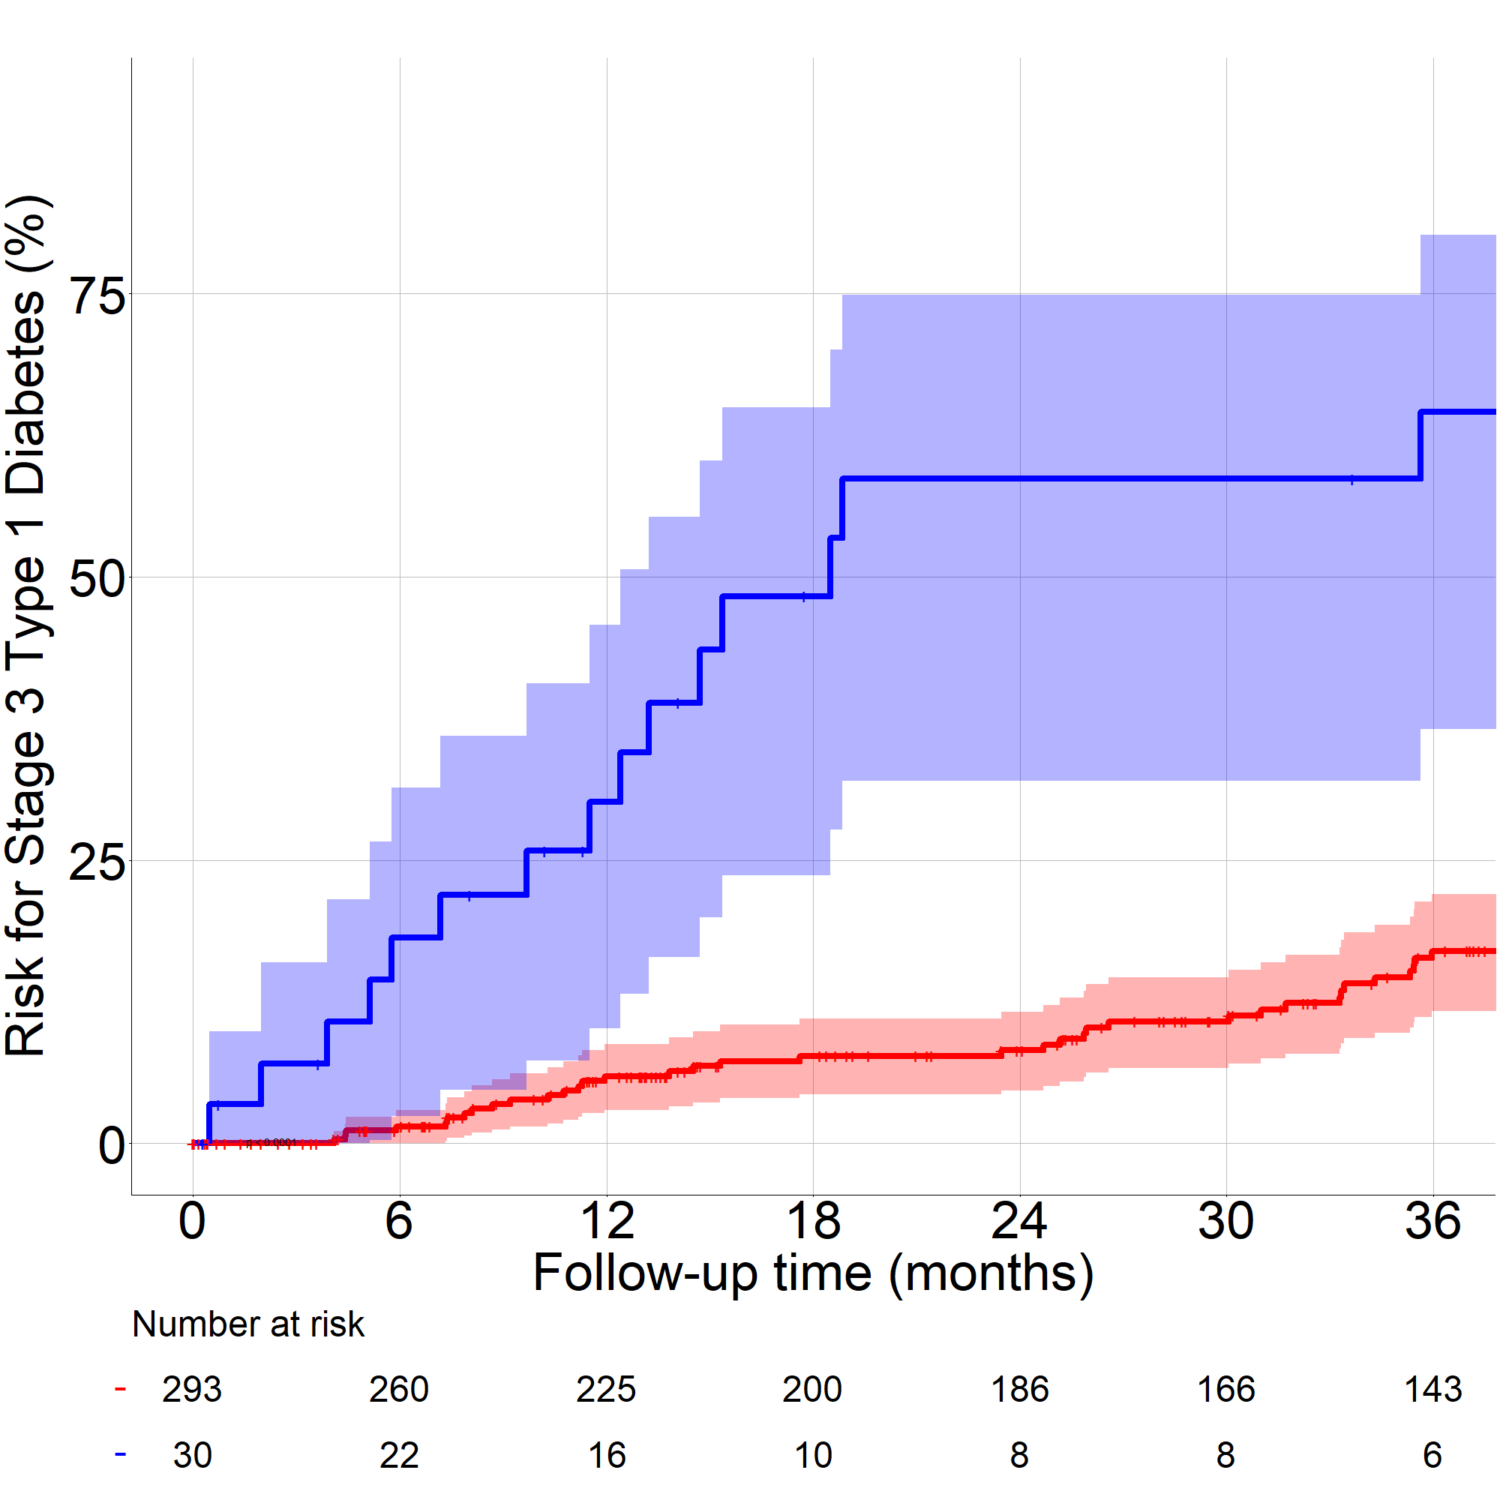
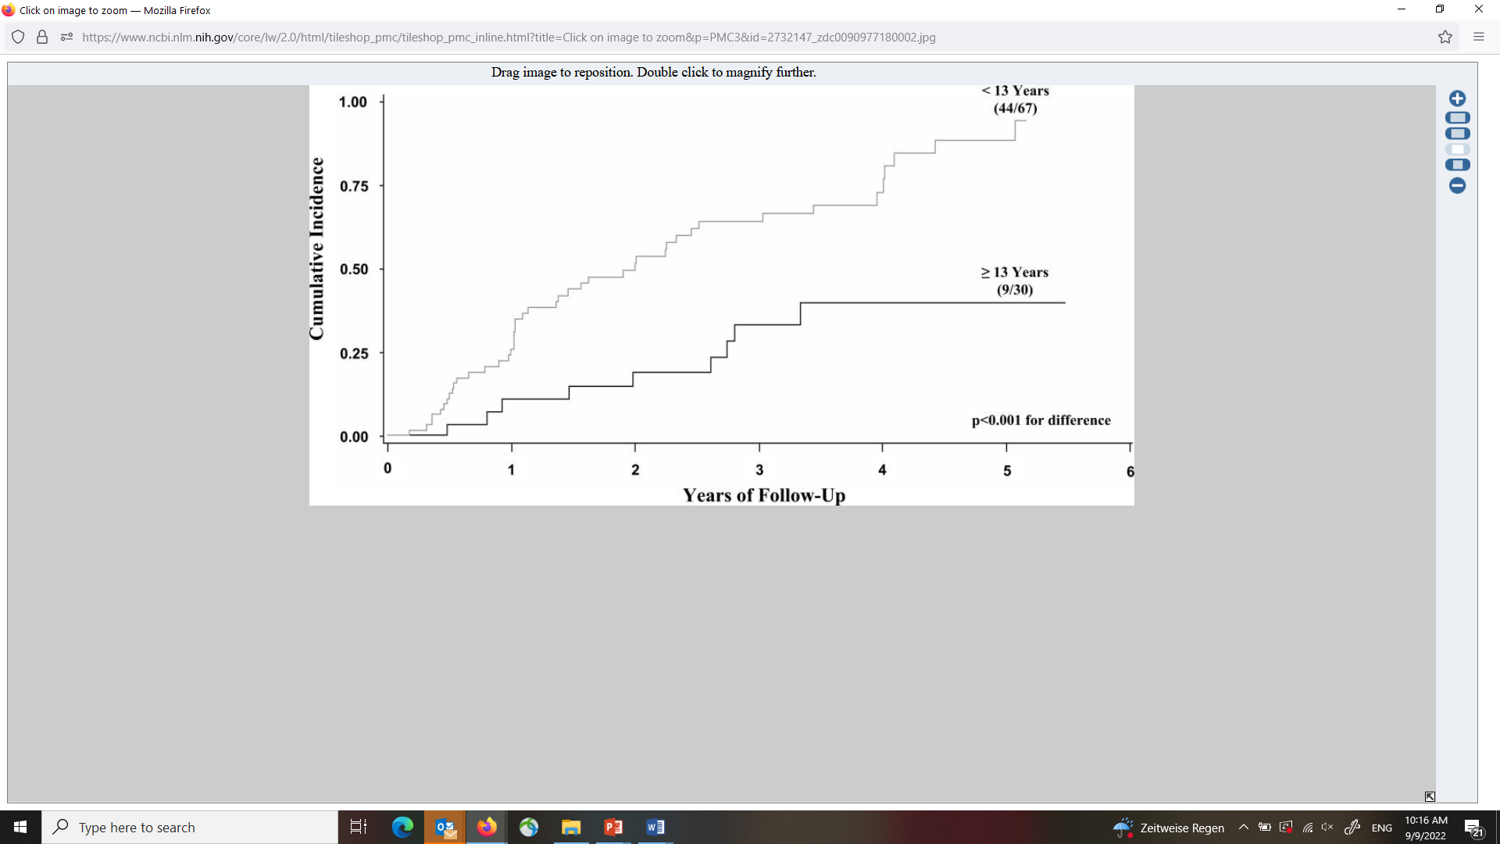
Disease progression from stage 2 to to stage 3 T1D
Progression to Stage 3 T1D
Progression to stage 3 in children with a T1D family history
from stage 2
from stage 2
from stage 1
Weiss A et al, Diabetologia 2022

Slide 6
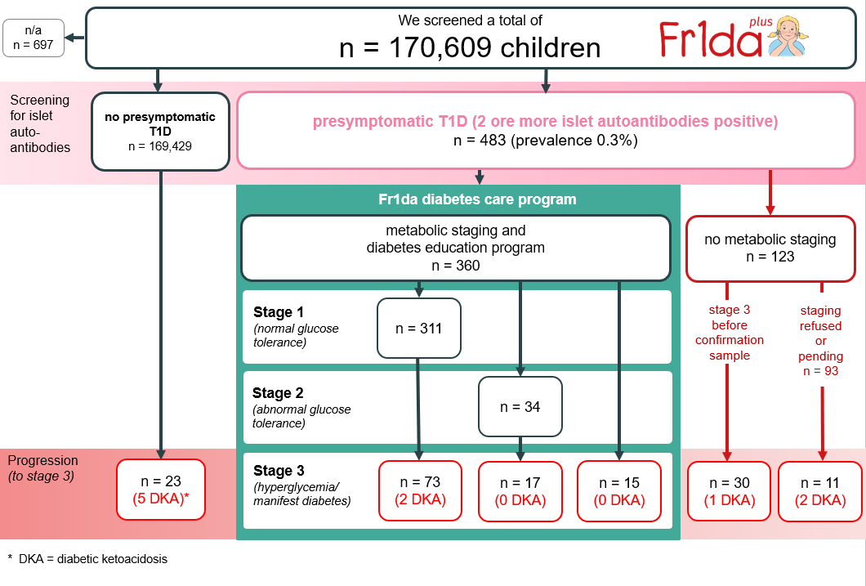
14%
(0.01%)
n = 57
27%
+6%
169 T1D
43%
10%

Slide 7
169 with stage 3 T1D in Fr1da
27 % diagnosed with presymptomatic stage 3a at staging or between screening and confirmatory sample
20% developed stage 3 and were islet AB neg at screening or refused participation in education and monitoring
53% developed stage 3 in follow-up after being diagnosed with stage 1 or stage 2
Important new indication for immunotherapy
Current target group for disease modifying immunotherapy

Slide 8
Can we improve staging ?
Can we identify a substage of stage 1 with a high rate of disease progression similar to stage 2

Slide 9
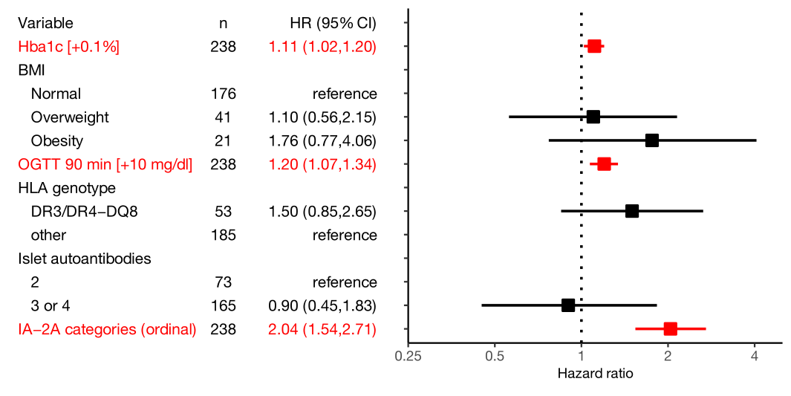


Which factors contributes to disease progression ?
- stage 1 to stage 3, multivariable -
Andreas Weiss
Jose Zapardiel Gonzalo
Weiss A et al, Diabetologia 2022
Progression Likelihood Score: exp[(HbA_{1c}[%] − 5.233) ×
1.125 + (OGTT₉₀[mg/dl] − 107.6) × 0.0195 + (IA-2A_{cat} − 1.27) × 0.662)]

Slide 10
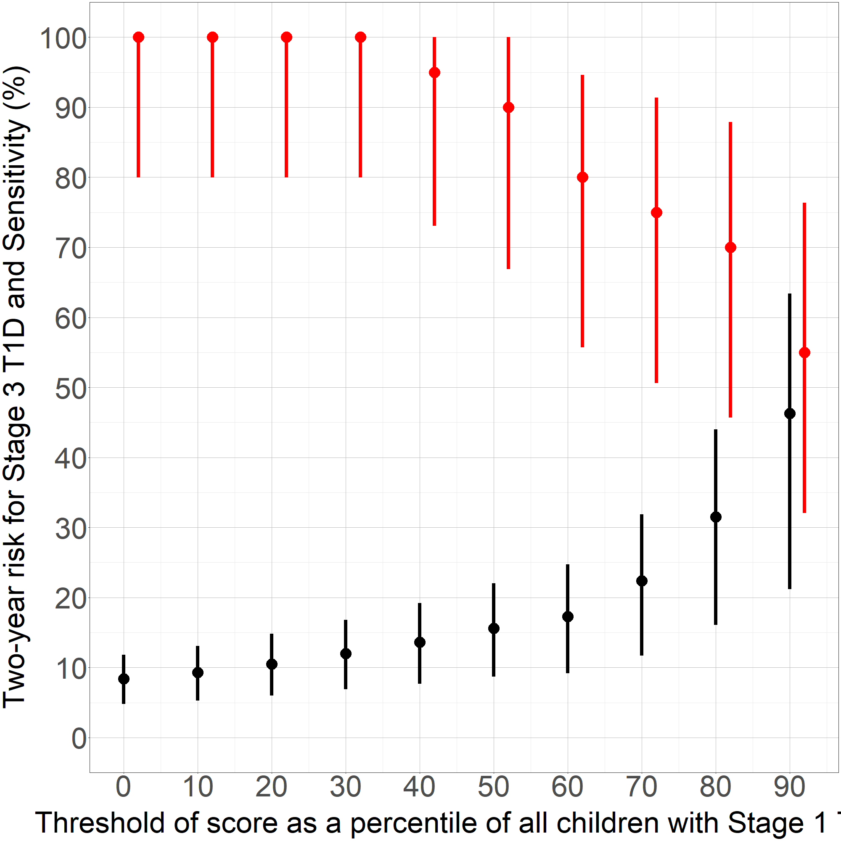
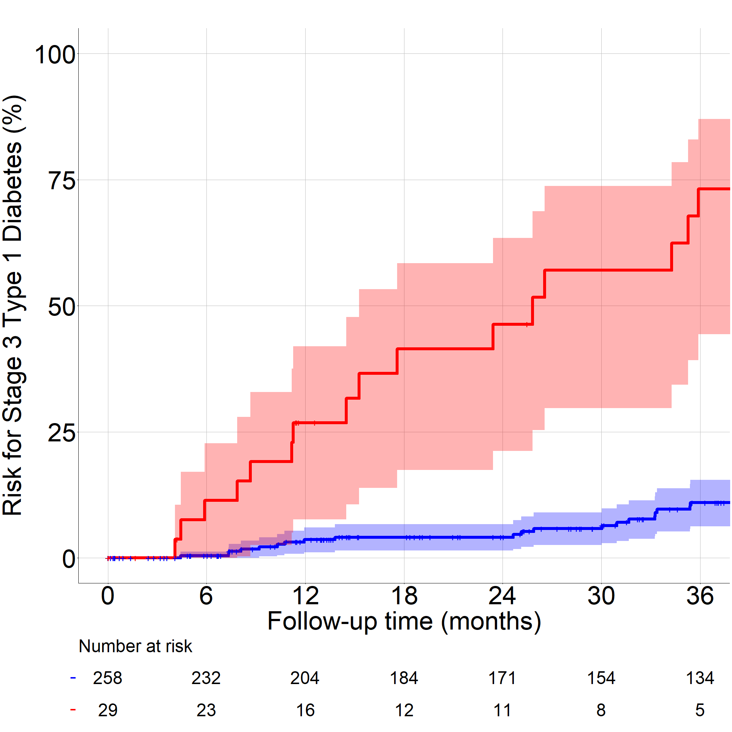
PLS > 90th centile identifies children with stage 1 with 50% risk of progression within 2 years
Progression from Stage 1 to Stage 3 T1D
Stage 1b; PLS > 90th centile
Stage 1a; PLS ≤ 90th centile
Weiss A et al, Diabetologia 2022

Slide 11
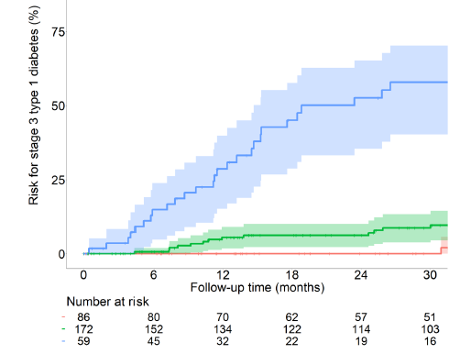
Staging plus PLS can identify very high risk and
majority of progressors within 2 years
Stage 1b and 2
25 (74%) cases within 2 years
9 cases within 2 years
Stage 1 PLS 30th – 90th centile
Stage 1 PLS <30th centile

Slide 12
Trial design and costs

Slide 13
Trial design and costs of screening
For a trial with 154 participants with a 2 year risk of ~ 50% (stage 2 or 1b)
For a ONE year enrollment: Screening of 810,000 children required (double for stage 2 only)
(requires testing of 13% of German children aged 2 to 10 years)
(16,000 tested per week)
€ 17 Million screening costs in Germany (double for stage 2 only)
Karl et al, Diabetes Care 2022; Weiss et al, Diabetologia 2022

Slide 14
Societal benefits of screening the general population for islet autoantibodies

Slide 15
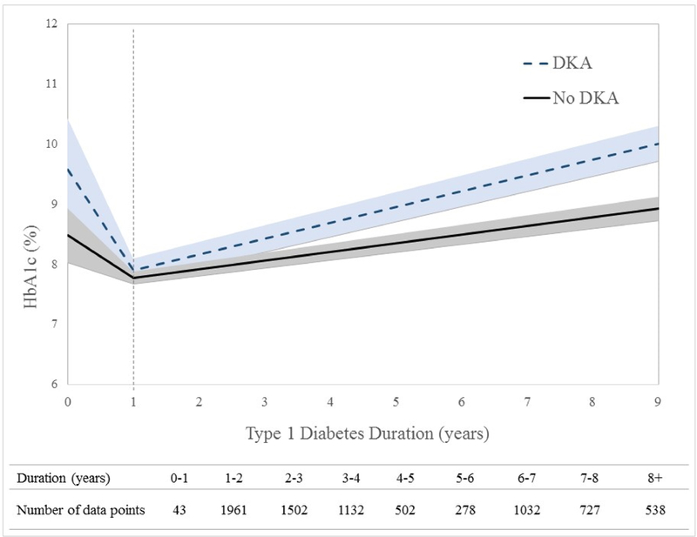
Reduction in the rate of diabetic ketoacidosis
Drastically reduced DKA rate
Improved long-term metabolic control (HBA1C) SEARCH, USA
DPV-Register
44.7%
2015-2022
24.5%
4.3%
2%
Total
2019
2020
Kamrath et al, JAMA 2022
Ziegler et al, JAMA 2020
Duca et al, Pediatr Diabetes 2019
education

Slide 16
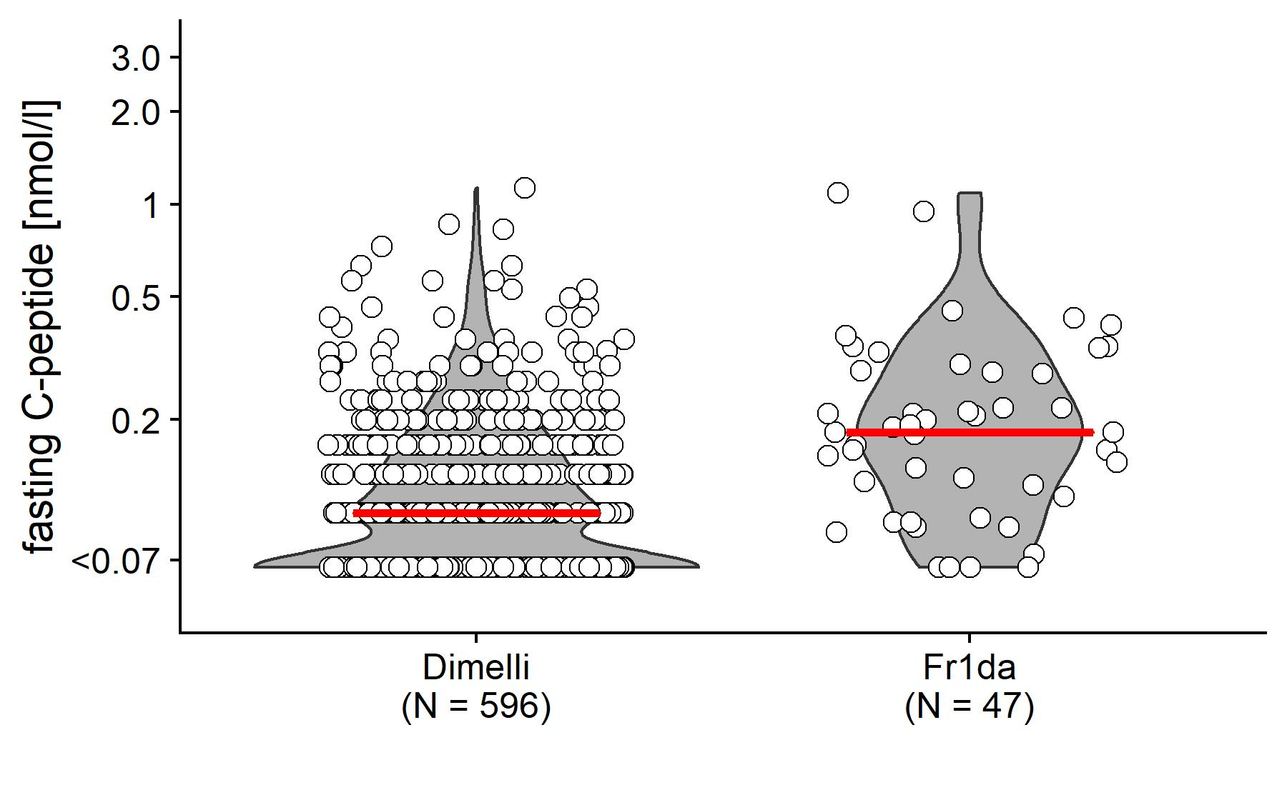
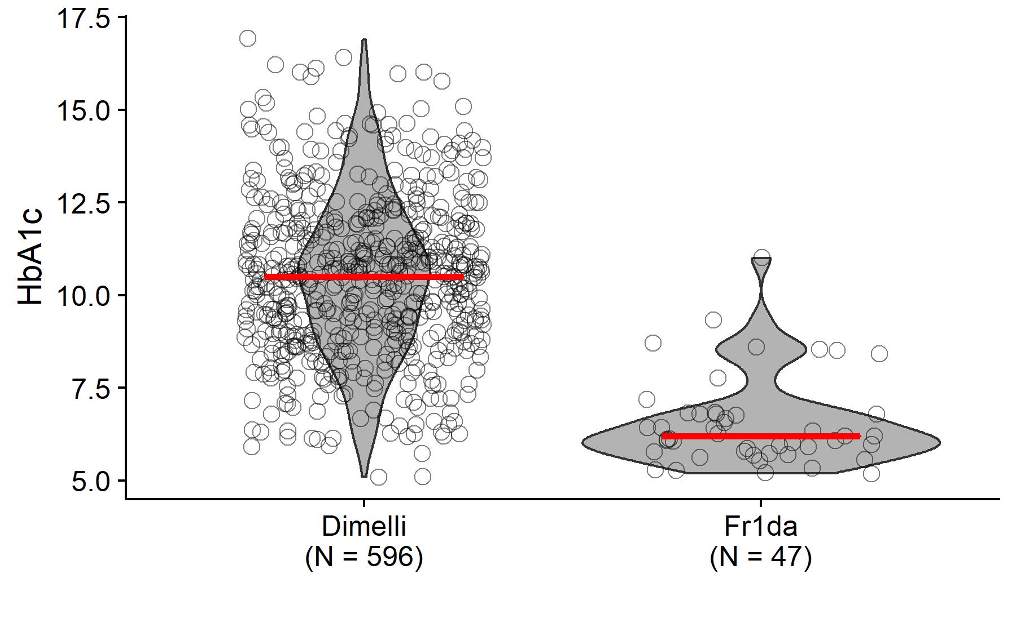
More beta-cell function at clinical diagnosis
Fasting C-Peptide at clinical manifestation
HbA1c at clinical manifestation
Median: 10.5
Median: 6.2
Median: 0.09
Median: 0.18
P<0.001
P<0.001
New onset register cohort in children in Bavaria, Germany

Slide 17
Summary: Successes and societal benefit
Improving care through early diagnosis, education, and treatment
Reduction in the rate of diabetic ketoacidosis
Improved metabolic control and beta-cell function at clinical diagnosis
Reduction in psychological distress through preventive education
Development of immune-based preventive therapy through recruitment into clinical trials
Future: Access to novel immunotherapy (Teplizumab)

Slide 18
Summary
General population screening is feasible
Progression rates are very similar to children with a family history of T1D
The identification of children with stage 1b T1D will double the number of people who may benefit from disease modifying therapy (> 50% progression to clinical T1D within 2 years)
Beyond immunotherapy there is an enormous societal benefit of screening and an early diagnosis
An important new indication for disease modifying immunotherapy may be stage 3a (= presymptomatic clinical T1D one third of cases)

Slide 19


Slide 20





Acknowledgements
Anette-G Ziegler, Peter Achenbach
Kerstin Kick, Joanna Stock
Florian Haupt, Christiane Winkler
Marlon Scholz, Rebecca Niewöhner
Franziska Voss, Jose Zapardiel Gonzalo
Manja Jolink, Andreas Weiss, Nadine Friedl
Clinical Centers in Bavaria
Fr1da Coodination Center at Helmholtz Munich

