Slide 1
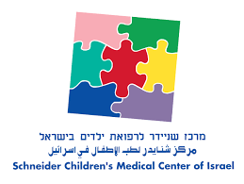

The
Antibody Detection Israeli Research
Tal Oron & Moshe Phillip
Schneider Children’s Medical Center of Israel
Childhood Diabetes Prevention Symposium 11.11.22
Notes:
I will shortly present the ADIR study
ADIR stansd for Antibody Detection Israeli Research. ADIR in hebrew means great or owsome which exactly what we think of this study

Slide 2
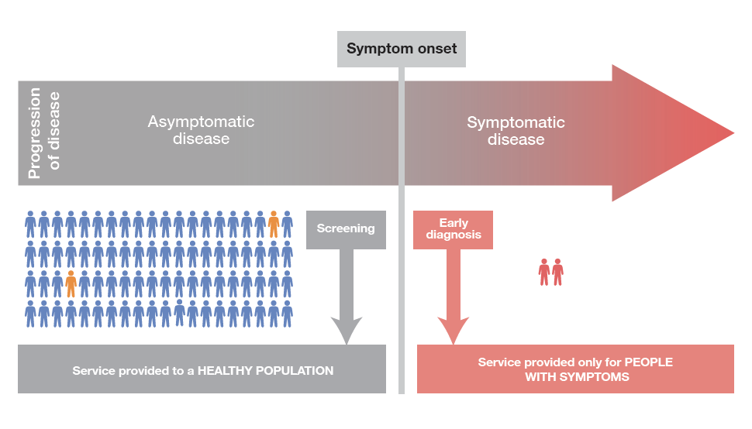
Screening for type 1 diabetes in the general population
Notes:
It is a general population screening program based on detection of islet autoantibodies. Looking at our ability to predict and prevent diabetes, one must remember that almost all the children diagnosed, have no family history of type 1 diabetes. So, in order to efficiantly detect children at risk for developing dibetes a general population screening program is warented. Such a program based on antibodis will detect children at risk of developing diabetes before the clinical appearance of the disease. detecting these children will help in preventing DKA episodes at prensentation and it seems that early interventions in these children will delay or even prevent the the clincal disease.

Slide 3
ADIR- Aim
Prevent DKA Episodes
Effective Therapy for T1D
Disease Prevention
Biomarkers
Further Studies

Slide 4
ADIR- Aim
A national, mandatory screening program based on antibodies that will identify children at risk of developing T1D
Prevent DKA Episodes
Effective Therapy for T1D
Disease Prevention
Biomarkers
Further Studies

Slide 5
ADIR- Design
A screening program for children all over Israel
20,000 children in this part of the study (50,000 children all over)
Aged 9-18 months, capillary blood
Each child will be evaluated again at ages 2-5 years
Children with multiple antibodies are followed- education, stress, prevention
An innovative screening technology
Notes:
As for the design of the study it is a

Slide 6

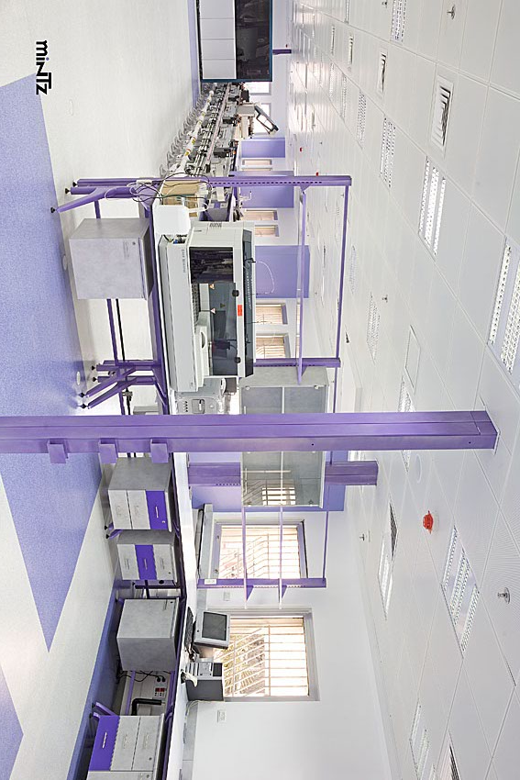
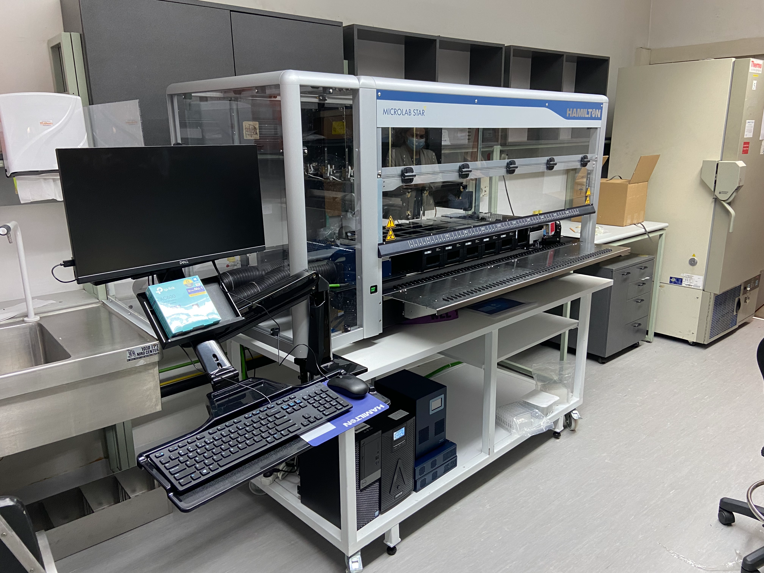
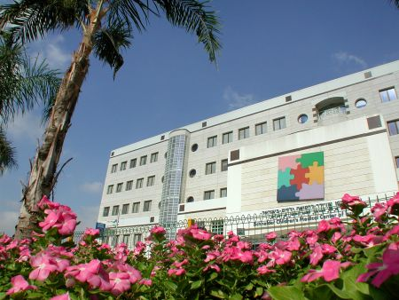

ADIR- Design
Enrollment
Community clinics
Central HMO labs
Study lab
Research center
Follow up
Diabetes centers

Slide 7

Clinics all over Israel

Slide 8
ADAP- Antibody Detection by Agglutination PCR
IA-2, IAA, GADA (Celiac)
Fully automated
1-4µL of blood
Enable Biosciences©
Reliable in serum
Notes:
We Use an innovtive method to detect th antiboddies. ADAP stands for antibody detection by PCR agglutination. As can be seen on the cartoon on the right, the assay is based on specific antigens that are conjugated to DNA strands. Using a bridge oligo an agglutination liagtion reaction occurs to create PCR amplicons that are amplified and quantified by real time PCR. The asay uses 1-4µL of blood and is fully automated done with the Hamilton robot. In our study we test for IA-2, IAA, GADA but with the same sample we can screen for other Abs such as celiac or zinc transporter. The assay was extensively evaluated in serum samples and to some extent in whole blood as well. Compared to the currently used RBA, and other methods ADAP has the highest sensitivity of all assays for GAD and IA-2 autoantibodies and is in the top-tier performance for insulin autoantibodies.
Establishing our program, we wanted to validate the assay in our hands and to see if it works as promised

Slide 9
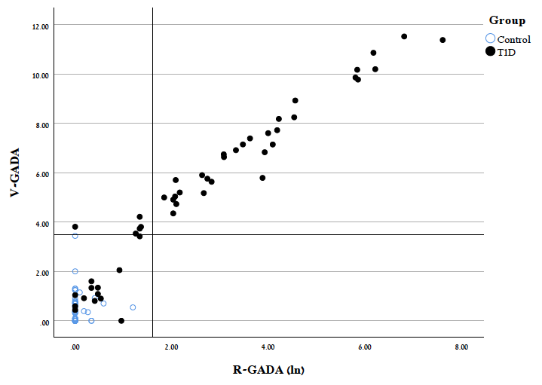
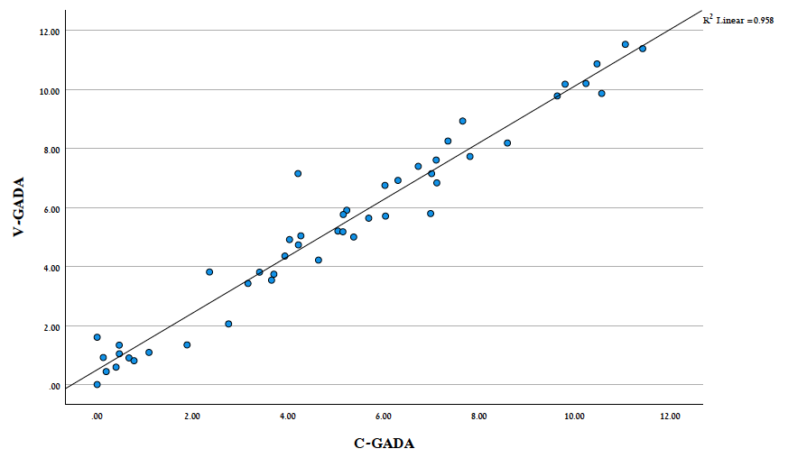
ADAP- Validation Study
ADAP vs. RBA
Venous vs. Capillary
Conclusions
Comparable to RBA /more sensitive
Whole blood=capillary blood
Notes:
We took blood from 50 T1D patients & 50 controls. from the patients- capillary & venous blood while from the healthy controls we took venous blood only. 200 µL were taken for each. We compered the currently used RBA to ADAP in whole blood and we compared the results in whole blood to those of capillary blood.

Slide 10
ADIR- Current Status
29 clinics recruiting >> 40 clinics
~2500 children recruited
9 positive children
Follow up at the diabetes centers
Working on the second stage

Slide 11

Diabetes centers- follow up
Education- DKA prevention
Signs and symptoms of diabetes
Defining stage 1&2 diabetes?
Future interventions

Slide 12

Stress assessment
A major concern
Specific questioners
Psychological interview
Stress alleviating interventions

Slide 13
The Israeli Prevention Network
An Israeli network dedicated to the study, prevention, and early treatment of type 1 diabetes
The goal of the Israeli prevention network (IPN) is to develop a primary prevention approach that is safe enough for administration to all children
A comprehensive and intensive effort of Israeli clinicians, academia, industry, funders, regulatory authorities, health care providers, and the diabetes community

Slide 14
ADIR- Summary
An ongoing general population screening program
A model for a national screening program
Screening at a young age & Two screens for a child
A promising screening technology
The Israeli prevention network

Slide 15
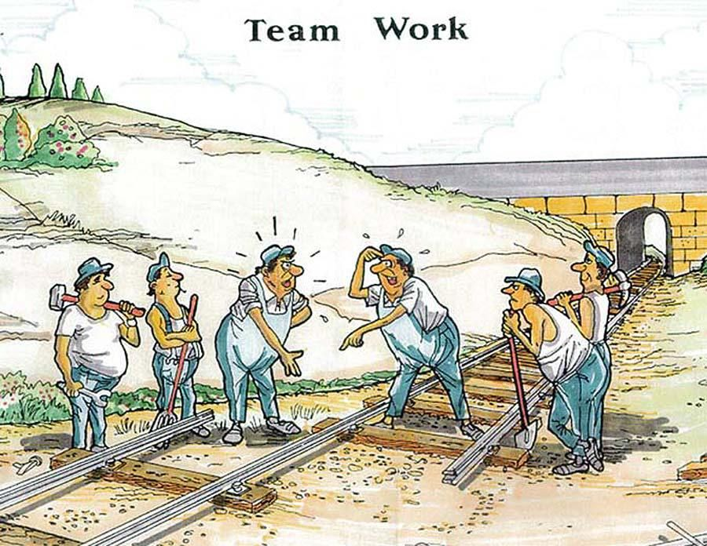

Thanks
Community clinics
Central labs
Diabetes centers
SCMCI
Our team

