Slide 1




Tracheal Intubation in the Pediatric Emergency Department:
Initial Findings from the VIPER Collaborative
Sage Myers, Karen O’Connell, Benjamin Kerrey, Alexis Sandler, Mary Frey, Aaron Donoghue on behalf of the VIPER Collaborative

Slide 2
COI
No relevant conflicts
Notes:
Mention that we combine video with direct collection of VS data from the monitor

Slide 3
Background: Tracheal Intubation
Essential but uncommon for individual providers in a PED
Self-report/chart review: unreliable for data on success/adverse events^{1,2}
Video review allows accurate and comprehensive data collection
¹Kerrey et al, Ann Emer Med 2012
²Rinderknecht et al, Acad Emer Med 2017
Notes:
Mention that we combine video with direct collection of VS data from the monitor

Slide 4
Objective
To report the initial findings from a multicenter research collaborative to study TI in three academic PEDs using video review

Slide 5
The Videography In Pediatric Emergency Resuscitation (VIPER) Collaborative
3 tertiary PEDs (CHOP, CNHS, CCHMC) using videorecording during resuscitation events in the ED
Data during tracheal intubation (TI) events collected by video review at each site and stored in central database
Aug 1 2016 – Apr 1 2018
Notes:
Mention likely extension to other sites
Summarize methods/database/video and continuously measured VS?

Slide 6
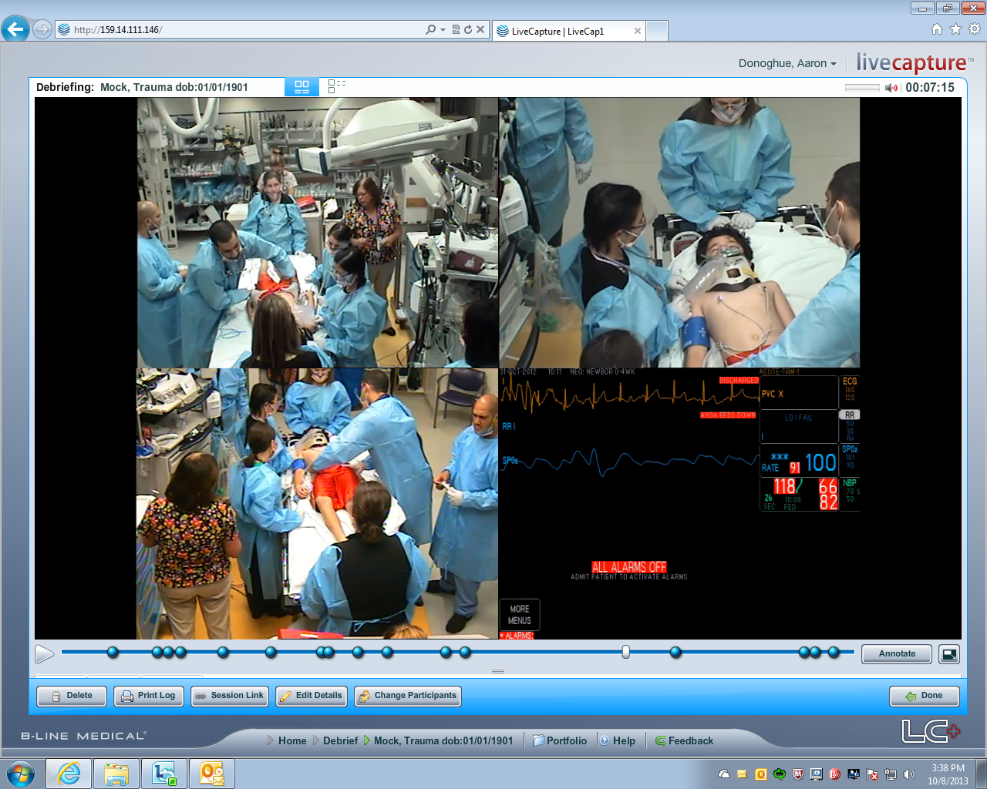
Notes:
Comments here can briefly summarize video programs (review, storage, deletion, consent)

Slide 7
Methods
Technical data (Y/N):
  Cricoid pressure
  External laryngeal manipulation (ELM)
  Apneic oxygenation
  Retraction of right corner of mouth to facilitate tube insertion¹
Time intervals (seconds):
  Duration of preoxygenation
  Total laryngoscopy time
  Time from start of laryngoscopy to tube insertion
  Time from start of laryngoscopy to ETCO2 detection
¹Shiima et al, Ped Crit Care Med 2018

Slide 8
Methods
Outcomes
  Intubation success
  Occurrence and duration (seconds) of hypoxemia (SPO₂ < 90%)

Slide 9
Results
140 patients underwent 216 TI attempts
Overall first attempt success: 89/140 (63%)
Median 1 attempt (IQR 1-2, range 1-5)
Notes:
Should we put the first attempt success by age into the pie chart?

Slide 10
Results: Hypoxemia
35/210 TI attempts occurred in patients with CPR in progress (no SPO₂ available)
Of remaining 175 attempts
  SPO₂ < 90 in 42 (24%)
  Duration of hypoxia (time to recover SPO₂ to > 90%):
  165 +/- 300 seconds
Notes:
desat <90%

Slide 11
Results: Time intervals
Time interval | Mean + SD
Duration of preoxygenation (first attempt) | 727 + 667 sec
Duration of preoxygenation (subsequent attempts) | 154 + 184 sec
Duration of laryngoscopy | 42 + 27 sec
Time to endotracheal tube insertion | 23 + 16 sec
Time to ETCO2 detection (for successful attempts) | 71 + 102 sec
Notes:
Maybe make the time ones into bar graph
I think that the people will most want to know:
First attempt success/total attempts
Duration of attempts
Desats
Times
Adjunctive maneuvers
I suggest presenting

Slide 12
Results: Adjunctive maneuvers
Maneuver | N (%) | Intubation success (%) |  | Larygoscopy time, seconds (mean + SD)
 |  | With | Without | With | Without
Cricoid pressure | 59 (27%) | 37/59 (63%) | 91/151 (60%) | 40 + 27 | 48 + 26
ELM | 9 (4%) | 6/9 (67%) | 91/151 (60%) | 42 + 27 | 44 + 39
Retraction of right corner of mouth | 16 (9%) | 13/16 (81%) | 114/167 (68%) | 43 + 28 | 45 + 13
Notes:
Maybe make the time ones into bar graph
I think that the people will most want to know:
First attempt success/total attempts
Duration of attempts
Desats
Times
Adjunctive maneuvers
I suggest presenting

Slide 13
Results: Adjunctive maneuvers
Maneuver | N (%) | Hypoxemia (%) |  | Larygoscopy time, seconds (mean + SD)
 |  | With | Without | With | Without
Apneic oxygenation | 8 (4%) | 0/7 (0%) | 40/160 (25%) | 33 + 13 | 43 + 28
Notes:
Maybe make the time ones into bar graph
I think that the people will most want to know:
First attempt success/total attempts
Duration of attempts
Desats
Times
Adjunctive maneuvers
I suggest presenting

Slide 14
Conclusions
First attempt failure, prolonged attempts and hypoxemia relatively common
Adjunctive maneuvers to improve success and prevent hypoxemia infrequently used
Video-based data registry allows accurate and comprehensive assessment of TI performance across multiple sites
Notes:
Do we know how the patients with adjunctive maneuvers compare to the whole group regarding intubation times and adverse events?

Slide 15
Limitations
Relatively close to beginning of data collection and differing start times for data submission
  Contribution of data not even by site
Data specific to pediatric tertiary care environment
No standardized protocols

Slide 16
Future Directions
Increase n and generalizability
  Time
  Addition of sites
Further analysis of detailed data
  Intubator level/specialty
  Type of laryngoscopy
Effect of interventions
  Training; Teamwork; Protocols

Slide 17

VIPER Collaborative
CHOP
  Aaron Donoghue, MD
  Sage Myers, MD
  Allison Mak
  Ichiro Watanabe
  Richard Hanna
  Priyanka Kharyat
CNHS
  Karen O’Connell, MD
  Alexis Sandler
  Matthew Ledda
CCHMC
  Benjamin Kerrey, MD
  Mary Frey, RN
  Stephanie Boyd, PhD
Notes:
? Should divide by location and put local logos- I am fine either way

