Slide 1




Video Versus Direct Laryngoscopy during Tracheal Intubation:
Initial Findings from the VIPER Collaborative
Benjamin Kerrey, Sage Myers, Karen O’Connell, Alexis Sandler, Mary Frey, Aaron Donoghue on behalf of the VIPER Collaborative

Slide 2
COI
No relevant conflicts

Slide 3
Background: VL versus DL
Tracheal intubation is an essential procedure in a PED
Video laryngoscopy (VL) in adults has been associated with higher success and longer procedure times
In the OR, VL in pediatric intubation has been shown to improve visualization but prolong intubation¹
Pediatric ED data is scant, and limited by imprecise definition of VL technique²
¹Fiadjoe et al, Anesthesiology 2012
²Eisenberg et al, Acad Emer Med 2016

Slide 4
Objective
To use video-based data collection to determine whether VL is associated with higher success rates and longer procedure times compared with intubations with DL during tracheal intubation in the PED
Notes:
Do we have any hypotheses?

Slide 5
Methods
Retrospective observational study
Data from Videography In Pediatric Emergency Resuscitation (VIPER) registry
  August 2016 – April 2018
  Inclusion: TI attempt including attempted tube placement
  Exclusion: TI attempt without attempted tube placement

Slide 6
Methods
Data fields from TI attempts:
  Use of VL versus DL
  Attempt success
  Time intervals: total laryngoscopy time, time from start to tube entry into mouth, time from tube insertion to end of attempt (laryngoscope removal)
  Hypoxemia to SPO₂ < 90%

Slide 7
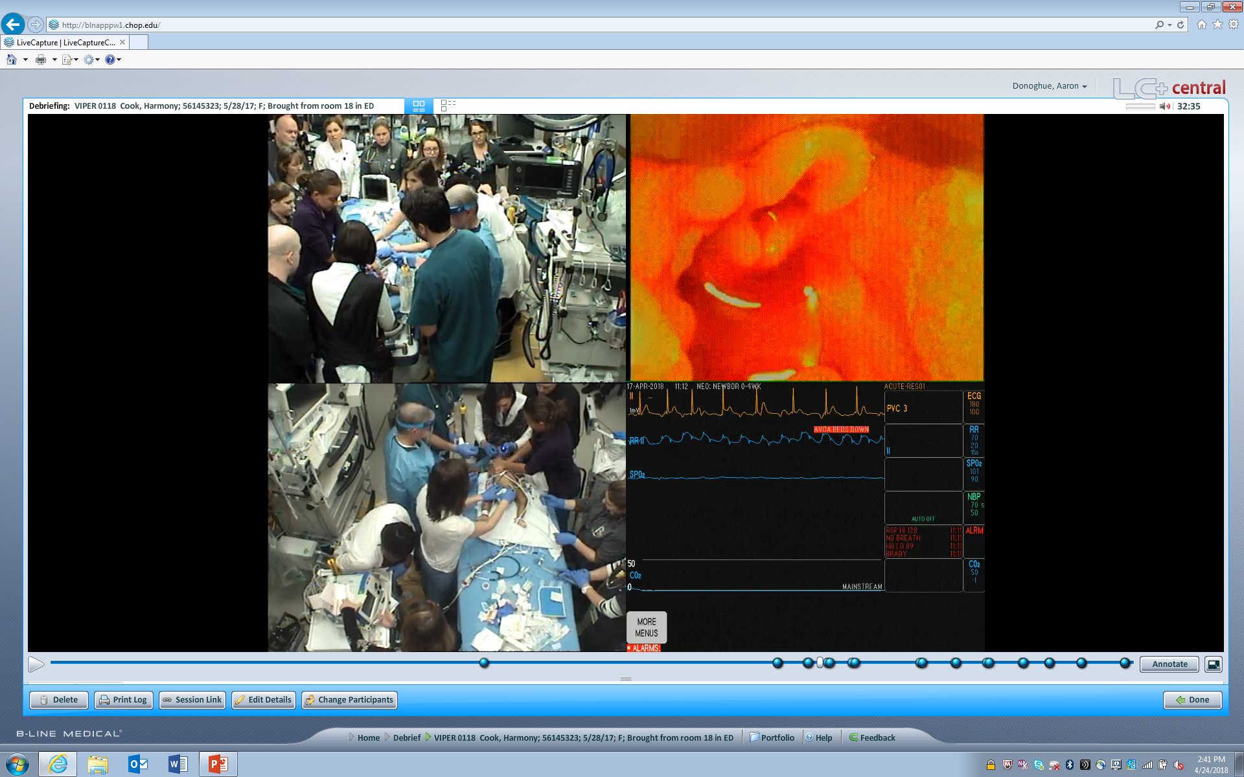
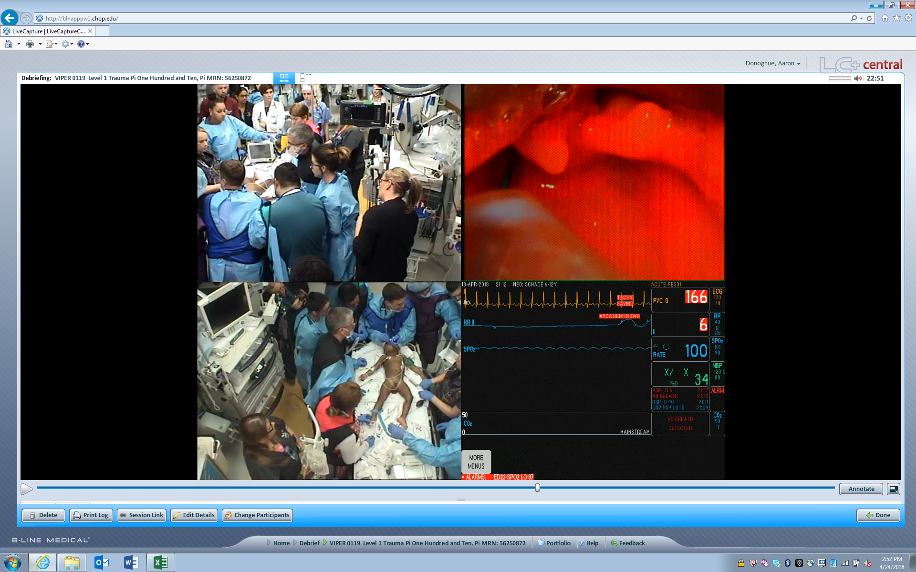
DL
VL

Slide 8
Methods
Univariate analysis between TI attempts using VL versus DL:
  Time intervals during procedure (Wilcoxon rank sum)
  Success (χ²)
  Hypoxemia (χ²)

Slide 9
Results
Complete data for 190 attempts in 120 patients
Overall first attempt success: 83/120 (69%)
Tube insertion was attempted during 176 (93%) attempts
VL was used in 80 (45%) of 176 attempts in 114 patients
  VL in 49/114 (42%) of 1st attempts
Notes:
Maybe make the time ones into bar graph
Will have to report enrollment by center - ?most VL done at one center?

Slide 10
Results: All TI attempts
Time interval (seconds) | DL | VL | p*
Total laryngoscopy time | 36 + 22 | 46 + 25 | 0.004
Time from start to tube entry | 21 + 15 | 23 + 17 | 0.3
Time from tube insertion to end of laryngoscopy | 17 + 14 | 23 + 17 | 0.001
Outcome | DL | VL | p**
Successful intubation | 75% | 66% | 0.2
SPO₂ < 90% | 24% | 24% | 0.9
*Wilcoxon rank sum; **χ2
Notes:
Maybe make the time ones into bar graph
Will have to report enrollment by center

Slide 11
Results: 1st attempts
Time interval (seconds) | DL | VL | p*
Total laryngoscopy time | 38 + 24 | 45 + 26 | 0.1
Time from start to tube entry | 22 + 16 | 23 + 18 | 0.3
Time from tube insertion to end of laryngoscopy | 16 + 15 | 21 + 17 | 0.07
Outcome | DL | VL | p**
Successful intubation | 74% | 71% | 0.7
SPO₂ < 90% | 20% | 19% | 0.9
*Wilcoxon rank sum; **χ2
Notes:
Maybe make the time ones into bar graph
Will have to report enrollment by center

Slide 12
Conclusions
VL and DL had similar success rates and incidence of hypoxemia
Across all attempts: VL had longer total time to procedure completion but similar time from TI start to tube insertion into mouth
  Difference not significant for 1st attempts only
Prolonged attempt duration with VL appears to be due to longer times needed for tube placement in trachea rather than glottic visualization

Slide 13
Limitations
Uneven enrollment (oversampling from 2/3 centers)
Effects of center, provider, and attempt number not controlled for
DL and VL are not always mutually exclusive
Visualization of airway inferred from video (e.g. cannot see what the VL sees)

Slide 14
Future Directions
Training/education regarding indirect technique during tube placement
Identification of patient characterstics associated with better outcomes from VL
RCT of DL vs. VL in the PED

Slide 15

VIPER Collaborative
CHOP
  Aaron Donoghue, MD
  Sage Myers, MD
  Allison Mak
  Ichiro Watanabe
  Richard Hanna
  Priyanka Kharyat
CNHS
  Karen O’Connell, MD
  Alexis Sandler
  Matthew Ledda
CCHMC
  Benjamin Kerrey, MD
  Mary Frey, RN
  Stephanie Boyd, PhD
Notes:
? Should divide by location and put local logos- I am fine either way

