Slide 1


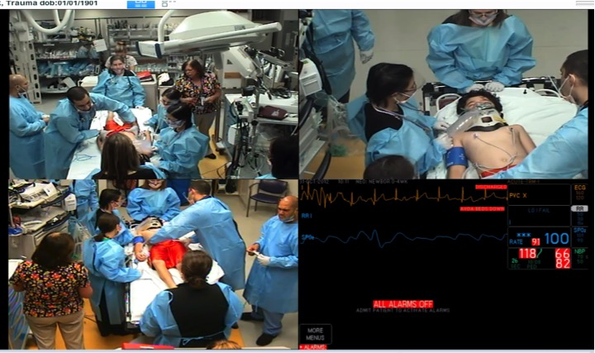
Evaluation of Team Performance in Video Review of Cardiopulmonary Resuscitation
Sage R Myers^{1,2}, Heather Wolfe^{1,2}, Aaron J Donoghue^{1,2},
(1) Children’s Hospital of Philadelphia (2) University of Pennsylvania
TAKE HOME POINTS:
Team performance in the delivery of CPR is an important metric and impacts compliance with care guidelines
Video-review of real resuscitation events is an efficient, reliable and feasible method for quantitatively rating team performance
METHODS
Event Characteristic | Mean BAT (SD) | Mean BAT (SD) | P-value
Infant vs Older child* | 37.5 (3.8) | 27.9 (3.6) | 0.005
Out-of-Hospital (OOH) arrest vs In-Hospital (IH) arrest | 35.4 (4.9) | 28.7 (5.7) | 0.04
Chest compression duration < 10min vs ≥ 10 min | 33.2 (5.3) | 31.8 (6.9) | 0.77
Chest compression fraction < 80% vs ≥ 80% | 34.5 (7.8) | 31.9 (6.2) | 0.49
Prospective observational study of pediatric cardiac arrests presenting to the ED
All pediatric resuscitations requiring CPR are video-recorded for QI purposes
Behavioral Assessment Tool (BAT) used to rate team performance
BAT = 10 domains of team performance each on a 0-4 Likert scale. Total score range 0-40.
Univariate comparisons BAT scores and patient characteristics using nonparametric methods.
11 events scored by 2nd study team member
OBJECTIVE
*Infant defined as <365 days of age: 4/6 infant arrests due to SUIDS / SIDS
To demonstrate the feasibility of the use of video review to evaluate team performance during real CPR events.
INTRODUCTION
CONCLUSIONS
RESULTS
Approximately 16,000 children suffer cardiac arrest per year
High-quality CPR is critical for optimizing patient outcomes¹
CPR involves multi-disciplinary team with multiple role-based tasks occurring simultaneously
Team dynamics are learning objectives of AHA courses
Video-based review of pediatric CPR events is a feasible and reliable method for efficient evaluation of team performance using validated tools
Better team performance is found in events involving infants and those involving OOH arrest
  More experience, more preparation time, expected/known algorithms
No association between team performance and CPR performance as measured by CCF
Lowest subscores in Attention Allocation, Distribution of Workload, Information Utilization and Communication within Team
  Consider interventions around presentation of information or information display
Quantitative assessment of team performance allows for needs assessments to determine areas in which intervention should focus to maximize impact on CPR quality and assess results of chosen interventions
Future work should focus on use of video-review and validated tools to test interventions to improve team performance
13 events requiring CPR reviewed
Interrater reliability: kappa = 0.82
Mean BAT scores = 32 (SD 6) of total 40
2015 AHA GUIDELINES
BAT subscore | Mean (SD)
Knowledge of Environment | 3.4 (0.8)
Anticipation of and Planning for Potential Problems | 3.3 (0.8)
Assumption of Leadership Role | 3.4 (0.8)
Communication with other Team Members | 3.1 (1.0)
Distribution of Workload / Delegation of Responsibility | 2.9 (0.9)
Attention Allocation | 2.5 (1.3)
Utilization of Information | 3.0 (1.3)
Utilization of Resources | 3.5 (1.2)
Recognition of Limitations / Call for Help Early Enough | 3.6 (0.8)
Professional Behavior / Interpersonal Skills | 3.6 (0.5)
“Given the importance of team dynamics in resuscitation, training with a focus on leadership and teamwork principles should be incorporated into advanced life support courses.”
AHA has developed a pit crew analogy to team performance in resuscitation and provides examples of team performance:
http://www.heart.org/cprquality.
REFERENCES
¹American Heart Association, Get With the Guidelines-Resuscitation QI Program; ²LeFlore, Sim in Healthcare, 2007
The authors wish to acknowledge the Zoll Foundation for their support of this research.

