Slide 1
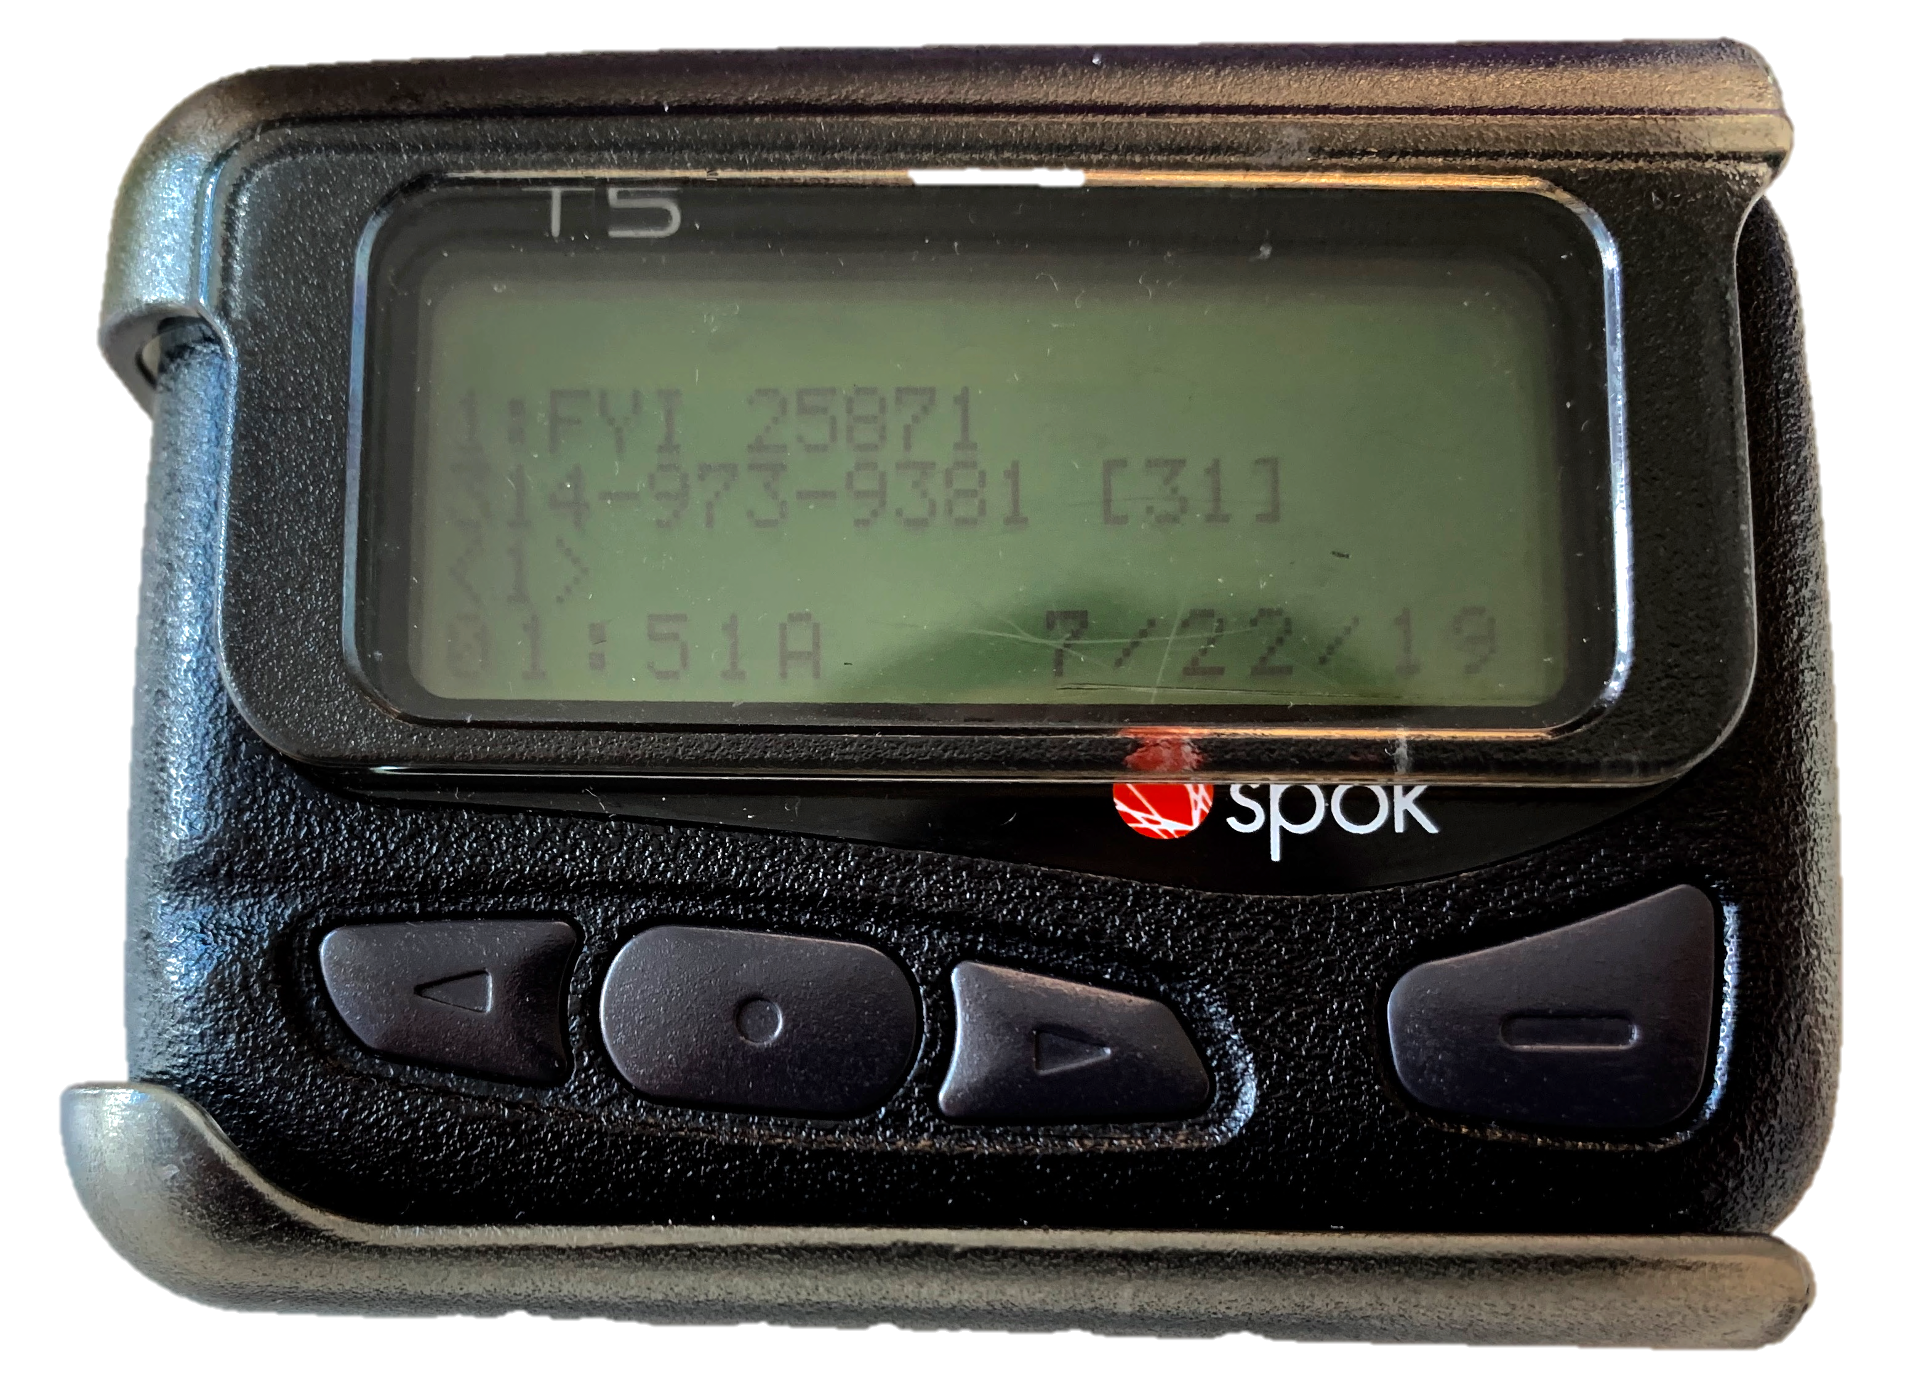


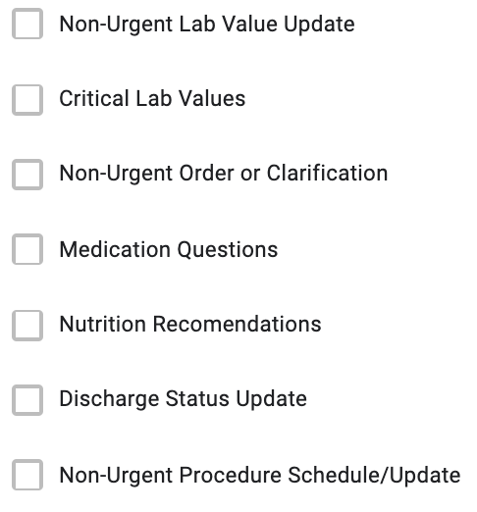
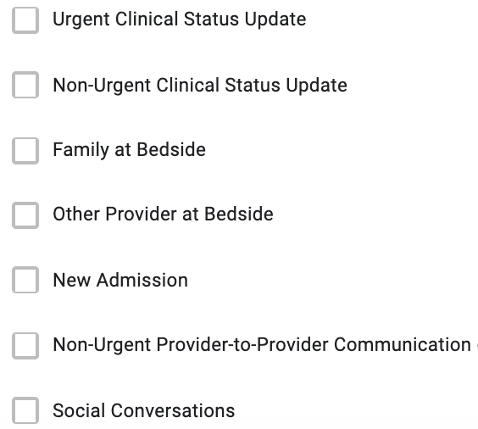

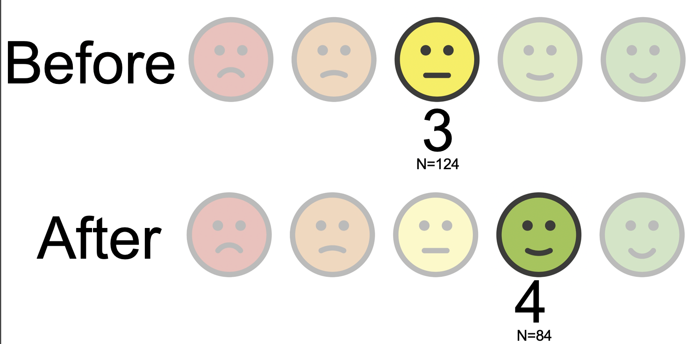
Not on the Same Page
Emily Wolverton, Arden Maren, Diana Rodriguiez, Raj Kondapally, Sagarika Arogyamswamy, Tony Ragusa
Tyler Anstett, DO, Manny Diaz, MD, Emily Gottenborg, MD
University of Colorado School of Medicine
Learning Points
Pagers alone cannot meet the communication needs of large academic hospital centers.
HIPAA-compliant group messaging systems are a new form of communication which serve a specific role in communication and thus require clear guidelines for use
Statement of Problem
Intervention
Results
Efficient communication among interdisciplinary care team providers is critical for high quality care.
Pagers are outdated and inefficient for communication: they disrupt workflow, interfere with learning, and require multiple steps.
HIPAA-compliant group messaging (HCGM) systems like Secure Chat increase communication volume and efficiency¹ and improve provider perception of hospital communication².
As a new method of communication, it is necessary to identify the appropriate settings in which to use Secure Chat and to create a set of clear universal guidelines for its use.
Surveyed 102 interprofessional members of inpatient healthcare teams at a large academic medical center regarding their perception of appropriate use of HCGM for common clinical questions and concerns
“Which of the following would you feel is APPROPRIATE to communicating about through Secure Chat -- the instant messaging service in Epic and on Haiku/Rover?”:
Secure Chat = wide variety of of non-urgent matters.
Pagers = reserved for high priority communication.
Appropriate Use:
Non-urgent order or clarification
Non-urgent procedure schedule/update
Non-urgent lab value update
Non-urgent provider-to-provider communication
Nutrition recommendations
Discharge status update
Non-urgent clinical status update
Inappropriate Use:
Critical lab values
Urgent clinical status update
Social conversation
Most common hospital communication satisfaction score before and after implementation of Secure Chat:
Items 75% or more of respondents agreed upon as appropriate
Lessons Learned
Discussion
Despite clear weaknesses to the paging system, it is strongly integrated into the healthcare system, meaning integration of a new communication system requires a stepwise transition.
Secure Chat is used by a huge variety of healthcare providers, so their preferences must be considered.
Aims
Survey administered as Secure Chat was being introduced to the University of Colorado Hospital. As its use becomes more consistent, it may be necessary to reassess our current guideline recommendations.
Future studies should be done in the outpatient setting and in smaller or non-academic hospitals to determine best practices in those settings.
Improve the communication experience of the healthcare team using Secure Chat
Develop clear and universal guidelines for the appropriate use of Secure Chat among health care providers.
Patel, S. P. et al. Resident Workload, Pager Communications, and Quality of Care. World J Surg 34, 2524–2529 (2010).
Katz, M. H. & Schroeder, S. A. The Sounds of the Hospital. New England Journal of Medicine 319, 1585–1589 (1988).
References

