Slide 1


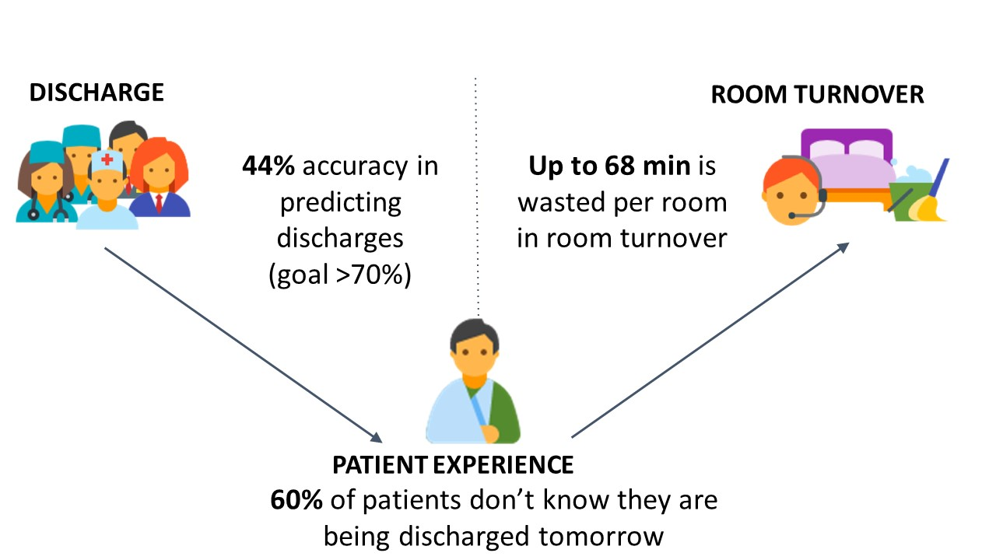



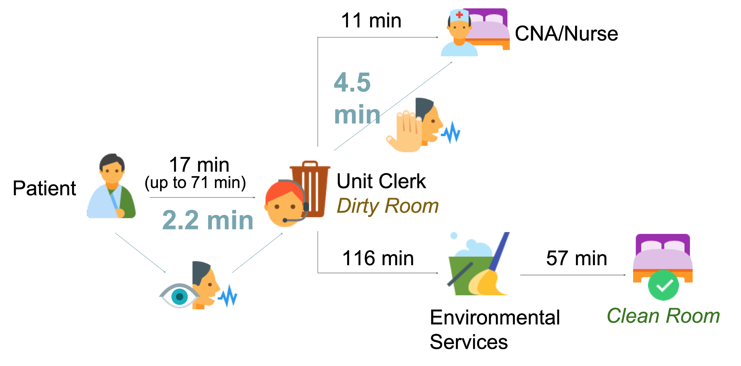
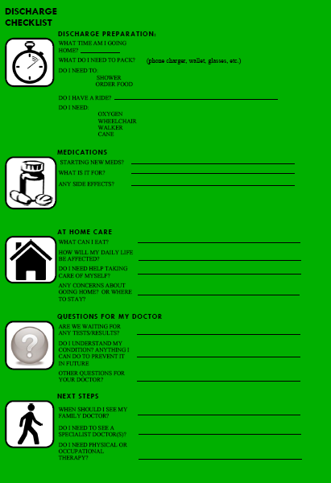
Reducing Patient Discharge Delays and Room Turnover Time: Quality Improvement on a
Hospital Medicine Unit
Joshua Baalman¹, Colleen Bono², Cody Harry³, Terah Hennick⁴, Afifah Khan⁵, Hans Lui⁶, Anastasiya Ponomaryova⁷, Colbey Ricklefs⁸, Tyler Anstett, DO⁷, Manny Diaz, MD⁷, Emily Gottenborg, MD⁷
¹University of Illinois School of Medicine, ²Lake Erie College of Osteopathic Medicine, 3University of Nevada, Reno School of Medicine, 4University of Central Florida College of Medicine, 5Eastern Virginia Medical School, 6UC Berkeley-UCSF Joint Medical Program, 7University of Colorado School of Medicine, 8University of Missouri School of Medicine
We can improve the ability to accurately identify discharge delays through a standardized process using the ‘Avoidable Delays form’ in Epic by integrating it into daily multidisciplinary rounds.
We can improve patient satisfaction as measured by three HCAHPS domains related to discharge communication by engaging patients 24 hours in advance with a patient-centered Discharge Checklist.
We can decrease the overall room turnover time of non-isolation patient rooms by 30 minutes by improving communication among MHSU staff and utilizing support staff in room cleaning tasks.
Key Point
We can improve the discharge and room turnover processes by targeting physicians, patients, and systems.
Background
Areas for Improvement
Conclusions
Hospitals spend an estimated $2721 for every inpatient day.
Longer lengths of stay are associated with increased patient mortality and reduced hospital reimbursement, and hinder efficient patient flow through the hospital.
The average length of stay is impacted by providers, patients themselves, systems, and external factors.
Tracking avoidable discharge delays can improve discharge prediction accuracy. We recommend implementing a standardized identification process.
As 60% of patients are unaware of their discharge time, we recommend implementing a patient-centered Discharge Checklist to improve patient readiness and satisfaction.
Room turnover time can be reduced and cleaning response times can be improved by addressing communication inefficiencies amongst hospital-wide entities. Efforts to expedite turnover time can include patients notifying a unit clerk of their departure and utilizing CNAs/volunteers to initiate turnover.
Purpose
In order to reduce length of stay, we focused on patient and provider barriers to discharge, and inefficiencies in the post-discharge room turnover time.
Results
Discharges were most often delayed due to patient readiness, including a lack of awareness of discharge (60% of patients) or lack of transportation from the hospital. More than 69% of patients were discharged on time when provided a Discharge Checklist. From our “stop” sheet, we reduced room turnover time from 192 to 162 minutes, a 16% overall reduction.
Discharge Hypotheses
References
Current
The Kaiser Family Foundation’s State Health Facts. Data Source: 1999 - 2015 AHA Annual Survey, Copyright 2016 by Health Forum, LLC, an affiliate of the American Hospital Association, “Hospital Adjusted Expenses per Inpatient Day.”
Wait
Room Turnover Results
Nurse
Discharge instructions
Patient
About the HISP Program
Proposed
The Health Innovations Scholars Program (HISP) is an intensive summer experience for pre-clinical medical students from across the country. As an initiative of the Young Hospitalist Academy Program at the University of Colorado Hospital (UCH), it accelerates mastery of the skills necessary to be a strong physician leaders and healthcare innovators.
Discharge Checklist
Nurse
Discharge instructions
Patient

