Slide 1

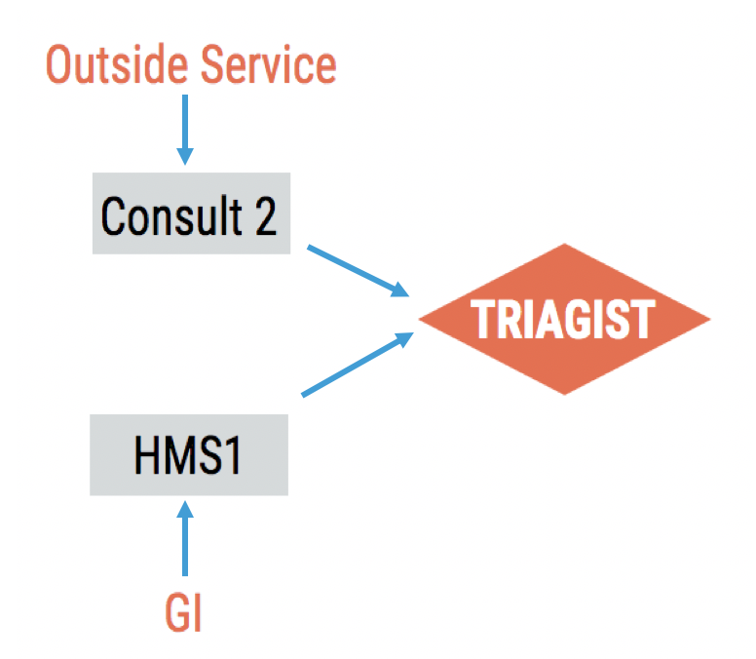
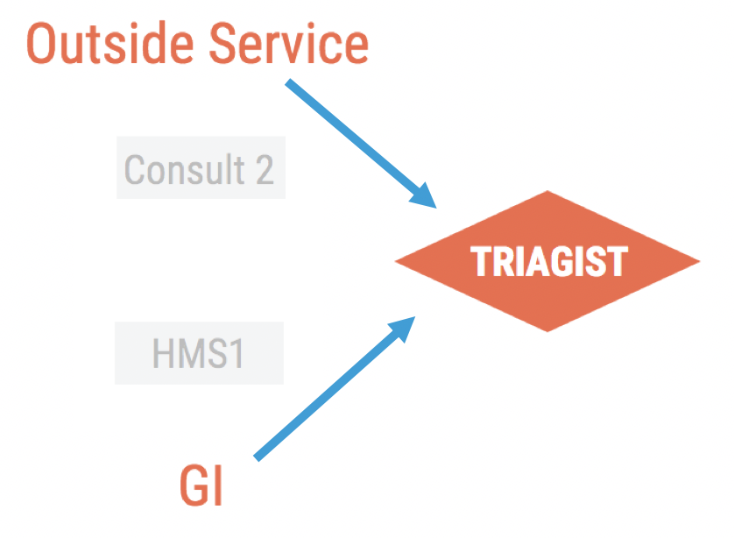
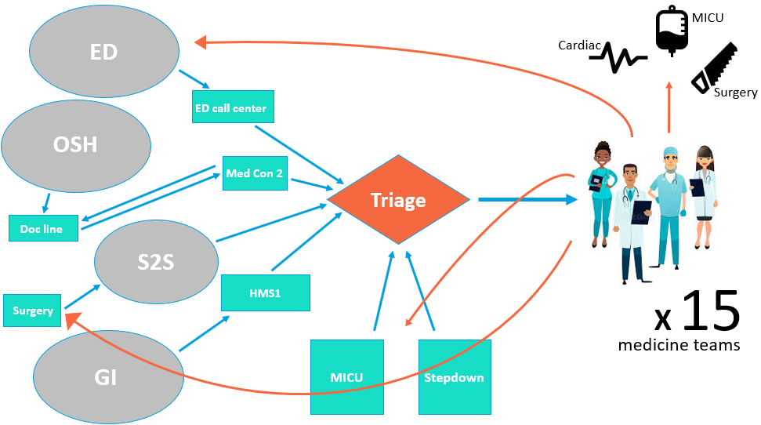
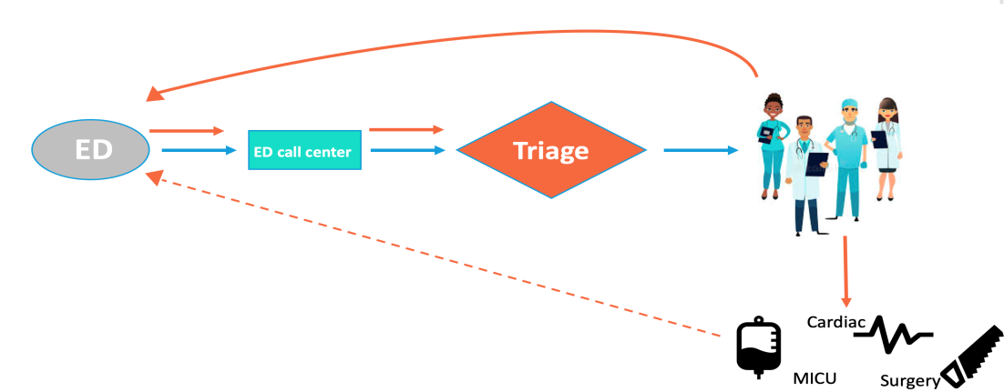
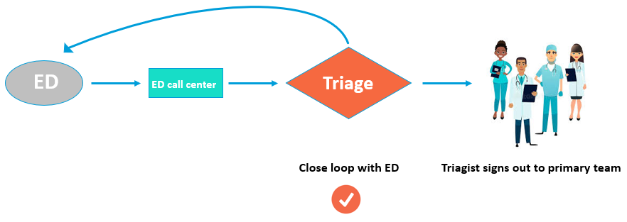
Optimizing the Medicine Triagist Role at
University of Colorado Hospital
Sandeep Bala¹, Mathilde Franklin², Sayeed Hasan³, Emma Pindra², Anushka Sindkar⁴, Molly Thayer⁵,
Neel Vahil⁶, Tyler Anstett DO⁵, Manny Diaz MD⁵, Emily Gottenborg⁵
¹University of Central Florida College of Medicine, ²Eastern Virginia Medical School, ³Medical College of Georgia, ⁴Rutgers New Jersey Medical School,
⁵University of Colorado School of Medicine, ⁶New York Medical College
Background
Aim Statement
Results
As hospitals across the nation become larger and more complex, they’re increasingly challenged to manage patient flow through various hospital departments as efficiently as possible. In 2017, the Department of Hospital Medicine (DHM) at UCH admitted 9,657 patients.
The Triagist position within the DHM is responsible for fielding patients from multiple inputs into the medicine service. The job was recently acquired by the DHM with the intention to be staffed by the advanced practice providers (APP) within the DHM.
Over the time period of this project, the DHM ran at or over capacity everyday, stressing the importance of optimal flow and accurate patient placement
The Health Innovations Scholars Program (HISP) 2018 cohort was charged with optimizing the “new” triagist role within the DHM.
To optimize the Triagist position by streamlining the triaging process (through centralization and step elimination) and integrating clinical decision making in order to reduce waste, ensure accurate patient placement and improve job satisfaction.
PDSA 1:
Reduction in # of steps by 50%
Saved ~40 minutes of call time per week
Positive feedback from the HMS1 and Consult 2 attendings
PDSA 2:
Potential 14 medicine beds identified per week
Triagist reported that the change was feasible and valuable
“I felt that I helped get patients to the right place while saving time for
my colleagues to do direct patient care”
PDSA 3:
Cut the ED consult to admit time by 20 minutes (34.5 to 14.2 minutes)
Positive feedback from ED providers
Triagists found it manageable but expressed concerns about whether it would be doable during times of higher call volume.
Methods
Conducted interviews with key stakeholders ranging from Docline, Emergency Department providers, Department of Hospital Medicine providers and the Advanced Practice Providers who have both performed the role of the Triagist as is or will be taking it over in the near future.
Conducted focus groups with former and future “Triagists” and observed the Triagist role.
Created a detailed process map of the steps and functions to appropriately admit patients to a hospital medicine service.
Implemented rapid, iterative PDSA cycles
Interventions (PDSA cycles)
Current State Analysis
Interventions (PDSA cycles)
PDSA 1: Transfer GI post procedure calls and Service to Service Transfers from intermediaries (HMS1 and Consult 2) directly to the Triage provider Fig. 2 Pre/Post PDSA1 process maps of GI and Outside Service admission to DHM
PDSA 2: The Triagist conducts a chart review on every patient before making team assignment to determine if it is an appropriate transfer. Specifically looking for: Family Medicine (FM) Readmission Floor appropriate/Medicine appropriate
PDSA 3: Closed loop signout between admitting ED provider and Triagist before team assignment 80% of patients are admitted to the medicine service from the ED and requires the greatest number of steps The Triagist was asked to chart review every patient upon admission request and confer directly with the ED to come to a shared decision on how the patient should be directed Fig. 4 Pre/Post PDSA3 process maps. Left: example of current state where blue arrows indicate initial communication and orange arrows depict next steps and potential downstream communications. Right: Direct Triagist to ED provider communication with closed loop handoff before transfer to destination DHM team.
Process:
There are 6 different inputs that can admit onto a medicine team.
4 out of 6 inputs (ED, outside hospital, service to service transfer, GI post procedure) use intermediaries that require call backs between multiple providers before reaching the Triagist.
The Triagist assigns patients to one of 15 medicine teams using “The Drip” algorithm, while being mindful of team caps, education days, and readmissions
Figure 1. Process map showing inputs into medicine with possible downstream outputs.
Observations:
APPs assigned the role feels it undervalues clinical expertise and is too clerical
Cultural dissonance between the ED and DHM, as well as professional hierarchies across department lead to “push backs” and potential misplacement of admitted patients
Areas of waste include education days, push backs, failure to chart review
Recommendations and Future Directions
Apply interventions.
  Incorporate S2S transfer calls, GI post procedure calls, ED call back / sign outs, and chart review into the Traigist’s role
  Annual potential:
    106 patient days saved
    $300,000 in reduced waste
    >700 medicine beds opened
Field post discharge calls to Triagists.
  60 out of 140 post discharge calls are currently going to non clinical DHM administrative staff.
  Streamline these post discharge calls into the triagist’s role to ensure appropriate post discharge care.
Begin dialogue towards greater hospital cultural shift.
Address cultural barriers between DHM and ED impacting patient care and hospital flow.
Encourage close collaboration and the fostering of mutual respect between hospital departments, especially between doctors and APPs across departments
Fig. 3 Percentage of patients transferred off of a DHM service within 12 hours of admission to DHM service. Between Feb-Jun, 41% were transferred to MICU and 14% were transferred to FM
References
Howell E, Bessman E, Kravet S, Kolodner K, Marshall R, Wright S. Active bed management by hospitalists and emergency department throughput. Ann Intern Med. 2008;149(11):804-811.
We can improve hospital flow and reduce waste through the Triage role within Hospital Medicine

