Slide 1


Patient Health Record
Linkage Methods
Toan C. Ong, PhD

Slide 2
Agenda
Definition and objectives of record linkage
Linkage process
Linkage variables
Linkage methods

Slide 3
Definition
Record linkage: a process to determine if two or more records belong to the same individual

Slide 4
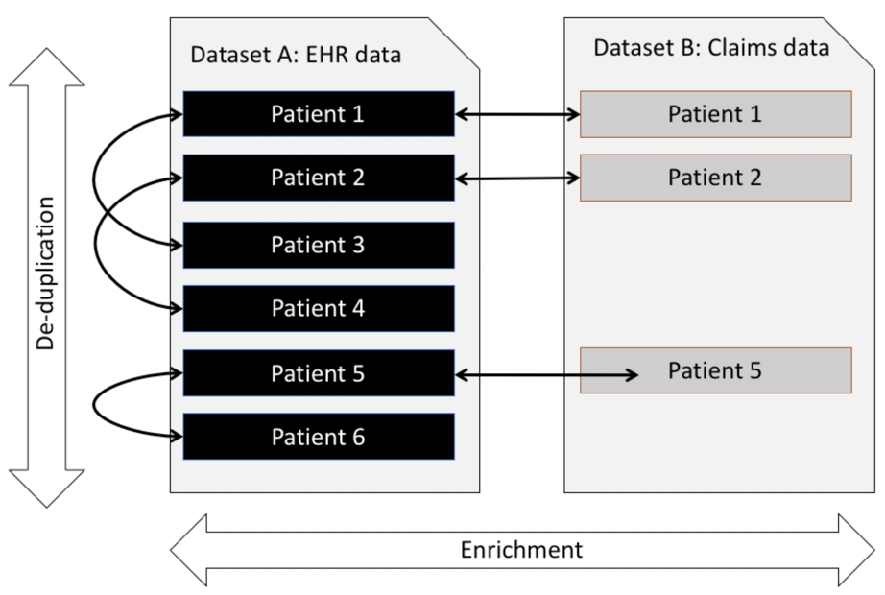
Objectives
Data de-duplication versus data enrichment using record-linkage

Slide 5
CU Record Linkage (CURL) Data Flow
Color code:
Clear-text PHI
Hashed PHI
(U of Colorado)
Linkage
Configurations
CURL Key Master
Generate Key
Hash key
Site A
Clean and profile data
Hashed data
Site A Source data
Hash Data
Review Hashed Data
Site B
Clean and profile data
Hash Data
Hashed data
Site B Source data
Review Hashed Data
Data transfer
NWI
CURL Honest Broker
Load, block and profile hashed data
Link data
Linked data
NWI = Network identifier

Slide 6
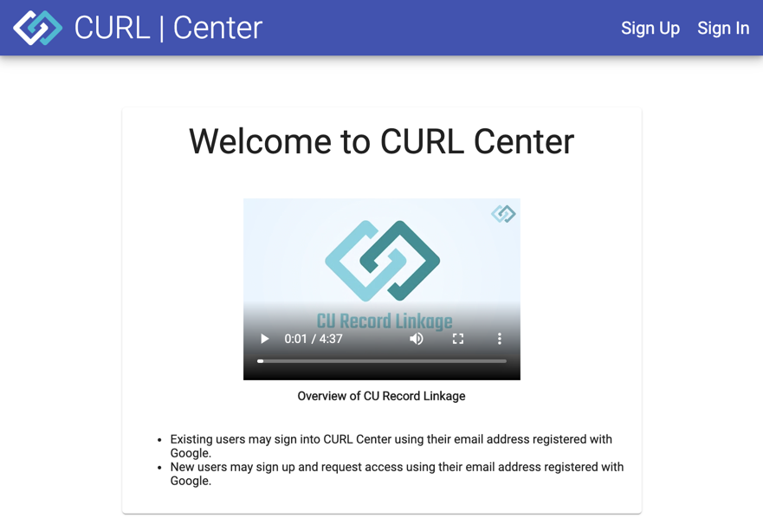
www.curl.center

Slide 7
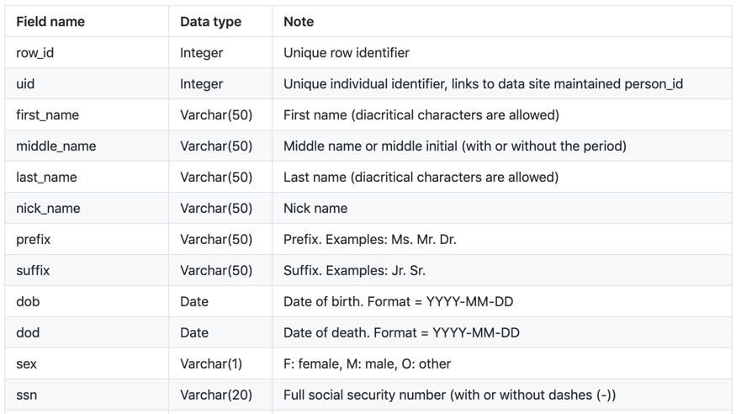
Linkage variables

Slide 8
Linkability measures
Missing data ratio
Unique data ratio
Group size
Information amount
  Shannon entropy
  Maximum theoretical entropy
  Percent of Maximum theoretical entropy

Slide 9
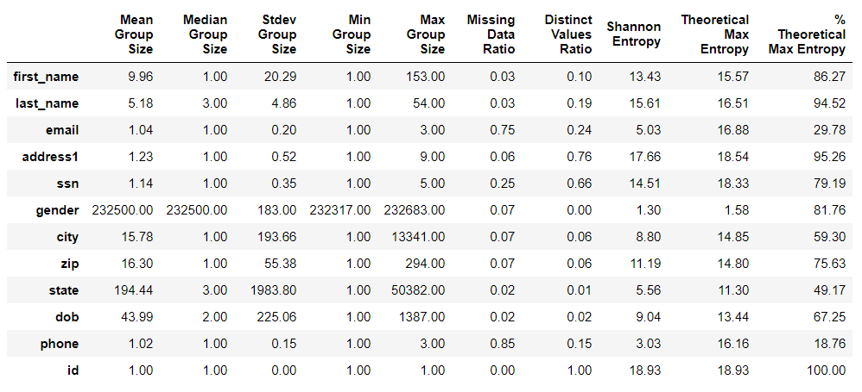
Linkability measures
Results of key quality and linkability measures using the 300K corrupted synthetic data set

Slide 10
Data normalization
First and last names: non-alphabetical characters, including spaces, were removed.
Middle name: shortened to middle initial.
Gender: all genders were converted to one of three possible values: F, M, or NULL.
Date of birth: converted to YYYYMMDD format.
SSN4: Extract last 4 digits from full SSN.

Slide 11
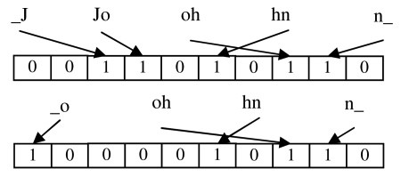

Data hashing
Data encryption/hashing
  Advanced encryption standard (AES) methods
  One-way hashing methods
  Bloom filters, locality-sensitivity hashing
Dice coefficient =

Slide 12
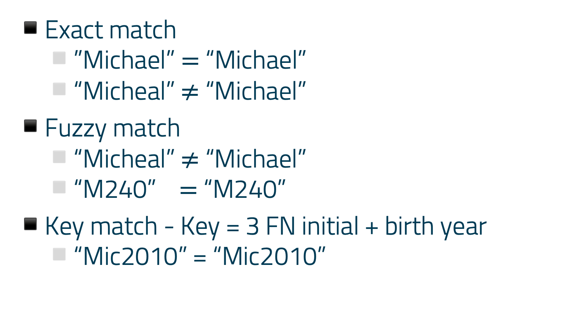
Deterministic linkage methods
Exact match
  ”Michael” $=$ “Michael”
  “Micheal” $≠$ “Michael”
Fuzzy match
  “Micheal” $≠$ “Michael”
  “M240” $=$ “M240”
Key match - Key = 3 FN initial + birth year
  “Mic2010” = “Mic2010”

Slide 13
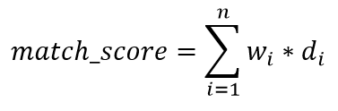
Probabilistic linkage methods
w_{i} : Weight of linkage variable i – Value Range: 0-1
d : Edit distance – Value Range: 0-100
Expectation Maximization (EM) for optimal weights
Edit distance

Slide 14
Linkage classification
Two classes
  match_score ≥ threshold➔ Matches
  match_score < threshold ➔ Non-Matches
Two classes
  match_score ≥ threshold➔ Matches
  match_score < threshold ➔ Non-Matches

Slide 15
Validation method
Sample: Potential linkages
Adjudicators:
  Two reviewers
  One tie-breaker
Validation result
  True match: >=2 yeses
  Incorrect match: >=2 nos OR 1 no + 1 maybe
  Undecided: >= 2 maybes

Slide 16
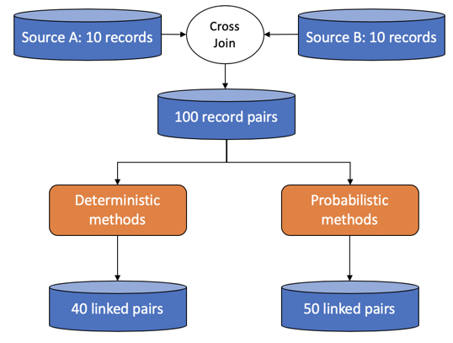
Linkage methods

Slide 17
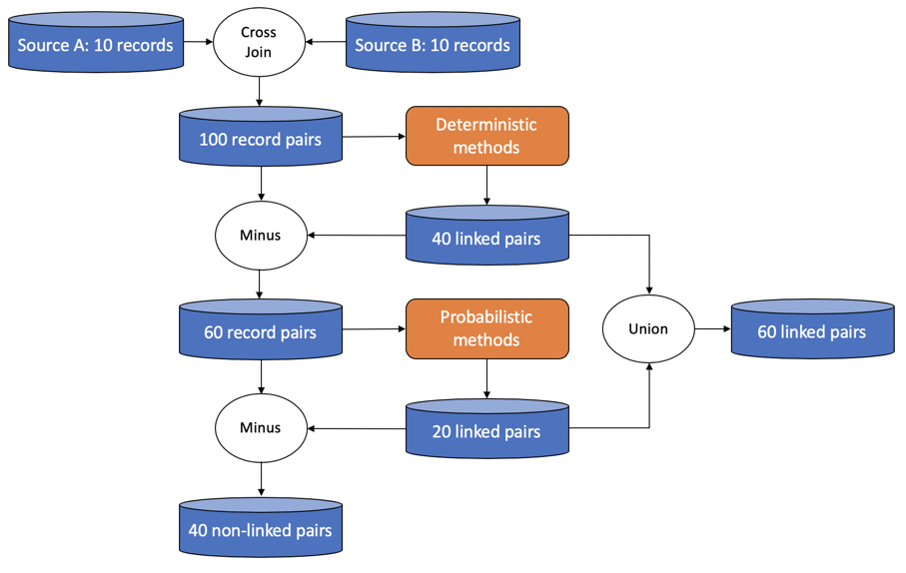
Hybrid linkage methods

Slide 18
Summary
CURL = CU Record Linkage
Linkage data
  Linkability measures
  Data normalization
  Data hashing
Linkage method
  Deterministic
  Probabilistic
  Hybrid

Slide 19
Funding
D2V
CDIFund
PCORI

Slide 20
Acknowledgement
Michael Kahn
Lisa Schilling
Chan Voong
Bethany Kwan
Jenna Reno
Chris Uhrich
Andrew Hill
Will Carter
Rachel Zucker
Kimberly Muller
Doreen Molk
James Roberts
Gali Baler
Tessa Crume
Lindsey Duca
Jessica Toth
Hossein Esteri
Ibrahim Lazrig

Slide 21
Thank You!

