Slide 1
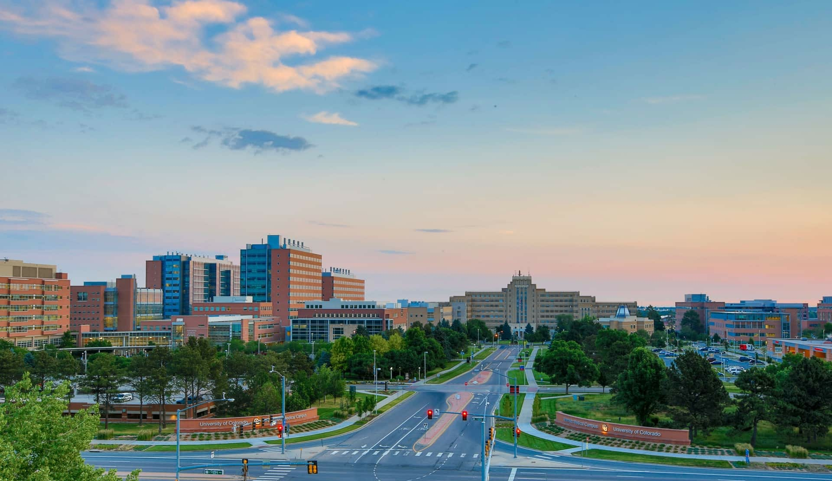
CU 2024 ASPIRE PROGRAM
Incubator for Programmatic Research
David Schwartz, MD
Lori Sussel, PhD

Slide 2
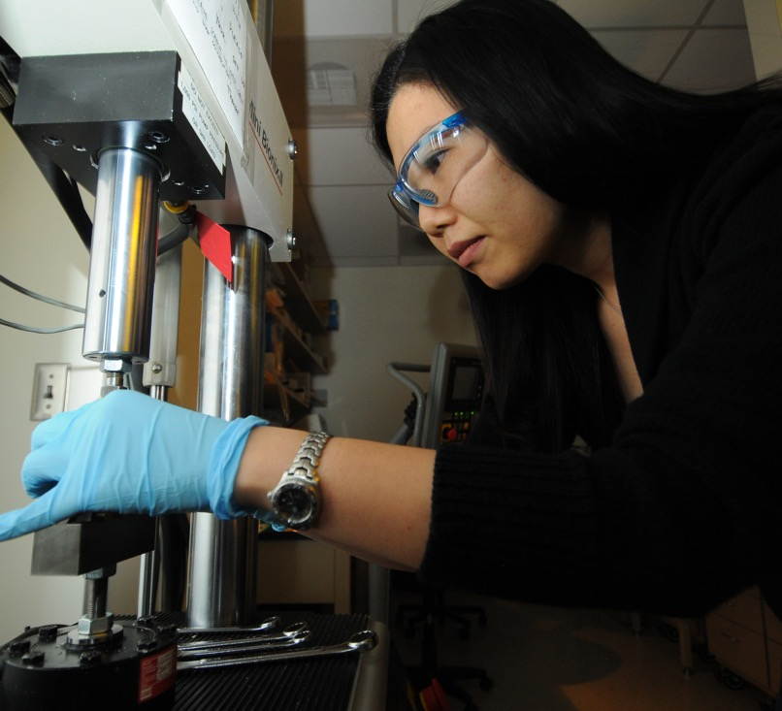
CU ASPIRE Program
Purpose: increase success of programmatic research on the Anschutz Medical Campus
Supports milestone-driven collaborations between investigators to solve unmet needs in basic science and clinical medicine
Mentored program – meet quarterly with leadership of ASPIRE Program to plan and develop PPG application

Slide 3

CU ASPIRE Program
Awards support up to $100,000/year with up to two years of support
Funds teams of 3-5 investigators with complementary scientific backgrounds focused on solving a complex unmet need in basic science or clinical medicine
Supports the development of interdisciplinary programmatic research. Single project MPI R01 type proposals will not be supported through this mechanism.
Category 1: SOM: PI and project leads must have a primary appointment in the School of Medicine (anticipate 2-3 awards in 2024)
Category 2: Cross-campus: PI and project leads must represent at least two different CU Anschutz Schools/Colleges (Medicine, Pharmacy and Pharmaceutical Sciences, Dental Medicine, Nursing, or Public Health; anticipate 1-2 awards in 2023)
Letters of Intent due October 30, 2023 and applications due December 15, 2023

Slide 4

RFA Components: Eligibility
At least 3 and no more than 5 investigators (inclusive of the PI) are required (no MPI applications)
At least two investigators (other than the PI) must have a primary appointment at the University of Colorado (including UCH, CHCO, DH, NJH, and VAMC)
Up to 2 investigators may be included from an institution outside of CU (include justification for going outside of CU)
Proposal needs to include multiple projects and cores that address an unmet basic or clinical need
Notes:
Multi-PI applications will not be accepted.
No minimum faculty rank for investigators but teams led by more senior people tend to do better in review for PPG-type applications at NIH. We recommend that at least the lead PI is a senior research to allow for a more competitive application for external funding.
This could include CU investigators in schools outside of the School of Medicine and throughout the CU System, and CU investigators employed by Denver Health, National Jewish Health, and VAMC.
Proposal must include justification for why the team chose to go outside of CU to obtain necessary expertise.

Slide 5
RFA Components: Letters of Intent
Required and will be used to assess eligibility
Deadline – October 30, 2023
Components
Names and Primary Appointments of Principal Investigator and Project Lead investigators
Email Address of Principal Investigator
ASPIRE Application Title
Selection of Application Category (SOM or Cross-Campus)
Brief Description of Anticipated Topic (approximately 100-150 words)
Notes:
Multi-PI applications will not be accepted.
No minimum faculty rank for investigators but teams led by more senior people tend to do better in review for PPG-type applications at NIH. We recommend that at least the lead PI is a senior research to allow for a more competitive application for external funding.
This could include CU investigators in schools outside of the School of Medicine and throughout the CU System, and CU investigators employed by Denver Health, National Jewish Health, and VAMC.
Proposal must include justification for why the team chose to go outside of CU to obtain necessary expertise.

Slide 6

RFA Components: Requirements
Title page: contact information and 200-word abstract
Specific Aims (1 page)
Research Plan (5 pages)
Investigators (1 page)
Path to external funding (1/2 page)
NIH biosketch for each investigator
Up to 3 letters of support (not required)
No limit on references
Appendices will not be accepted
Budget and justification: max $100k/year for up to 2 years
No indirect costs or investigator salary support

Slide 7
RFA Components: Evaluation
Scientific merit including significance of scientific theme
Programmatic integration of scientific team
Prior productivity of scientific team members
Likelihood of project leading to scientific accomplishments and external programmatic funding in 2-3 years
How the proposed structure of the expected external funding application will enable the scientific goals to be achieved
Applications will be evaluated by an ad hoc committee of non-conflicted faculty across campus

Slide 8
CU 2022-2023 ASPIRE Awardees
    Fernando Holguin, MD: Mechanisms of obese asthma
    York Miller, MD: Therapeutic targets in pulmonary premalignancy
    Ram Nagaraj, PhD: TBI-caused vision loss
    Beth Tamburini, PhD: Immune protection by lymph node stromal cells
    Brianne Bettcher, PhD: Alzheimer’s disease
    Craig Jordan, PhD: Metabolism of malignant stem cells
    Traci Lyons, PhD: Breast cancer
    Kika Sucharov, PhD: Mitochondrial dysfunction in CHF
Notes:
https://research.cuanschutz.edu/research-ppg/announcing-the-2022-aspire-program-team-awards

Slide 9
Additional Information
Program Manager:
Paul Wood
paul.wood@cuanschutz.edu
Category 2:
Jamie Kutner
jamie.kutner@cuanschutz.edu
aspirerfa@ucdenver.edu
Website:
https://medschool.cuanschutz.edu/program-to-advance-physician-scientists-translational-research/program-initiatives/aspire

